Slide 1
Research #1 Jae Jun Ha Multimedia Computing and Networking Lab POSTECH 2018-07-06
Notes:
세미나 발표를 시작하겠습니다.

Slide 2
Contents
Contents
Background
Goal
Basic Idea
Problem Description
Future Work

Slide 3
Background
Background
Video streaming over wireless networks is compelling for many applications, ranging from home entertainment to surveillance to search-and-rescue operations¹⁾
Technical challenges arise when the unpredictable nature of the wireless radio channel meets the requirements of high data rate and low latency for video transport¹⁾
There are some methods to treat unpredictable problems like Load Balancing and MPEG-DASH.
Load balancing is established based on the local information of the network in the conventional network. Hence it is not very precise²⁾
MPEG-DASH also use only local information.
1) Video Streaming Over Wireless Network, 2007 15th European Signal Processing Conference
2) Load Balancing Mechanisms in the Software Defined Networks: A Systematic and Comprehensive Review of the Literature, 2018 IEEE Access
Notes:
현재 접속하고 있는 AP에 다른 사용자들이 접속해서 속도가 느려지거나
MPEG-DASH는 비디오의 끊김을 방지하기 위해 클라이언트 상황에 따른 적응형 스트리밍

Slide 4
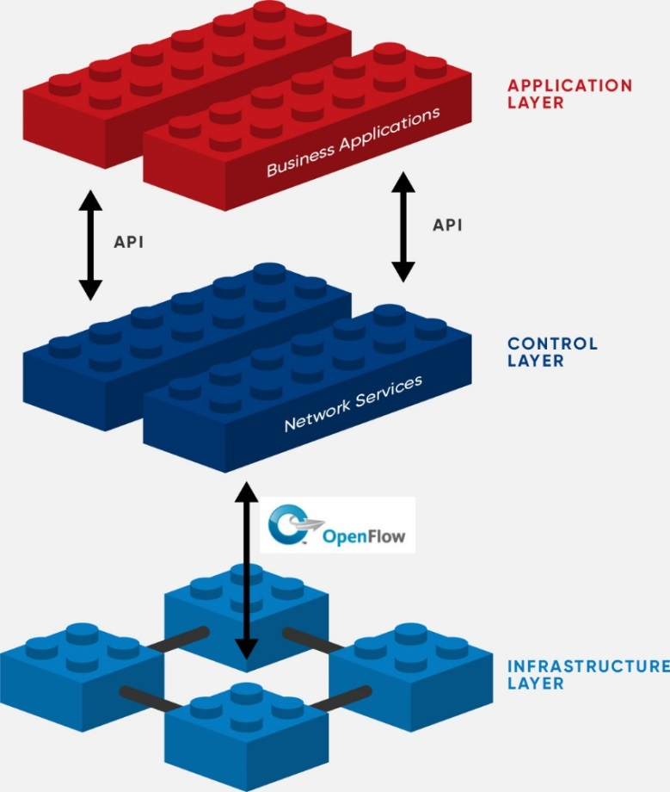
Goal
Goal
Because SDN has global view of the network, SDN based load balancing methods are more accurate and has high performance³⁾
Using SDN, to give satisfactory video streaming over unpredictable Wi-Fi networks
AP Load Balancing
Considering overall AP traffic, balance load
Adjusting Bitrate
Overall other clients traffic, adjust bitrate
< https://www.opennetworking.org/wp-content/uploads/2017/06/sdn-architecture-img.jpg >
3) Load Balancing Mechanisms in the Software Defined Networks: A Systematic and Comprehensive Review of the Literature, 2018 IEEE Access
Notes:
QoE에 대한 정의도 없음
Survey도 부족함
다른 논문에서 multiple WiFi 가져와서 설명할 필요도 있음
어떤 어려움, 이슈들이 있기에 SDN으로 AP를 관리하는 지
통신사는 실제로 이렇게 하고 있다
Related work 좀 뽑아놓아야
그런데에서는 QoE를 어떻게 쓰고 있다. 로드벨런싱을 어떻게 하고 잇는지
목표 -> 두가지 목표가 아니라 두 가지 방법
멀티플 네트워크나 비디오 스트리밍 갑자기 말하면 와닫지 않음 -> 관련 배경을 설명해줘야…(전에)

Slide 5




Basic Idea
Basic Idea
Media Server
SDN Controller
List of connectable
APs
AP
Client

Slide 6
Basic Idea
Basic Idea
Media Server
List of connectable
APs
SDN Controller
AP
Client

Slide 7
Basic Idea
Basic Idea
Media Server
Media Server
Traffic Monitoring
SDN Controller
AP
Client

Slide 8
Basic Idea
Basic Idea
Media Server
SDN Controller
Request load balancing
AP
Client is added
Client is disconnected
Load is over the threshold
Client

Slide 9
Basic Idea
Basic Idea
Media Server
SDN Controller
Make hand over decision
AP
Client

Slide 10
Basic Idea
Basic Idea
Media Server
SDN Controller
AP

Slide 11
Basic Idea
Basic Idea
AP collects information from clients
List of connectable APs
For load balancing
Buffer state
For bitrate adjustment

Slide 12
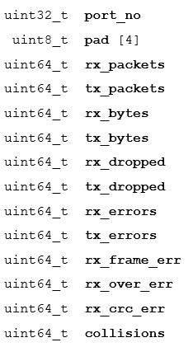
Traffic
Traffic
SDN collects information using Open Flow protocol
Using OFPMP_PORT_STATS message
Clients respond to it with ofp_port_stats message
< ofp_port_stats structure >

Slide 13
Traffic
Traffic
SDN collects information using Open Flow protocol
Using OFPMP_PORT_STATS message
Calculate available bandwidth
Define bandwidth as rx_bytes / time
< ofp_port_stats structure >

Slide 14
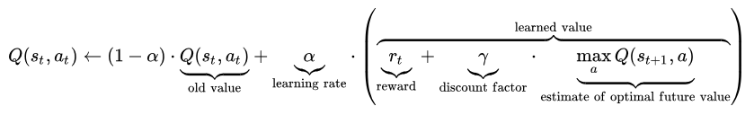
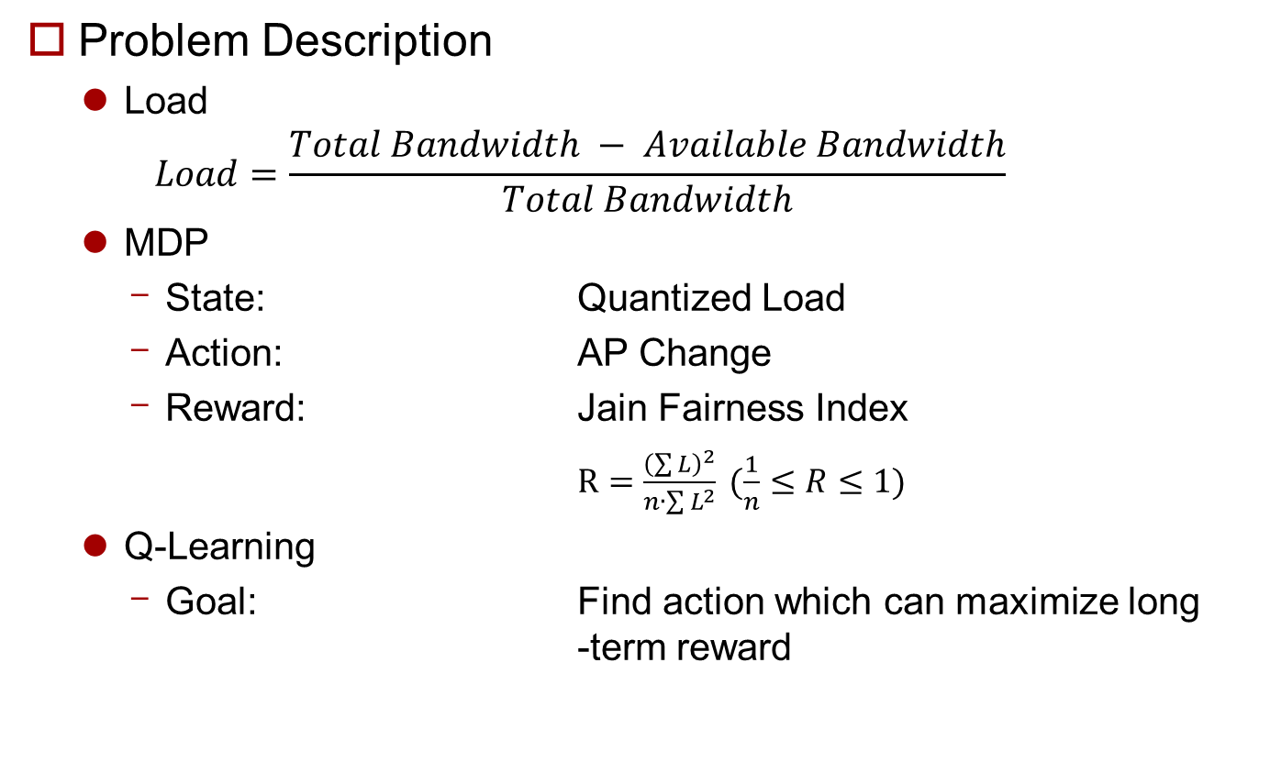
Problem Description
Problem Description
Load
$$Load=\frac{Total Bandwidth − Available Bandwidth}{Total Bandwidth}$$
MDP
State: Quantized Load
Action: AP Change
Reward: Jain Fairness Index
$R=\frac{{\left(\sum{L}\right)}^{2}}{n∙\sum{L^{2}}} (\frac{1}{n}≤R≤1)$
Q-Learning
Goal: Find action which can maximize long -term reward
Notes:
MDP 쓰는 이유 → Greedy와 비교

Slide 15
Future Work
Future Work
Bitrate Adjustment
Problem Formulation
System Architecture

