Slide 1



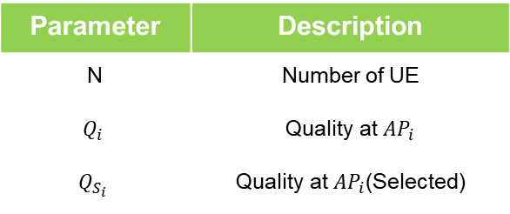

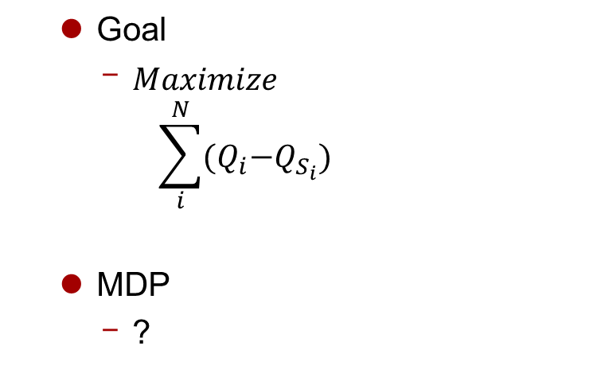





Problem Formulation
Problem Formulation
Goal
$Maximize$
$$\sum_{i}^{N}{(Q_{i}{−Q}_{S_{i}})}$$
MDP
?
$${AP}_{1}$$
$${UE}_{1}$$
$${AP}_{2}$$
$${UE}_{2}$$
Parameter | Description
N | Number of UE
$$Q_{i}$$ | Quality at ${AP}_{i}$
$$Q_{S_{i}}$$ | Quality at ${AP}_{i}$(Selected)
$${AP}_{3}$$
$${UE}_{3}$$
$${UE}_{4}$$

