Slide 1
Congestion-aware HTTP adaptive streaming over SDN-enabled Wi-Fi network Hyunmin Noh, Hwanwook Lee, Yunmin Go, and Hwangjun Song - Jae Jun Ha -
Notes:
세미나 발표를 시작하겠습니다.

Slide 2
Contents
Introduction
Background
Problem
Solution
Proposed System
Work
System Architecture
Workflow
Description
Formulation
Centralized Bitrate Selection Algorithm
Experiment
Environment
Verification
Comparison
Conclusion

Slide 3
Introduction

Slide 4
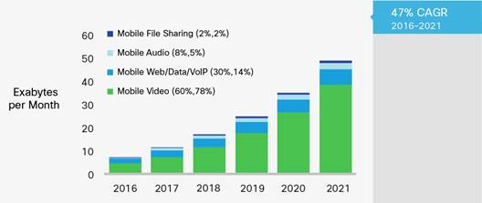
Background
Demand about video streaming over wireless network is increasing
The overall video traffic will grow up to 48.3 EB per month
Notes:
http://www.cisco.com/c/dam/en/us/solutions/collateral/service-provider/visual-networking-index-vni/mobile-white-paper-c11-520862.doc/

Slide 5
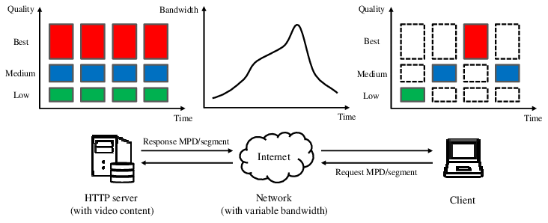
Background
HTTP Adaptive Streaming (HAS)
Technology which treats video streaming over the internet
Receives streaming service according to network situation
Content is segmented into small chunk files at multiple level
Commercial services
HTTP Live Streaming (Apple)
Smooth Streaming (Microsoft)
HTTP Dynamic Streaming (Adobe)
Dynamic Adaptive Streaming over HTTP (ISO Standard)
< https://www.researchgate.net/figure/Structure-of-HTTP-adaptive-streaming_fig1_331537774 >

Slide 6
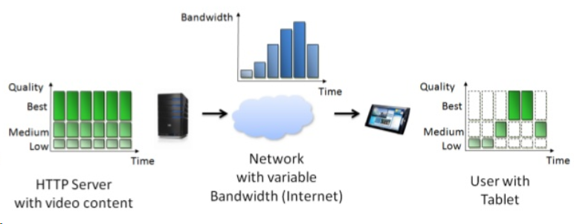
Background
Dynamic Adaptive Streaming over HTTP (DASH)
The Moving Picture Experts Group (MPEG) releases standard
It has a HTTP server which include MPD and video segments
< https://www.slideshare.net/christian.timmerer/dynamic-adaptive-streaming-over-http-from-content-creation-to-consumption >

Slide 7
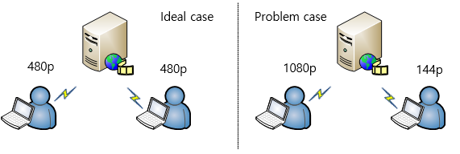
Problem
DASH has serious problem
Multiple clients compete at a network bottleneck
Some clients request excessive resources without considering other clients’ network situation
It causes unfairness and underutilization of resources

Slide 8
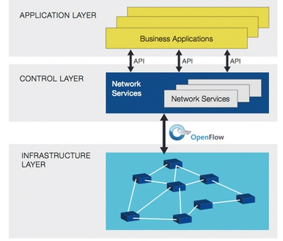
Solution
Software Defined Networking (SDN)
Centralized network architecture
It monitors overall network situation periodically
It can provide overall views to DASH system

Slide 9
Proposed System

Slide 10
Work
Propose SDN-assisted HTTP streaming system over Wi-Fi networks
To consider overall network situation, used SDN controller
Based on network situation, adjusted DASH clients’ bitrate level
To consider congestion, used time constraint
Goal
To maximize the overall video quality of clients while considering congestion

Slide 11
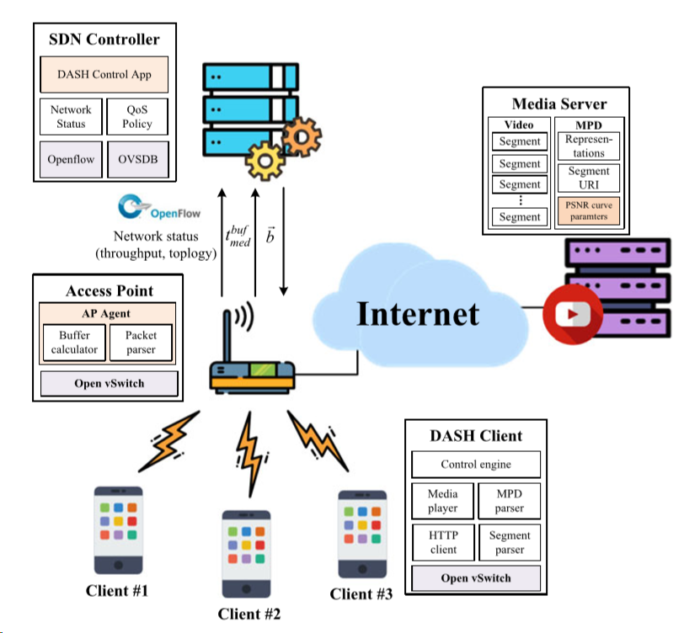
System Architecture
SDN Controller
Collects resources periodically
Media Server
Includes DASH segments and MPD file
Access Point
Modifies bitrate level determined from SDN
DASH Client

Slide 12
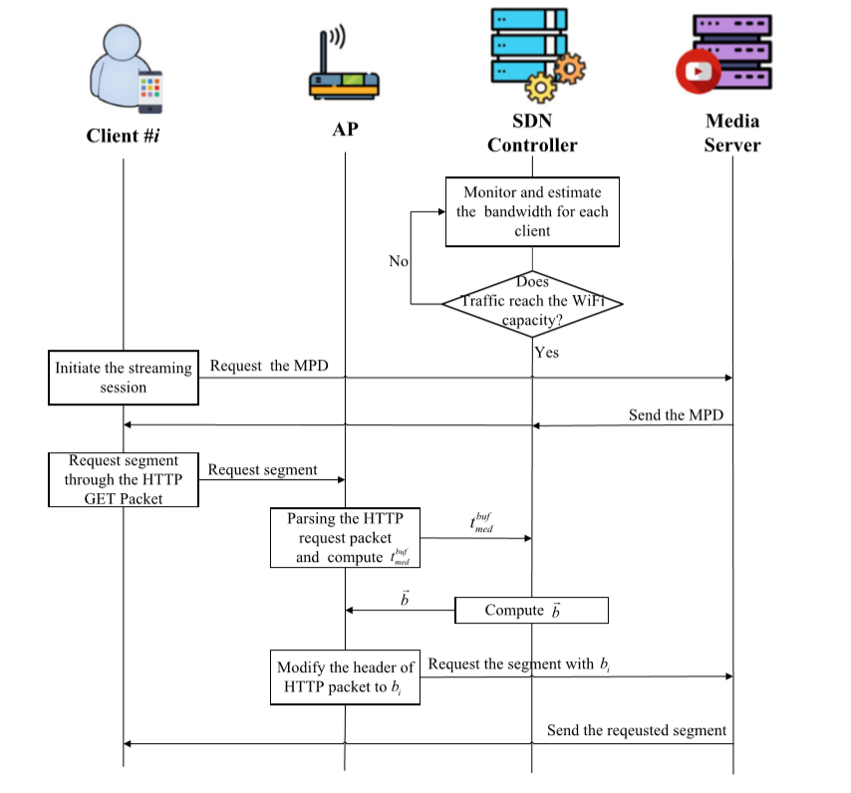
Workflow
Notes:
버퍼 정보는 뒤에

Slide 13
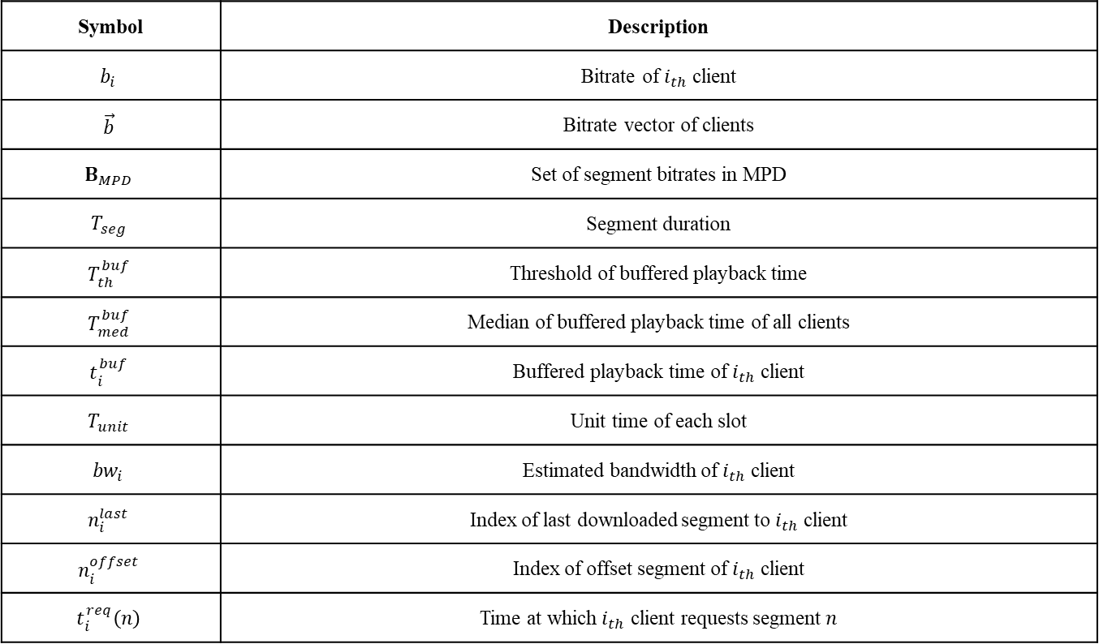
Description
Symbol | Description
$$b_{i}$$ | Bitrate of $i_{th}$ client
$$\vec{b}$$ | Bitrate vector of clients
$$B_{MPD}$$ | Set of segment bitrates in MPD
$$T_{seg}$$ | Segment duration
$$T_{th}^{buf}$$ | Threshold of buffered playback time
$$T_{med}^{buf}$$ | Median of buffered playback time of all clients
$$t_{i}^{buf}$$ | Buffered playback time of $i_{th}$ client
$$T_{unit}$$ | Unit time of each slot
$${bw}_{i}$$ | Estimated bandwidth of $i_{th}$ client
$$n_{i}^{last}$$ | Index of last downloaded segment to $i_{th}$ client
$$n_{i}^{offset}$$ | Index of offset segment of $i_{th}$ client
$$t_{i}^{req}\left(n\right)$$ | Time at which $i_{th}$ client requests segment $n$

Slide 14
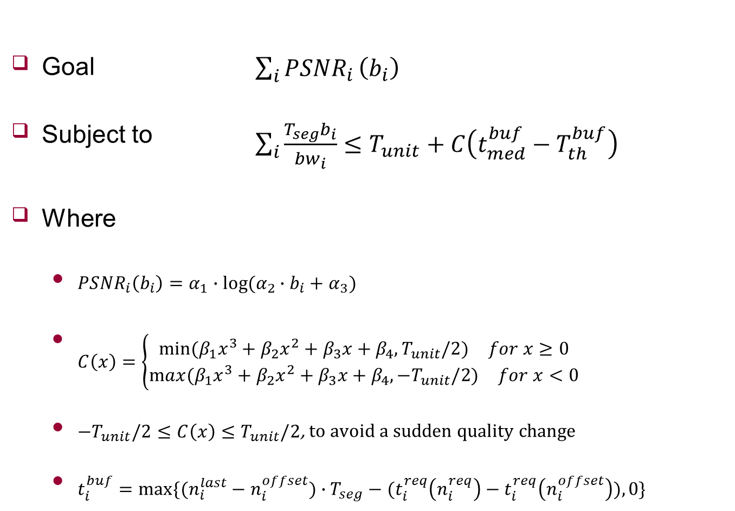
Formulation
Goal $\sum_{i}{{PSNR}_{i}}\left(b_{i}\right)$
Subject to $\sum_{i}{\frac{T_{seg}b_{i}}{{bw}_{i}}}≤T_{unit}+C\left(t_{med}^{buf}−T_{th}^{buf}\right)$
Where
${PSNR}_{i}\left(b_{i}\right)=α_{1}∙log⁡(α_{2}∙b_{i}+α_{3})$
$C\left(x\right)=\left\{\begin{aligned}\begin{matrix}min⁡(β_{1}x^{3}+β_{2}x^{2}+β_{3}x+β_{4},T_{unit}/2) & for x≥0\end{matrix} \\ \begin{matrix}max(β_{1}x^{3}+β_{2}x^{2}+β_{3}x+β_{4},{−T}_{unit}/2) & for x<0\end{matrix}\end{aligned}\right.$
${−T}_{unit}/2≤C\left(x\right)≤T_{unit}/2$, to avoid a sudden quality change
$t_{i}^{buf}=max⁡\{(n_{i}^{last}−n_{i}^{offset})∙T_{seg}−(t_{i}^{req}\left(n_{i}^{req}\right)−t_{i}^{req}\left(n_{i}^{offset}\right)),0\}$
Maximize PSNR
Manage resource
In terms of time
Consider buffer state
Downloaded
Request time
Notes:
버퍼길이가 음수면 언더플로
현재 요청하는 세그먼트 시간과 이전에 요청한 세그먼트 시간 차이 보다 재생할 수 있는 길이가 더 쌓여있어야 한다.
버퍼 상태에 따라 현재 필요한 세그먼트의 요청을 지연한다.
C(x): 마진 함수
버퍼 중앙 값 가지고 고려, Thresh 보다 작다면 언더플로우 발생, 전체 bitrate 줄이도록

Slide 15
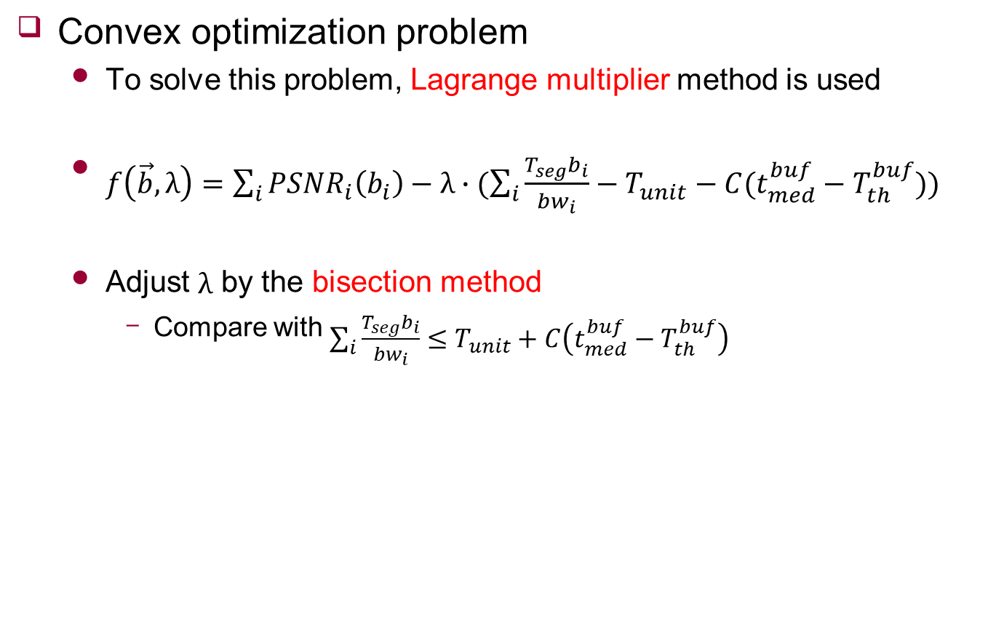
Centralized Bitrate Determining Algorithm
Convex optimization problem
To solve this problem, Lagrange multiplier method is used
$f\left(\vec{b},λ\right)=\sum_{i}{{PSNR}_{i}\left(b_{i}\right)−λ∙(\sum_{i}{\frac{T_{seg}b_{i}}{{bw}_{i}}−T_{unit}−C(t_{med}^{buf}−T_{th}^{buf})})}$
Adjust $λ$ by the bisection method
Compare with $\sum_{i}{\frac{T_{seg}b_{i}}{{bw}_{i}}}≤T_{unit}+C\left(t_{med}^{buf}−T_{th}^{buf}\right)$

Slide 16
Experiment

Slide 17
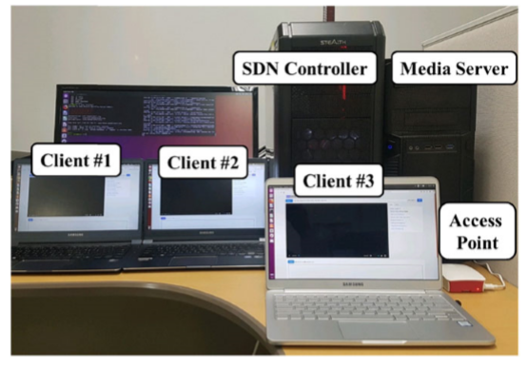
Environment
SDN Controller
ONOS 1.7.0
Media Server
Apache HTTP Server
Access Point
Hostapd
OVS
Client
DASH 2.4.0
OVS

Slide 18
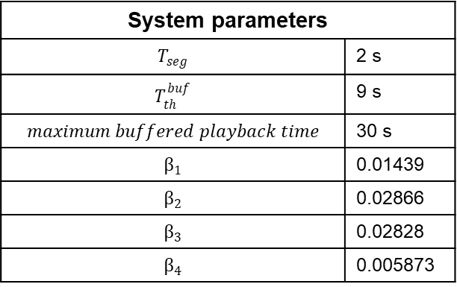
Environment
Comparison
DASH.js
BOLA
Based on Buffer info
PANDA
Using principle of TCP congestion control (AIMD)
System parameters
$$T_{seg}$$ | 2 s
$$T_{th}^{buf}$$ | 9 s
$$maximum buffered playback time$$ | 30 s
$$β_{1}$$ | 0.01439
$$β_{2}$$ | 0.02866
$$β_{3}$$ | 0.02828
$$β_{4}$$ | 0.005873

Slide 19
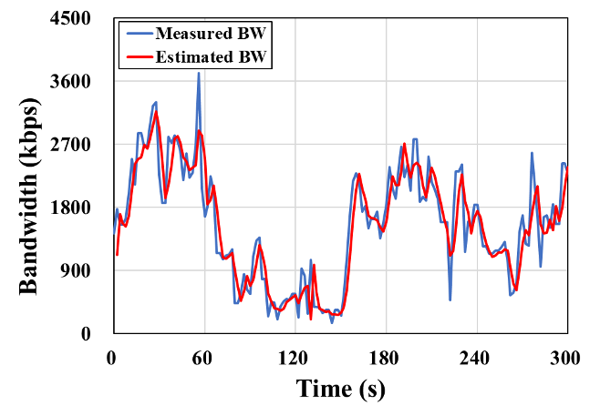
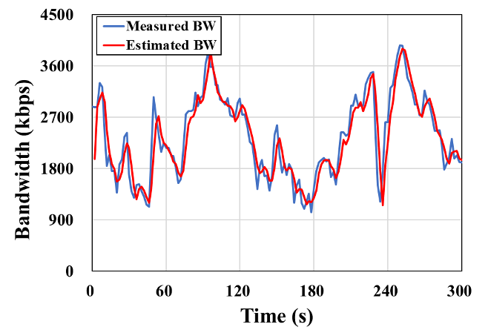
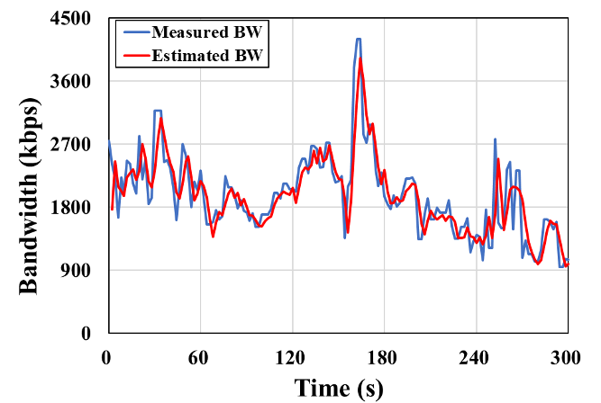
Environment
Bandwidth
Based on information from SDN controller
Using ARIMA, derive estimate Bandwidth
State of each client

Slide 20
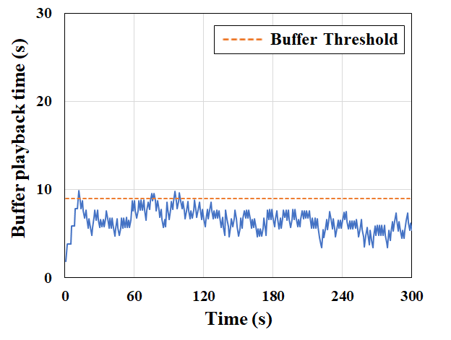
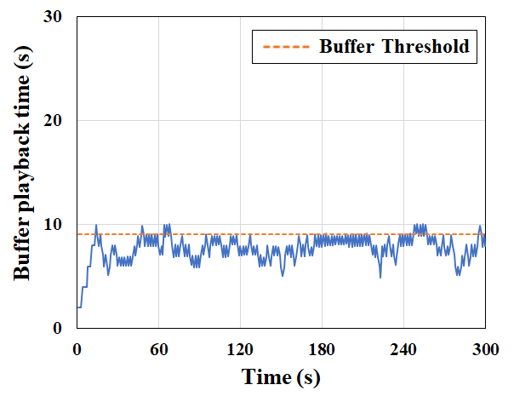
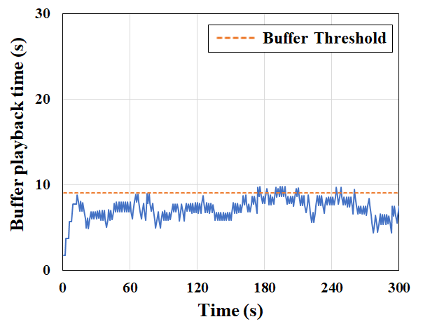

Verification
Using margin function
$\sum_{i}{\frac{T_{seg}b_{i}}{{bw}_{i}}}≤T_{unit}+C\left(t_{med}^{buf}−T_{th}^{buf}\right)$
Test video: Big Buck Bunny
State of each client

Slide 21
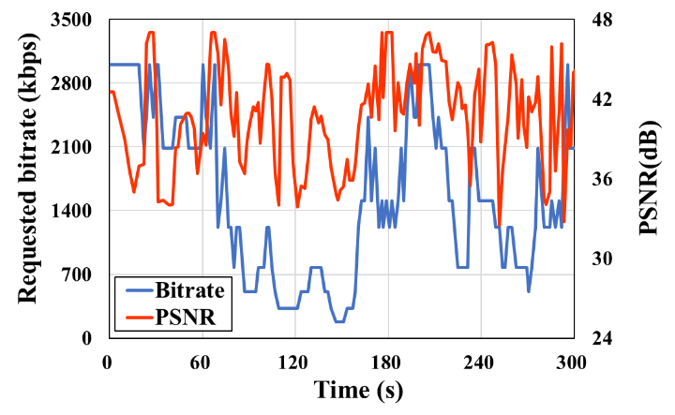
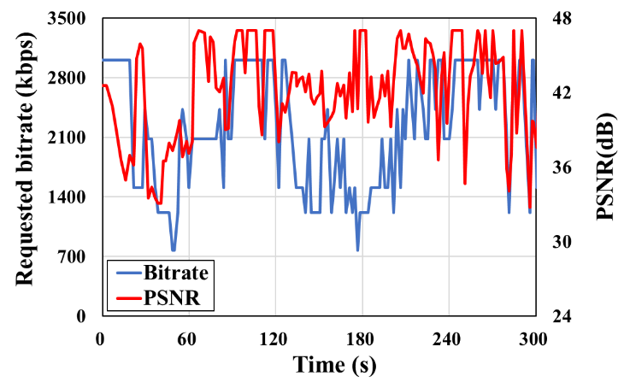
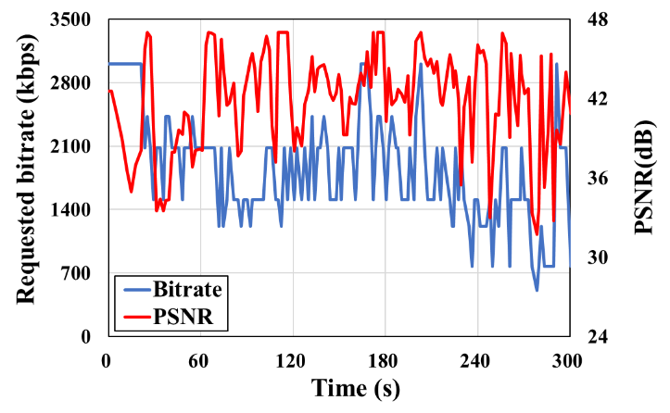
Verification
Request bitrate and PSNR
Test video: Big Buck Bunny
State of each client

Slide 22
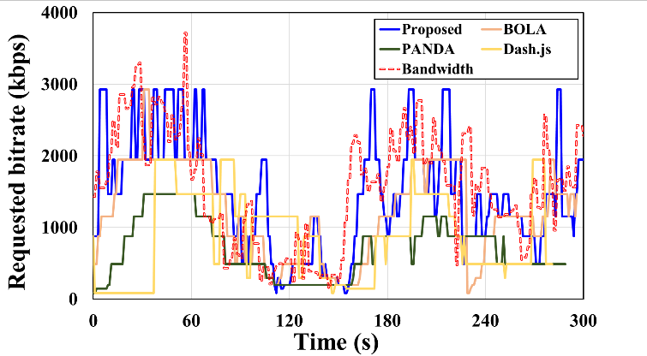
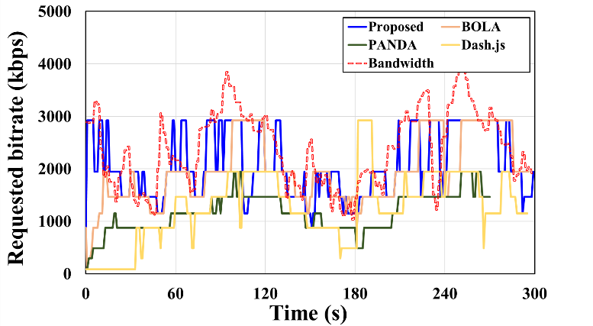
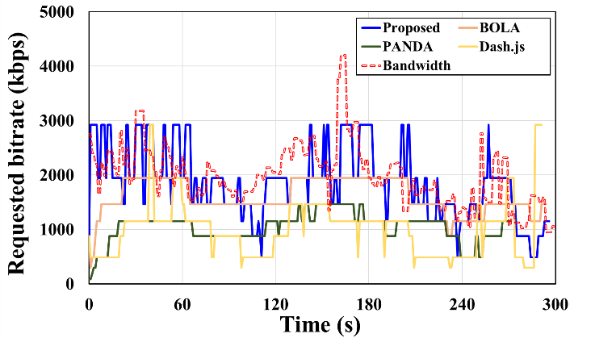
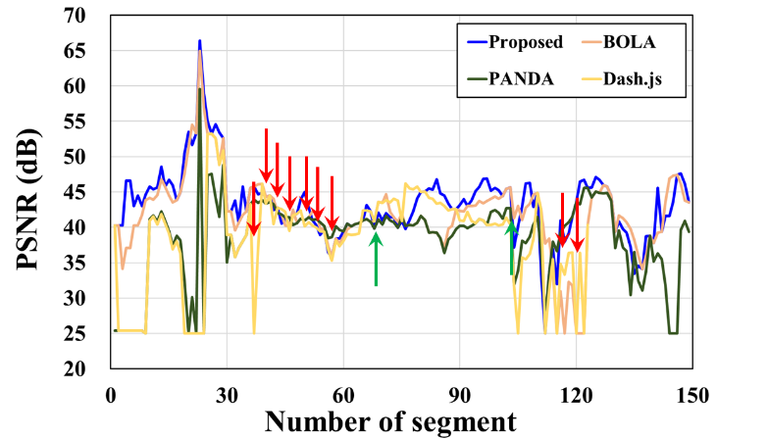
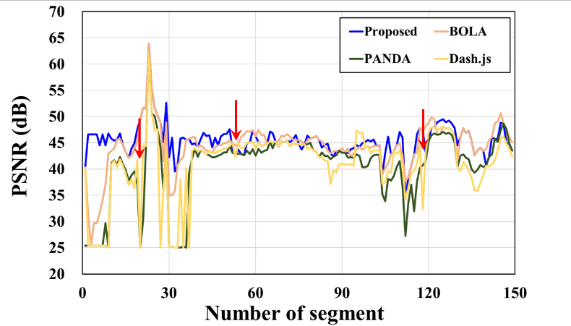
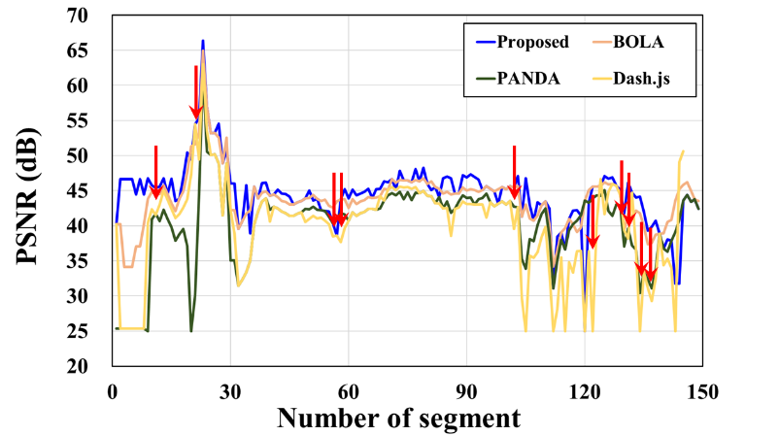
Comparison
Three elements
Rate adaptation, PSNR, Buffered playback time
Test video: Redbull Play streets
State of each client
Notes:
DASH는 MA기법을 사용해서 bw를 예측하기 때문에 BW의 급격한 변화를 감지 못함, 그래서 BW보다 크게 bitrate를 선택하게 되고 underflow가 자주 발생
PANDA는 AIMD 기법 이용해서 bitrate 선택, buffered playback time이 높은 상태로 유지됨
BOLA는 buffer 기반으로 rate adaptation하기 때문에 BW의 급격한 변화 감지 못함 underflow 발생

Slide 23
Comparison
Three elements
Rate adaptation, PSNR, Buffered playback time
Test video: Redbull Play streets
State of each client
Notes:
DASH는 MA기법을 사용해서 bw를 예측하기 때문에 BW의 급격한 변화를 감지 못함, 그래서 BW보다 크게 bitrate를 선택하게 되고 underflow가 자주 발생
PANDA는 AIMD 기법 이용해서 bitrate 선택, buffered playback time이 높은 상태로 유지됨
BOLA는 buffer 기반으로 rate adaptation하기 때문에 BW의 급격한 변화 감지 못함 underflow 발생

Slide 24
Comparison
Video | Algorithm | Average PSNR (dB) | Number of buffer underflows | Underflow duration (s) | Buffered playback time (s)
 |  |  |  |  | Average | Standard deviation
Big Buck Bunny | Dash.js | 40.91 | 9 | 18 | 6.36 | 2.96
 | PANDA | 39.20 | 0 | 0 | 22.57 | 7.66
 | BOLA | 40.73 | 3 | 8 | 7.04 | 3.11
 | Proposed | 41.94 | 0 | 0 | 6.34 | 1.28
Redbull Play Streets | Dash.js | 39.17 | 23 | 51 | 6.66 | 5.21
 | PANDA | 39.83 | 0 | 0 | 21.35 | 7.62
 | BOLA | 43.41 | 2 | 2 | 7.99 | 2.65
 | Proposed | 44.42 | 0 | 0 | 7.02 | 1.55
Of Forest And Men | Dash.js | 36.74 | 12 | 42 | 7.64 | 2.67
 | PANDA | 34.59 | 0 | 0 | 19.83 | 7.45
 | BOLA | 37.02 | 1 | 3 | 6.02 | 2.33
 | Proposed | 37.24 | 0 | 0 | 7.04 | 1.36

Slide 25
Conclusion
SDN-assisted HAS system
Goal: to maximize the overall video quality
SDN collects network information periodically and determines the segment bitrates of all clients
Advantage
Provide higher video quality
Keep buffer state

