Slide 1
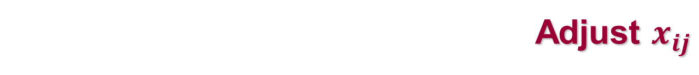
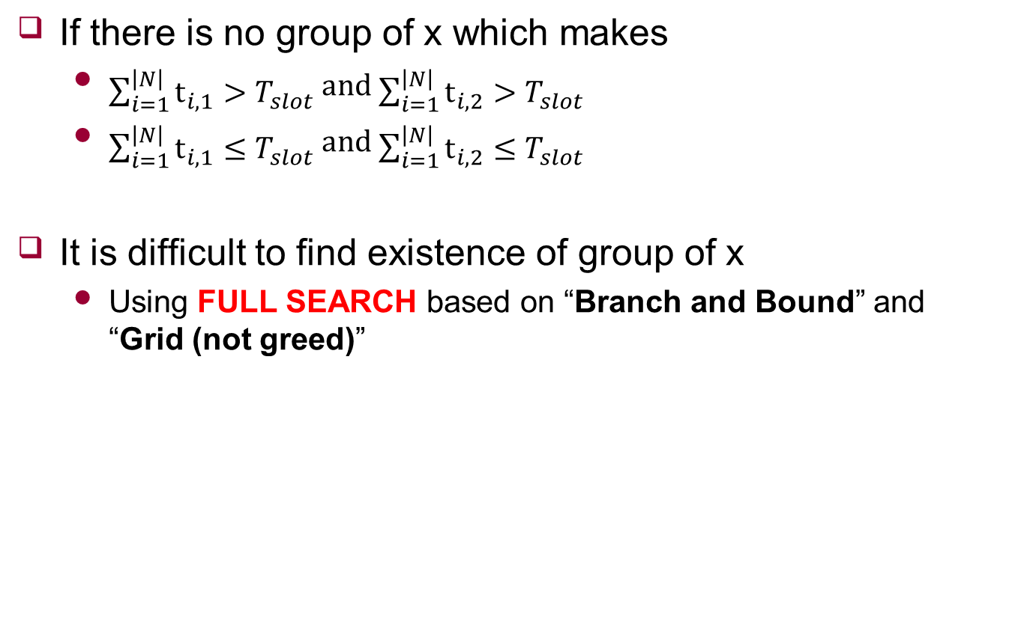
Adjust $x_{ij}$
If there is no group of x which makes
$\sum_{i=1}^{\left|N\right|}{t_{i,1}}>T_{slot}$ and $\sum_{i=1}^{\left|N\right|}{t_{i,2}}>T_{slot}$
$\sum_{i=1}^{\left|N\right|}{t_{i,1}}≤T_{slot}$ and $\sum_{i=1}^{\left|N\right|}{t_{i,2}}≤T_{slot}$
It is difficult to find existence of group of x
Using FULL SEARCH based on “Branch and Bound” and “Grid (not greed)”

Slide 2
Adjust $x_{ij}$
To find existence of group of x
(Grid) Search all cases of x with 0.1 interval (or other interval)
(Branch and Bound) remove unnecessary cases
1.0 | 1.0 | 1.0 | 1.0 | 0.0
0.0 | 0.0 | 0.0 | 0.0 | 1.0
0.5 | 1.3
1.0 | 1.0 | 1.0 | 1.0 | 0.1
0.0 | 0.0 | 0.0 | 0.0 | 0.9
0.45 | 1.4

Slide 3

Adjust $x_{ij}$
If there are groups of x
Using the group of x which makes other states
Increase or decrease $λ$
Else
Using Divide and Conquer

Slide 4





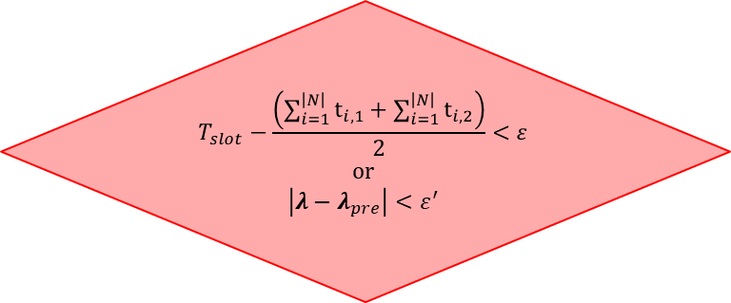
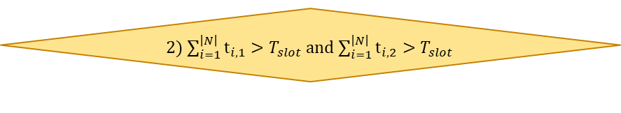
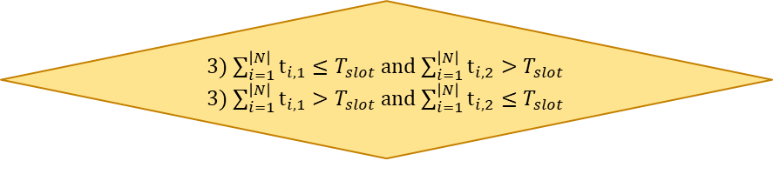

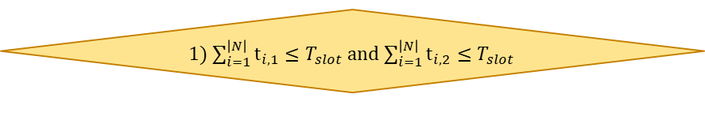

Appendix
Loop
UE requests streaming with $r_{i}^{req}$
Over AP’s timeslot
Provide streaming $r_{i}^{service}$ with $r_{i}^{req}$
no
yes
Initialize $x_{ij}$ and $λ$
Determine $d_{i}(x_{i}^{∗})$ with $λ$
Calculate Virtual Bandwidth on VAP with $x_{ij}$
Adjust $x_{ij}$
Adjust $λ$
3) $\sum_{i=1}^{\left|N\right|}{t_{i,1}}≤T_{slot}$ and $\sum_{i=1}^{\left|N\right|}{t_{i,2}}>T_{slot}$
3) $\sum_{i=1}^{\left|N\right|}{t_{i,1}}>T_{slot}$ and $\sum_{i=1}^{\left|N\right|}{t_{i,2}}≤T_{slot}$
yes
no
2) $\sum_{i=1}^{\left|N\right|}{t_{i,1}}>T_{slot}$ and $\sum_{i=1}^{\left|N\right|}{t_{i,2}}>T_{slot}$
yes
$$T_{slot}−\frac{\left(\sum_{i=1}^{\left|N\right|}{t_{i,1}}+\sum_{i=1}^{\left|N\right|}{t_{i,2}}\right)}{2}<ε$$
or
$$\left|λ−λ_{pre}\right|<ε^{′}$$
no
1) $\sum_{i=1}^{\left|N\right|}{t_{i,1}}≤T_{slot}$ and $\sum_{i=1}^{\left|N\right|}{t_{i,2}}≤T_{slot}$
yes
END

