Slide 1
Research Jae Jun Ha Media Computing and Networking Laboratory POSTECH 2019-06-13

Slide 2
Last Seminar
Not consider request bitrate
Clients want to get streaming with specific bitrate
more bitrate → other clients will not get enough streaming
So, consider request bitrate and simulate

Slide 3
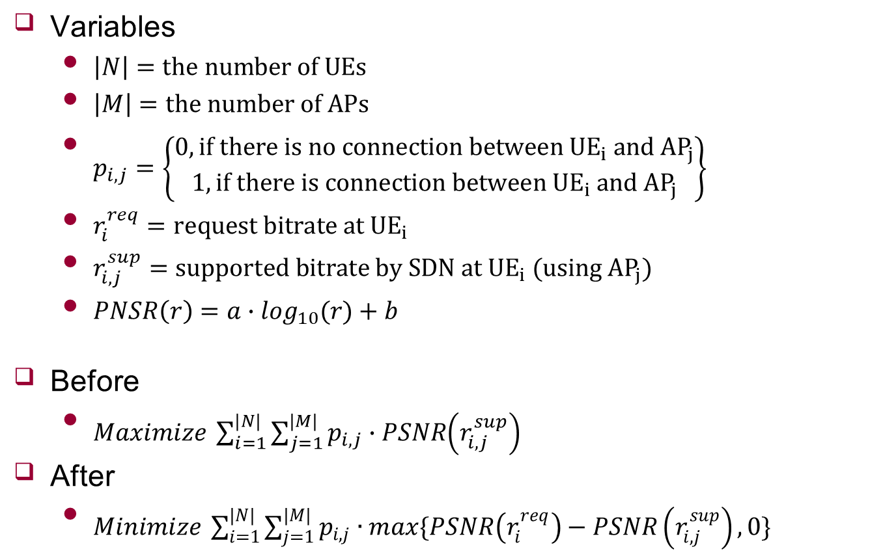
Goal
Variables
$\left|N\right|=the number of UEs$
$\left|M\right|=the number of APs$
$p_{i,j}=\left\{\begin{matrix}0, if there is no connection between {UE}_{i} and {AP}_{j} \\ 1, if there is connection between {UE}_{i} and {AP}_{j}\end{matrix}\right\}$
$r_{i}^{req}=request bitrate at {UE}_{i}$
$r_{i,j}^{sup}=supported bitrate by SDN at {UE}_{i} (using {AP}_{j})$
$PNSR\left(r\right)=a∙\log_{10}(r)+b$
Before
$Maximize \sum_{i=1}^{|N|}{\sum_{j=1}^{|M|}{p_{i,j}∙PSNR\left(r_{i,j}^{sup}\right)}}$
After
$Minimize \sum_{i=1}^{|N|}{\sum_{j=1}^{|M|}{p_{i,j}∙max\{PSNR\left(r_{i}^{req}\right)−PSNR\left(r_{i,j}^{sup}\right),0\}}}$

Slide 4
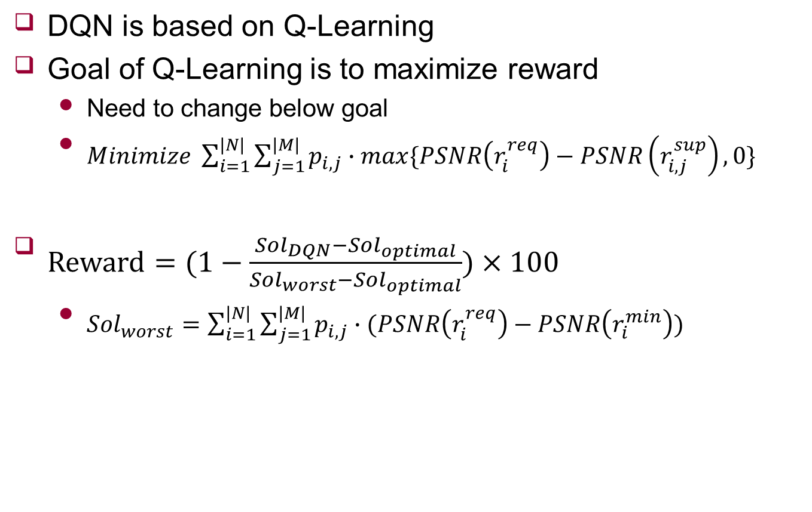



Reward function
DQN is based on Q-Learning
Goal of Q-Learning is to maximize reward
Need to change below goal
$Minimize \sum_{i=1}^{|N|}{\sum_{j=1}^{|M|}{p_{i,j}∙max\{PSNR\left(r_{i}^{req}\right)−PSNR\left(r_{i,j}^{sup}\right),0\}}}$
$Reward=(1−\frac{{Sol}_{DQN}−{Sol}_{optimal}}{{Sol}_{worst}−{Sol}_{optimal}})×100$
${Sol}_{worst}=\sum_{i=1}^{|N|}{\sum_{j=1}^{|M|}{p_{i,j}∙(PSNR\left(r_{i}^{req}\right)−PSNR\left(r_{i}^{min}\right))}}$
$${Sol}_{optimal}$$
$${Sol}_{DQN}$$
$${Sol}_{worst}$$

Slide 5

Comparison
Request bitrate vs No request bitrate
How close
$Reward=(1−\frac{{Sol}_{DQN}−{Sol}_{optimal}}{{Sol}_{worst}−{Sol}_{optimal}})×100$
$Reward=\frac{{Sol}_{DQN}−{Sol}_{worst}}{{Sol}_{optimal}−{Sol}_{worst}}×100$
3UEs and 2APs
 | 1~100 | 101~200 | 201~300 | 301~400 | avg
reward | 94.3879 | 94.73835 | 94.80607 | 94.18136 | 94.52842
speed | 0.132699 | 0.126501 | 0.157191 | 0.132329 | 0.13718
 | 1~100 | 101~200 | 201~300 | 301~400 | avg
reward | 88.71832 | 85.27961 | 87.47818 | 87.74975 | 87.30646
speed | 1.409178 | 1.542601 | 1.486983 | 1.657398 | 1.52404
Request bitrate
No request bitrate

Slide 6
Analysis
More optimal
Request bitrate can reduce waste of resource
It seems that using request bitrate is slower than no request bitrate
Because of branch and bound method
Speed is almost same
 | 1~100 | 101~200 | 201~300 | 301~400 | avg
reward | 94.3879 | 94.73835 | 94.80607 | 94.18136 | 94.52842
speed | 0.132699 | 0.126501 | 0.157191 | 0.132329 | 0.13718
 | 1~100 | 101~200 | 201~300 | 301~400 | avg
reward | 88.71832 | 85.27961 | 87.47818 | 87.74975 | 87.30646
speed | 1.409178 | 1.542601 | 1.486983 | 1.657398 | 1.52404
Request bitrate
No request bitrate

Slide 7

How to mix
Speed
$\frac{Optimal}{DQN}$
3UEs and 2APs
4UEs and 3APs
5UEs and 3APs
6UEs and 4APs
 | 1~100 | 101~200 | 201~300 | 301~400 | avg
reward | 94.3879 | 94.73835 | 94.80607 | 94.18136 | 94.52842
speed | 0.132699 | 0.126501 | 0.157191 | 0.132329 | 0.13718
 | 1~100 | 101~200 | 201~300 | 301~400 | avg
reward | 92.39862 | 90.02617 | 88.63231 | 90.35138 | 90.35212
speed | 0.493283 | 0.462837 | 0.533976 | 0.440026 | 0.48253
 | 1~100 | 101~200 | 201~300 | 301~400 | avg
reward | 92.52879 | 91.73763 | 89.64773 | 90.20264 | 91.0292
speed | 0.866274 | 0.879528 | 0.910608 | 0.899638 | 0.889012
 | 1~100 | 101~200 | 201~300 | 301~400 | avg
reward | 89.87929 | 87.82155 | 91.38032 | 90.67034 | 89.93787
speed | 5.165893 | 4.959823 | 4.733054 | 6.270945 | 5.282429

Slide 8

How to mix
Speed
If UE < 6
Using optimal solution
If UE $=$ 6
Following ratio
If UE $>$ 6
Using DQN
Sometimes, it takes over 1~2s.

Slide 9
Clustering
Using sort according to request bitrate
Need to consider AP connection
For example UE1 can not use AP in group1
 | UE4 | UE12 | UE5 | UE2 | UE3 | UE11 | UE9 | UE1 | UE7 | UE6 | UE8 | UE10
Request | 2000 | 2000 | 2000 | 1500 | 1500 | 1200 | 1200 | 1200 | 1200 | 900 | 900 | 900
Group | 1 | 2 | 3 | 1 | 2 | 3 | 1 | 2 | 3 | 1 | 2 | 3

Slide 10
Conclusion
Summary
Consider request bitrate
How to mix
Future Work
Test at real testbed
Clustering

