Slide 1
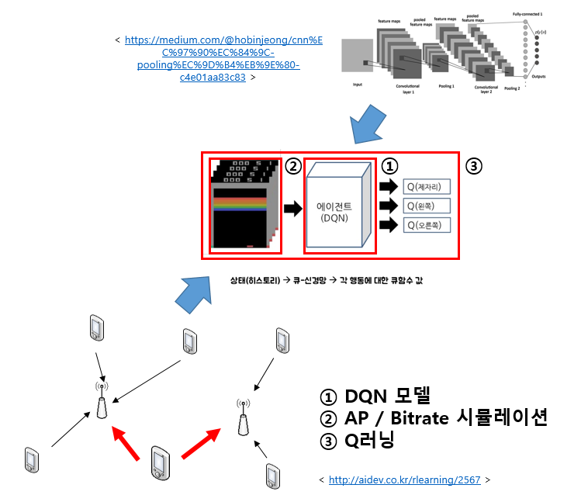
How to simulate
Overview

Slide 2


DQN
Each episode

Slide 3
DQN
Each episode

