Slide 1
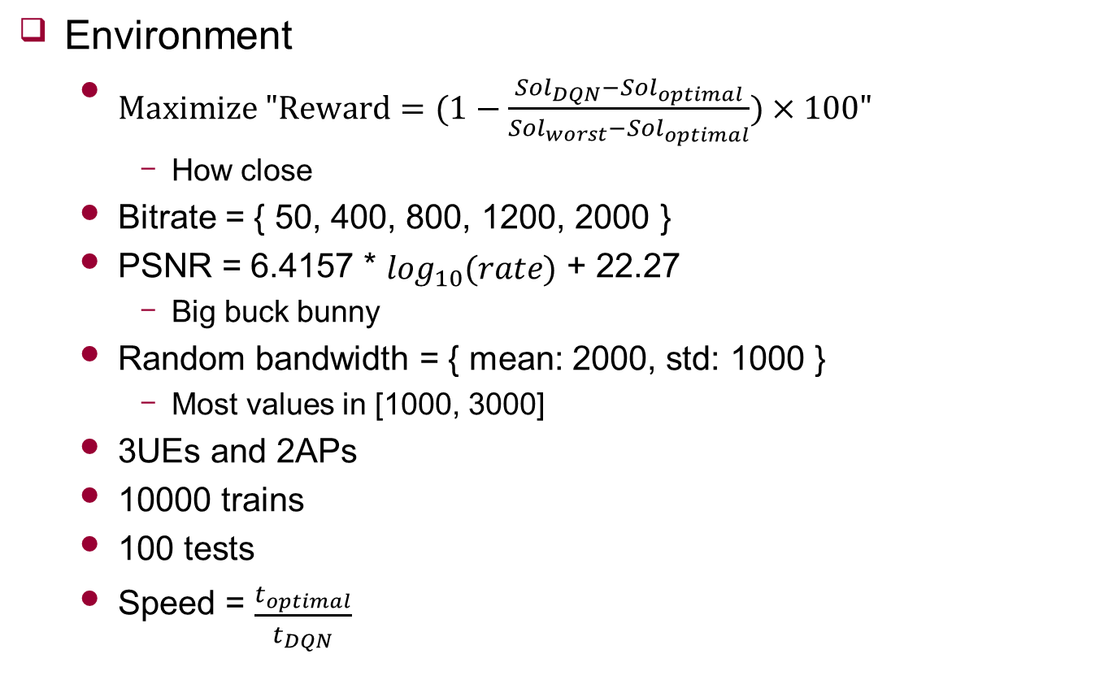
Comparison
Environment
$Maximize "Reward=(1−\frac{{Sol}_{DQN}−{Sol}_{optimal}}{{Sol}_{worst}−{Sol}_{optimal}})×100"$
How close
Bitrate = { 50, 400, 800, 1200, 2000 }
PSNR = 6.4157 * $\log_{10}(rate)$ + 22.27
Big buck bunny
Random bandwidth = { mean: 2000, std: 1000 }
Most values in [1000, 3000]
3UEs and 2APs
10000 trains
100 tests
Speed = $\frac{t_{optimal}}{t_{DQN}}$
 | 1~100
reward | 92.82
speed | 0.19

Slide 2


Experiment
1 case
1000
1200
1500
2500
500

Slide 3
Experiment
1 case
2000
600
1200
1500
1000

Slide 4
Connection
If enough time slot
?
1~20Kbps
0.5~11Kbps
From the perspective of AP
UE1
UE2

Slide 5
Feedback
Not Considered
Supported → service
Detail experiment description
6.17 morning meeting
DQN + Optimal solution
UE < 6
Need to show time experiment
UE == 6 ~ 7
Hybrid
Need consequent scenario
UE > 7
Use only Optimal solution

