Slide 1
Wireless Networks Jae Jun Ha Media Computing and Networking Laboratory POSTECH 2018-09-01
Notes:
세미나 발표를 시작하겠습니다.

Slide 2
Contents
MAC layer
Some backgrounds on Wireless channel
Wireless versus Wired
Fading
Model
Modulation
Analog modulation
Digital modulation
Adaptive modulation
Multi-carrier modulation

Slide 3
MAC
Medium Access Control
Determines who/when to transmit a packet through channel
Provides MAC-specific framing
Fragmentation, splitting into slots
Provides error control mechanism
How to detect the errors
How to correct the errors (ex ARQ, FEC, etc.)
Performs management functions
QoS
Handover
Power saving, etc.

Slide 4
Distributed vs Centralized
Distributed and contention-based
Random Access
Robust to a single point failure
Good for bursty traffic in light load
Centralized and controlled
Controlled by BS
More controllable
Could be more efficient, esp. with many users in heavy load

Slide 5
Random Access MAC
When node has packets to send
Transmit without a priori coordination among nodes
Two or more transmitting nodes → collision
Random access MAC protocol specifies
How to detect collisions
How to recover from collisions
Examples
Slotted ALOHA, ALOHA
CSMA, CSMA/CD, CSMA/CA

Slide 6
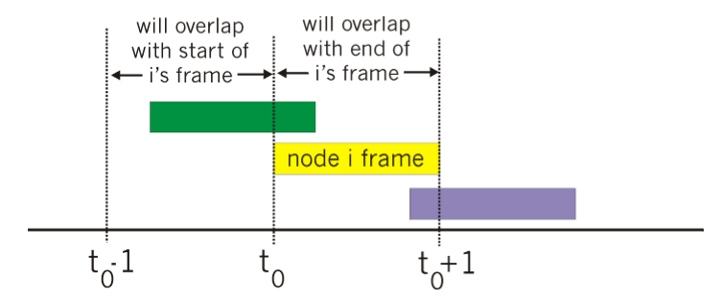
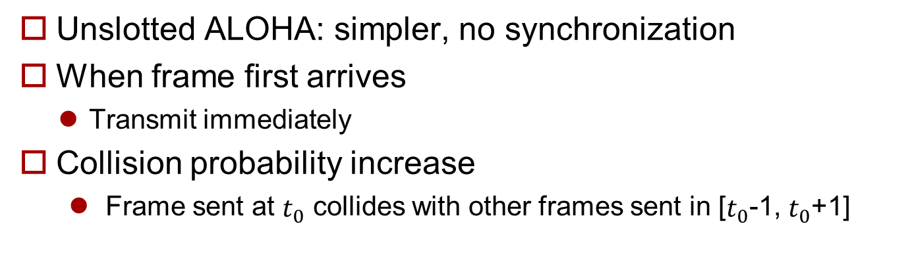
Pure (unslotted) ALOHA
Unslotted ALOHA: simpler, no synchronization
When frame first arrives
Transmit immediately
Collision probability increase
Frame sent at $t_{0}$ collides with other frames sent in [$t_{0}$-1, $t_{0}$+1]

Slide 7
Slotted ALOHA
Assumptions
All frames same size
Time is divided into equal size slots, time to transmit 1 frame
Nodes start to transmit frames only at beginning of slots
Nodes are synchronized
If 2 or more nodes transmit in slot, all nodes detect collision
Operation
When node obtain fresh frame, it transmits in next slot
No collision, node can send new frame in next slot
If collision, node retransmits frame in each subsequent slot with prob. P until success

Slide 8
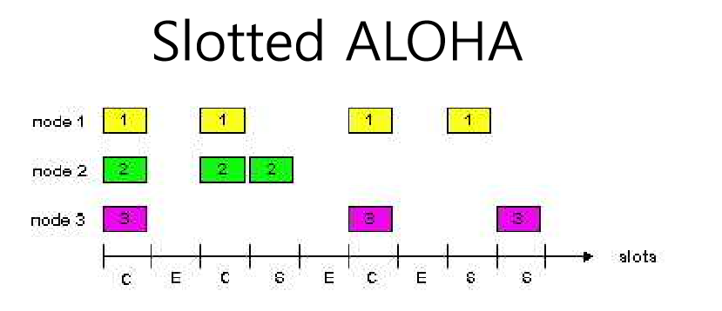
Slotted ALOHA
Pros
Single active node can continuously transmit at full rate of channel
Highly decentralized: only slots in nodes need to be in sync
simple
Cons
Collisions, wasting slots
Idle slots
Nodes may be able to detect collision in less than time to transmit packet

Slide 9
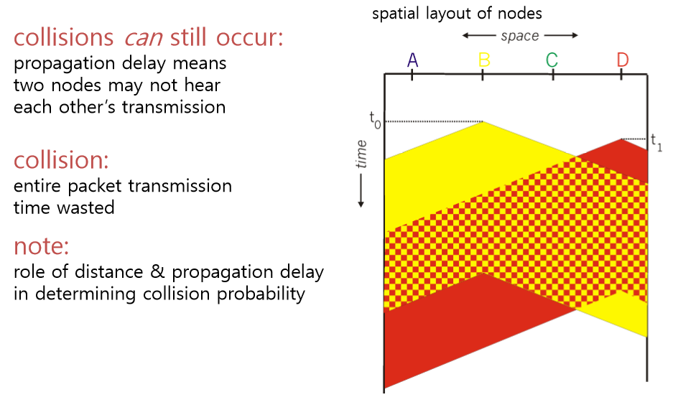
CSMA
Carrier Sense Multiple Access
Listen before transmit
If channel sensed idle: transmit entire frame
If channel sensed busy, defer transmission

Slide 10
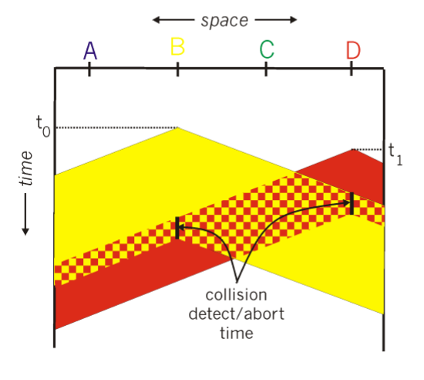
CSMA/CD
Carrier Sense Multiple Access / Collision Detection
Carrier sensing, deferral as in CSMA
Collisions detected within short time
Colliding transmissions aborted, reducing channel wastage
Collision detection
Easy in wired LANs: measure signal strengths, compare transmitted, received signals
Difficult in wireless LANs: receiver shut off while transmitting

Slide 11
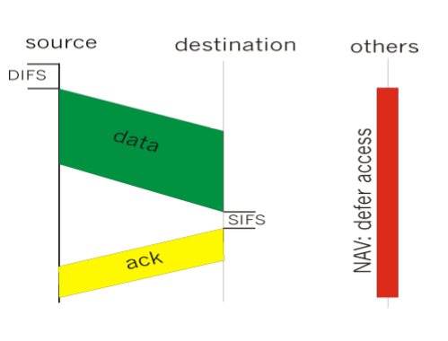
CSMA/CA
Carrier Sense Multiple Access / Collision Avoidance
Sender
If sense channel idle for DISF sec., then transmit entire frame (no collision detection)
If sense channel busy then binary backoff
Receiver
If received OK return ACK after SIFS (ACK is needed due to hidden terminal problem)

Slide 12
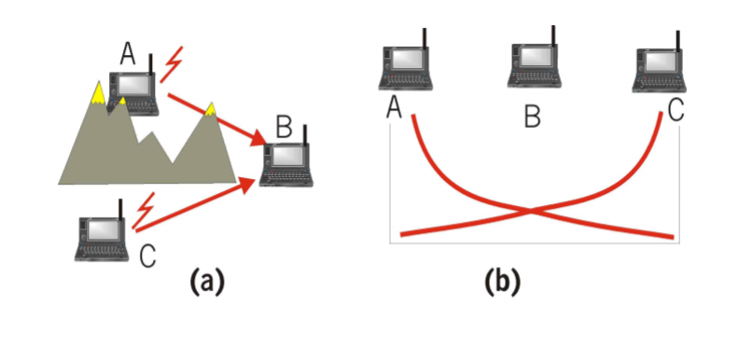
Hidden Terminal Problem
Notes:
숨겨진 노드 문제 (Hidden Terminal Problem)
무선 LAN에서 3개의 노드가 있을 때, 중간 1개 노드는 양 노드가 보여 통신이 가능하나, 2개 사이에는 통신이 불가 그래서 둘다 가운데 노드에게 신호를 보낼 때 서로 보낸 지를 모르기 때문에 충돌이 일어날 수 있음
http://www.ktword.co.kr/abbr_view.php?m_temp1=3262 + 첨언

Slide 13
CSMA/CA
Problem
Two nodes, hidden from each other, transmit complete frames to base station
Wasted bandwidth for long duration!
Solution
small reservation packets
Nodes track reservation interval with internal “network allocation vector” (NAV)

Slide 14
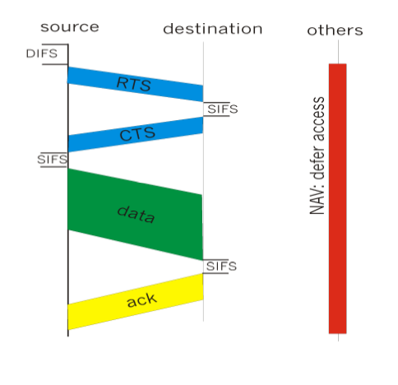
CSMA/CA
Sender transmits short RTS (Request To Send) packet
indicates duration of transmission
Receiver replies with short CTS (Clear To Send) packet
Notifying (possibly hidden) nodes
Hidden nodes will not transmit for specified duration: NAV

Slide 15
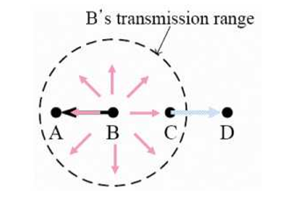
Exposed Terminal Problem
Node B is transmitting to node A
Node C has a packet to be transmitted to node D
But, node C defers its transmission since node C is within node B’s transmission range
Node C is an exposed terminal to node B
Reduction of channel utilization
Notes:
Exposed Terminal Problem 이 먼지

Slide 16
Centralized MAC: Static versus Dynamic
Static MAC well suited for circuit switching
Voice-oriented 1G/2G cellular system
Inefficient for packet switching, i.e. bandwidth is wasted when not utilized
Dynamic MAC is needed to handle various traffic patterns and QoS requirement
Polling scheme
Dynamic TDMA

Slide 17
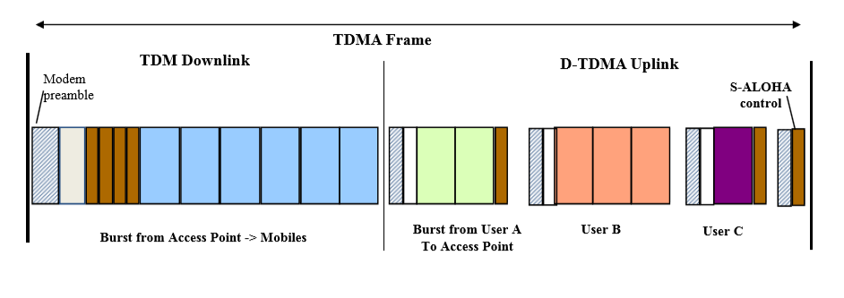
Dynamic TDMA
Frames divided into resource request (i.e. mini slots) and data slots
ALOHA variations be used for request
Data slots are allocated based on requests and scheduling

Slide 18
Polling MAC
A master polls a slave for the transmission
Based on the polling order scheduling
TDD inherently
A master polls a slave for the transmission
Concern
Polling overhead
When the traffic load is light, polling overhead is relatively high
Latency, especially when lightly loaded
Single point of failure (master node)

