Slide 1
Research Jae Jun Ha Media Computing and Networking Laboratory POSTECH 2019-01-11
Notes:
세미나 발표를 시작하겠습니다.

Slide 2
Contents
Intro
Fairness
Max-min Fairness
Proportional Fairness
Problem Formulation
Algorithm
Offline Algorithm
Online Algorithm
Research
Future Work

Slide 3
Intro
T. Bu, L. Li, and R. Ramjee, “Generalized proportional fair scheduling in third generation wireless data networks,” in Proc. 2006 IEEE INFOCOM, pp. 1–12
Why I chose this paper?
Prefer “Proportional fairness” (to “Max-min fairness”)
Similar Problem formulation
To refer algorithm
Notes:
논문에 대한 간단한 요약 설명
논문을 선택한 이유

Slide 4
Fairness
Used to determine whether users are using fair system resources.
It is important concept in AP selection
System must balance bandwidth while giving fair resource to users
It is not appropriate for users to receive unfair resources (too small or too large resources)
I will introduce two fairness
Max-min fairness
Proportional fairness

Slide 5
Max-min Fairness
To maximize the minimum bandwidth of flow
How to solve
Using Water-Filling method
Increase bandwidth of all flows until remain bandwidth is zero
Bandwidth
Node’s index

Slide 6
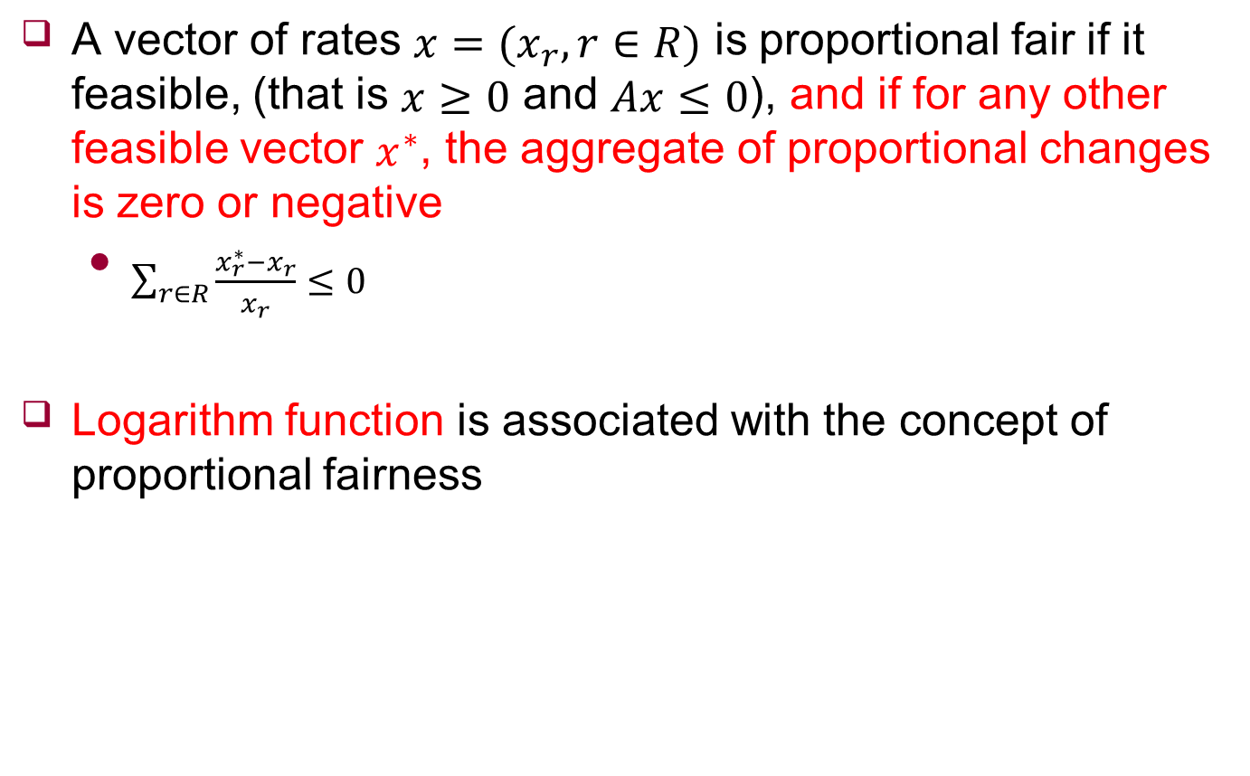
Proportional Fairness
A vector of rates $x=(x_{r},r∈R)$ is proportional fair if it feasible, (that is $x≥0$ and $Ax≤0$), and if for any other feasible vector $x^{∗}$, the aggregate of proportional changes is zero or negative
$\sum_{r∈R}{\frac{x_{r}^{∗}−x_{r}}{x_{r}}≤0}$
Logarithm function is associated with the concept of proportional fairness

Slide 7








Max-min Fairness Example
Max-min fairness
Solution
$Maximize min\{{Flow}_{i}\}$ $(i=0,1,2,3)$
$Subject to {Flow}_{0}+{ Flow}_{1}≤1$
${Flow}_{0}+{ Flow}_{2}≤1$
${Flow}_{0}+{ Flow}_{3}≤1$
Capacity: 1
Capacity: 1
Capacity: 1
${Flow}_{0}$
${Flow}_{1}$
${Flow}_{2}$
${Flow}_{3}$
First link
$$Capacity=1$$
${Flow}_{0}$
${Flow}_{1}$

Slide 8
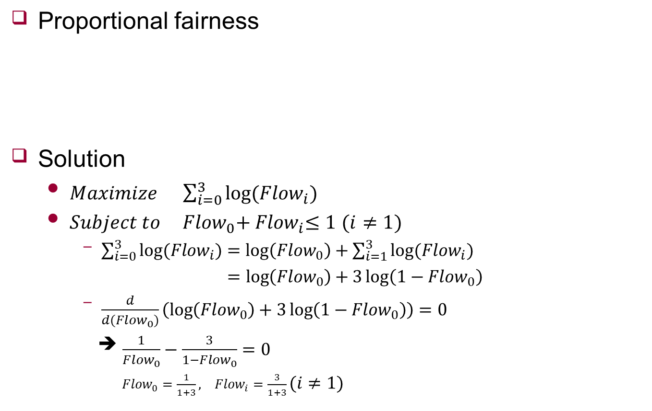
Proportional Fairness Example
Proportional fairness
Solution
$Maximize \sum_{i=0}^{3}{log⁡({Flow}_{i})}$
$Subject to {Flow}_{0}+{ Flow}_{i}≤1$ $(i≠1)$
$\sum_{i=0}^{3}{log⁡({Flow}_{i})}=\log\left({Flow}_{0}\right)+\sum_{i=1}^{3}{log⁡({Flow}_{i})}$
$=\log\left({Flow}_{0}\right)+3\log\left(1−{Flow}_{0}\right)$
$\frac{d}{d{(Flow}_{0})}\left(\log\left({Flow}_{0}\right)+3\log\left(1−{Flow}_{0}\right)\right)=0$
➔ $\frac{1}{{Flow}_{0}}−\frac{3}{1−{Flow}_{0}}=0$
${Flow}_{0}=\frac{1}{1+3}, {Flow}_{i}=\frac{3}{1+3}(i≠1)$
Capacity: 1
Capacity: 1
Capacity: 1
${Flow}_{0}$
${Flow}_{1}$
${Flow}_{2}$
${Flow}_{3}$

Slide 9











Max-min Fairness vs Proportional Fairness
Max-min fairness
Proportional fairness
“Proportional fairness” guarantees more bandwidth than “Max-min fairness”.
$$\frac{1}{2}$$
Capacity: 1
Capacity: 1
Capacity: 1
${Flow}_{0}$
$$\frac{1}{2}$$
${Flow}_{1}$
${Flow}_{2}$
${Flow}_{3}$
$$\frac{1}{2}$$
$$\frac{1}{2}$$
$$Total=\frac{4}{2}$$
$$\frac{1}{4}$$
Capacity: 1
Capacity: 1
Capacity: 1
${Flow}_{0}$
$$\frac{3}{4}$$
${Flow}_{1}$
${Flow}_{2}$
${Flow}_{3}$
$$\frac{3}{4}$$
$$\frac{3}{4}$$
$$Total=\frac{5}{2}$$

Slide 10
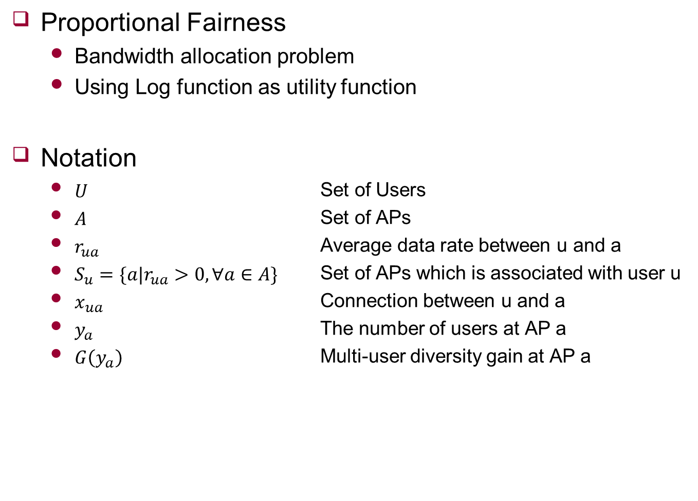
Problem Description
Proportional Fairness
Bandwidth allocation problem
Using Log function as utility function
Notation
$U$ Set of Users
$A$ Set of APs
$r_{ua}$ Average data rate between u and a
$S_{u}=\{a|r_{ua}>0,∀a∈A\}$ Set of APs which is associated with user u
$x_{ua}$ Connection between u and a
$y_{a}$ The number of users at AP a
$G\left(y_{a}\right)$ Multi-user diversity gain at AP a

Slide 11

Problem Formulation
Determine $x_{ua}$
Maximize $\sum_{u∈U}{\sum_{a∈S_{u}}{x_{ua}log⁡(r_{ua}\frac{G(y_{a})}{y_{a}})}}$
Subject to
$\sum_{a∈S_{u}}{x_{ua}}=1, ∀u∈U$
$y_{a}=\sum_{u:a∈S_{u}}{x_{ua}},∀a∈A$
$x_{ua}=\{0,1\}$

Slide 12
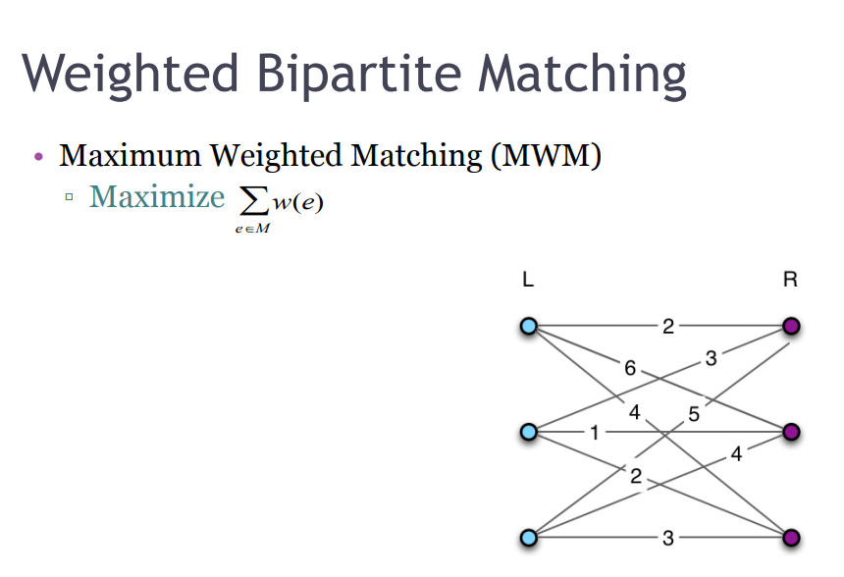


Algorithm
There are two algorithm to solve problem
Offline Algorithm
K-component algorithm
Online Algorithm
Greedy algorithm
Proposition
$Know y_{a}$
Maximizing weighted bipartite matching with weight( )
It can be solved optimally in polynomial time
https://resources.mpi-inf.mpg.de/departments/d1/teaching/ss12/AdvancedGraphAlgorithms/Slides06.pdf
$$p_{ua}=log⁡(r_{ua}\frac{G(y_{a})}{y_{a}})$$

Slide 13

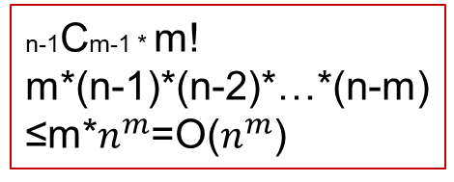
Offline Algorithm
Brute force
Enumerate all possible $y_{a}$ case
$O(n^{m})$
Maximum weighted matching
“Enumerate all possible $y_{a}$ case” means
Ex) $y_{1}=2,y_{2}=3, …y_{m}=6, (\sum_{i=1}^{m}{y_{i}}=n)$
n-1Cm-1 * m!
m*(n-1)*(n-2)*…*(n-m)
≤m*$n^{m}$=O($n^{m}$)
...

Slide 14
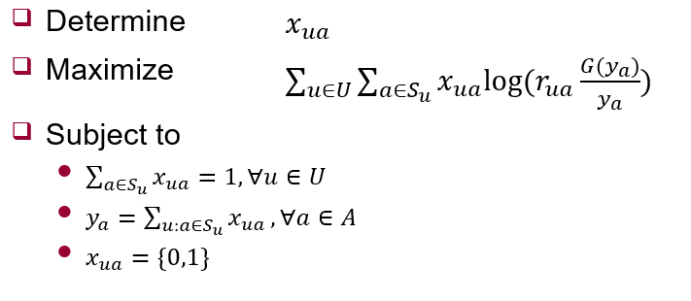


Offline Algorithm
Brute force
Enumerate all possible $y_{a}$ case
$O(n^{m})$
Maximum weighted matching
“Maximum weighted matching” means
AP
$$p_{ua}=log⁡(r_{ua}\frac{G(y_{a})}{y_{a}})$$
UE
...
...

Slide 15
Online Algorithm
Offline algorithm is hard to use
Because of dynamic network status
Greedy-k
Can change connection at most k existing users
Because k is small, can consider all possible case

Slide 16
Research
Problem Formulation with Proportional Fairness
Two Algorithms
Offline
Online
Using Online algorithm
결론 구체적으로
실험 넣기
Notes:
논문 결론 말하면서

Slide 17
Future work
Apply them in my research
Survey other papers
구체적으로

