Slide 1
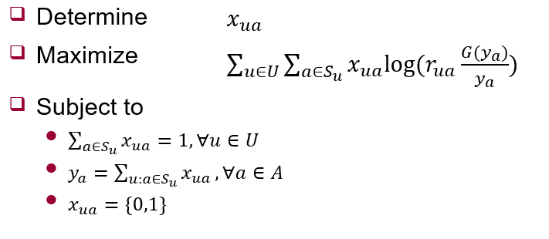



Offline Algorithm
Brute force
Enumerate all possible $y_{a}$ case
$O(n^{m})$
Maximum weighted matching
“Maximum weighted matching” means
$$min\{u\left(r_{i,j}^{sup}\right)−u\left(r_{i}^{req}\right),0\}$$
AP
$$p_{ua}=log⁡(r_{ua}\frac{G(y_{a})}{y_{a}})$$
UE
...
...

