Slide 1
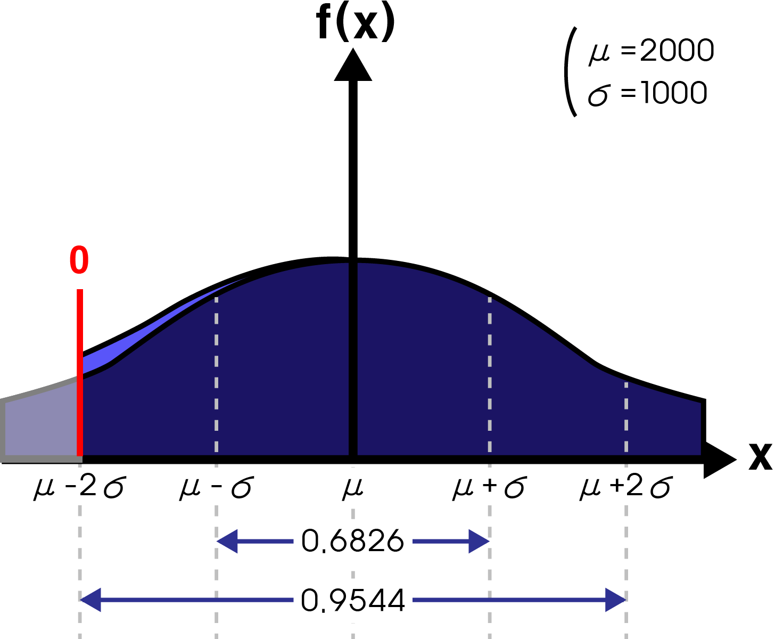
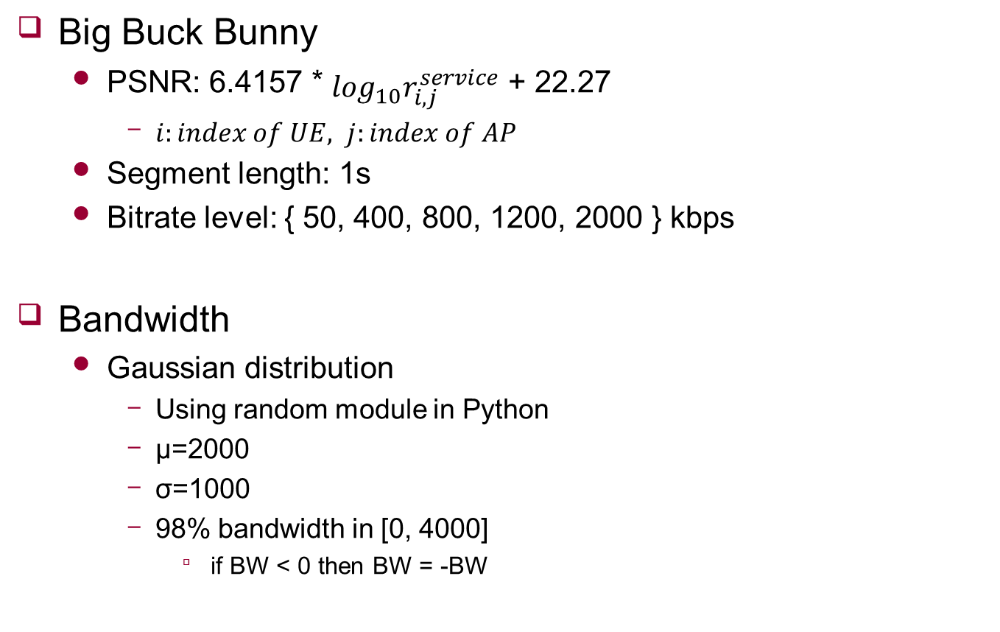
Video & Bandwidth
Big Buck Bunny
PSNR: 6.4157 * $\log_{10}r_{i,j}^{service}$ + 22.27
$i:index of UE, j:index of AP$
Segment length: 1s
Bitrate level: { 50, 400, 800, 1200, 2000 } kbps
Bandwidth
Gaussian distribution
Using random module in Python
μ=2000
σ=1000
98% bandwidth in [0, 4000]
if BW < 0 then BW = -BW

Slide 2


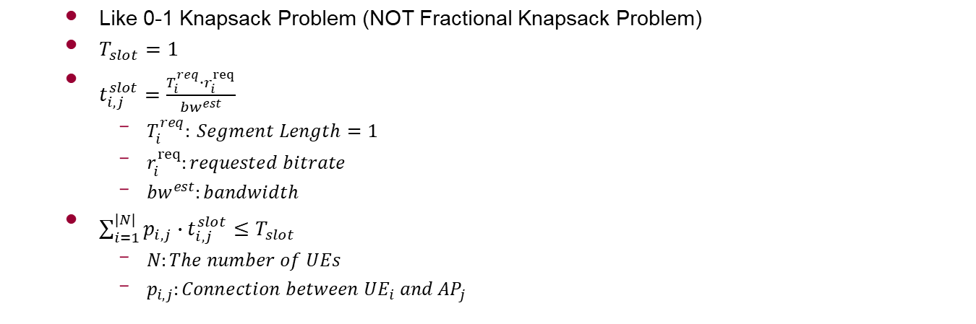


Timeslot
To express AP capacity
AP1
$$t_{1,1}^{slot}$$
$$t_{2,1}^{slot}$$
UE1
UE2
$$T_{slot}$$
Possible?
Like 0-1 Knapsack Problem (NOT Fractional Knapsack Problem)
$T_{slot}=1$
$t_{i,j}^{slot}=\frac{T_{i}^{req}∙r_{i}^{req}}{{bw}^{est}}$
$T_{i}^{req}: Segment Length=1$
$r_{i}^{req}:requested bitrate$
${bw}^{est}:bandwidth$
$\sum_{i=1}^{|N|}{p_{i,j}∙t_{i,j}^{slot}≤T_{slot}}$
$N:The number of UEs$
$p_{i,j}:Connection between {UE}_{i} and {AP}_{j}$

Slide 3
Result
DQN vs Optimal solution
Simultaneously
Performance 92 ~ 93%
Time (DQN is fast)
If # of UEs == 5:
If AP >= 4:
If # of UEs == 6:
If AP >= 3:
If # of UEs == 7:
If AP >= 2:
If # of UEs == 8:
It takes lots of time(consider segment length is 1)
Only considering DQN is better

