Slide 1

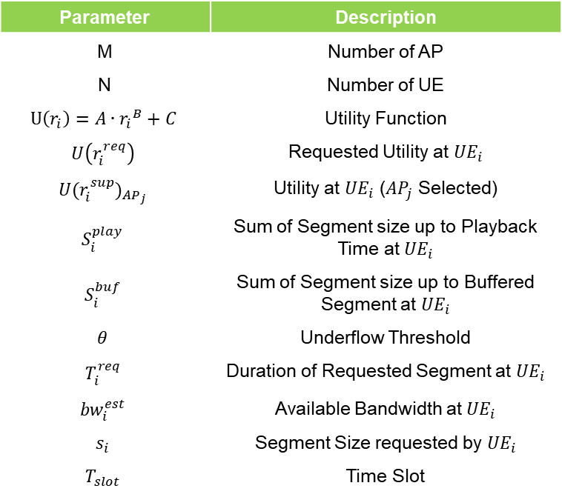
Problem Formulation
Determine $\overset{⃑}{AP}=\left\{{AP}_{1},…,{AP}_{j},…,{AP}_{M}\right\}, \overset{⃑}{R}=\left\{r_{1}^{sup},{…,r}_{i}^{sup},…,r_{N}^{sup}\right\}$ to minimize $\sum_{i}^{N}{U\left(r_{i}^{req}\right)−{U(r_{i}^{sup})}_{{AP}_{j}}}$
Subject to
$S_{i}^{play}+θ≤r_{i}^{req}∙T_{i}^{req}+S_{i}^{buf}$
$r_{i}^{sup}≤{bw}_{i}^{est}$
$\sum_{i}^{N}{\frac{s_{i}}{r_{i}^{sup}}≤T_{slot}}$
Parameter | Description
M | Number of AP
N | Number of UE
$$U\left(r_{i}\right)=A∙{r_{i}}^{B}+C$$ | Utility Function
$$U\left(r_{i}^{req}\right)$$ | Requested Utility at ${UE}_{i}$
$${U(r_{i}^{sup})}_{{AP}_{j}}$$ | Utility at ${UE}_{i}$ (${AP}_{j}$ Selected)
$$S_{i}^{play}$$ | Sum of Segment size up to Playback Time at ${UE}_{i}$
$$S_{i}^{buf}$$ | Sum of Segment size up to Buffered Segment at ${UE}_{i}$
$$θ$$ | Underflow Threshold
$$T_{i}^{req}$$ | Duration of Requested Segment at ${UE}_{i}$
$${bw}_{i}^{est}$$ | Available Bandwidth at ${UE}_{i}$
$$s_{i}$$ | Segment Size requested by ${UE}_{i}$
$$T_{slot}$$ | Time Slot
Notes:
지적 받은 것:
bitrate 어떻게 줄일 건지

Slide 2
제약 조건 1을 SI에 관한 식으로 (수요일 작업 예정)

Slide 3
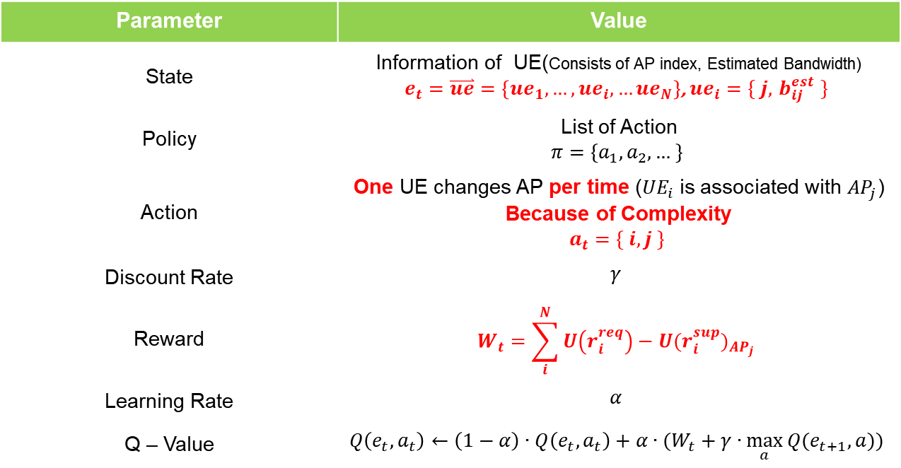
MDP Definition
Find Policy which minimize long term reward
Parameter | Value
State | Information of UE(Consists of AP index, Estimated Bandwidth) $e_{t}=\overset{⃑}{ue}=\left\{{ue}_{1}, …,{ue}_{i}, …{ue}_{N}\right\}$, ${ue}_{i}=\{ j, { b}_{ij}^{est} \}$
Policy | List of Action $$π=\left\{a_{1},a_{2},… \right\}$$
Action | One UE changes AP per time (${UE}_{i}$ is associated with ${AP}_{j}$) Because of Complexity $$a_{t}=\left\{ i, j \right\}$$
Discount Rate | $$γ$$
Reward | $$W_{t}=\sum_{i}^{N}{U\left(r_{i}^{req}\right)−{U(r_{i}^{sup})}_{{AP}_{j}}}$$
Learning Rate | $$α$$
Q – Value | $$Q\left(e_{t},a_{t}\right)←\left(1−α\right)∙Q\left(e_{t},a_{t}\right)+α∙(W_{t}+γ∙\max_{a}{Q(e_{t+1},a))}$$
Notes:
State 지적 받을 요소 있음

Slide 4


Bandwidth Estimation
Bandwidth is decided by
Connected AP
Time (input for ARIMA model)
When network is changed (AP changed), need to estimate changed bandwidth
RSSI
Number of APs
?
?
1~20Kbps
2~23Kbps
?
0.5~11Kbps
< before >
< after >

Slide 5
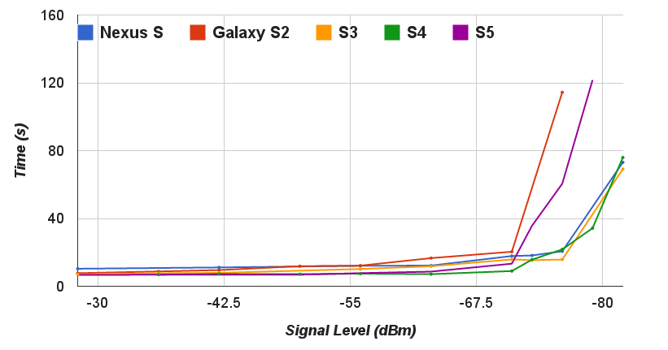
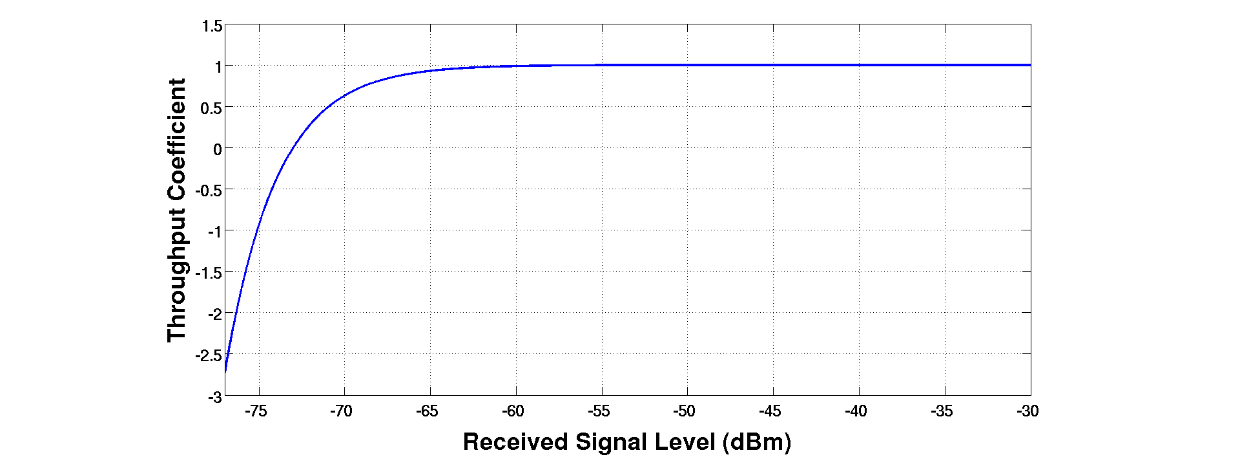
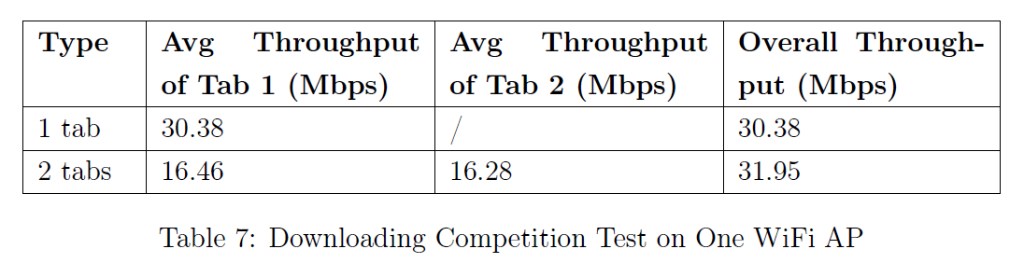

An SDN Platform for Traffic Offloading
RSSI
$1−e^{−k_{0}∙(S−k_{1)}}$
Multiple APs

Slide 6
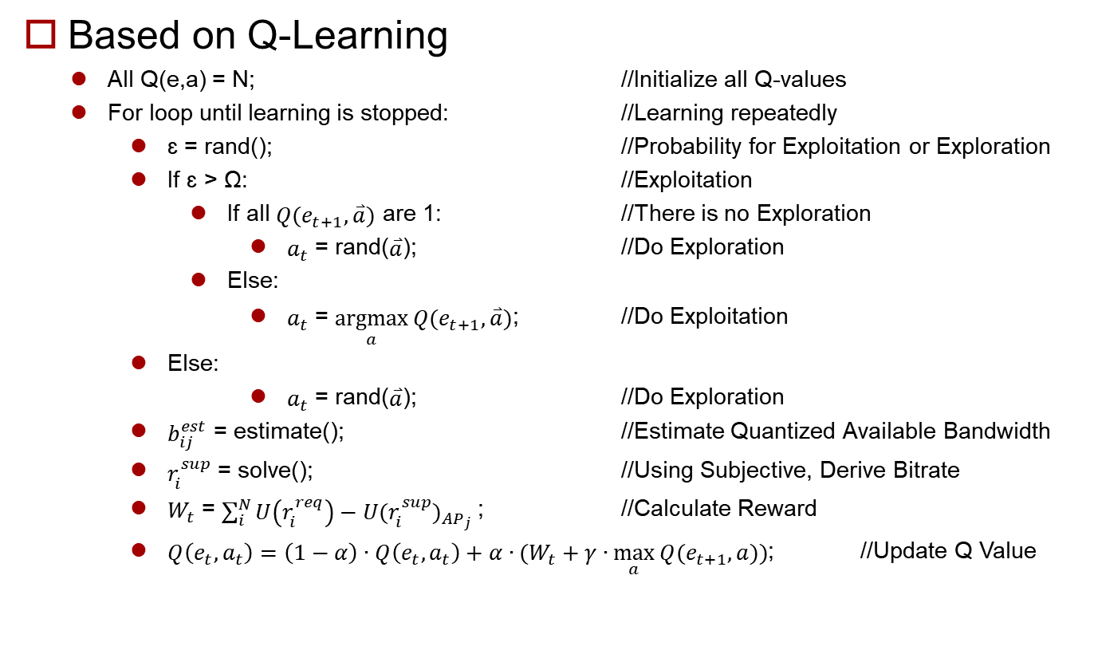
Algorithm
Based on Q-Learning
All Q(e,a) = N; //Initialize all Q-values
For loop until learning is stopped: //Learning repeatedly
ɛ = rand(); //Probability for Exploitation or Exploration
If ɛ > Ω: //Exploitation
If all $Q(e_{t+1},\overset{⃑}{a})$ are 1: //There is no Exploration
$a_{t}$ = rand($\overset{⃑}{a}$); //Do Exploration
Else:
$a_{t}$ = $\underset{a}{argmax}{Q(e_{t+1},\overset{⃑}{a})}$; //Do Exploitation
Else:
$a_{t}$ = rand($\overset{⃑}{a}$); //Do Exploration
$b_{ij}^{est}$ = estimate(); //Estimate Quantized Available Bandwidth
$r_{i}^{sup}$ = solve(); //Using Subjective, Derive Bitrate
$W_{t}$ = $\sum_{i}^{N}{U\left(r_{i}^{req}\right)−{U(r_{i}^{sup})}_{{AP}_{j}}}$; //Calculate Reward
$Q\left(e_{t},a_{t}\right)=\left(1−α\right)∙Q\left(e_{t},a_{t}\right)+α∙(W_{t}+γ∙\max_{a}{Q(e_{t+1},a))}$; //Update Q Value

