Slide 1
Research Jae Jun Ha Media Computing and Networking Laboratory POSTCH 2020-02-08
Notes:
발표 시작하겠습니다.
오늘 발표 드릴 내용은 알고리즘에 관한 내용을 정리했습니다.

Slide 2
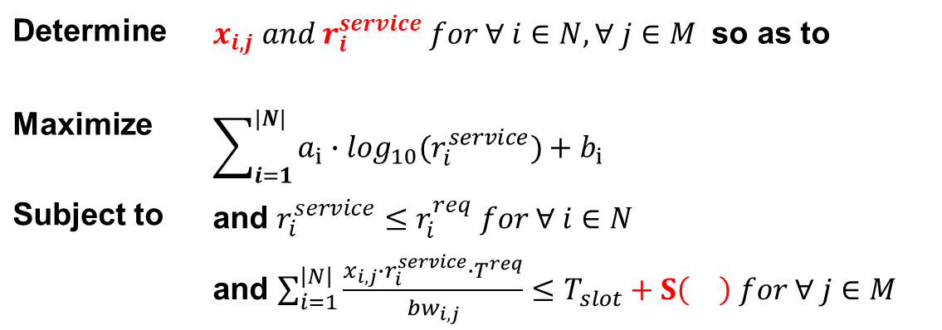
Formulation
Determine | $x_{i,j} and r_{i}^{service} for ∀ i∈N, ∀ j∈M$ so as to
Maximize | $$\sum_{i=1}^{|N|}{a_{i}∙\log_{10}(r_{i}^{service})+b_{i}}$$
Subject to | and $r_{i}^{service}≤r_{i}^{req} for ∀ i∈N$
 | and $\sum_{i=1}^{\left|N\right|}{\frac{x_{i,j}∙r_{i}^{service}∙T^{req}}{{bw}_{i,j}}}≤T_{slot}+S\left(\right) for ∀ j∈M$
Notes:
결정해야 하는 것:
$x_{i,j}$(chunk rate), $r_{i}^{service}$(bitrate)
우선은 $S\left(\right)$를 고려하지 않음
최적화 문제를 풀기 위해 Lagrange Multiplier를 활용

Slide 3
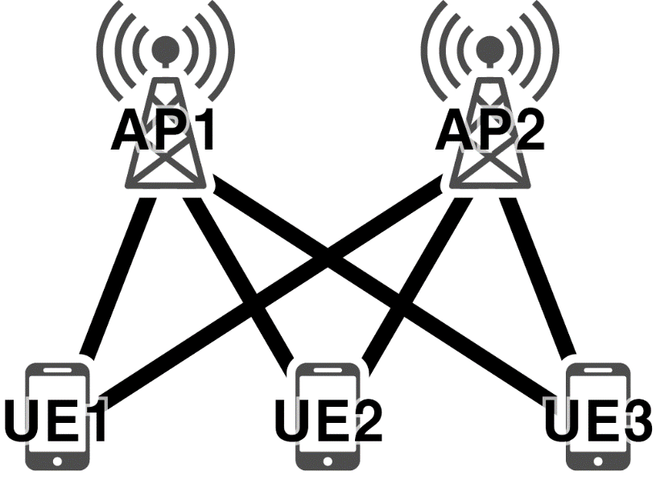
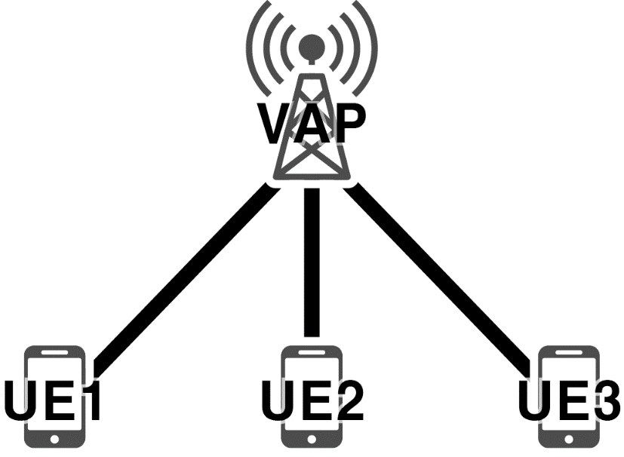

Lagrange Multiplier
Function
$L=\sum_{i=1}^{|N|}{(a_{i}∙\log_{10}(r_{i}^{service})+b_{i})}−\sum_{j=1}^{\left|M\right|}{λ_{j}∙\left(\sum_{i=1}^{\left|N\right|}{\frac{x_{i,j}∙r_{i}^{service}∙T^{req}}{{bw}_{i,j}}}−T_{slot}\right)}$
Too many lambdas… ➔ It is similar to Full Search
VAP
Like one AP (one lambda)
Notes:
Lagrange Multiplier가지고 푼다고 설명하기
(배경) Lagrange Multiplier를 사용할 경우 AP 하나당 람다가 생기게 때문에 여러 개의 람다를 조절할 경우 Full Search 와 다를 바가 없음

Slide 4










Lagrange Multiplier
Merged bandwidth
Assuming clients use a multipath interface, each client receives streaming services with different chunk rates (x) for each AP
Therefore, merged bandwidth related to UE (i) can be expressed as
$bw_{i}=\frac{\sum_{j=1}^{M}{x_{i,j}∙bw_{i,j}}}{\sum_{j=1}^{M}{x_{i,j}}}=\sum_{j=1}^{M}{x_{i,j}∙bw_{i,j}}$
$$x_{1,1}, bw_{1,1}$$
$$x_{3,2}, bw_{3,2}$$
$$bw_{1}$$
$$bw_{2}$$
$$bw_{3}$$
$$x_{2,1}, bw_{2,1}$$
$$x_{2,2}, bw_{2,2}$$
$$x_{1,2}, bw_{1,2}$$
$$x_{3,1}, bw_{3,1}$$

Slide 5


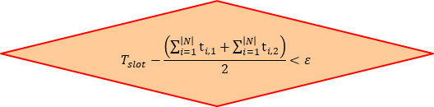



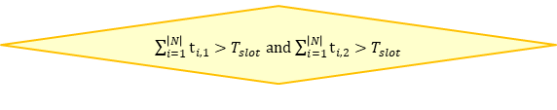
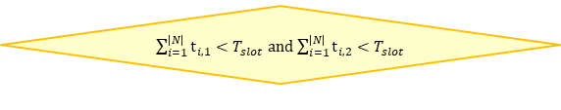


Algorithm
Initialize $x_{i,j}$
Derive $r_{i}^{service}$ (Lagrange Multiplier - Analytic)
Satisfy $r_{i}^{req}$ and $T_{slot}$
END
yes
no
Adjust $x_{i,j}$
$\sum_{i=1}^{\left|N\right|}{t_{i,1}}<T_{slot}$ and $\sum_{i=1}^{\left|N\right|}{t_{i,2}}<T_{slot}$
yes
no
yes
$$T_{slot}−\frac{\left(\sum_{i=1}^{\left|N\right|}{t_{i,1}}+\sum_{i=1}^{\left|N\right|}{t_{i,2}}\right)}{2}<ε$$
no
Adjust $r_{i}^{service}$
$\sum_{i=1}^{\left|N\right|}{t_{i,1}}>T_{slot}$ and $\sum_{i=1}^{\left|N\right|}{t_{i,2}}>T_{slot}$
yes
no
update $r_{i}^{service}$ until fully utilize $T_{slot}$
$\sum_{i=1}^{\left|N\right|}{t_{i,1}}>T_{slot}$ and $\sum_{i=1}^{\left|N\right|}{t_{i,2}}<T_{slot}$
$\sum_{i=1}^{\left|N\right|}{t_{i,1}}<T_{slot}$ and $\sum_{i=1}^{\left|N\right|}{t_{i,2}}>T_{slot}$
yes
Notes:
$x_{i,j}$ 초기화는 이용 가능한 bandwidth 비율대로
Ex) AP 1에서 많이 쓰면 AP 1에 많이 할당 하는 방식으로
---
Lagrange Multiplier 이용해서 λ 값 및 $r_{i}^{service}$ 값 구함
여기서 $r_{i}^{service}$ 값의 경우 MPD에 맞지 않기 때문에 맞추는 과정이 필요
또한 $r_{i}^{service}$를$r_{i}^{req}$에 맞추는 과정도 필요
---
만약 가능성은 낮지만 $r_{i}^{service}$가 $r_{i}^{req}$에 맞고 timeslot의 합이 $T_{slot}$ 안에 들 경우 알고리즘 종료
---
각 UE들의 timeslot 합을 구함 여기서 timeslot 합이 세 가지 경우로 나뉨
모두 AP timeslot 안에 드는 경우
모두 AP timeslot 보다 큰 경우
하나만 AP timeslot 안에 드는 경우

Slide 6


Initialize x
Basic idea
Increase chunk rate if more resources are available
If the videos are the same, the curve-fitting PSNR value is maximized when the chunk rate follows the bandwidth ratio
Adjust chunk rate adaptively
1000 kbps
2000 kbps
0.33*1000 + 0.66*2000 = 1666kbps

Slide 7
Algorithm
Initialize $x_{i,j}$
Derive $r_{i}^{service}$ (Lagrange Multiplier - Analytic)
Satisfy $r_{i}^{req}$ and $T_{slot}$
END
yes
no
Adjust $x_{i,j}$
$\sum_{i=1}^{\left|N\right|}{t_{i,1}}<T_{slot}$ and $\sum_{i=1}^{\left|N\right|}{t_{i,2}}<T_{slot}$
yes
no
yes
$$T_{slot}−\frac{\left(\sum_{i=1}^{\left|N\right|}{t_{i,1}}+\sum_{i=1}^{\left|N\right|}{t_{i,2}}\right)}{2}<ε$$
no
Adjust $r_{i}^{service}$
$\sum_{i=1}^{\left|N\right|}{t_{i,1}}>T_{slot}$ and $\sum_{i=1}^{\left|N\right|}{t_{i,2}}>T_{slot}$
yes
no
update $r_{i}^{service}$ until fully utilize $T_{slot}$
$\sum_{i=1}^{\left|N\right|}{t_{i,1}}>T_{slot}$ and $\sum_{i=1}^{\left|N\right|}{t_{i,2}}<T_{slot}$
$\sum_{i=1}^{\left|N\right|}{t_{i,1}}<T_{slot}$ and $\sum_{i=1}^{\left|N\right|}{t_{i,2}}>T_{slot}$
yes

Slide 8

Lagrange Multiplier
Function
$L=\sum_{i=1}^{|N|}{(a_{i}∙\log_{10}(r_{i}^{service})+b_{i})}−λ∙(\sum_{i=1}^{\left|N\right|}{\frac{r_{i}^{service}∙T^{req}}{{bw}_{i}}}−T_{slot})$
$\frac{∂L}{∂r_{i}^{service}}=\frac{a_{i}}{r_{i}^{service}}−λ∙\frac{T^{req}}{{bw}_{i}}=0$
$\frac{a_{i}}{λ}=\frac{r_{i}^{service}∙T^{req}}{{bw}_{i}}$
$From \sum_{i=1}^{\left|N\right|}{\frac{r_{i}^{service}∙T^{req}}{{bw}_{i,j}}}≤T_{slot}$
$\sum_{i=1}^{\left|N\right|}{\frac{a_{i}}{λ}}≤T_{slot}$
$\frac{\sum_{i=1}^{\left|N\right|}{a_{i}}}{λ}≤T_{slot}$
$λ≥\frac{\sum_{i=1}^{\left|N\right|}{a_{i}}}{T_{slot}}$
N + 1 variables
(N: rate, 1: lambda)
N + 1 equations
(N: Differential equation, 1: constraint)
Notes:
변수 N + 1(rate, 람다)
식 N + 1개 이기 때문에 analytic하게
Rate를 구할 수 있음

Slide 9
Quantization
Consider
MPD
Like Hwan wook’s method
Request rate (constraint)

Slide 10
Algorithm
Initialize $x_{i,j}$
Derive $r_{i}^{service}$ (Lagrange Multiplier - Analytic)
Satisfy $r_{i}^{req}$ and $T_{slot}$
END
yes
no
Adjust $x_{i,j}$
$\sum_{i=1}^{\left|N\right|}{t_{i,1}}<T_{slot}$ and $\sum_{i=1}^{\left|N\right|}{t_{i,2}}<T_{slot}$
yes
no
yes
$$T_{slot}−\frac{\left(\sum_{i=1}^{\left|N\right|}{t_{i,1}}+\sum_{i=1}^{\left|N\right|}{t_{i,2}}\right)}{2}<ε$$
no
Adjust $r_{i}^{service}$
$\sum_{i=1}^{\left|N\right|}{t_{i,1}}>T_{slot}$ and $\sum_{i=1}^{\left|N\right|}{t_{i,2}}>T_{slot}$
yes
no
update $r_{i}^{service}$ until fully utilize $T_{slot}$
$\sum_{i=1}^{\left|N\right|}{t_{i,1}}>T_{slot}$ and $\sum_{i=1}^{\left|N\right|}{t_{i,2}}<T_{slot}$
$\sum_{i=1}^{\left|N\right|}{t_{i,1}}<T_{slot}$ and $\sum_{i=1}^{\left|N\right|}{t_{i,2}}>T_{slot}$
yes

Slide 11
Algorithm
Initialize $x_{i,j}$
Derive $r_{i}^{service}$ (Lagrange Multiplier - Analytic)
Satisfy $r_{i}^{req}$ and $T_{slot}$
END
yes
no
Adjust $x_{i,j}$
$\sum_{i=1}^{\left|N\right|}{t_{i,1}}<T_{slot}$ and $\sum_{i=1}^{\left|N\right|}{t_{i,2}}<T_{slot}$
yes
no
yes
$$T_{slot}−\frac{\left(\sum_{i=1}^{\left|N\right|}{t_{i,1}}+\sum_{i=1}^{\left|N\right|}{t_{i,2}}\right)}{2}<ε$$
no
Adjust $r_{i}^{service}$
$\sum_{i=1}^{\left|N\right|}{t_{i,1}}>T_{slot}$ and $\sum_{i=1}^{\left|N\right|}{t_{i,2}}>T_{slot}$
yes
no
update $r_{i}^{service}$ until fully utilize $T_{slot}$
$\sum_{i=1}^{\left|N\right|}{t_{i,1}}>T_{slot}$ and $\sum_{i=1}^{\left|N\right|}{t_{i,2}}<T_{slot}$
$\sum_{i=1}^{\left|N\right|}{t_{i,1}}<T_{slot}$ and $\sum_{i=1}^{\left|N\right|}{t_{i,2}}>T_{slot}$
yes

Slide 12
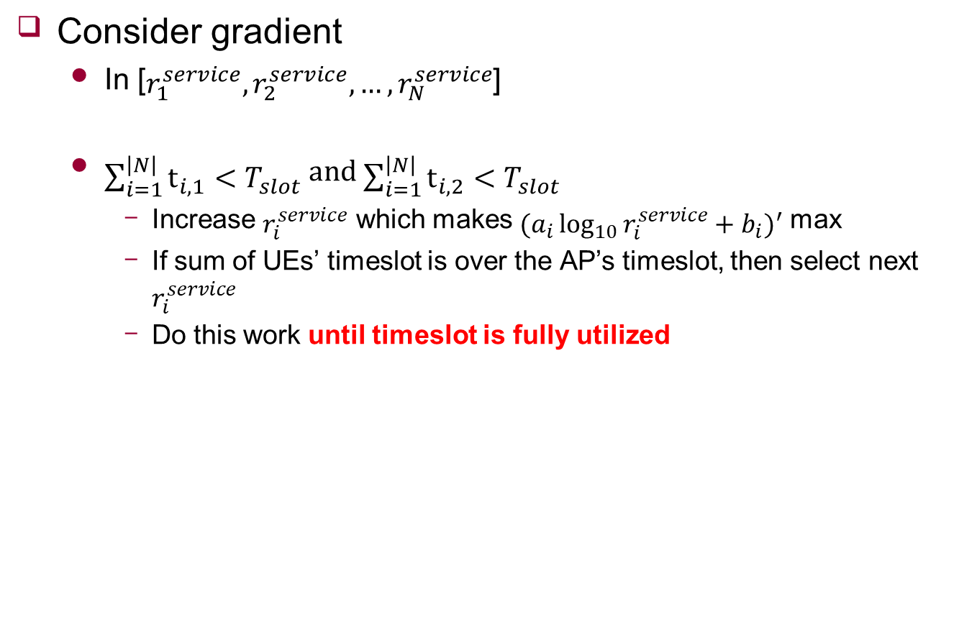
Adjust bitrate
Consider gradient
In [$r_{1}^{service},r_{2}^{service},…,r_{N}^{service}$]
$\sum_{i=1}^{\left|N\right|}{t_{i,1}}<T_{slot}$ and $\sum_{i=1}^{\left|N\right|}{t_{i,2}}<T_{slot}$
Increase $r_{i}^{service}$ which makes ${(a_{i}\log_{10}{r_{i}^{service}}+b_{i})}^{′}$ max
If sum of UEs’ timeslot is over the AP’s timeslot, then select next $r_{i}^{service}$
Do this work until timeslot is fully utilized

Slide 13
Algorithm
Initialize $x_{i,j}$
Derive $r_{i}^{service}$ (Lagrange Multiplier - Analytic)
Satisfy $r_{i}^{req}$ and $T_{slot}$
END
yes
no
Adjust $x_{i,j}$
$\sum_{i=1}^{\left|N\right|}{t_{i,1}}<T_{slot}$ and $\sum_{i=1}^{\left|N\right|}{t_{i,2}}<T_{slot}$
yes
no
yes
$$T_{slot}−\frac{\left(\sum_{i=1}^{\left|N\right|}{t_{i,1}}+\sum_{i=1}^{\left|N\right|}{t_{i,2}}\right)}{2}<ε$$
no
Adjust $r_{i}^{service}$
$\sum_{i=1}^{\left|N\right|}{t_{i,1}}>T_{slot}$ and $\sum_{i=1}^{\left|N\right|}{t_{i,2}}>T_{slot}$
yes
no
update $r_{i}^{service}$ until fully utilize $T_{slot}$
$\sum_{i=1}^{\left|N\right|}{t_{i,1}}>T_{slot}$ and $\sum_{i=1}^{\left|N\right|}{t_{i,2}}<T_{slot}$
$\sum_{i=1}^{\left|N\right|}{t_{i,1}}<T_{slot}$ and $\sum_{i=1}^{\left|N\right|}{t_{i,2}}>T_{slot}$
yes

Slide 14
Algorithm
Initialize $x_{i,j}$
Derive $r_{i}^{service}$ (Lagrange Multiplier - Analytic)
Satisfy $r_{i}^{req}$ and $T_{slot}$
END
yes
no
Adjust $x_{i,j}$
$\sum_{i=1}^{\left|N\right|}{t_{i,1}}<T_{slot}$ and $\sum_{i=1}^{\left|N\right|}{t_{i,2}}<T_{slot}$
yes
no
yes
$$T_{slot}−\frac{\left(\sum_{i=1}^{\left|N\right|}{t_{i,1}}+\sum_{i=1}^{\left|N\right|}{t_{i,2}}\right)}{2}<ε$$
no
Adjust $r_{i}^{service}$
$\sum_{i=1}^{\left|N\right|}{t_{i,1}}>T_{slot}$ and $\sum_{i=1}^{\left|N\right|}{t_{i,2}}>T_{slot}$
yes
no
update $r_{i}^{service}$ until fully utilize $T_{slot}$
$\sum_{i=1}^{\left|N\right|}{t_{i,1}}>T_{slot}$ and $\sum_{i=1}^{\left|N\right|}{t_{i,2}}<T_{slot}$
$\sum_{i=1}^{\left|N\right|}{t_{i,1}}<T_{slot}$ and $\sum_{i=1}^{\left|N\right|}{t_{i,2}}>T_{slot}$
yes

Slide 15






Adjust chunk rate
Calculate each timeslot between UE and AP
Increase chunk rate which has min timeslot
$$t_{1,1}$$
$$t_{3,2}$$
$$t_{2,1}$$
$$t_{2,2}$$
$$t_{1,2}$$
$$t_{3,1}$$

Slide 16
Algorithm
Initialize $x_{i,j}$
Derive $r_{i}^{service}$ (Lagrange Multiplier - Analytic)
Satisfy $r_{i}^{req}$ and $T_{slot}$
END
yes
no
Adjust $x_{i,j}$
$\sum_{i=1}^{\left|N\right|}{t_{i,1}}<T_{slot}$ and $\sum_{i=1}^{\left|N\right|}{t_{i,2}}<T_{slot}$
yes
no
yes
$$T_{slot}−\frac{\left(\sum_{i=1}^{\left|N\right|}{t_{i,1}}+\sum_{i=1}^{\left|N\right|}{t_{i,2}}\right)}{2}<ε$$
no
Adjust $r_{i}^{service}$
$\sum_{i=1}^{\left|N\right|}{t_{i,1}}>T_{slot}$ and $\sum_{i=1}^{\left|N\right|}{t_{i,2}}>T_{slot}$
yes
no
update $r_{i}^{service}$ until fully utilize $T_{slot}$
$\sum_{i=1}^{\left|N\right|}{t_{i,1}}>T_{slot}$ and $\sum_{i=1}^{\left|N\right|}{t_{i,2}}<T_{slot}$
$\sum_{i=1}^{\left|N\right|}{t_{i,1}}<T_{slot}$ and $\sum_{i=1}^{\left|N\right|}{t_{i,2}}>T_{slot}$
yes

Slide 17

Adjust bitrate
Consider gradient
In [$r_{1}^{service},r_{2}^{service},…,r_{N}^{service}$]
$\sum_{i=1}^{\left|N\right|}{t_{i,1}}>T_{slot}$ and $\sum_{i=1}^{\left|N\right|}{t_{i,2}}>T_{slot}$
Decrease $r_{i}^{service}$ which makes ${(a_{i}\log_{10}{r_{i}^{service}}+b_{i})}^{′}$ min
Do this work until $\sum_{i=1}^{\left|N\right|}{t_{i,1}}<T_{slot}$ and $\sum_{i=1}^{\left|N\right|}{t_{i,2}}<T_{slot}$

Slide 18
Algorithm
Initialize $x_{i,j}$
Derive $r_{i}^{service}$ (Lagrange Multiplier - Analytic)
Satisfy $r_{i}^{req}$ and $T_{slot}$
END
yes
no
Adjust $x_{i,j}$
$\sum_{i=1}^{\left|N\right|}{t_{i,1}}<T_{slot}$ and $\sum_{i=1}^{\left|N\right|}{t_{i,2}}<T_{slot}$
yes
no
yes
$$T_{slot}−\frac{\left(\sum_{i=1}^{\left|N\right|}{t_{i,1}}+\sum_{i=1}^{\left|N\right|}{t_{i,2}}\right)}{2}<ε$$
no
Adjust $r_{i}^{service}$
$\sum_{i=1}^{\left|N\right|}{t_{i,1}}>T_{slot}$ and $\sum_{i=1}^{\left|N\right|}{t_{i,2}}>T_{slot}$
yes
no
update $r_{i}^{service}$ until fully utilize $T_{slot}$
$\sum_{i=1}^{\left|N\right|}{t_{i,1}}>T_{slot}$ and $\sum_{i=1}^{\left|N\right|}{t_{i,2}}<T_{slot}$
$\sum_{i=1}^{\left|N\right|}{t_{i,1}}<T_{slot}$ and $\sum_{i=1}^{\left|N\right|}{t_{i,2}}>T_{slot}$
yes

Slide 19
Adjust chunk rate
Calculate each timeslot between UE and AP
decrease chunk rate which has max timeslot
$$t_{1,1}$$
$$t_{3,2}$$
$$t_{2,1}$$
$$t_{2,2}$$
$$t_{1,2}$$
$$t_{3,1}$$

Slide 20
Future Work
Evaluate PSNR
Compare single connection
UE select AP which has Max RSSI

