Slide 1
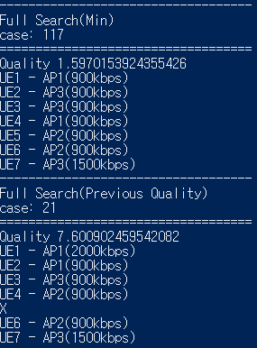
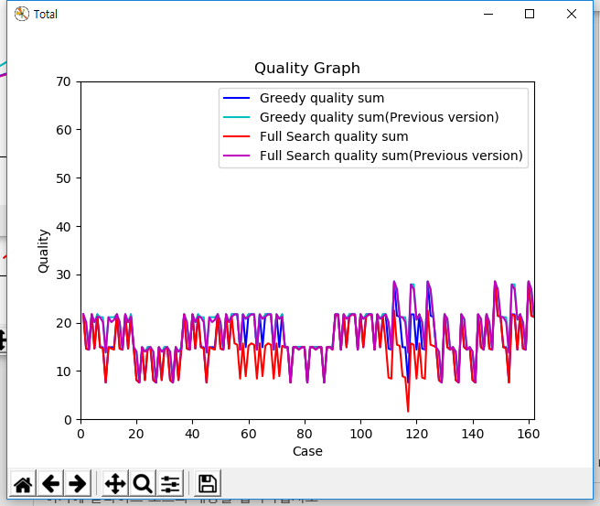
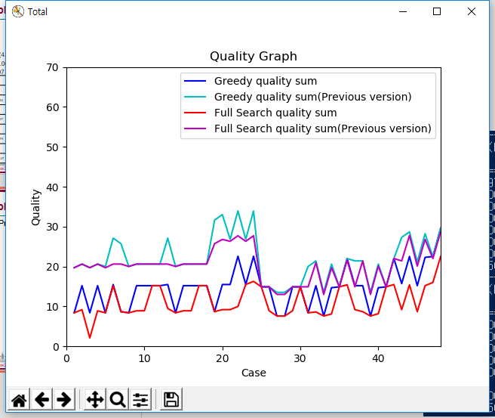
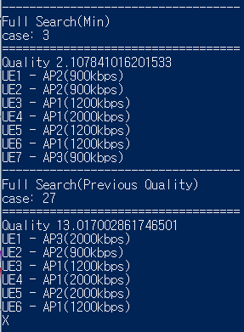
Multiple Knapsack Problem
Current Utility function vs Previous Utility function
7UEs and 3APs

Slide 2
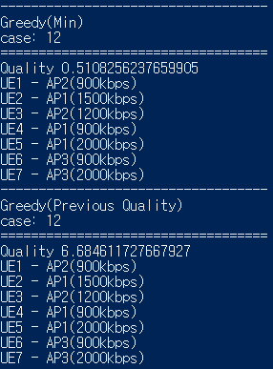
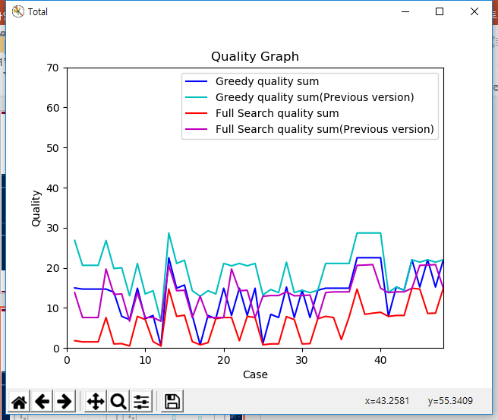
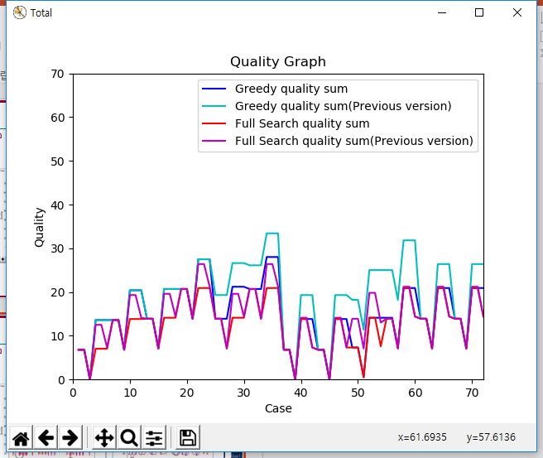
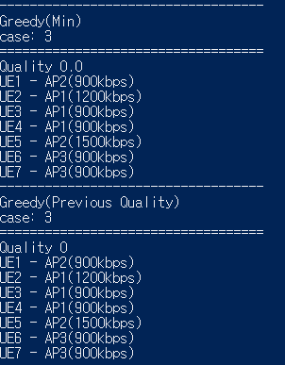
Multiple Knapsack Problem
Current Utility function vs Previous Utility function
7UEs and 3APs

Slide 3
Multiple Knapsack Problem
Compare MKP Solutions
7UEs and 4APs
Greedy: 4.48, 0.00076 sec
MTHM: 4.48, 0.00328 sec (4.3 times)
Branch and Bound: 1.13, 0.00640sec (8.4 times)
Full Search: 1.13, 8.020397 (10553 times)
 |  | 1 | 2 | 3 | 4 | 5 | 6 | 7 | 8 | 9 | 10
Greedy | Quality | 0.80 | 0 | 13.60 | 0 | 7.31 | 0 | 22.29 | 0 | 0 | 0.80
 | Time | 0.00052 | 0.00100 | 0.00054 | 0.00054 | 0.00053 | 0.00091 | 0.00081 | 0.00051 | 0.00122 | 0.00104
MTHM | Quality | 0.80 | 0 | 13.60 | 0 | 7.31 | 0 | 22.29 | 0 | 0 | 0.80
 | Time | 0.00550 | 0.00538 | 0.00317 | 0.00527 | 0.00452 | 0.00617 | 0.00577 | 0.00599 | 0.00442 | 0.00328
Branch and Bound | Quality | 0.29 | 0 | 0.51 | 0 | 1.31 | 0 | 8.85 | 0 | 0 | 0.29
 | Time | 0.00231 | 0.00077 | 0.00587 | 0.00079 | 0.04204 | 0.00079 | 0.00538 | 0.00100 | 0.00186 | 0.00319
Full Search | Quality | 0.29 | 0 | 0.51 | 0 | 1.31 | 0 | 8.85 | 0 | 0 | 0.29
 | Time | 0.43168 | 0.71291 | 0.74124 | 29.62347 | 2.70725 | 39.42939 | 0.34525 | 0.12552 | 3.87820 | 2.20906

