Slide 1
Utility function
To represent Quality with Bitrate

Slide 2
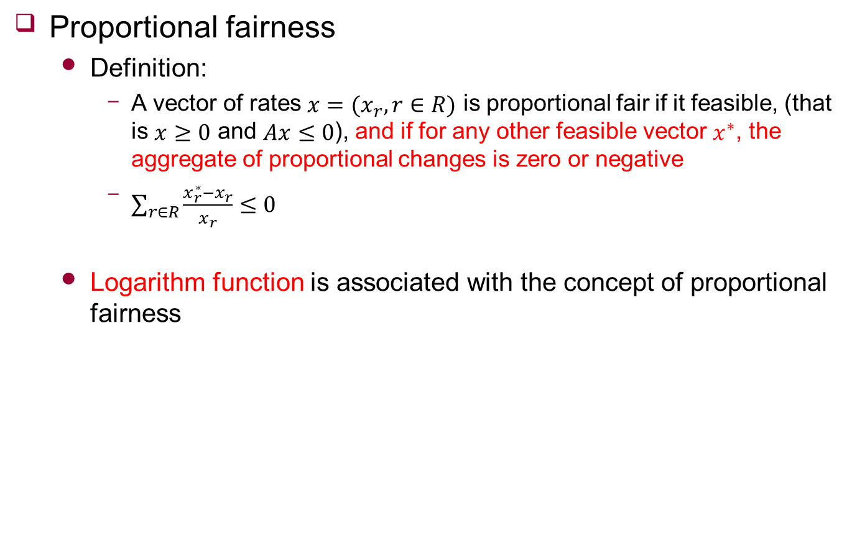
Fairness
Proportional fairness
Definition:
A vector of rates $x=(x_{r},r∈R)$ is proportional fair if it feasible, (that is $x≥0$ and $Ax≤0$), and if for any other feasible vector $x^{∗}$, the aggregate of proportional changes is zero or negative
$\sum_{r∈R}{\frac{x_{r}^{∗}−x_{r}}{x_{r}}≤0}$
Logarithm function is associated with the concept of proportional fairness

Slide 3
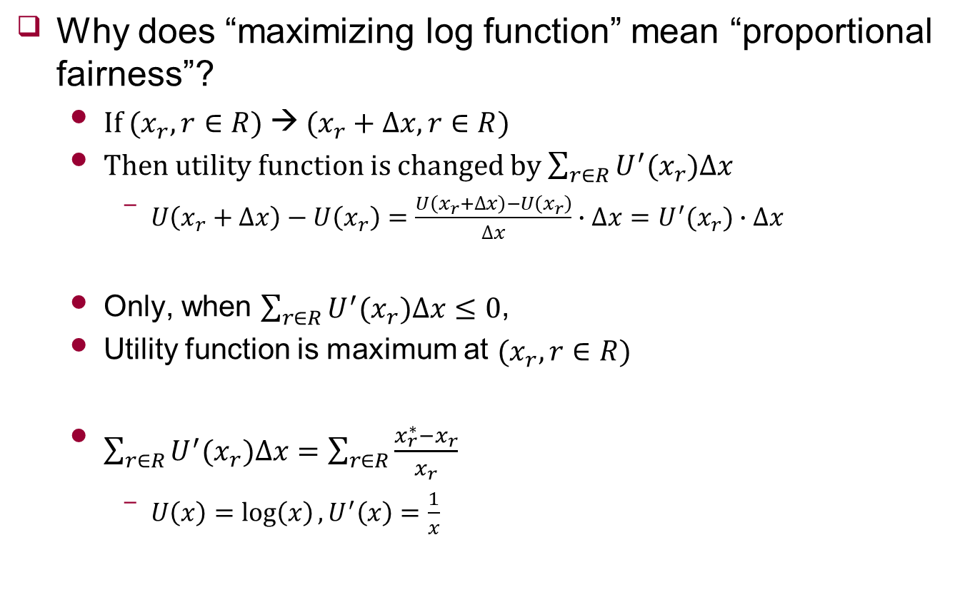
Proof
Why does “maximizing log function” mean “proportional fairness”?
If ($x_{r},r∈R$) → ($x_{r}+∆x,r∈R$)
Then utility function is changed by $\sum_{r∈R}{U^{′}(x_{r})∆x}$
$U\left(x_{r}+∆x\right)−U\left(x_{r}\right)=\frac{U\left(x_{r}+∆x\right)−U\left(x_{r}\right)}{∆x}∙∆x=U^{′}(x_{r})∙∆x$
Only, when $\sum_{r∈R}{U^{′}(x_{r})∆x}≤0$,
Utility function is maximum at ($x_{r},r∈R$)
$\sum_{r∈R}{U^{′}(x_{r})∆x}=\sum_{r∈R}{\frac{{x_{r}^{∗}−x}_{r}}{x_{r}}}$
$U\left(x\right)=\log\left(x\right), U^{′}\left(x\right)=\frac{1}{x}$

