Slide 1
Research Jae Jun Ha Media Computing and Networking Laboratory POSTECH 2019-04-19
Notes:
세미나 발표를 시작하겠습니다.

Slide 2
Contents
Background
Implementations
Future Work

Slide 3
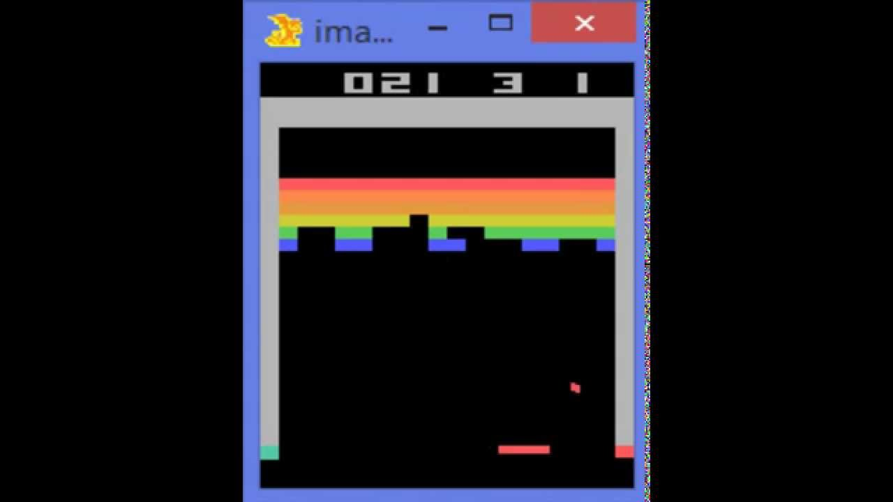
Background
DQN(Deep Q Network)
From “Playing Atari with Deep Reinforcement Learning”, Google DeepMind team, NIPS 2013
< https://www.youtube.com/watch?v=V1eYniJ0Rnk >

Slide 4
Background
DQN(Deep Q Network)
From “Playing Atari with Deep Reinforcement Learning”, Google DeepMind team, NIPS 2013
We present the first deep learning model to successfully learn control policies directly from high-dimensional sensory input using reinforcement learning. The model is a convolutional neural network, trained with a variant of Q-learning, whose input is raw pixels and whose output is a value function estimating future rewards. We apply our method to seven Atari 2600 games from the Arcade Learning Environment, with no adjustment of the architecture or learning algorithm. We find that it outperforms all previous approaches on six of the games and surpasses a human expert on three of them.
Notes:
저번에 DQN에 대해 잘못 설명한 부분이 있어 DQN에 대해 다시 정확히 짚고 가겠다.
DNN과 RL 연결시키려는 시도 여러 번 있었는데 해당 논문에서 처음으로 성공
전에는 이미지를 입력하면 아웃풋으로 state를 출력한다고 착각
모델은 CNN 사용하고 state인 이미지를 인풋으로 넣으면 아웃풋으로 value function이 나옴
Value function을 통해 미래의 reward를 추정

Slide 5
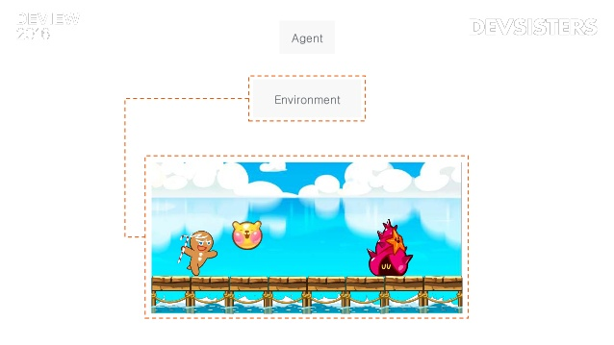
Background
Alpha run
< https://www.slideshare.net/deview/ai-67608549 >

Slide 6
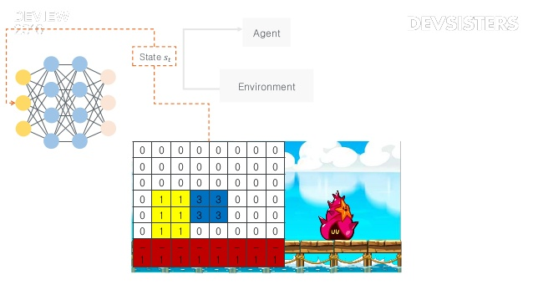
Background
Alpha run
< https://www.slideshare.net/deview/ai-67608549 >
Notes:
이미지 자체를 state로

Slide 7
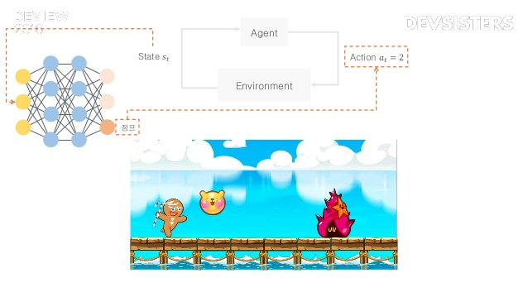
Background
Alpha run
< https://www.slideshare.net/deview/ai-67608549 >
Notes:
Q값 높은 action택함

Slide 8
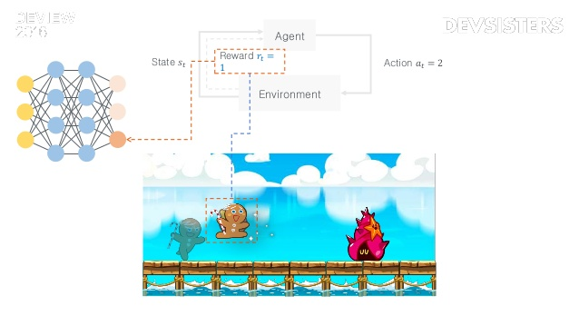
Background
Alpha run
< https://www.slideshare.net/deview/ai-67608549 >
Notes:
Reward 1증가
해당 게임에서는 방해물 부딪히면 -1
순조롭게 게임 진행되면 0
동전 먹으면 +1
그리고 결과를 네트워크에 반영

Slide 9
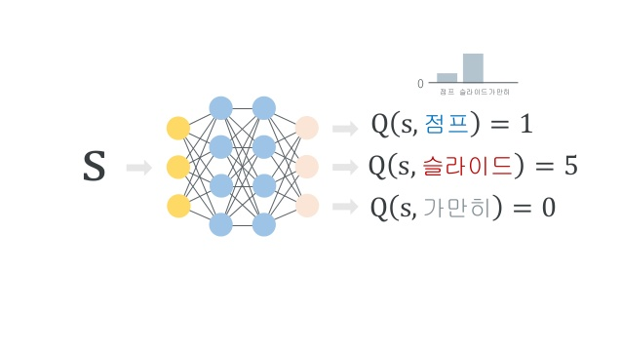
Background
Alpha run
< https://www.slideshare.net/deview/ai-67608549 >
Notes:
Q값이 가장 높은 action선택

Slide 10
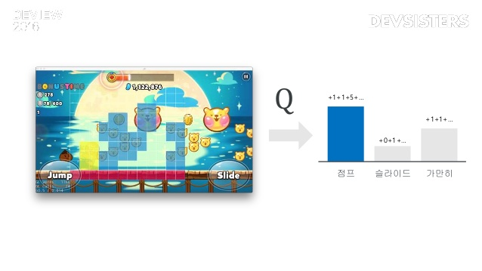
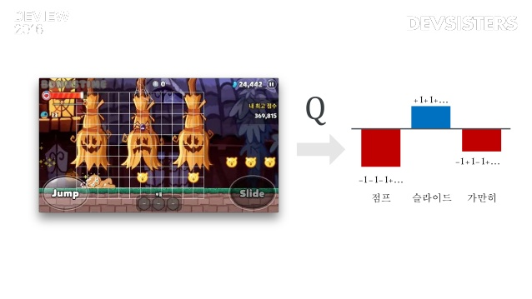
Background
Alpha run
< https://www.slideshare.net/deview/ai-67608549 >
Notes:
학습이 충분히 된 경우
첫번째 그림에서는 점프해서 점수 먹는게 리워드 높임
두번째 그림에는 슬라이드해야 부딛히지 않고 점수 획득

Slide 11

Implementations
DQN
< https://github.com/golbin/TensorFlow-Tutorials >
Notes:
해당 사이트에서 구현된 충돌 피하기 게임을 수정해서 시도

Slide 12
Implementations
Problem
Definition of State
CNN receives input consists of two dimensional array basically in Tensor flow
conv2d method in Tensor flow
In my research, there are
UE-AP connections
Streaming bitrates
Resource
ETC…
Notes:
구현상 문제점
기본적으로 2차원인데
2차원으로 하는 것은 state를 나타내기에 제한적임

Slide 13
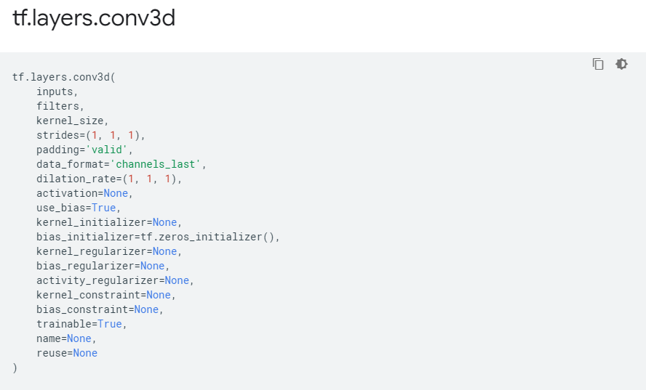
Implementations
Problem
There is conv3d method
It can also receives three dimensional array
< https://www.tensorflow.org/api_docs/python/tf/layers/conv3d >
Notes:
하지만 찾아보니 3차원 관련 함수 존재

Slide 14
Implementations
Bitmask
Bitmask depends on size of UE and AP
Ex) 4AP 7UE
1032401
It requires (4+1)^7 array size
To represent bitrate level, it requires at least ((4+1)^7)*((L+1)^7) array size
Maximum array size is 536,870,912 in python
In addition, to represent resource, it needs more space
4번째 UE가 2번째 AP 연결됨을 의미
Notes:
어제 말씀드린 bitmask 방법 이용하려고 했는데… 이야기

Slide 15
Implementations
State
Because I can use dimension array up to 3, I will not use bitmask method
State[# of UE][# of AP][mode]
Mode: connection, resource, bitrate
Action
To represent action, I will use bitmask method
Consider only AP connection
Bitrate selection will be derived from AP connection
Notes:
Action은 bitmask 사용이 적합

Slide 16
Future Work
Keep implementing
Consider re-defined state and action
Notes:
현재 왤케 진행 많이 못했냐 디펜스 어떻게?

