Slide 1
Research Jae Jun Ha Media Computing and Networking Laboratory POSTCH 2020-06-11
Notes:
발표 시작하겠습니다.
오늘 발표 드릴 내용은 알고리즘에 관한 내용을 정리했습니다.

Slide 2
Contents
Introduction
Proposed Video Streaming Services
System Architecture
Problem Description
Proposed Algorithm
Experimental Results
Experiment Environments
Performance Verification of Proposed System
Performance Comparison with Other Algorithms
Conclusion
Notes:
30초

Slide 3
Experimental Results Experimental Environment

Slide 4
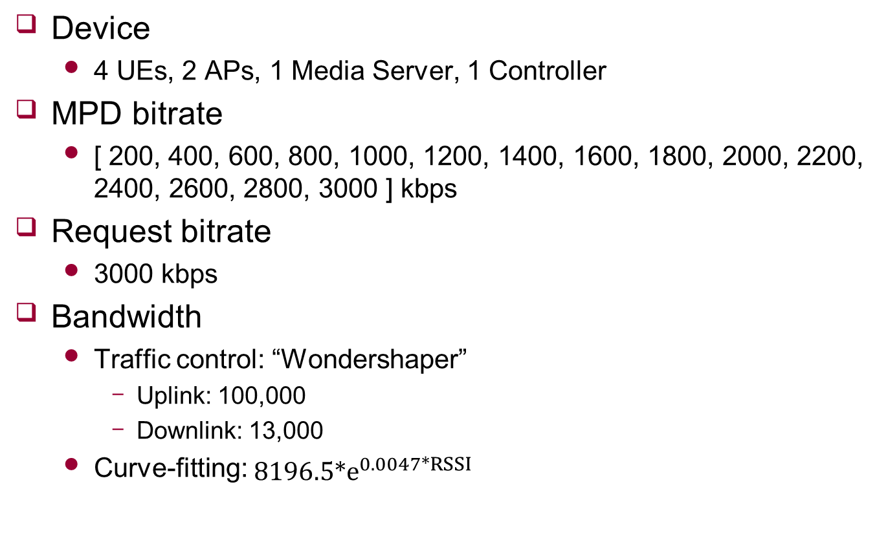
Experimental Environment
Device
4 UEs, 2 APs, 1 Media Server, 1 Controller
MPD bitrate
[ 200, 400, 600, 800, 1000, 1200, 1400, 1600, 1800, 2000, 2200, 2400, 2600, 2800, 3000 ] kbps
Request bitrate
3000 kbps
Bandwidth
Traffic control: “Wondershaper”
Uplink: 100,000
Downlink: 13,000
Curve-fitting: $8196.5*e^{0.0047*RSSI}$
Notes:
Frozen이 발생하는 조건 찾으면서 traffic control과 timeslot 값 정함

Slide 5

Experimental Environment
Time
Timeslot: 1.0 sec
Segment length: 2.0 sec
Buffer
Using cubic function
Threshold: 9.0 sec
Parameter
$p_{1}=0.01439$
$p_{2}=0.02866$
$p_{3}=0.02828$
$p_{4}=0.005873$
Lambda termination condition
0.00001

Slide 6


Experimental Environment
Situation
Three cases
(4 / 0)
(3 / 1)
(2 / 2)

Slide 7
Experimental Results Performance Verification of Proposed System

Slide 8
Performance Verification of Proposed system
Bitrate
PSNR
 | Multi (4 / 0) |  | Multi (3 / 1) |  | Multi (2 / 2)
 | Avg | Std | Avg | Std | Avg | Std
UE 1 | 1629 | 120.68 | 1611 | 122.10 | 1629 | 120.68
UE 2 | 1629 | 106.75 | 1611 | 111.95 | 1629 | 106.75
UE 3 | 1661 | 134.22 | 1655 | 129.34 | 1661 | 134.22
UE 4 | 1643 | 111.17 | 1623 | 113.05 | 1643 | 111.17
Total | 1641 | 119.38 | 1625 | 120.63 | 1641 | 119.38
 | Multi (4 / 0) |  | Multi (3 / 1) |  | Multi (2 / 2)
 | Avg | Std | Avg | Std | Avg | Std
UE 1 | 43.45 | 3.99 | 43.40 | 4.00 | 43.45 | 3.99
UE 2 | 43.45 | 3.96 | 43.41 | 3.98 | 43.45 | 3.96
UE 3 | 43.53 | 3.97 | 43.51 | 3.98 | 43.53 | 3.97
UE 4 | 43.49 | 3.94 | 43.41 | 3.98 | 43.49 | 3.94
Total | 43.48 | 3.96 | 43.43 | 3.99 | 43.48 | 3.96
Notes:
x를 조절해서 psnr 증가시킨다

Slide 9
Performance Verification of Proposed system
Buffer state (-: consumed, -: received)
UE 1
UE 2
UE 3
UE 4
(4 / 0)
(3 / 1)
(2 / 2)
Notes:
초반 구간은 확인 결과 버퍼를 다 못 채우는 경향

Slide 10
Experimental Results Performance Comparison with Other Algorithms

Slide 11
Performance Comparison with Other Algorithms
Normal DASH
Decide bitrate based on download throughput
Decide AP based on strong RSSI
Single (Non-cooperative) DASH
Same algorithm when decide bitrates
However each UE can connect only one AP
Decide AP based on strong RSSI

Slide 12
Performance Comparison with Other Algorithms
Bitrate
PSNR
 | Multi (2 / 2) |  | Single (4 / 0) |  | Single (3 / 1) |  | Single (2 / 2) |  | Normal (4 / 0) |  | Normal (3 / 1) |  | Normal (2 / 2)
 | Avg | Std | Avg | Std | Avg | Std | Avg | Std | Avg | Std | Avg | Std | Avg | Std
UE 1 | 1629 | 120.68 | 815 | 54.013 | 1049 | 95.05 | 1576 | 97.30 | 480 | 818.96 | 312 | 551.45 | 3000 | 0
UE 2 | 1629 | 106.75 | 821 | 62.305 | 1077 | 122.58 | 1580 | 77.10 | 848 | 1032.84 | 1332 | 1289.34 | 524 | 882.5
UE 3 | 1661 | 134.22 | 849 | 86.315 | 3000 | 0.00 | 1588 | 83.59 | 896 | 1122.58 | 2972 | 280 | 1656 | 1405.927
UE 4 | 1643 | 111.17 | 849 | 90.787 | 1066 | 94.05 | 1588 | 67.91 | 894 | 1118.97 | 1422 | 1359.71 | 2740 | 679.57
Total | 1641 | 119.38 | 834 | 76.570 | 1545 | 841.78 | 1583 | 82.44 | 779 |  | 1509 |  | 1980
 | Multi (2 / 2) |  | Single (4 / 0) |  | Single (3 / 1) |  | Single (2 / 2) |  | Normal (4 / 0) |  | Normal (3 / 1) |  | Normal (2 / 2)
 | Avg | Std | Avg | Std | Avg | Std | Avg | Std | Avg | Std | Avg | Std | Avg | Std
UE 1 | 43.45 | 3.99 | 40.27 | 3.80 | 41.46 | 3.80 | 43.55 | 4.10 | 34.13 | 5.21 | 33.18 | 3.47 | 45.85 | 4.01
UE 2 | 43.45 | 3.96 | 40.30 | 3.86 | 41.57 | 3.95 | 43.33 | 3.97 | 36.43 | 7.03 | 38.36 | 6.93 | 34.02 | 4.40
UE 3 | 43.53 | 3.97 | 40.45 | 3.85 | 45.85 | 3.99 | 43.35 | 3.95 | 36.24 | 7.01 | 45.75 | 3.93 | 39.43 | 6.23
UE 4 | 43.49 | 3.94 | 40.45 | 3.80 | 41.47 | 3.88 | 43.33 | 3.93 | 36.27 | 6.87 | 38.59 | 6.99 | 45.05 | 5.60
Total | 43.48 | 3.96 | 40.37 | 3.84 | 42.58 | 4.34 | 43.39 | 3.99 | 35.77 |  | 38.97 |  | 41.09

Slide 13
Performance Verification of Proposed system
Buffer state (-: consumed, -: received)
UE 1
UE 2
UE 3
UE 4
Normal
(4 / 0)
Normal
(2 / 2)
Single
(4 / 0)
Notes:
초반 구간은 확인 결과 버퍼를 다 못 채우는 경향

