Slide 1
Deep Reinforcement Learning based Computation Offloading and Resource Allocation for MEC Ji Li, Hui Gao, Tiejun Lv, and Yueming Lu 2018 IEEE Wireless Communications and Networking Conference (WCNC)
Notes:
질문) 저널 언급(중요)
해당 내용에서 action을 두 가지로 정의했는데 이게 제 논문과 가장 유사하다
추후에 더 찾아보겠다.

Slide 2
Why I choose this paper
It is challenging to obtain an optimal solution in NP-hard problem like knapsack
Used DQN to solve this problem
Action consists of two component
MEC offloading + resource allocation

Slide 3
Background
5G networks are now emerging to support massive connections among humans, machines and things with diverse services
Meanwhile, more and more computational-intensive applications in 5G require low delay, such as interactive game, augmented reality (AR), virtual reality (VR), etc, which are also energy-consuming applications
Noting the limited battery power and computing capacity, it is difficult for mobile user equipment (UE) to meet these requirements.
Aiming to tackle the contradiction between UEs and applications, Mobile Edge Computing (MEC) has been recently proposed as viable solution

Slide 4
Background
MEC is a new paradigm which can enhance the computation capacity at the edge of mobile network by deploying high-performance servers
The MEC servers are densely distributed close to mobile users, and the user devices can offload computing tasks to the MEC servers through wireless channel.
Through computation offloading, mobile users can observably reduce the experienced delay of applications and improve the Quality of Service (QoS)
Therefore, the computation offloading and computational resource allocation themes have attracted great interests as a key point in the MEC system

Slide 5
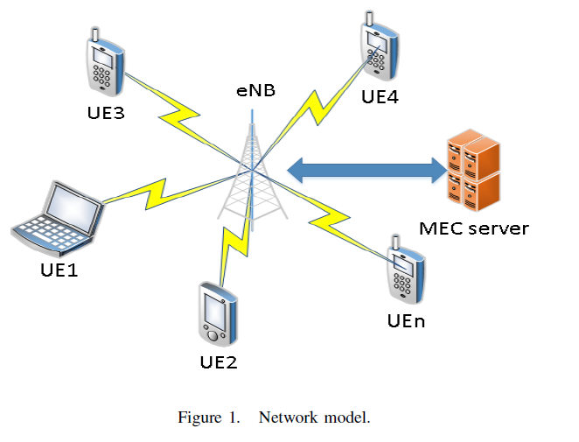
Network Model
One eNodeB (eNB) and N UEs in one small cell
MEC server is deployed with the eNB
Each UE can offload the task to the MEC server through wireless or execute it locally
The capacity of MEC server is limited
Notes:
질문) eNB란? LTE혹은 무선에서의 UE와 연결되는 기지국

Slide 6
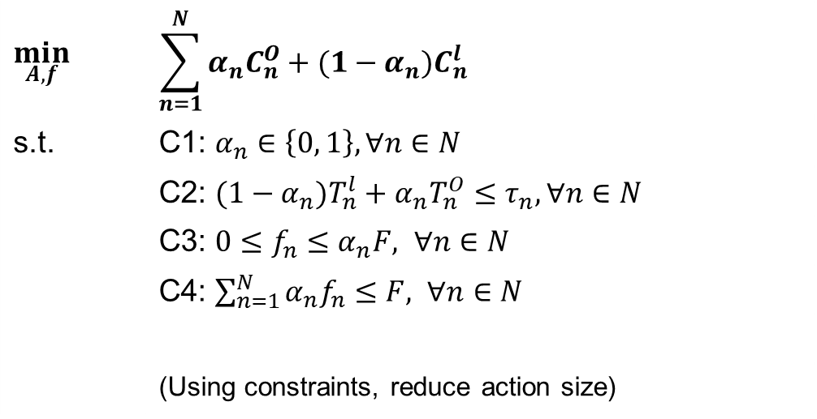
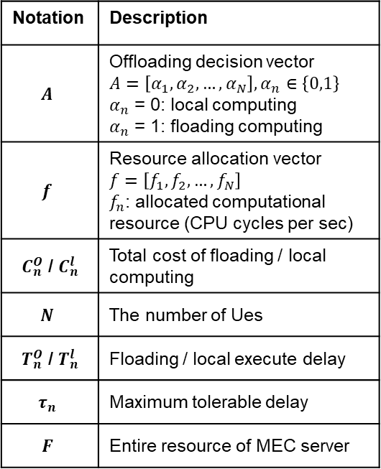
Formulation
As an optimization problem, the objective of this paper is to minimize the sum cost combining execution delay and energy consumption of all users in MEC system
Notation | Description
$$A$$ | Offloading decision vector $$A=\left[α_{1},α_{2},…,α_{N}\right],α_{n}∈\left\{0,1\right\}$$ $α_{n}$ = 0: local computing $α_{n}$ = 1: floading computing
$$f$$ | Resource allocation vector $$f=\left[f_{1},f_{2},…,f_{N}\right]$$ $f_{n}$: allocated computational resource (CPU cycles per sec)
$C_{n}^{O}$ / $C_{n}^{l}$ | Total cost of floading / local computing
$$N$$ | The number of Ues
$T_{n}^{O}$ / $T_{n}^{l}$ | Floading / local execute delay
$$τ_{n}$$ | Maximum tolerable delay
$$F$$ | Entire resource of MEC server
$$\min_{A, f}{}$$ | $$\sum_{n=1}^{N}{α_{n}C_{n}^{O}+(1−α_{n})C_{n}^{l}}$$
s.t. | C1: $α_{n}∈\left\{0, 1\right\}, ∀n∈N$
 | C2: ${(1−α}_{n})T_{n}^{l}+α_{n}T_{n}^{O}≤τ_{n}, ∀n∈N$
 | C3: $0≤f_{n}≤α_{n}F, ∀n∈N$
 | C4: $\sum_{n=1}^{N}{α_{n}f_{n}}≤F, ∀n∈N$
 | (Using constraints, reduce action size)

Slide 7

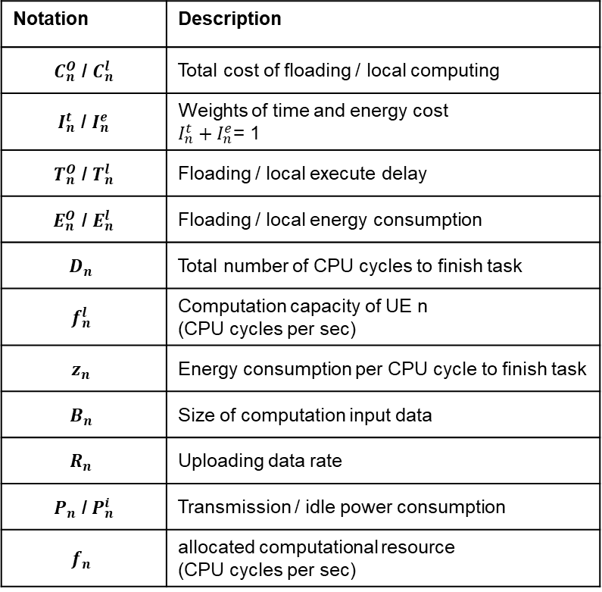
Cost
Combining the time delay and energy consumption
$C_{n}^{l}=I_{n}^{t}T_{n}^{l}+I_{n}^{e}E_{n}^{l}$
$T_{n}^{l}=\frac{D_{n}}{f_{n}^{l}}$
$E_{n}^{l}=z_{n}D_{n}$
$C_{n}^{O}=I_{n}^{t}T_{n}^{O}+I_{n}^{e}E_{n}^{O}$
$T_{n}^{O}=\frac{B_{n}}{R_{n}}+\frac{D_{n}}{f_{n}}$
$E_{n}^{O}=\frac{P_{n}B_{n}}{R_{n}}+\frac{{P_{n}^{i}D}_{n}}{f_{n}}$
Notation | Description
$C_{n}^{O}$ / $C_{n}^{l}$ | Total cost of floading / local computing
$I_{n}^{t}$ / $I_{n}^{e}$ | Weights of time and energy cost $I_{n}^{t}+I_{n}^{e}$= 1
$T_{n}^{O}$ / $T_{n}^{l}$ | Floading / local execute delay
$E_{n}^{O}$ / $E_{n}^{l}$ | Floading / local energy consumption
$$D_{n}$$ | Total number of CPU cycles to finish task
$$f_{n}^{l}$$ | Computation capacity of UE n (CPU cycles per sec)
$$z_{n}$$ | Energy consumption per CPU cycle to finish task
$$B_{n}$$ | Size of computation input data
$$R_{n}$$ | Uploading data rate
$P_{n}$ /$P_{n}^{i}$ | Transmission / idle power consumption
$$f_{n}$$ | allocated computational resource (CPU cycles per sec)

Slide 8
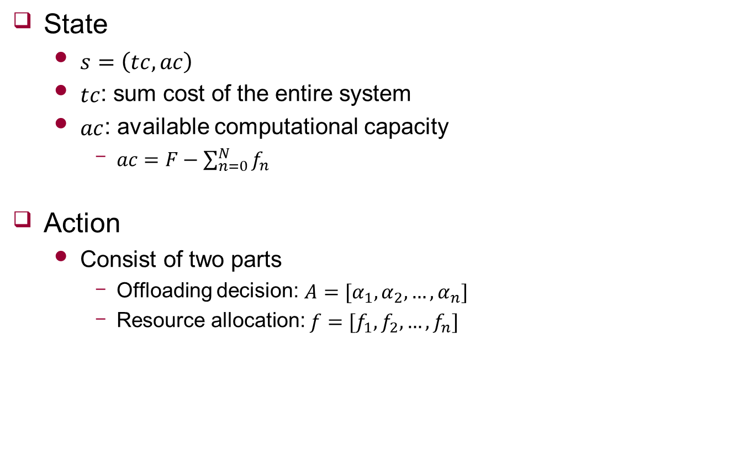
Key element in RL
State
$s=\left(tc, ac\right)$
$tc$: sum cost of the entire system
$ac$: available computational capacity
$ac=F−\sum_{n=0}^{N}{f_{n}}$
Action
Consist of two parts
Offloading decision: $A=[α_{1},α_{2},…,α_{n}]$
Resource allocation: $f=[f_{1},f_{2},…,f_{n}]$
Notes:
강화학습을 사용하기 위한 주요 요소들을 설명 드리겠습니다.
강화학습을 사용하기 위해서는 State, Action, Reward 등이 정의되어야 합니다.
먼저 state입니다. State는 두 가지 요소로 이루어져있습니다.

Slide 9
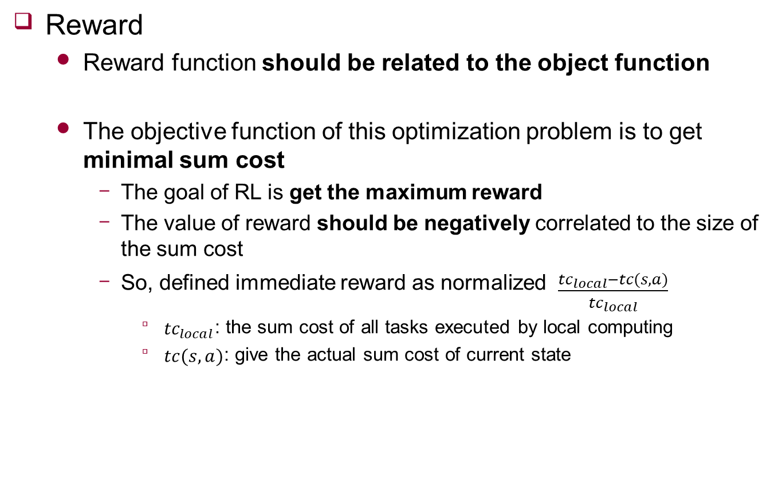
Key element in RL
Reward
Reward function should be related to the object function
The objective function of this optimization problem is to get minimal sum cost
The goal of RL is get the maximum reward
The value of reward should be negatively correlated to the size of the sum cost
So, defined immediate reward as normalized $\frac{{tc}_{local}−tc(s,a)}{{tc}_{local}}$
${tc}_{local}$: the sum cost of all tasks executed by local computing
$tc(s,a)$: give the actual sum cost of current state
Notes:
Reward를 설명 드리겠습니다.
Reward에 formulation에서의 objective function 넣음

Slide 10
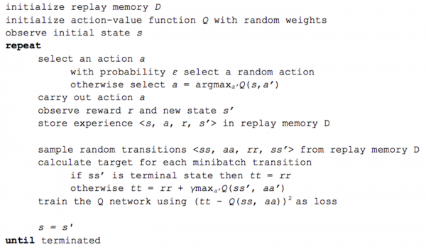
Algorithm
DQN
< https://www.popit.kr/torch-dqn-%EA%B0%95%ED%99%94%ED%95%99%EC%8A%B5-%EC%86%8C%EA%B0%9C/ >

Slide 11
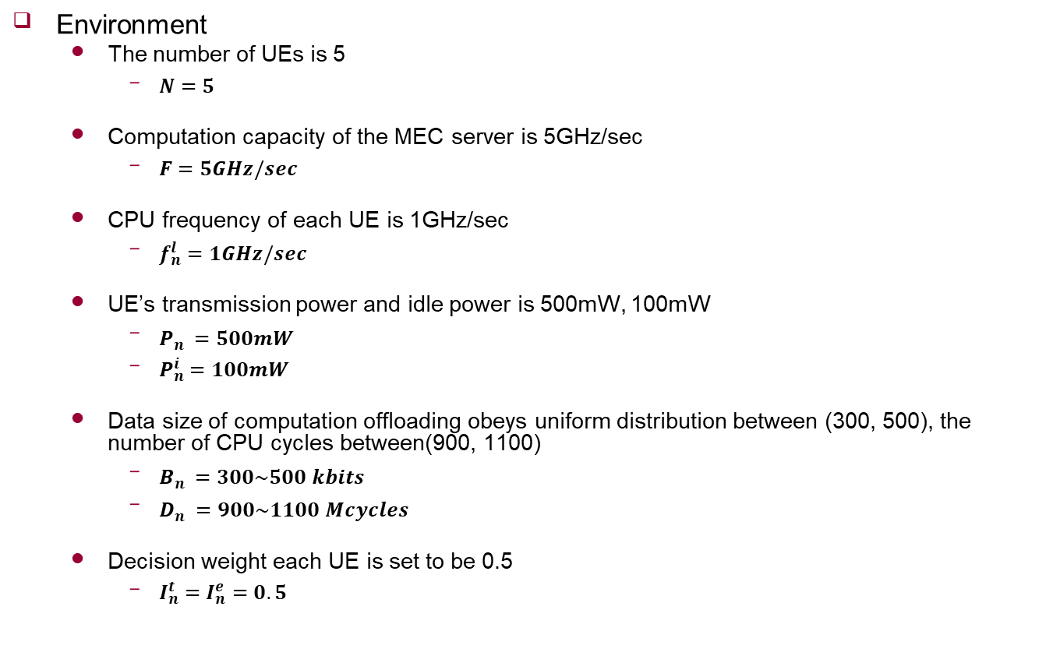
Simulation
Environment
The number of UEs is 5
$N=5$
Computation capacity of the MEC server is 5GHz/sec
$F=5GHz/sec$
CPU frequency of each UE is 1GHz/sec
$f_{n}^{l}=1GHz/sec$
UE’s transmission power and idle power is 500mW, 100mW
$P_{n}^{}=500mW$
$P_{n}^{i}=100mW$
Data size of computation offloading obeys uniform distribution between (300, 500), the number of CPU cycles between(900, 1100)
$B_{n}^{}=300\sim 500 kbits$
$D_{n}^{}=900\sim 1100 Mcycles$
Decision weight each UE is set to be 0.5
$I_{n}^{t}=I_{n}^{e}=0.5$
Notes:
Dn은 Bn과 상관 있게 uniform distribution따름

Slide 12
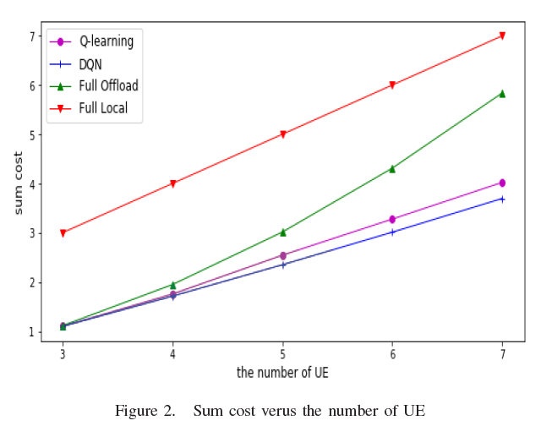
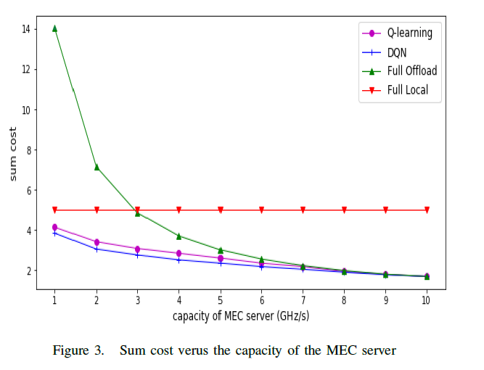
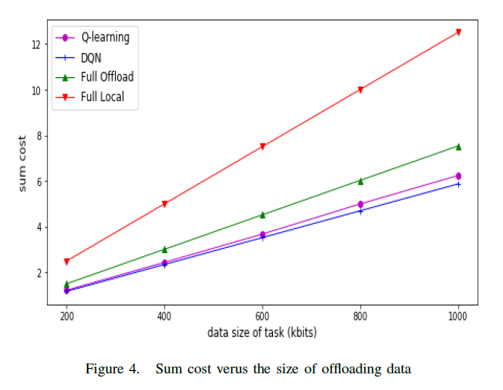
Result
Notes:
Q 러닝 안쓰고 DQN 쓰는 이유가 스테이트가 무수하게 많은데 그 많은 스테이트를 저장하기에는 메모리 부족으로 Q 러닝 방법은 일부만 저장
그 결과가 전체가 아닌 일부만 메모리 저장해서 결과가 부정확
DQN은 뉴럴 네트워크를 이용하여 메모리를 추상적으로 저장하여 한계에 부딛히지 않음
2번째에서 full offload가 큰 이유: capacit가 작으면 local과 큰차이가 없는데 데이터 전송하는데에 time 소모 큼
UE개수 5라는 것을 언급

Slide 13
Future work
Implementation
More survey

