Slide 1
Ch2_Python
Let`s learn python together!
Team Placeholder from NIA(KOREA)

Slide 2
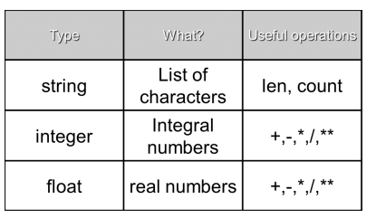

Values and Data Types
str =
“BUSINESS”
“51” , “$@”
int = -24 , -100, 121, 2333
float = -24.0 , -100.3, 121.0, 2333.22

Slide 3

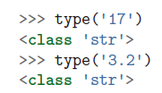
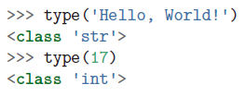



Slide 4
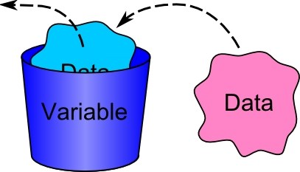

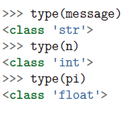

Variables

Slide 5
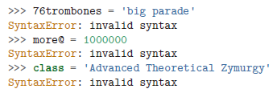
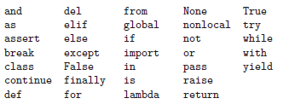
Variable names and keywords

Slide 6
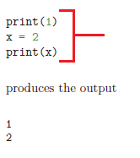
Statement
Script

Slide 7
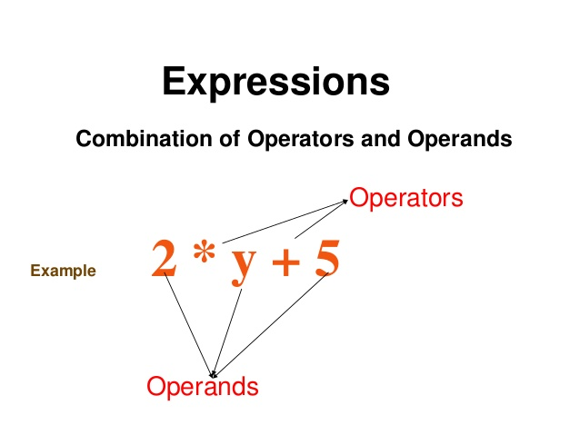
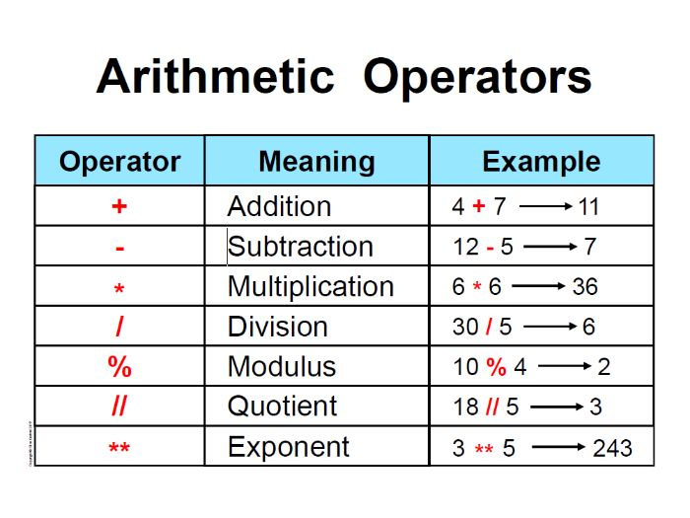
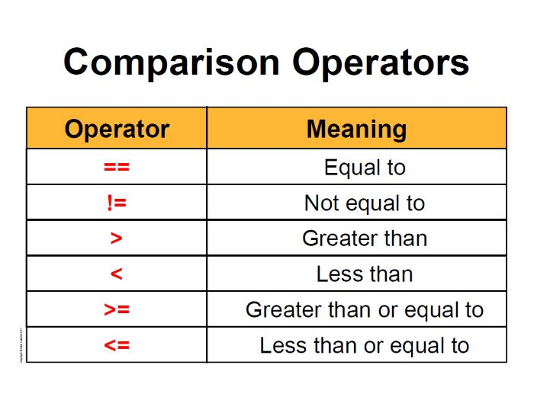
Operators and operands

Slide 8


Operators and operands
Python 3.x
Python 2.0

Slide 9


Expression

Slide 10
Order of operations
The rules of precedence
1. Parentheses → ( )
2. Exponentiation → **
3. Multiplication, Division → *, /
4. Addition, Subtraction→ +, -

Slide 11
Operator | Description
( ) | Parentheses (grouping)
f(args...) | Function call
x[index:index] | Slicing
x[index] | Subscription
x.attribute | Attribute reference
** | Exponentiation
~x | Bitwise not
+x, -x | Positive, negative
*, /, % | Multiplication, division, remainder
+, - | Addition, subtraction
<<, >> | Bitwise shifts
& | Bitwise AND
^ | Bitwise XOR
| | Bitwise OR
in, not in, is, is not, <, <=, >, >=, <>, !=, == | Comparisons, membership, identity
not x | Boolean NOT
and | Boolean AND
or | Boolean OR
lambda | Lambda expression

Slide 12
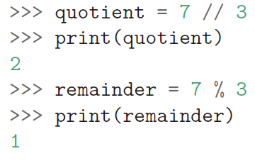
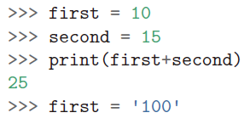

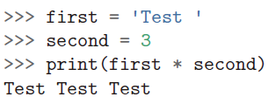
Modulus operator/ String operator
Modulus operator
String operator

Slide 13
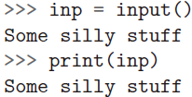
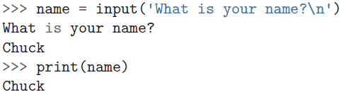
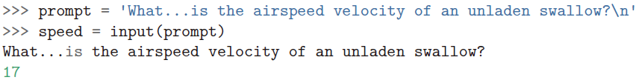
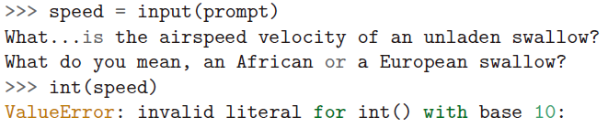
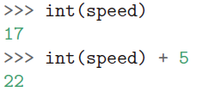
Asking the user for input

Slide 14
Comment

Slide 15
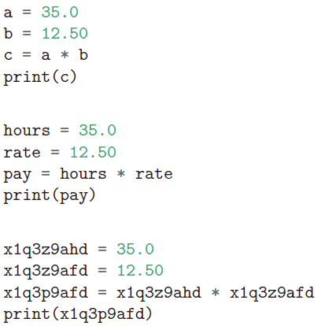
Choosing Mnemonic variable names
A mnemonic is a word, short poem, or sentence that is intended to help you remember things such as scientific rules or spelling rules

Slide 16


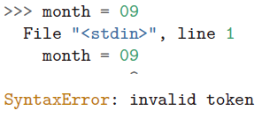

Debugging

Slide 17
Debugging

Slide 18
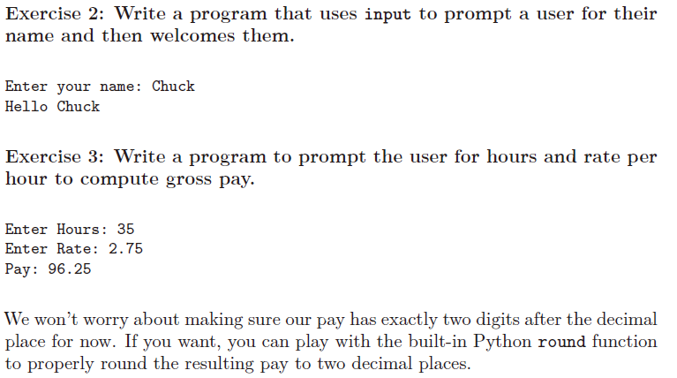
Exercises

Slide 19
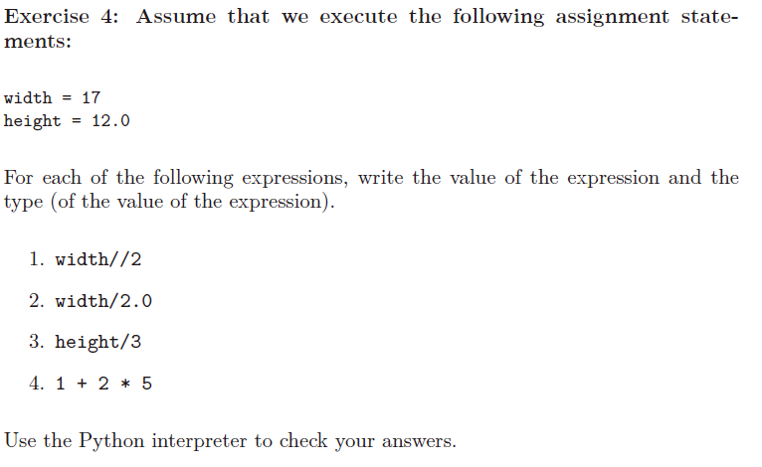
Exercises

Slide 20
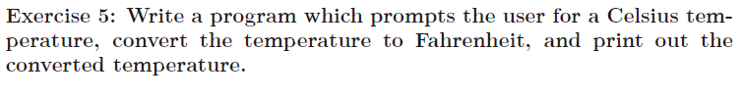

Exercises
Notes:
print("this program is a program to convert the temperature a Celsius to Fahrenheit!")
print("enter a Celsius tempreture: ")
user_input = input()
fah = ((9/5) * float(user_input)) + 32
print("the Celsius degree : ", user_input)
print("the Fahrenheit degree :", fah)

