Slide 1
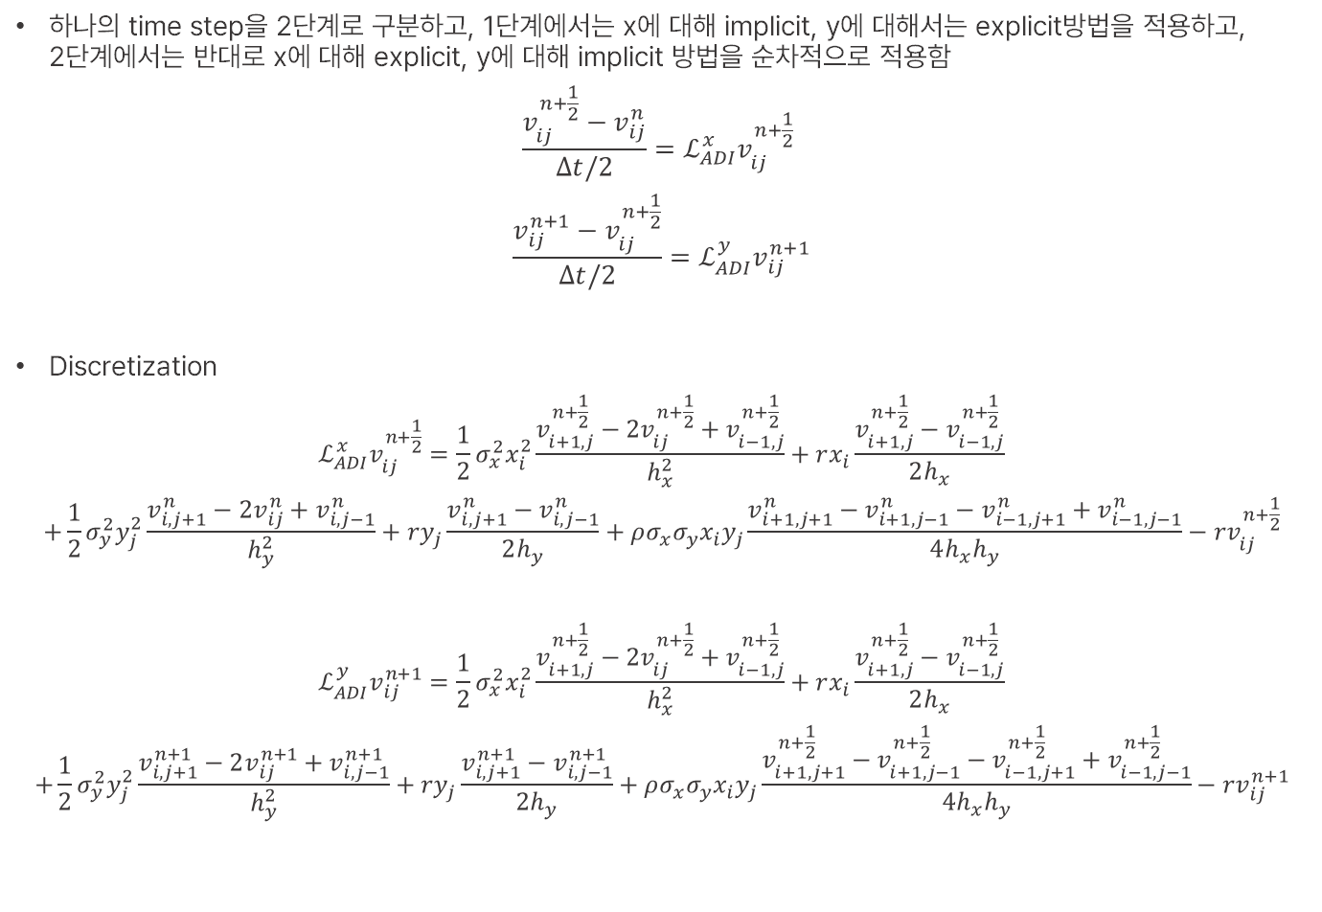
Alternating Direction Implicit (ADI)
하나의 time step을 2단계로 구분하고, 1단계에서는 x에 대해 implicit, y에 대해서는 explicit방법을 적용하고, 2단계에서는 반대로 x에 대해 explicit, y에 대해 implicit 방법을 순차적으로 적용함
$$\frac{v_{ij}^{n+\frac{1}{2}}−v_{ij}^{n}}{Δt/2}=ℒ_{ADI}^{x}v_{ij}^{n+\frac{1}{2}}$$
$$\frac{v_{ij}^{n+1}−v_{ij}^{n+\frac{1}{2}}}{Δt/2}=ℒ_{ADI}^{y}v_{ij}^{n+1}$$
Discretization
$$ℒ_{ADI}^{x}v_{ij}^{n+\frac{1}{2}}=\frac{1}{2}σ_{x}^{2}x_{i}^{2}\frac{v_{i+1,j}^{n+\frac{1}{2}}−2v_{ij}^{n+\frac{1}{2}}+v_{i−1,j}^{n+\frac{1}{2}}}{h_{x}^{2}}+rx_{i}\frac{v_{i+1,j}^{n+\frac{1}{2}}−v_{i−1,j}^{n+\frac{1}{2}}}{2h_{x}}$$
$$+\frac{1}{2}σ_{y}^{2}y_{j}^{2}\frac{v_{i,j+1}^{n}−2v_{ij}^{n}+v_{i,j−1}^{n}}{h_{y}^{2}}+ry_{j}\frac{v_{i,j+1}^{n}−v_{i,j−1}^{n}}{2h_{y}}+ρσ_{x}σ_{y}x_{i}y_{j}\frac{v_{i+1,j+1}^{n}−v_{i+1,j−1}^{n}−v_{i−1,j+1}^{n}+v_{i−1,j−1}^{n}}{4h_{x}h_{y}}−rv_{ij}^{n+\frac{1}{2}}$$
$$ℒ_{ADI}^{y}v_{ij}^{n+1}=\frac{1}{2}σ_{x}^{2}x_{i}^{2}\frac{v_{i+1,j}^{n+\frac{1}{2}}−2v_{ij}^{n+\frac{1}{2}}+v_{i−1,j}^{n+\frac{1}{2}}}{h_{x}^{2}}+rx_{i}\frac{v_{i+1,j}^{n+\frac{1}{2}}−v_{i−1,j}^{n+\frac{1}{2}}}{2h_{x}}$$
$$+\frac{1}{2}σ_{y}^{2}y_{j}^{2}\frac{v_{i,j+1}^{n+1}−2v_{ij}^{n+1}+v_{i,j−1}^{n+1}}{h_{y}^{2}}+ry_{j}\frac{v_{i,j+1}^{n+1}−v_{i,j−1}^{n+1}}{2h_{y}}+ρσ_{x}σ_{y}x_{i}y_{j}\frac{v_{i+1,j+1}^{n+\frac{1}{2}}−v_{i+1,j−1}^{n+\frac{1}{2}}−v_{i−1,j+1}^{n+\frac{1}{2}}+v_{i−1,j−1}^{n+\frac{1}{2}}}{4h_{x}h_{y}}−rv_{ij}^{n+1}$$

Slide 2
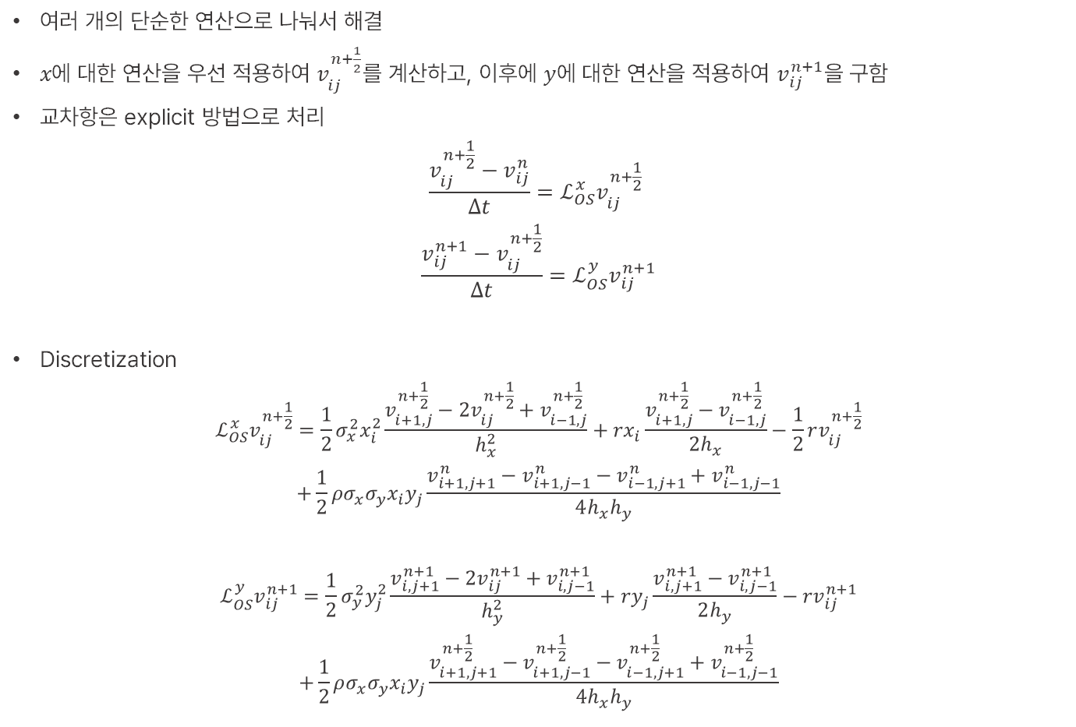
Operator Splitting Method (OSM)
여러 개의 단순한 연산으로 나눠서 해결
$x에$ 대한 연산을 우선 적용하여 $v_{ij}^{n+\frac{1}{2}}$를 계산하고, 이후에 $y$에 대한 연산을 적용하여 $v_{ij}^{n+1}$을 구함
교차항은 explicit 방법으로 처리
$$\frac{v_{ij}^{n+\frac{1}{2}}−v_{ij}^{n}}{Δt}=ℒ_{OS}^{x}v_{ij}^{n+\frac{1}{2}}$$
$$\frac{v_{ij}^{n+1}−v_{ij}^{n+\frac{1}{2}}}{Δt}=ℒ_{OS}^{y}v_{ij}^{n+1}$$
Discretization
$$ℒ_{OS}^{x}v_{ij}^{n+\frac{1}{2}}=\frac{1}{2}σ_{x}^{2}x_{i}^{2}\frac{v_{i+1,j}^{n+\frac{1}{2}}−2v_{ij}^{n+\frac{1}{2}}+v_{i−1,j}^{n+\frac{1}{2}}}{h_{x}^{2}}+rx_{i}\frac{v_{i+1,j}^{n+\frac{1}{2}}−v_{i−1,j}^{n+\frac{1}{2}}}{2h_{x}}−\frac{1}{2}rv_{ij}^{n+\frac{1}{2}}$$
$$+\frac{1}{2}ρσ_{x}σ_{y}x_{i}y_{j}\frac{v_{i+1,j+1}^{n}−v_{i+1,j−1}^{n}−v_{i−1,j+1}^{n}+v_{i−1,j−1}^{n}}{4h_{x}h_{y}}$$
$$ℒ_{OS}^{y}v_{ij}^{n+1}=\frac{1}{2}σ_{y}^{2}y_{j}^{2}\frac{v_{i,j+1}^{n+1}−2v_{ij}^{n+1}+v_{i,j−1}^{n+1}}{h_{y}^{2}}+ry_{j}\frac{v_{i,j+1}^{n+1}−v_{i,j−1}^{n+1}}{2h_{y}}−rv_{ij}^{n+1}$$
$$+\frac{1}{2}ρσ_{x}σ_{y}x_{i}y_{j}\frac{v_{i+1,j+1}^{n+\frac{1}{2}}−v_{i+1,j−1}^{n+\frac{1}{2}}−v_{i−1,j+1}^{n+\frac{1}{2}}+v_{i−1,j−1}^{n+\frac{1}{2}}}{4h_{x}h_{y}}$$

