Slide 1

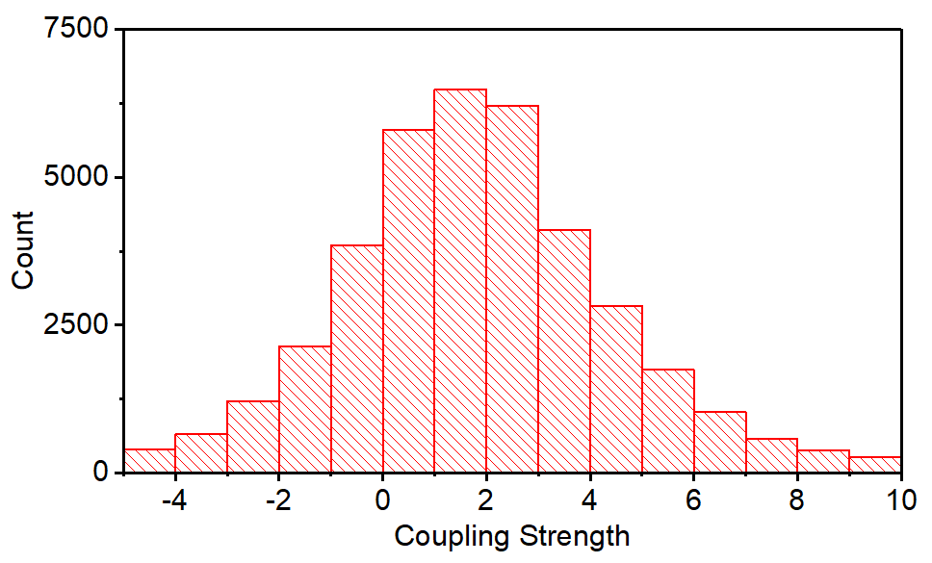
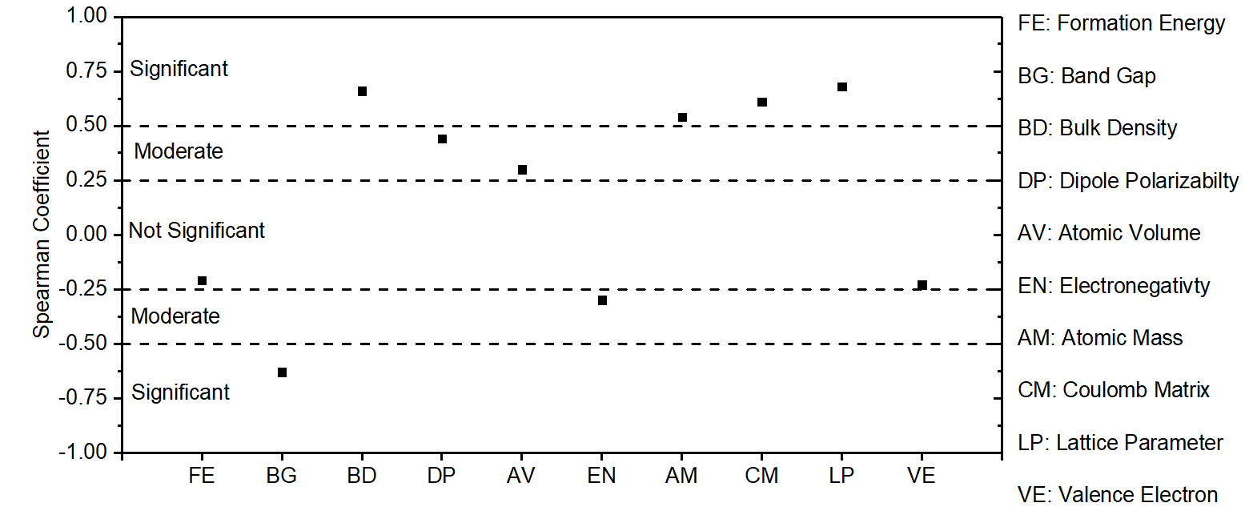
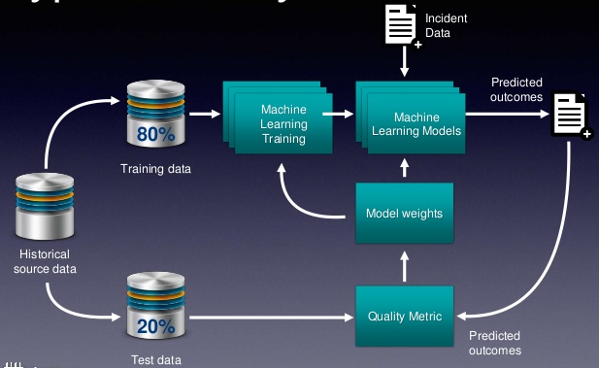
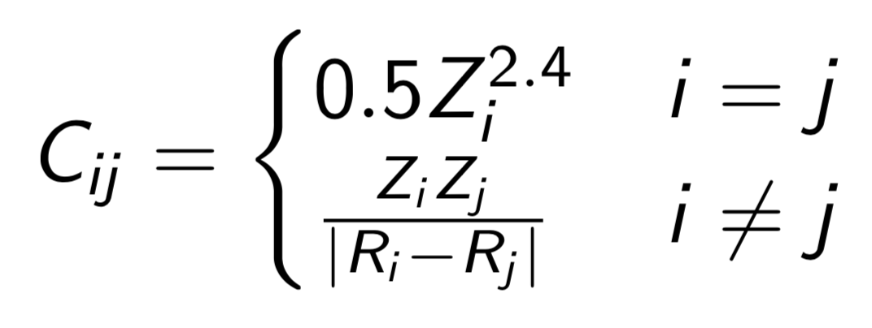
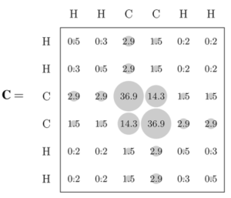
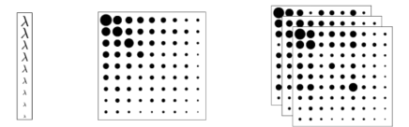
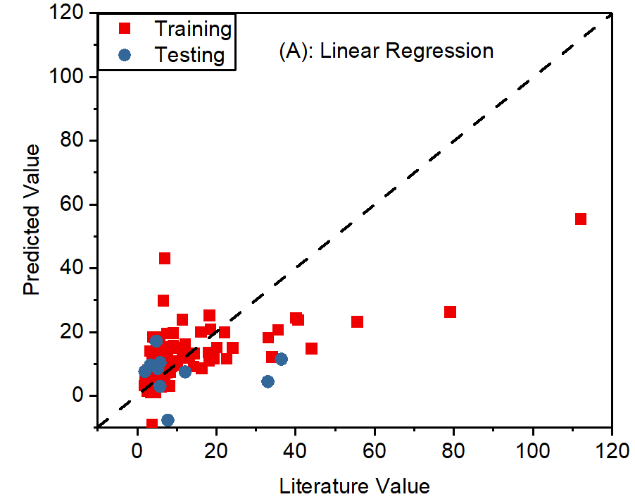
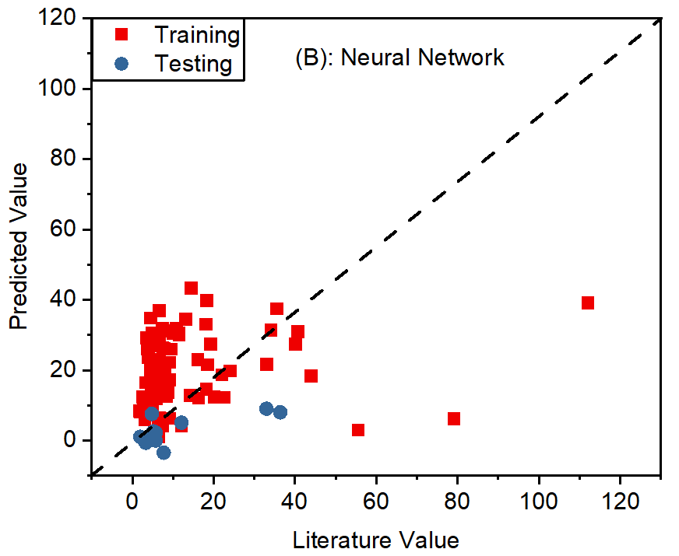
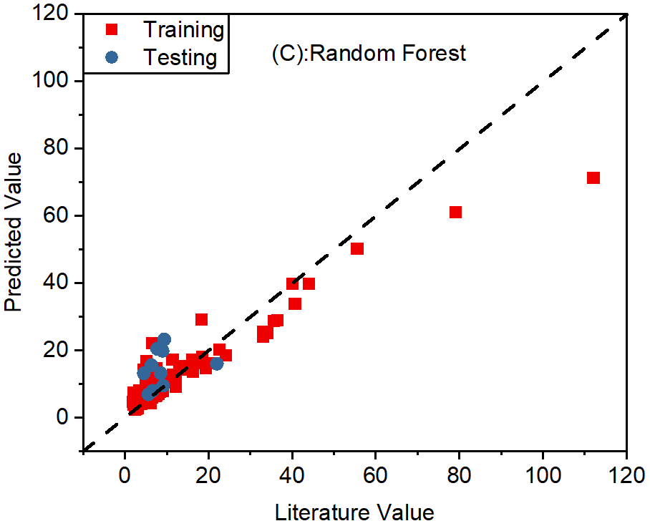
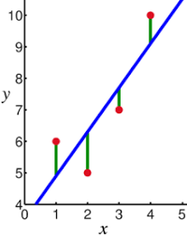
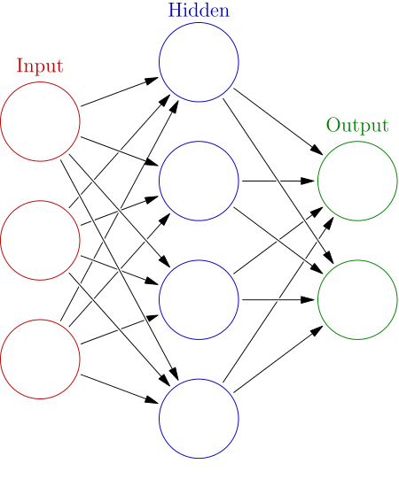
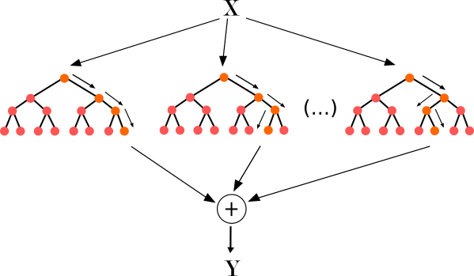





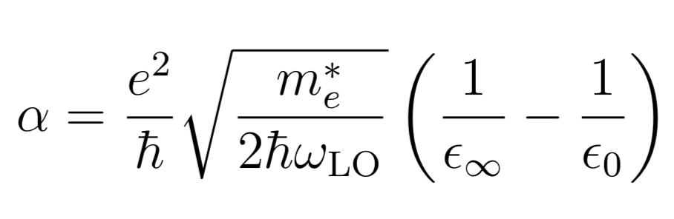
Machine Learning and Data Mining for Semiconductor Materials
Jaerin Kim , Ruoyao Zhang, Yifan Yao, Matthew Truskowski, Jue Zhang
INTRODUCTION
There is a constant search for new semiconductor materials with more efficient charge generation capabilities. Material properties such as the dielectric constant can be highly correlated with better semiconductor performance. Some materials likely have desirable semiconductor properties but have not yet been discovered or utilized. However, it is impossible to synthesize and test all potential materials. Such a hands-on approach can be time and resource intensive.
SOLUTION
Use machine learning to analyze known experimental data for certain materials to train a relationship model.
Use the model to predict the property (dielectric constant) for other candidate materials.
METHOD
DESCRIPTORS
The descriptors are atomic and material properties (bandgap, lattice parameter, density, etc.) that can be paired with known values of the to-be-predicted property (dielectric constant) to train the ML model. The descriptors were generated from querying the Materials Project database and Mendeleev python package, and the training set high and low frequency dielectric constants were compiled from Springer Materials and other published literature experiments.
COULOMB MATRIX
A three-dimensional molecular structure is converted to a numerical Coulomb matrix using atomic coordinates R_{i} and nuclear charges Z_{i}. The matrix contains one row per atom, is symmetric, and requires no explicit bond information
Figure 2: Schematics of coulomb matrix and eigenspectrum of Ethene
MACHINE LEARNING
The Scikit Learn machine learning module for Python was chosen to train a model and use it to predict dielectric constants. The model generally takes two inputs to train: a set of known target values (dielectric constants from our literature search) and a complementary set of measured descriptor properties for each target value (material properties queried from Materials Project). There are many methods (models) to train a machine learning process. Commonly used models include linear regression and its variation (Lasso & Ridge), neural network and random forest regressor, of which we explored in the project.
Linear Regression Neural Network Random Forest Regression
Figure 3: Representation of common learning model
DENSITY FUNCTIONAL THEORY (DFT) VALIDATION
Use open source package Quantum Espresso
Use PW package to calculate high-freq dielectric constant
Test done on Silicon: Calculated value 11.77, literature value 11.97 at 300K
Use Phonon package to calculate low-freq dielectric constant
Verify the predicted α with the calculated values from DFT
Compare the Machine learning-predicted α with the DFT α to evaluate the performance of the machine learning model
RESULTS
DESCRIPTORS SELECTION
Descriptors can be selected by evaluating the strength of the monotonic relationship with the output using the Spearman Coefficient [1]:
Figure 4: Spearman Coefficient of elemental, compound, and lattice properties with the infinity dielectric constant
MODEL SELECTION
ELECTRON-PHONON COUPLING STRENGTH
Within the Frohlich model, the strength of the electron-phonon coupling is characterized by the dimensionless coupling coefficient [2]
Where ω_{LO} is the longitudinal optical phonon mode as
predicted by Group 26a.
RESULTS
CANDIDATE MATERIALS
Choose amongst the materials with smallest α to reduce the Electron-phonon coupling (EPC) effect
Typical Values for Semiconductor ranges from 0.02~4
Figure 6: Coupling Strength of 39190
materials in the material project database
Candidate materials generally include Se-based and H-based compound materials. Selenides are historically an important semiconductor [3], so this lends confidence to the basic predictive capabilities of our ML model. Some of the predicted types of compounds are also observed in the literature [4] [5] for superconductor materials.
The error of final results can be as high as 105% through the propagation of uncertainty.
Figure 1: Schematic of a typical machine learning process
Linear Regression
Least sum of square of error Approach
Sensitive to outliers (noise)
Better with penalty function such as Lasso and Ridge
Neural Network
Each connection is a nonlinear function
Each neuron contains the weighted sum of values calculated from the previous layer
Weight adjusts as learning proceeds
CONCLUSIONS
Training sets of approximately 200 literature values each were collected for high and low frequency dielectric constants along with a similarly sized set of optical phonon frequencies collected by Group 26a. The random forest regressor model was chosen as the most accurate for our descriptor/target relationship and dataset size. Uniting the ML predicted optical phonon frequency and dielectric constants with α returned several thousand materials in the semiconductor range, with selenides and hydrides being a chief appearance in low α predictions. Future work for this project would involve confirming these materials with DFT.
MISSION STATEMENT
Conduct literature review of low and high frequency dielectric constants in order to construct a training set (approximately 200 data points) for the machine learning model
Find and choose an appropriate machine learning model between predictions and literature values
Query all of Materials Projects and use the trained model to predict 60,000+ dielectric constants
Identify candidate materials and confirm with Density Function Theory (DFT)
DESIGN CONSTRAINTS
Data Collection: Conditions in which data were obtained in the literature are not consistent such as frequency and temperature.
Model Convergence: Many ML models exist and the relationship between dielectric constant and other parameters is complex. Even 200 data points may be too small to accurately train the ML model with such varying dependencies on material properties.
Random Forest Regressor
Each split is a decision making process
Splitting node develops as the learning proceeds
Sensitive to overtraining
Most reliable of all three
ACKNOWLEDGEMENTS
Figure 5: Literature values versus predicted values (training & testing) using (a) linear regression, (b) neural network, and (c) random forest. The dotted line represents a perfectly reliable model wherein predicted values exactly match real-life measurements.
REFERENCES
[1] The Concise Encyclopedia of Statistics. Springer, New York (2010)
[2] arXiv preprint arXiv:1611.06122 (2016)
[3]Fengxia Yang et al. Semicond. Sci. Technol. 27 125017 (2012)
[4] Nature vol. 525, p. 73–76 (2015)
[5] Nature Materials vol.14 , p. 285–289 (2015)

