Slide 1
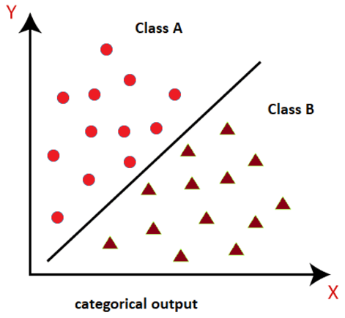
Machine Learning Methods: Classification
For Cyber Club

Slide 2
Insights from Machine Learning
Descriptive
Describes a past phenomenon
Methods: classifications, clustering, dimensionality, reinforcement learning, etc.
Predictive
Predict about a new situation
Methods: neural networks, time-series
Prescriptive
What an agent should do
Methods: simulation, reinforcement learning, reasoning.

Slide 3
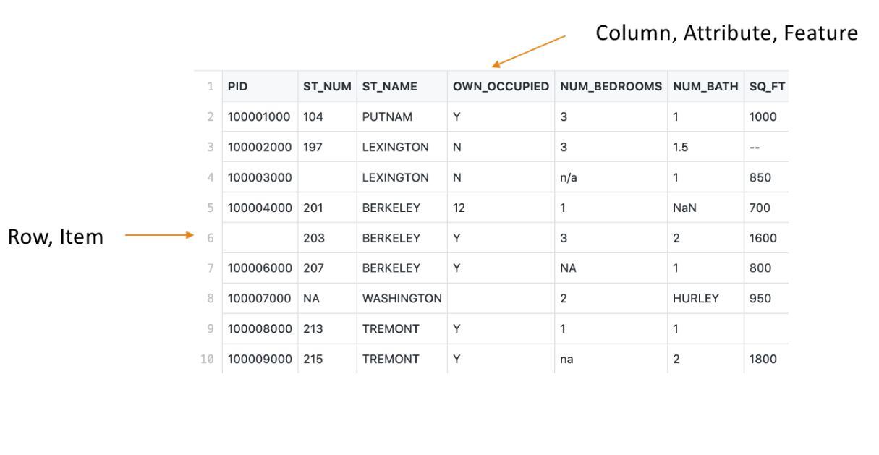
Nomenclature

Slide 4
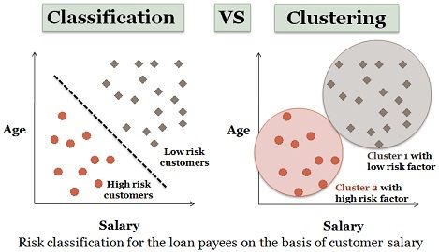
Classification vs Clustering
Classification
Separating data into classes (also called labels, or categorical types)
One of the attributes is the label we are trying to learn
Class label is the supervision
Clustering
Trying to learn grouping of data
There is no attribute indicating membership in group (no label), aka unsupervised

Slide 5
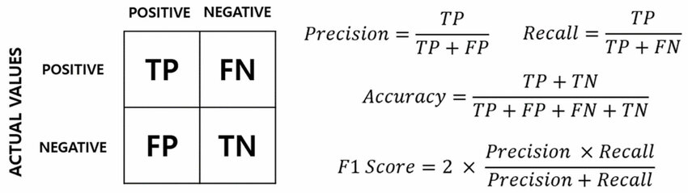
Metrics

Slide 6
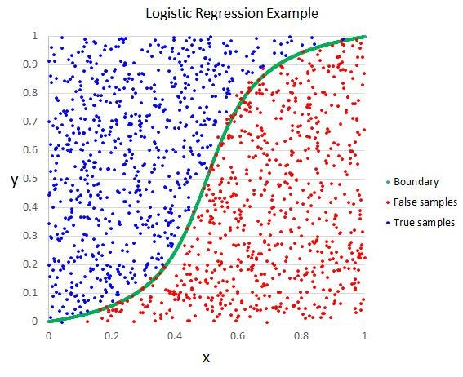
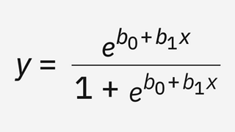
Logistic Regression
Logistic regression is a modification to the linear regression such as the output value (or independent variable) is limited to any value between 0 and 1. It does this by applying a logit transformation to the standard linear regression formula

Slide 7
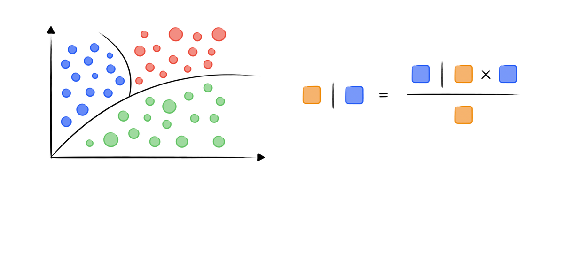
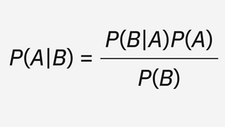
Naïve Bayes
Classification based on Bayes’ theorem. Naïve Bayes updates initial class predictions with each new piece of data. Naïve Bayes is often utilized in natural language processing (NLP) for tasks such as sentiment analysis.

Slide 8
K-Nearest Neighbors
K-Nearest Neighbors (KNN) maps points onto a multidimensional space. It then simply groups points with similar feature values into separate groups or classes. To classify new data samples, the classifier looks at the k points nearest to a new sample and counts how many members of each class comprise the neighboring points.

Slide 9
Demo!

