Slide 1

Hello World in Go

Slide 2
0. Hello World in Go
Install Go

Slide 3
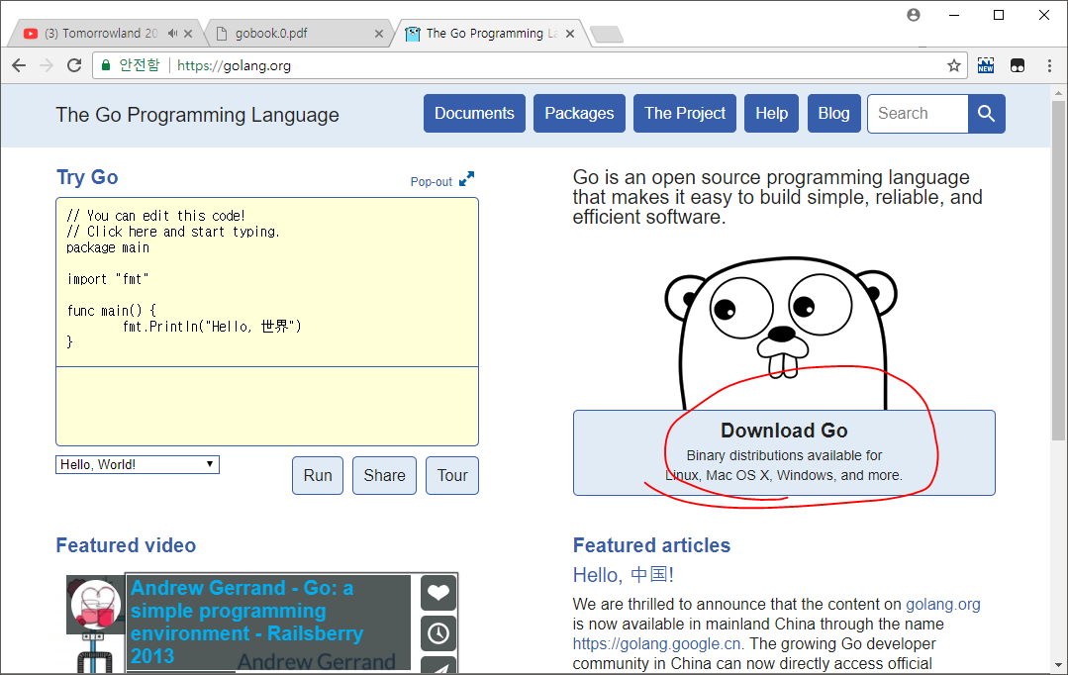
Install Go – Go to golang.org & Click

Slide 4
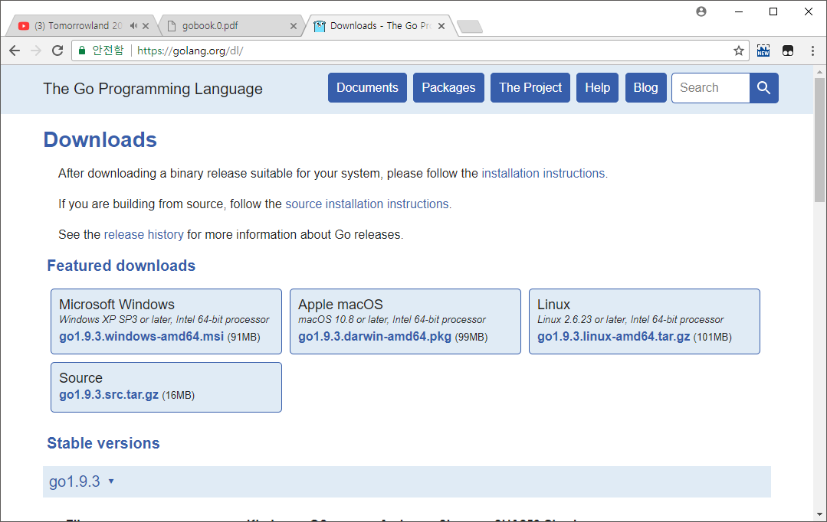
Install Go – Click and Download Installer

Slide 5
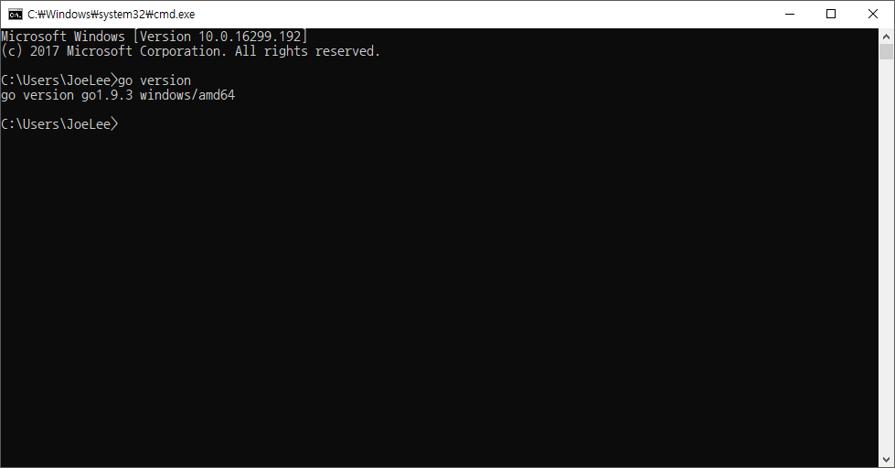
Install Go – Check Installed

Slide 6
0. Hello World in Go
Install LiteIDE

Slide 7
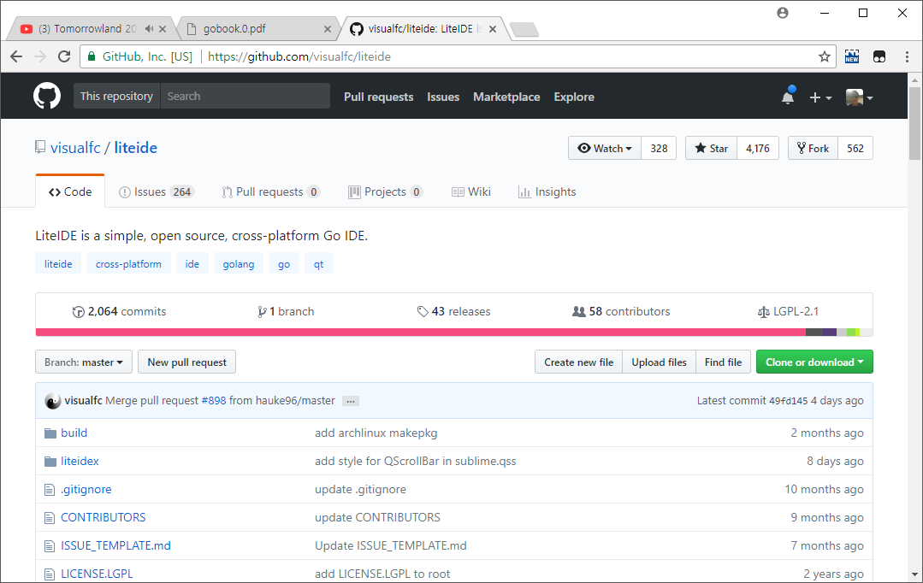
Go To - github.com/visualfc/liteide

Slide 8
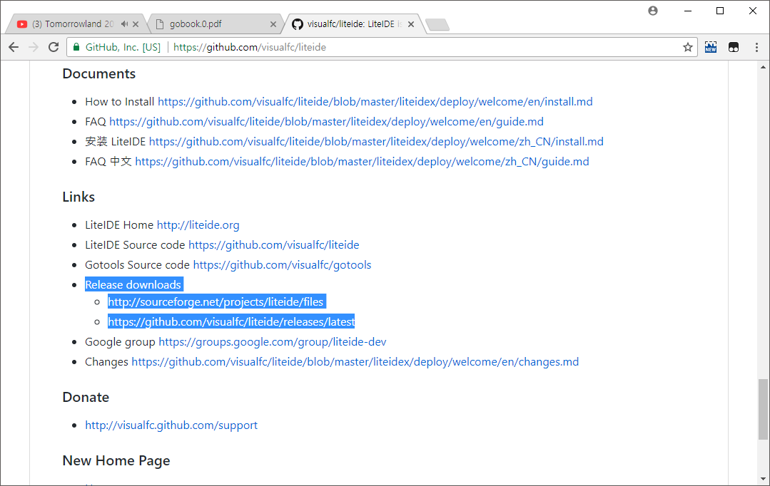
Two Ways To Download Sourceforge OR Github Release
Two Ways To Download

Slide 9
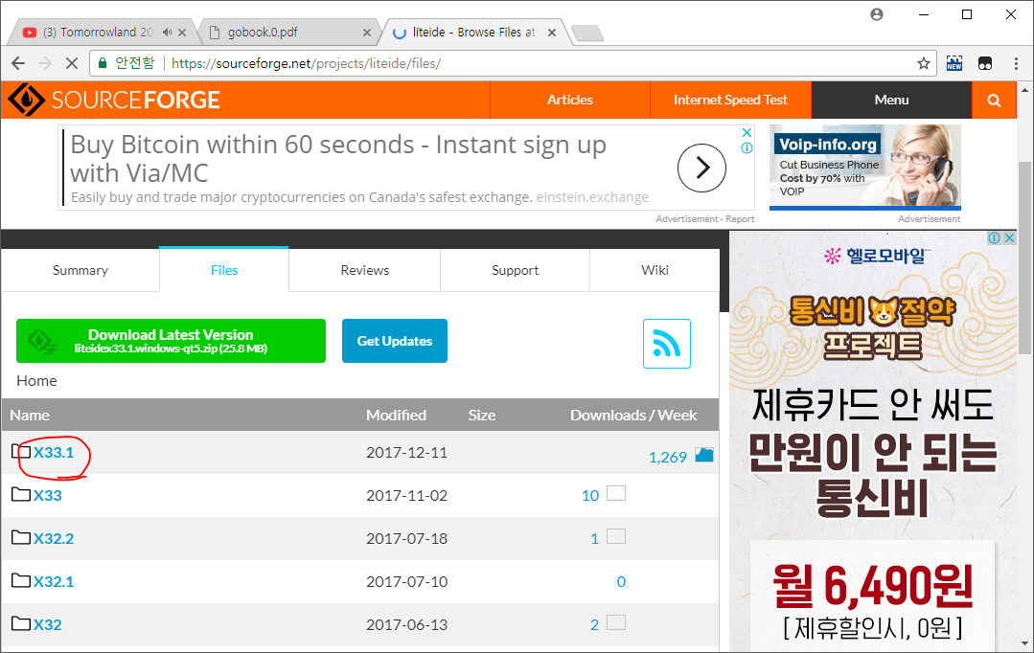
First. Sourceforge

Slide 10
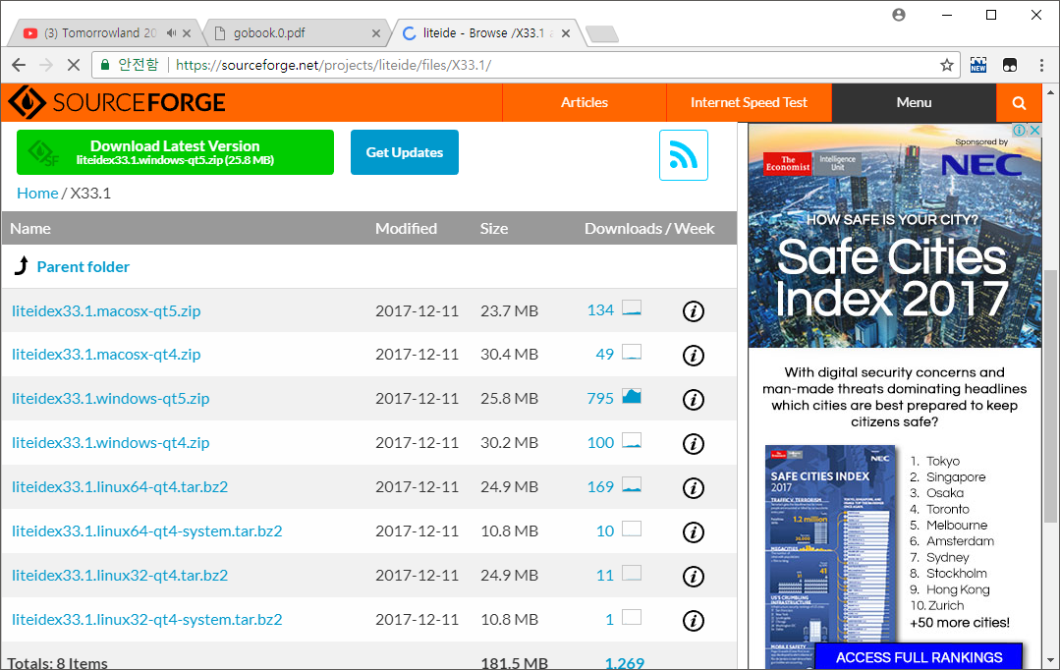
First. Sourceforge

Slide 11
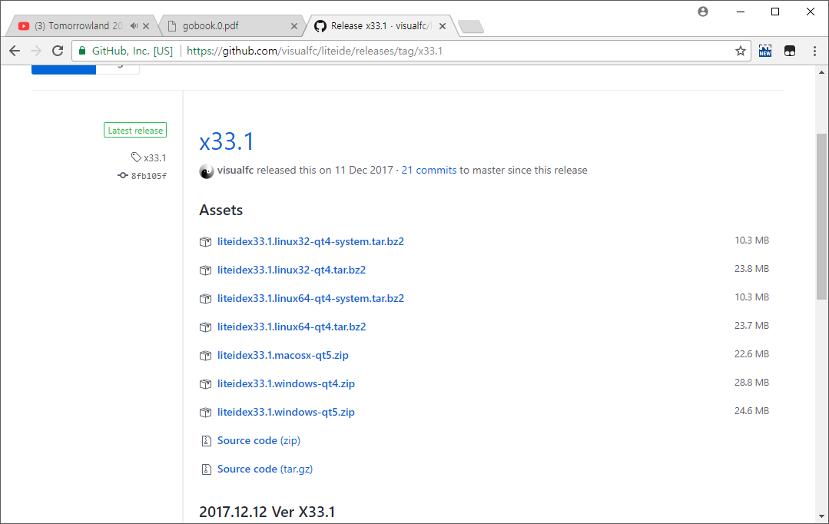
Second. Github Release

Slide 12
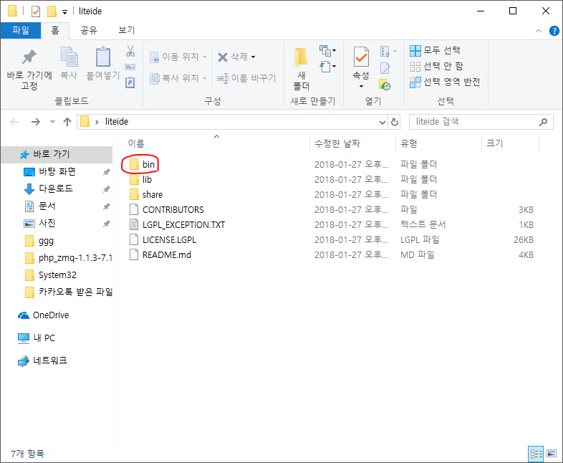
Both Unzip & Click Executable File

Slide 13
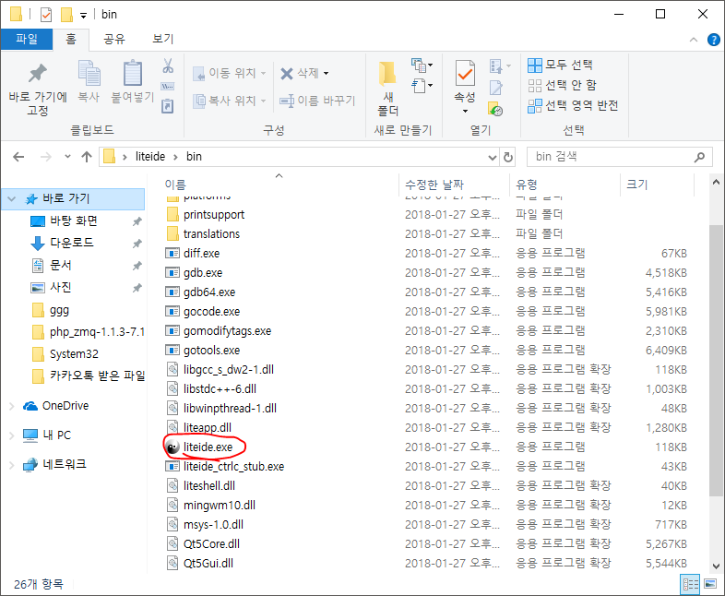
Both Unzip & Click Executable File

Slide 14
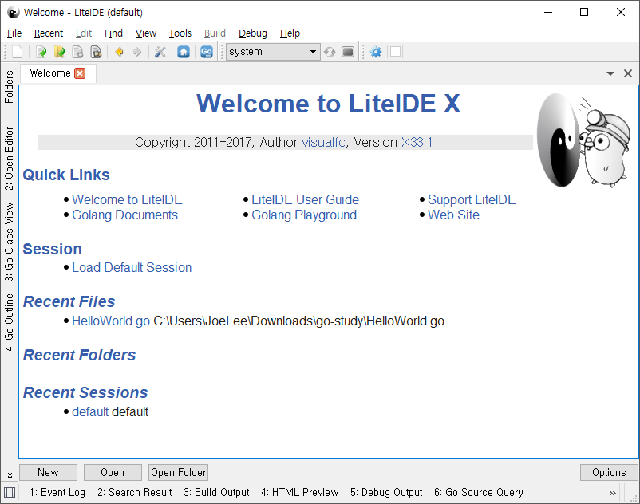
LiteIDE Were Open!

Slide 15
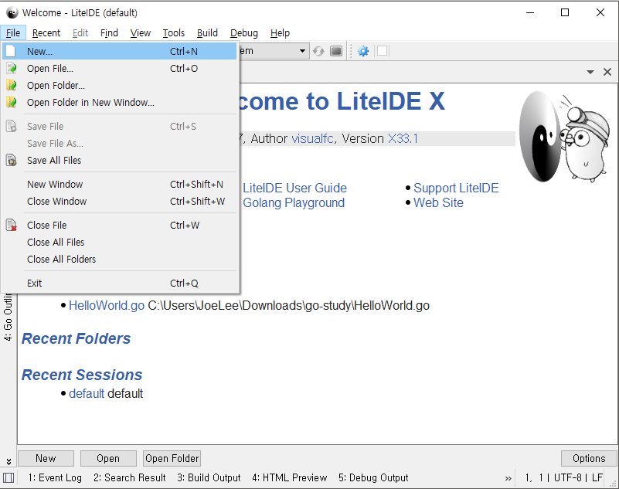
Make a New File

Slide 16
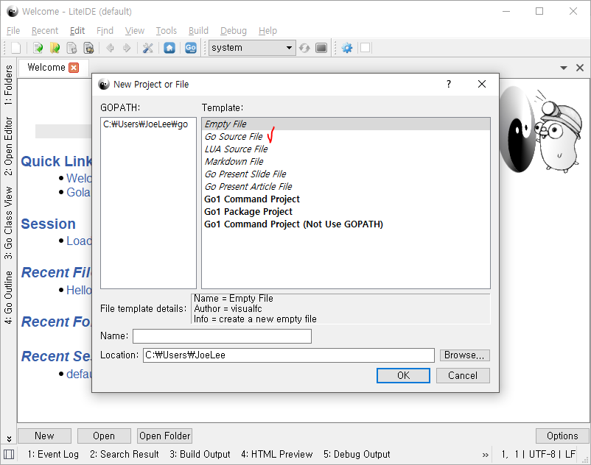
Make a New File

Slide 17
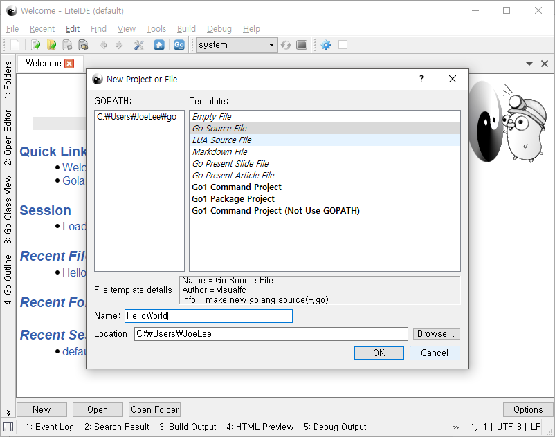
Make a New File

Slide 18
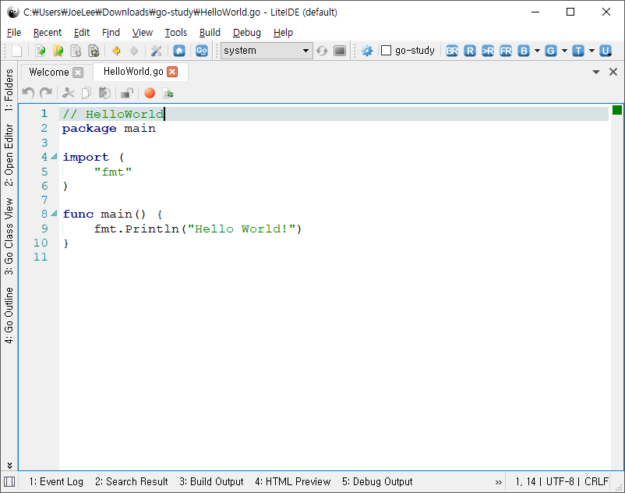
Make a New File

Slide 19
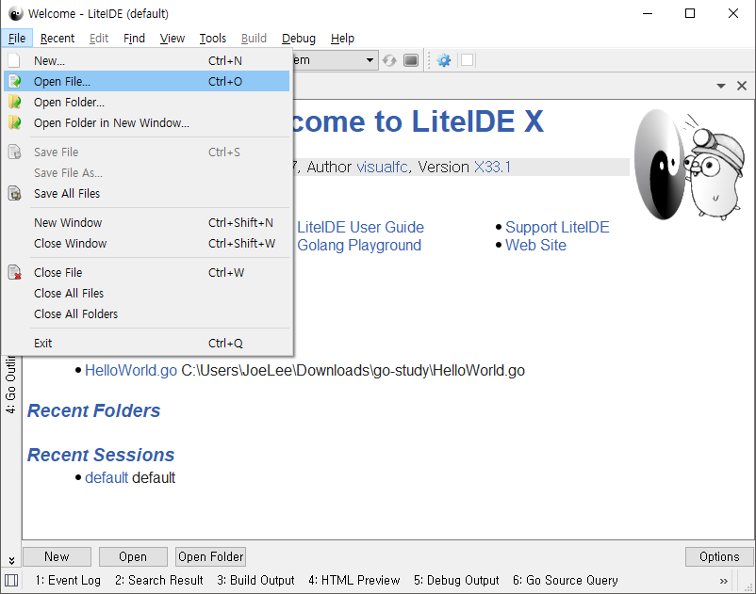
Open a File

Slide 20
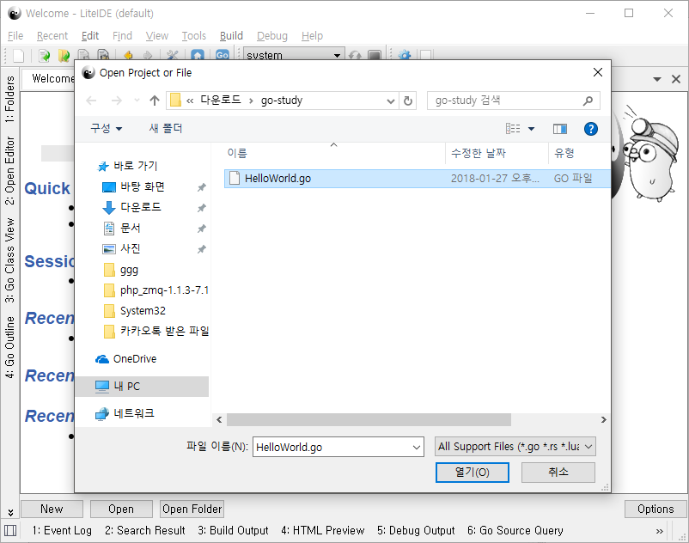
Open a File

Slide 21
Open a File

Slide 22
0. Hello World in Go
Write HelloWorld

Slide 23
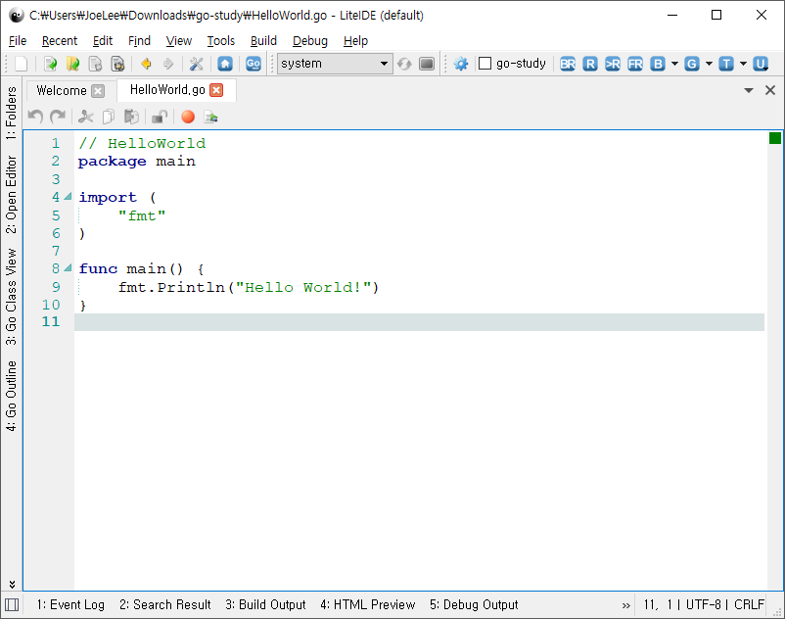
Let’s Build and RUN! Click BR Button on Top

Slide 24
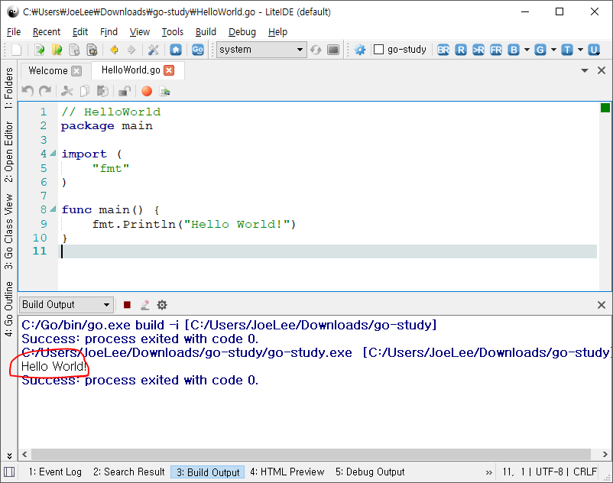
And Finished!

