Slide 1
Here’s to the good life
subtitle

Slide 2
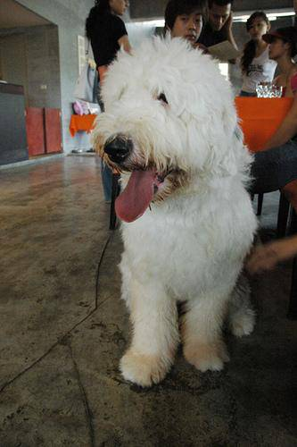
This dog was part of a project
Not sure what kind of dog it is

