Slide 1
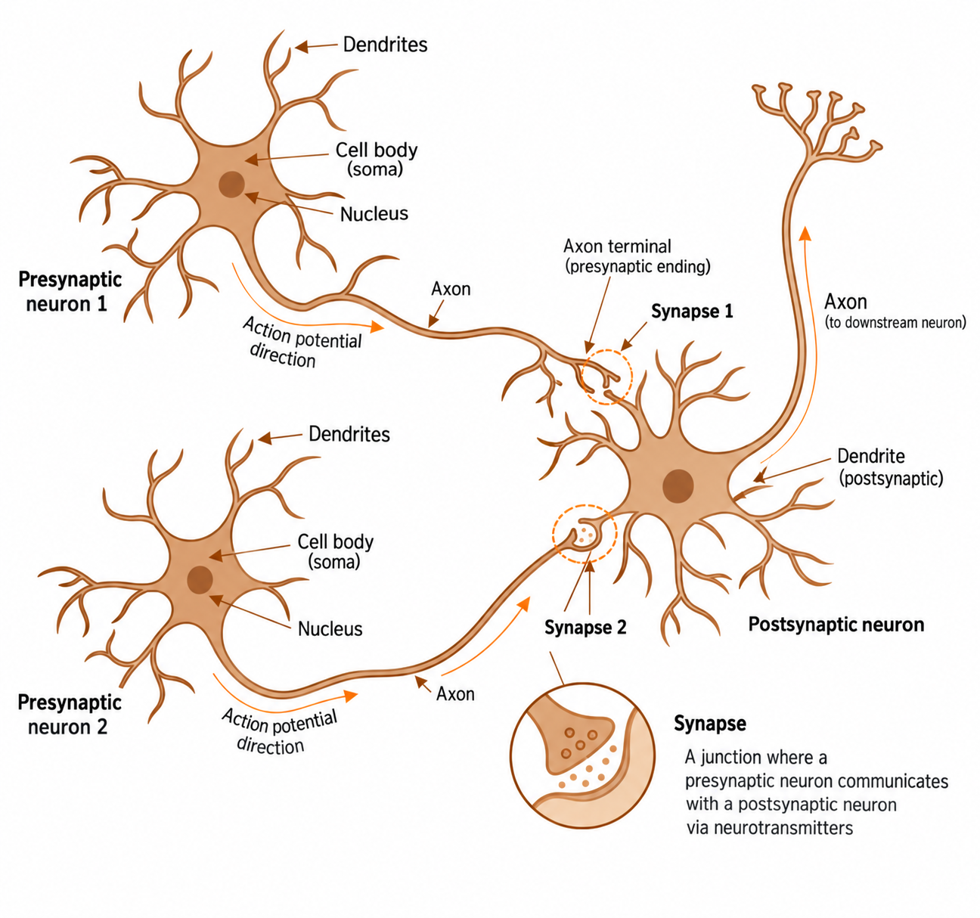
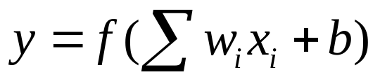
x1 w1
b f
x2 w2

Slide 2
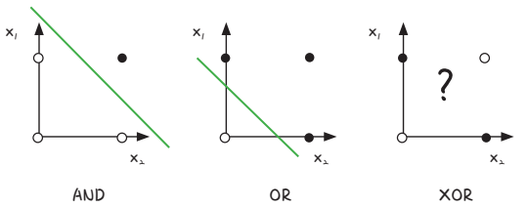
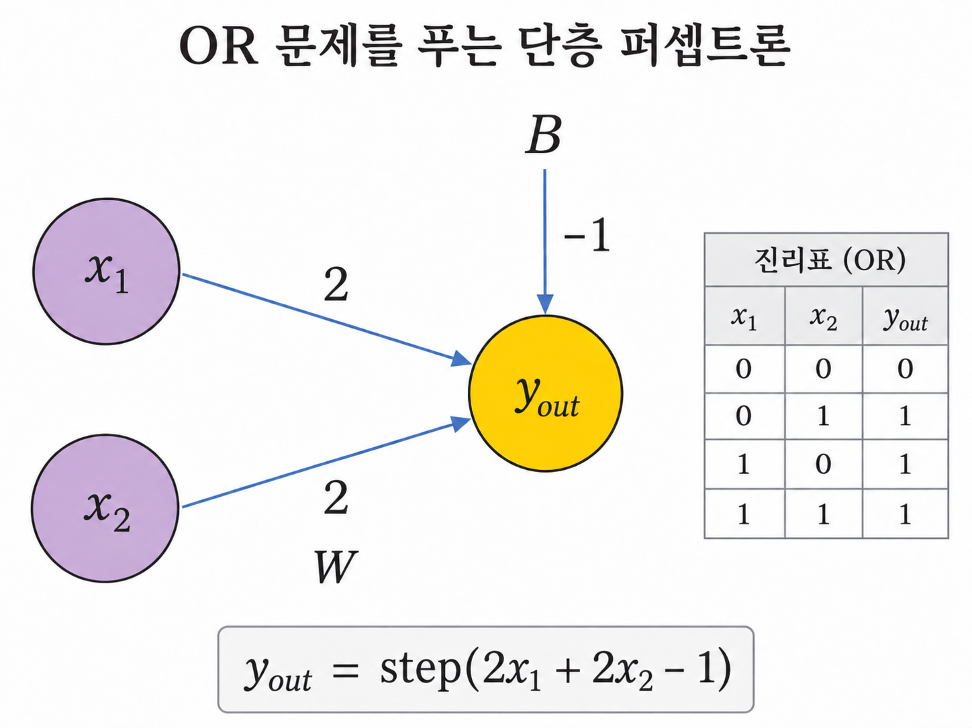
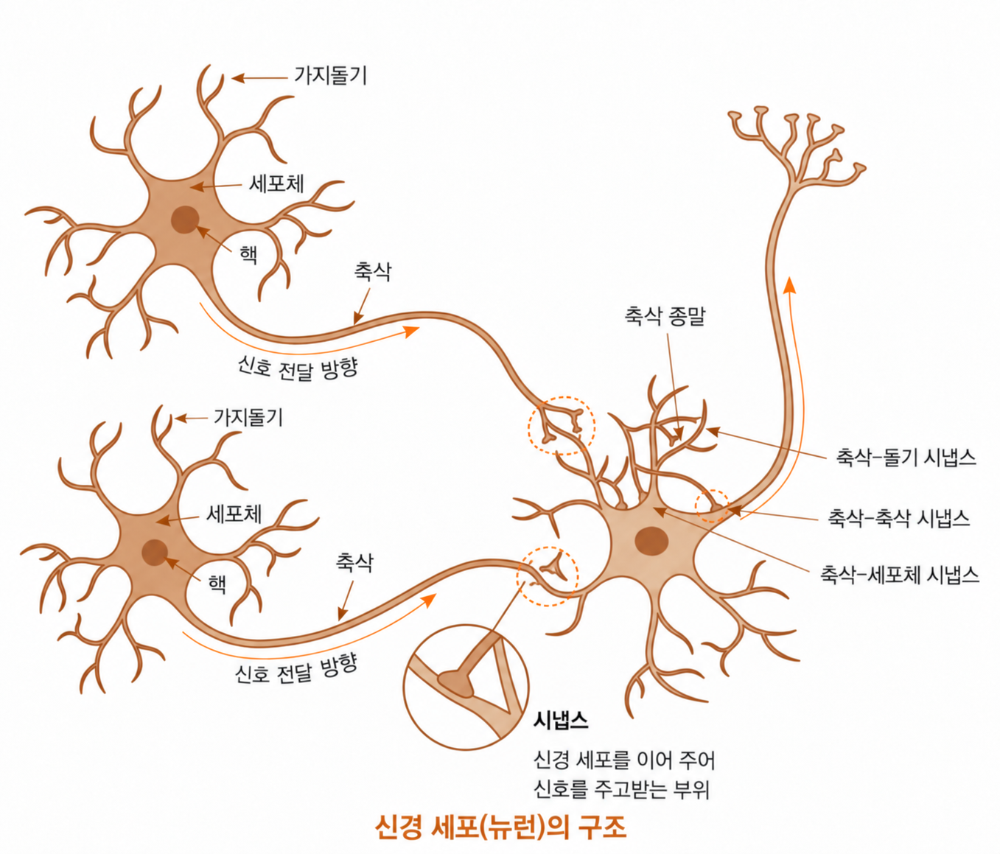
Training completed!

Slide 3
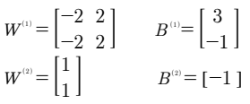
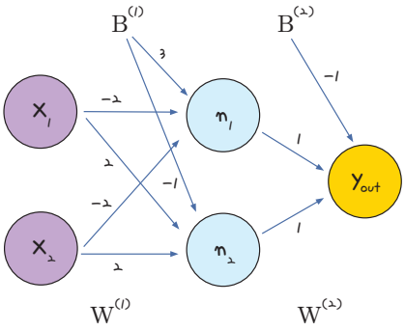
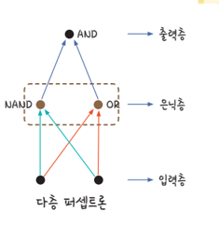
3. Solving the XOR Problem
Solving the XOR problem
Assign the following parameters and examine how a multilayer perceptron solves XOR.
▼ Figure 8-6 | Parameters inside a multilayer perceptron

Slide 4
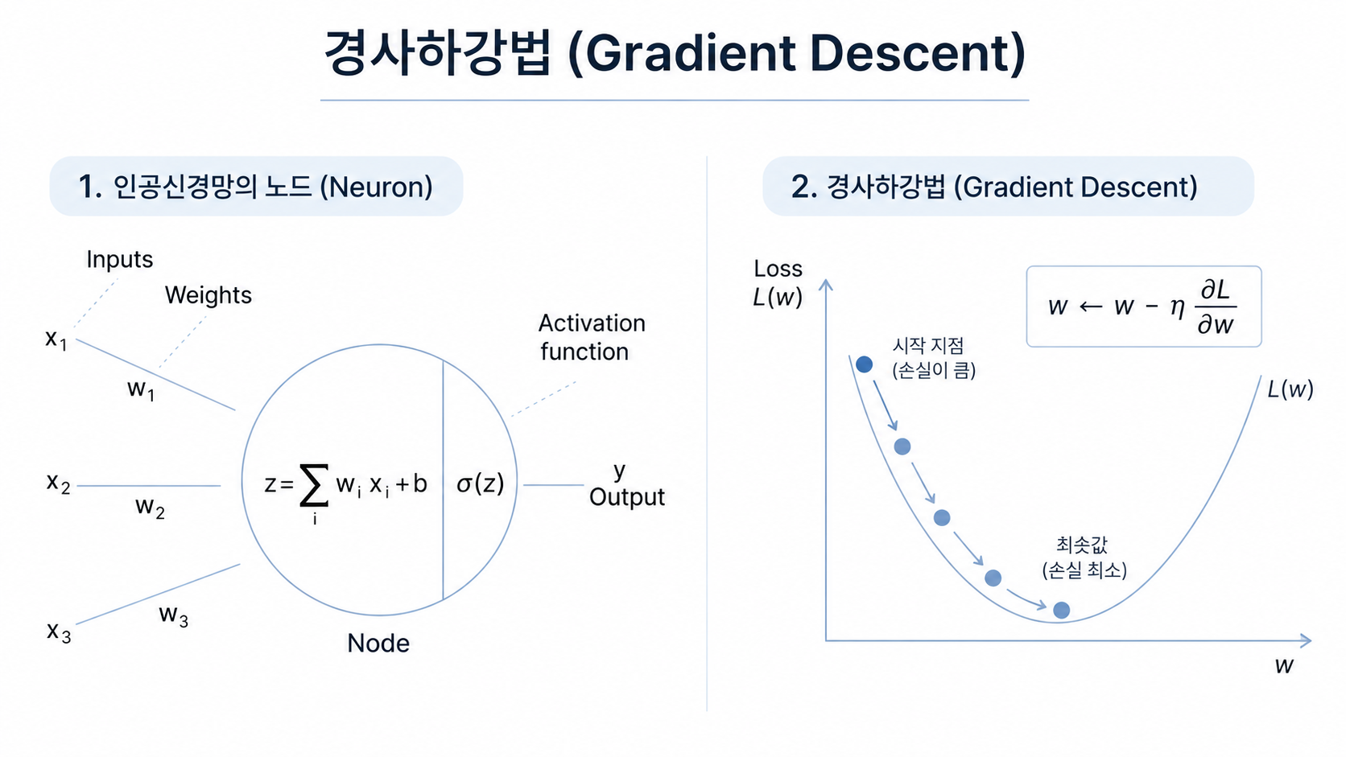
ŷᵢ = σ(zᵢ)

Slide 5

ŷᵢ = σ(zᵢ)
$$L=f(y−\hat{y})$$

Slide 6
Model and Chain Rule
Computational path from input vector xᵢ to loss L
xᵢⱼ
j-th input
zᵢ =
Σₖ wₖ xᵢₖ + b
ŷᵢ = σ(zᵢ)
L =
(1/n) Σᵢ(ŷᵢ − yᵢ)²
dL/dwⱼ = Σᵢ (dL/dŷᵢ)(dŷᵢ/dzᵢ)(dzᵢ/dwⱼ)
Compute each sample gradient and sum them; xᵢⱼ appears for the j-th weight.
For MSE, the sigmoid derivative does not cancel.

Slide 7
Fundamentals of Machine Learning: Prediction → Loss → Gradient → Learning
Focused on binary classification (logistic regression)
Input data
→
Linear combination
→
Sigmoid
→
Error and loss
X = (x₁, …, xₘ)
zᵢ = Σⱼwⱼxᵢⱼ + b
ŷᵢ = σ(zᵢ)
yᵢ - ŷᵢ → L
Loss functions
Chain rule and gradients
Error = |y − ŷ|
∂zᵢ/∂wⱼ = xᵢⱼ σ′(zᵢ) = ŷᵢ(1−ŷᵢ)
MSE = (1/N) Σᵢ(yᵢ − ŷᵢ)²
∂L/∂wⱼ = (∂L/∂ŷᵢ)(∂ŷᵢ/∂zᵢ)(∂zᵢ/∂wⱼ)
BCE = −(1/N) Σᵢ[yᵢ ln ŷᵢ + (1−yᵢ)ln(1−ŷᵢ)]
BCE + Sigmoid: ∂L/∂wⱼ = (1/N)Σᵢ(ŷᵢ−yᵢ)xᵢⱼ
Regression: MSE | Binary classification: BCE recommended
∂L/∂b = (1/N)Σᵢ(ŷᵢ−yᵢ)
Gradient descent
wⱼ ← wⱼ − η ∂L/∂wⱼ b ← b − η ∂L/∂b
η: learning rate | positive gradient: decrease parameter; negative gradient: increase it | repeat to minimize loss
Key idea: Compute loss from X and targets y, then update w and b opposite to the gradient.

Slide 8
Mean Squared Error (MSE)
MSE measures the squared difference between predicted probability ŷ and binary target y.
Mean MSE loss
L = (1/n) Σᵢ (ŷᵢ − yᵢ)²
Using half-MSE adds a factor of 1/2.
Interpretation
yᵢ = 1: loss = (1 − ŷᵢ)²
yᵢ = 0: loss = ŷᵢ²
Loss increases as the prediction
moves away from the label.
Unlike BCE, MSE remains bounded
even for confidently wrong predictions.
However, gradients can be small
when sigmoid saturates.
Single-sample MSE loss curves
2

Slide 9
Binary Cross-Entropy (BCE)
BCE measures how well sigmoid probabilities match binary labels.
Mean BCE loss
L = −(1/n) Σᵢ [
yᵢ log(ŷᵢ) + (1 − yᵢ) log(1 − ŷᵢ) ]
Interpretation
yᵢ = 1: loss = −log(ŷᵢ)
yᵢ = 0: loss = −log(1 − ŷᵢ)
Loss increases sharply when the
model is confidently wrong.
Because ŷᵢ is a sigmoid probability,
0 < ŷᵢ < 1.
Single-sample BCE loss curves
8

Slide 11
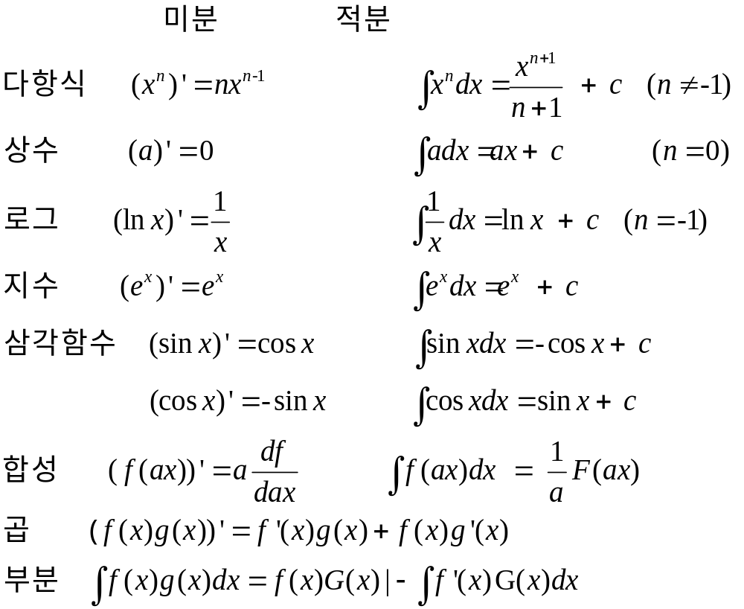
꼭 알아야 할 미적분 공식
놓적치적

Slide 12
Derivative of the Sigmoid Activation Function
Derive σ′(z), the factor remaining in the MSE gradient.
Sigmoid function
Derivative
1
σ(z) =
1 + e^{−z}
⇒
σ′(z) = σ(z)[1 − σ(z)]
ŷᵢ = σ(zᵢ)
dŷᵢ/dzᵢ = ŷᵢ(1 − ŷᵢ)
Derivation
dσ
d
(1 + e^{−z})⁻¹
=
dz
dz
= −(1 + e^{−z})⁻²(−e^{−z})
e^{−z}
1
e^{−z}
=
(1 + e^{−z})²
= [
1 + e^{−z}
] [
1 + e^{−z}
]
= σ(z)[1 − σ(z)]
Thus, for each sample i: dŷᵢ/dzᵢ = ŷᵢ(1 − ŷᵢ).
For weight wⱼ, also multiply by dzᵢ/dwⱼ = xᵢⱼ.
3

Slide 13
Deriving the Sigmoid + MSE Gradient
Set MSE loss = (1/n) Σᵢ(ŷᵢ − yᵢ)² and differentiate with respect to wⱼ.
ŷᵢ = σ(zᵢ)
zᵢ = Σₖ wₖ xᵢₖ + b
MSE loss = (1/n) Σᵢ(ŷᵢ − yᵢ)²
Key difference: σ′(z) cancels for BCE, but remains as σ′(z) = ŷ(1−ŷ) for MSE.
Convention: MSE over n samples, loss = (1/n) Σᵢ(ŷᵢ − yᵢ)²

Slide 14
3. Differentiate the Three Factors
Use the mean squared error convention.
L = (1/n) Σᵢ(ŷᵢ − yᵢ)²
dL/dŷᵢ = (2/n)(ŷᵢ − yᵢ)
ŷᵢ = σ(zᵢ)
dŷᵢ/dzᵢ = ŷᵢ(1 − ŷᵢ)
zᵢ = Σₖ wₖ xᵢₖ + b
dzᵢ/dwⱼ = xᵢⱼ
dzᵢ/db = 1
For MSE, dL/dŷᵢ = (2/n)(ŷᵢ−yᵢ). Multiply by dŷᵢ/dzᵢ = ŷᵢ(1−ŷᵢ), and by xᵢⱼ for wⱼ.
With half-MSE loss = (1/2n)Σᵢ(ŷᵢ−yᵢ)², the factor of 2 disappears.

Slide 15
Final Gradient
Apply the chain rule using the three derivatives.
dL/dwⱼ
= Σᵢ (dL/dŷᵢ)(dŷᵢ/dzᵢ)(dzᵢ/dwⱼ)
= (2/n) Σᵢ(ŷᵢ − yᵢ) ŷᵢ(1 − ŷᵢ) xᵢⱼ
dL/db = (2/n) Σᵢ(ŷᵢ − yᵢ) ŷᵢ(1 − ŷᵢ)
wⱼ ← wⱼ − η (2/n) Σᵢ(ŷᵢ − yᵢ) ŷᵢ(1 − ŷᵢ) xᵢⱼ
b ← b − η (2/n) Σᵢ(ŷᵢ − yᵢ) ŷᵢ(1 − ŷᵢ)
Compared with BCE, the MSE gradient has an extra factor of ŷ(1−ŷ).
For mean BCE + sigmoid: dL/dwⱼ = (1/n)Σᵢ(ŷᵢ−yᵢ)xᵢⱼ.

Slide 16
Comparison of Gradient Descent Updates
wⱼ,new = wⱼ,old - η dL/dwⱼ b_new = b_old - η dL/db
MSE + sigmoid
BCE + sigmoid
For n samples and m input features
MSE loss = (1/n) Σᵢ(ŷᵢ − yᵢ)²
zᵢ = Σₖ wₖ xᵢₖ + b
dL/dwⱼ = (2/n) Σᵢ(ŷᵢ − yᵢ) ŷᵢ(1 − ŷᵢ) xᵢⱼ
dL/db = (2/n) Σᵢ(ŷᵢ − yᵢ) ŷᵢ(1 − ŷᵢ)
wⱼ ← wⱼ − η dL/dwⱼ
b ← b − η dL/db
Mean BCE + sigmoid
BCE loss = −(1/n) Σᵢ [yᵢ log ŷᵢ + (1 − yᵢ) log(1 − ŷᵢ)]
dL/dwⱼ = (1/n) Σᵢ(ŷᵢ − yᵢ) xᵢⱼ
dL/db = (1/n) Σᵢ(ŷᵢ − yᵢ)
MSE code requires sigmoid_derivative. For mean batch gradients, multiply by 1/n.
1

Slide 17
7. Deriving the BCE + Sigmoid Gradient
The sigmoid derivative cancels the denominator in the BCE derivative.
Loss and model
L = −(1/n) Σᵢ [ yᵢ log(ŷᵢ) + (1 − yᵢ) log(1 − ŷᵢ) ]
ŷᵢ = σ(zᵢ), zᵢ = Σₖ wₖ xᵢₖ + b
Derivative with respect to ŷᵢ
Cancellation with sigmoid
dL
= (1/n)[ − yᵢ/ŷᵢ
dŷᵢ/dzᵢ = ŷᵢ(1 − ŷᵢ)
dŷᵢ
+ (1 − yᵢ)/(1 − ŷᵢ) ]
Therefore
1/n (ŷᵢ − yᵢ)
dL
=
dzᵢ
= 1/n (ŷᵢ − yᵢ)
ŷᵢ(1 − ŷᵢ)
Final batch gradients
dL/dwⱼ = Σᵢ (dL/dzᵢ)(dzᵢ/dwⱼ) = (1/n) Σᵢ(ŷᵢ − yᵢ)xᵢⱼ
dL/db = (1/n) Σᵢ(ŷᵢ − yᵢ)
9

Slide 18
5. Numerical Example: yᵢ = 1, ŷᵢ = 0.7, xᵢⱼ = 2, n samples
Why the MSE contribution to the j-th weight gradient is smaller than BCE
MSE contribution:
dL/dwⱼ = (2/n)(0.7−1)(0.7)(0.3)(2)
= −0.252/n
BCE contribution:
dL/dwⱼ = (1/n)(0.7−1)(2)
= −0.600/n
MSE includes another factor σ′(zᵢ) = ŷᵢ(1−ŷᵢ) = 0.21. Here its contribution is −0.252/n.
Interpretation: As sigmoid saturates near 0 or 1, ŷᵢ(1−ŷᵢ) becomes very small, potentially slowing learning.
With half-MSE loss = (1/2n)Σᵢ(ŷᵢ−yᵢ)², the MSE contribution is −0.126/n.

Slide 19
Simple Neural Network Example
Threshold Classification: x < 3 → 0, x ≥ 3 → 1
Pure Python · TensorFlow · Keras
y
boundary
1
Learning objective
Implement the same one-neuron logistic classifier in three ways: manual calculations → automatic differentiation → high-level API.
0.5
x
weight w
z = wx + b
sigmoid
ŷ
bias b
0
x
0
1
2
3
4
5

Slide 20
1. Problem Definition
Learn threshold classification using a small dataset.
Training data
y
boundary
1
x
0
1
2
3
4
5
y
0
0
0
1
1
1
Key question
Can a neural network learn to separate 0s and 1s from data, without being told the rule x = 3?
0.5
Expected result
If the decision boundary lies between x = 2 and x = 3, all training samples are classified correctly.
0
x
0
1
2
3
4
5

Slide 21
2. The Simplest Neural Network
One input, one output neuron, and one sigmoid activation function.
weight w
z = wx + b
sigmoid
x
ŷ
bias b
Forward pass
Decision boundary
z = wx + b
ŷ = sigmoid(z) = 1/(1 + exp(−z))
ŷ ≥ 0.5 → class 1
ŷ < 0.5 → class 0
sigmoid(0) = 0.5
wx + b = 0
x boundary = −b/w

Slide 22
3. What Changes During Training?
Initially all predictions are 0.5; training adjusts w and b and moves the decision boundary.
Before training
Training loop
y
1
Data
Prediction
Loss
Gradient
Update
all predictions = 0.5
repeat 1000 epochs
0.5
Update rule
0
x
w ← w − η dw
b ← b − η db
η = learning rate
0
1
2
3
4
5

Slide 23
4. Pure Python: Implement Every Calculation
Students can see the inner workings of gradient descent most clearly.
Pure Python: key code
Model
y_pred = sigmoid(w*x + b)
for epoch in range(1000):
dw = 0
db = 0
for x, y in zip(X, Y):
y_pred = sigmoid(w*x + b)
error = y_pred - y
dw += error*x
db += error
w -= learning_rate*dw
b -= learning_rate*db
Gradient
dw += error*x
db += error
Update
w -= learning_rate*dw
b -= learning_rate*db
Teaching point
Without libraries, the full learning cycle remains visible: prediction → error → gradient → parameter update.

Slide 24
5. TensorFlow: Automatic Gradient Computation
We write the forward pass; GradientTape handles differentiation.
Same model
TensorFlow: key code
with tf.GradientTape() as tape:
y_pred = tf.sigmoid(tf.matmul(X, w) + b)
loss = binary_crossentropy(Y, y_pred)
dw, db = tape.gradient(loss, [w, b])
w.assign_sub(learning_rate*dw)
b.assign_sub(learning_rate*db)
x
weight w
z = wx + b
sigmoid
ŷ
bias b
Automatic differentiation
tape.gradient(loss, [w, b]) computes dw and db.
Explicit parameter updates
Compared with Pure Python
Parameter changes remain visible in code, e.g., w.assign_sub(learning_rate*dw).
The mathematical structure is the same, but derivatives need not be derived by hand. This is especially useful for deep networks.

Slide 25
6. Keras: Define the Network Using Layers
Model, loss function, optimizer, and training loop use a high-level API.
Dense(1)
Keras: key code
1 input → 1 output neuron
model = keras.Sequential([
keras.layers.Dense(1, activation='sigmoid',
input_shape=(1,))
])
model.compile(
optimizer=SGD(learning_rate=0.1),
loss='binary_crossentropy'
)
model.fit(X, Y, epochs=1000)
prediction = model.predict(X)
compile()
SGD + binary crossentropy
fit()
training loop hidden inside
predict()
trained model output
Key message
Keras is closest to real-world projects. However, studying Pure Python and TensorFlow first makes the underlying mechanism clearer.

Slide 26
7. Comparing Three Implementations: Same Model, Different Abstraction Levels
All three programs use the same architecture: 1 input → 1 neuron → sigmoid → 1 output.
ŷ
Item
Pure Python
TensorFlow
Keras
1
Model
Manual code
Explicit definition
Dense layer
Sigmoid
Manual code
tf.sigmoid
activation
Gradient
Manual calculation
GradientTape
Automatic
Update
Manual code
assign_sub
optimizer
0.5
ŷ = 0.5
Loop
Manual code
Manual code
fit()
Goal
Understand principles
Understand autodiff
Practical API
0
x
0
1
2
3
4
5
Final discussion question
Do these three programs train different neural networks?
No. They implement the same model at different levels of abstraction.

