Slide 1
Single-cell RNA-sequencing

Slide 2
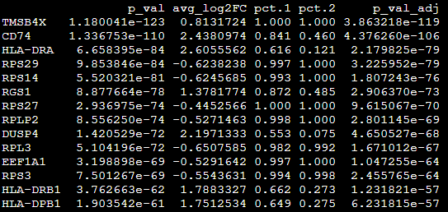
Differentially expressed gene analysis between two groups
- Wilcoxon rank sum test between two groups for each cell type (or cluster)
Nonparametric approach (does not require a specific distribution of data)
Adjusted p-value, average_Log2FC + expression cell ratio (pct.1, pct.2)
GZMA: Tumor_CD8 T cell > Normal_CD8 T cell
Cytotoxic
HLA-DRA, HLA-DRB1, HLA-DPB1: Tumor_CD8 T cell > Normal_CD8 T cell
activated

Slide 3
Geneset analysis
Celltype1
Celltype2 …
CTRL
Treat
→ Fisher’s exact test or GSEA
Or measuring “signature score” for each cell
Kind of supervised dimension reduction (?)

Slide 4
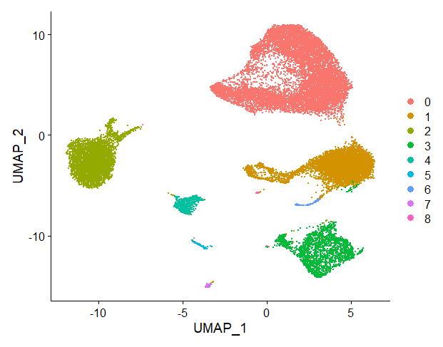
AddModuleScore
Single-cell1
Signature1
Signature2
…
-Mean expression of a given geneset
-Each gene will be binned
-Subtracted by random (selected by each bin) noise

Slide 5
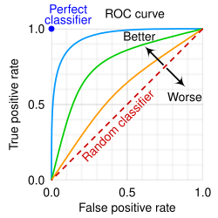
AUCell
-Order genes by expression for each cell
-Measure AUC for a given geneset
0.89
0.67
0
-Receiver operating characteristic
(ROC) curve: performance measurement
-AUC: area under curve
→ Quantification
Given genes (6,2,1: 9)

Slide 6
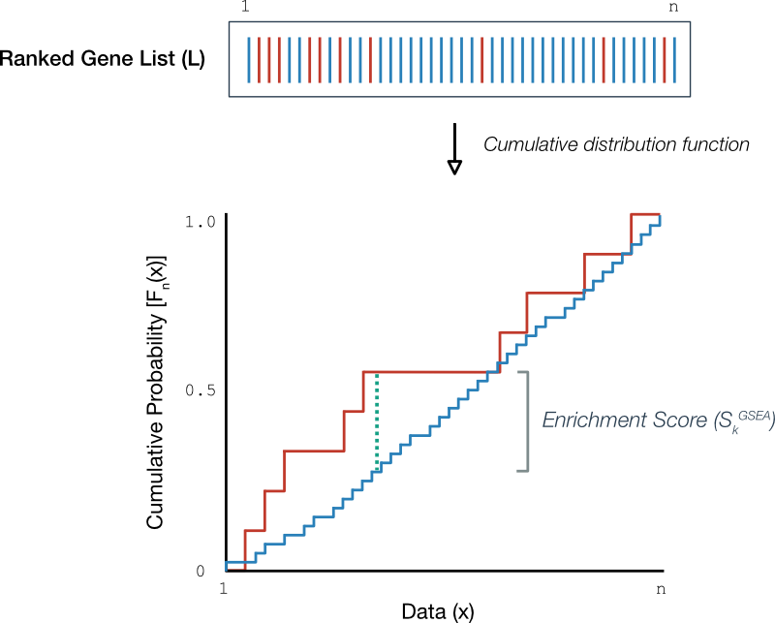
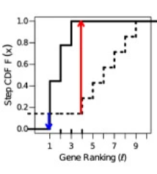
ssGSEA & GSVA
*ssGSEA
-Order genes by expression for each cell
-Make a ECDF (empirical cumulative distribution function)
for a given geneset and remaining genes, respectively
-Integration of difference between two ECDFs
*GSVA
-Order genes by expression for each cell
-Make a ECDF
-KS-test (Kolmogorov-Smirnov test)
Statistics by maximum difference

Slide 7
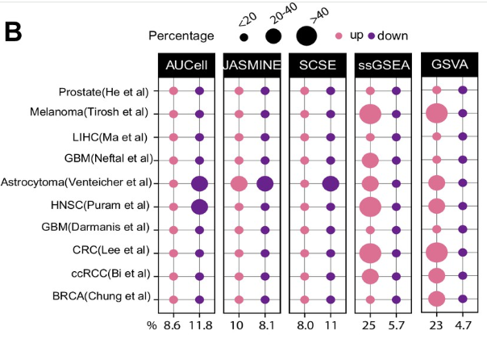
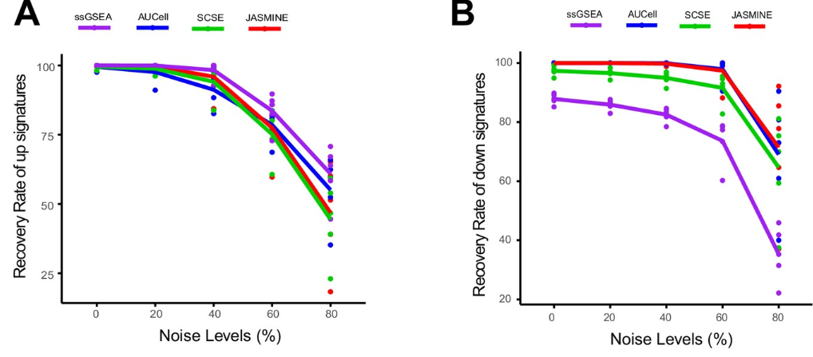
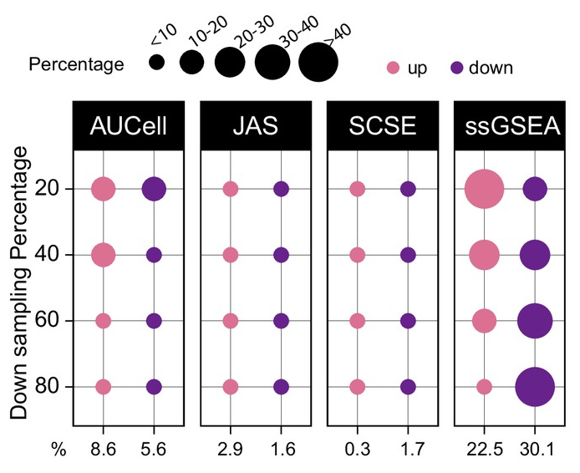
Is not always good
Up
Down
-Biased to cancer (upregulation >> down regulation)
-Robustness (against noise): Up > Down
-Robustness (against down-sampling): ssGSEA (worst)
Signature-scoring methods developed for bulk samples are not adequate for cancer single-cell RNA sequencing data

Slide 8
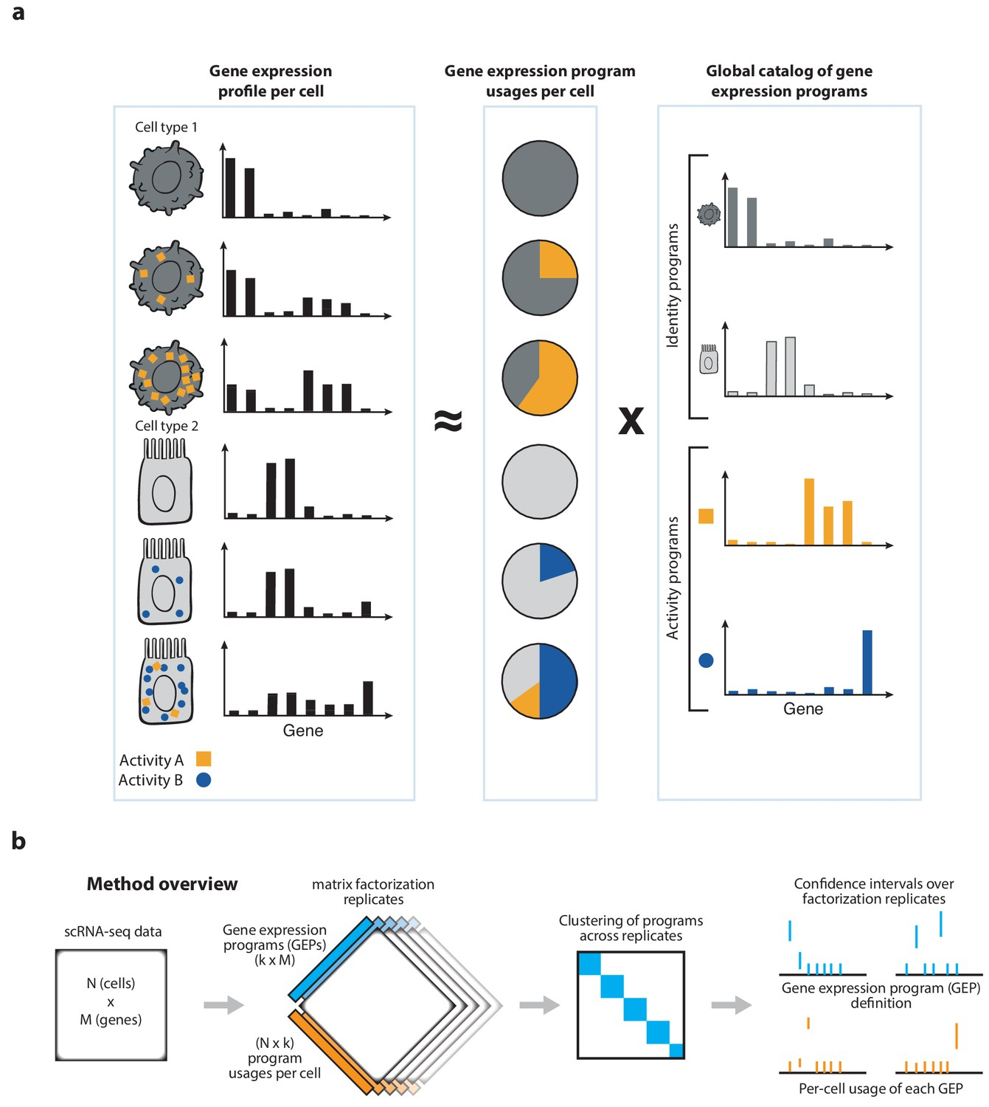



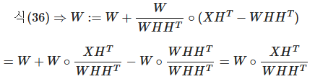
cNMF
(consensus non-negative matrix factorization)
*Unsupervised approach
NMF: Decomposition method
Make W,H be close to X
Gradient descending
Notes:
Learning rate

Slide 9
cNMF
X = WH
-X: gene expression (N x M)
N: cell, M: gene
-W: program usage (activity): N x k
k: number of program
-H: gene expression program: weight of each gene
k x M
Consensus → robustness
Take median value of each gene
Notes:
Learning rate

Slide 10
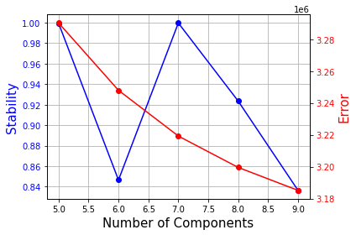
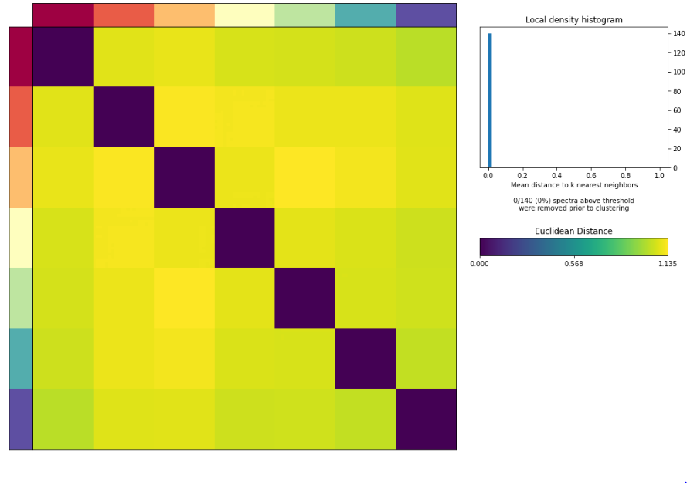
cNMF
-K selection → stability: high, error: low
-Define density_threshold by KNN distance distribution
-Batch correction for input count matrix (harmony)
moe_correct_ridge (same algorithm in harmony)
Notes:
Learning rate

Slide 11
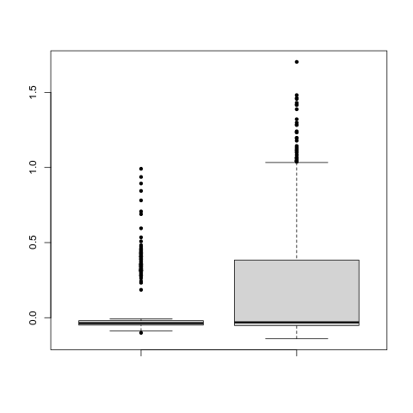
Signature analysis
Tumor infiltrating T cell → might be exhausted
Exhaustion signature: PDCD1, CTLA4, HAVCR2, LAG3, TOX
CD8 T cells
P value: 2.595e-05
→ T cells in the tumor-microenvironment are exhausted
Normal
Tumor

Slide 12
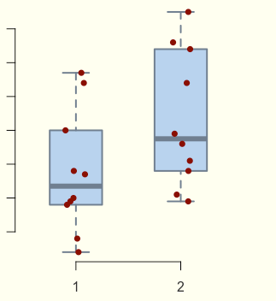
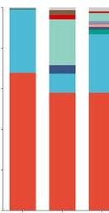
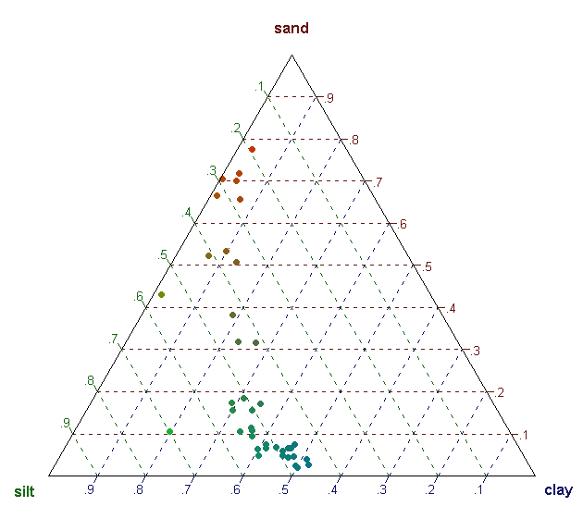
Cell abundance
*T-test, Wilcoxon
Always! Relative abundance
Why? The cell counts for each sample is always different
Sample size is usually very small for scRNA-seq
Poor power analysis (less significant)
*Dirichlet Regression
-one celltype ↑→ one celtype ↓
-prior reference
celltype selection
*Fisher’s exact test
-Comparing by group-level
-Very sensitive; high false-positive
Notes:
삼각형 합이 계속 일정

Slide 13
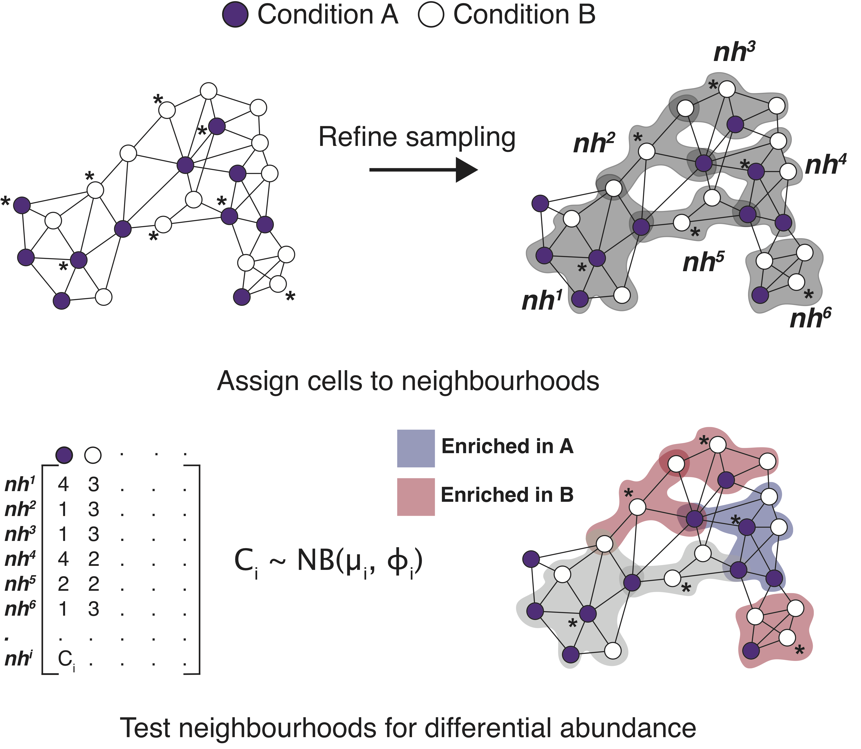
Cell abundance (MILO)
-KNN graph of cells
-Sampling to increase statistical power
-Perform enrichment test for each sampling
Which condition has more in the neighborhood

Slide 14
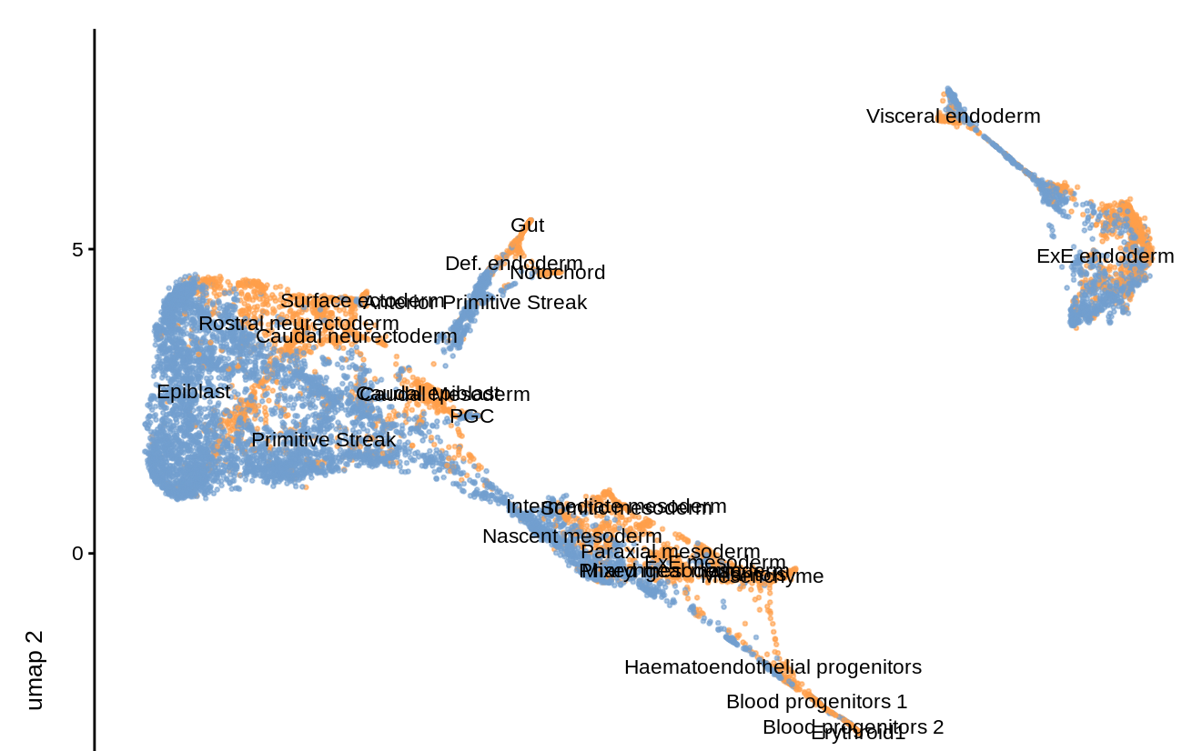
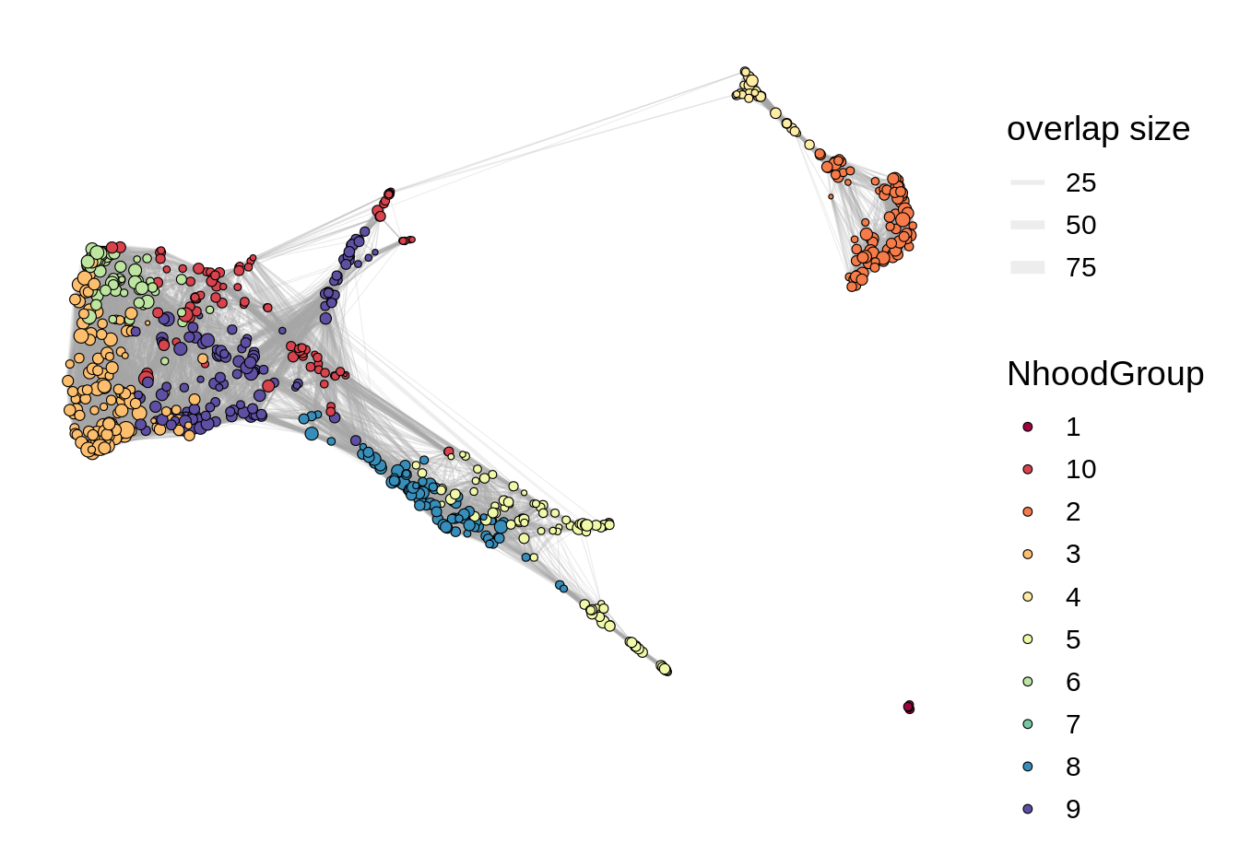
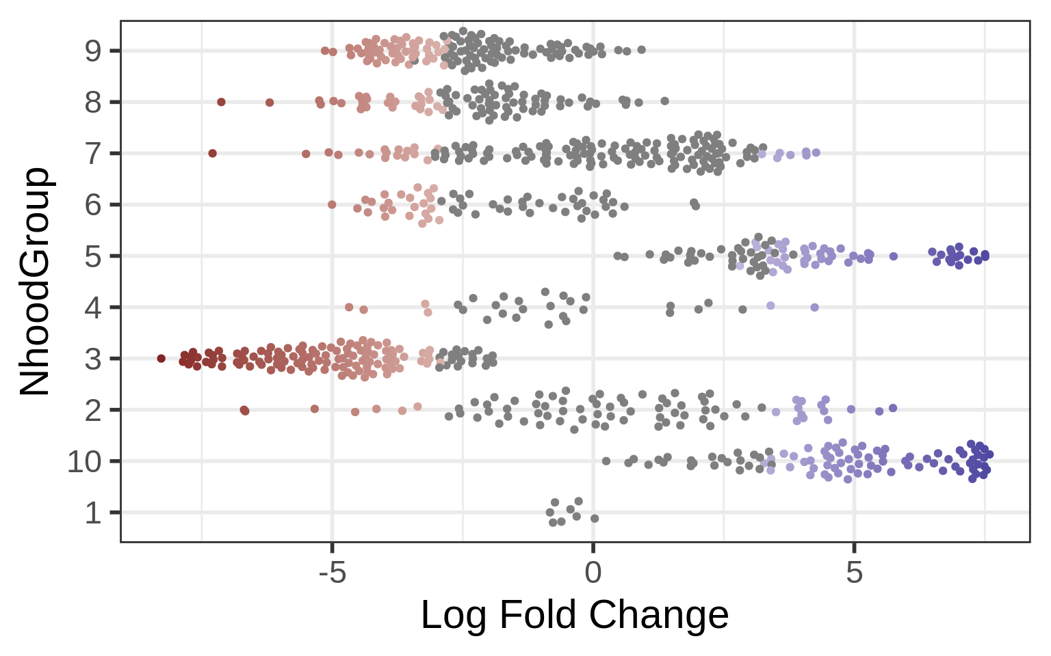
Cell abundance (MILO)

Slide 15
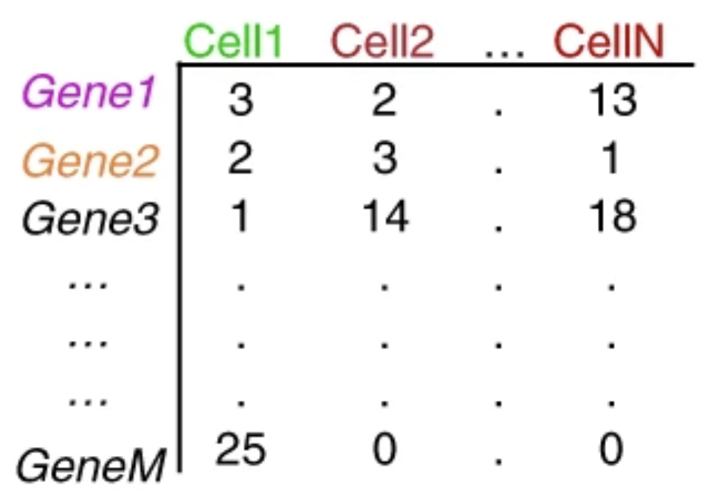
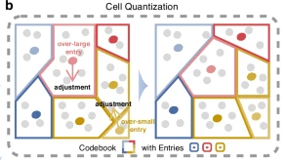
Cell-pooling
-High drop-out rate: zero count ↑
-merge cells → pseudo cell → averaging → overcome drop-out!

Slide 16
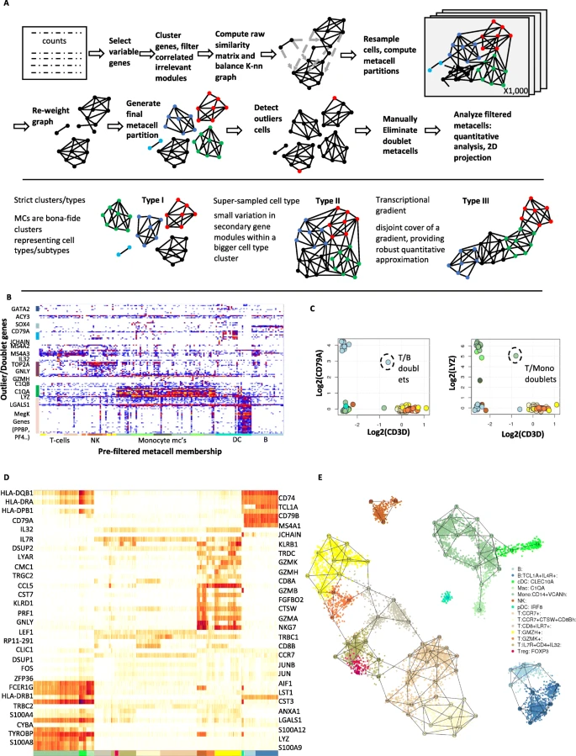
Metacell
-balanced KNN graph construction
-resampling → consensus-based partitioning
-remove outliers

Slide 17
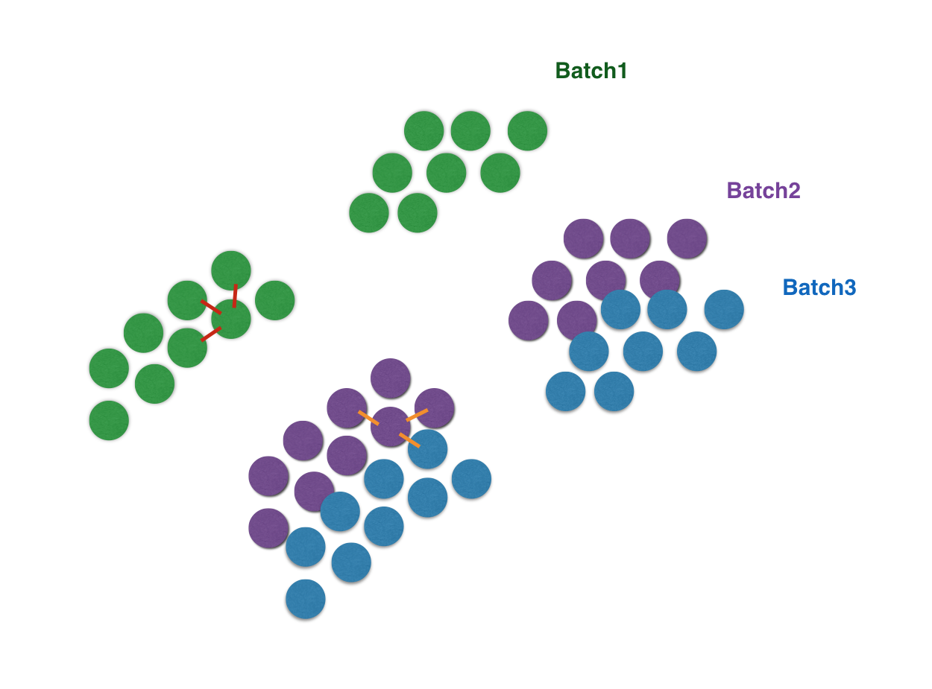
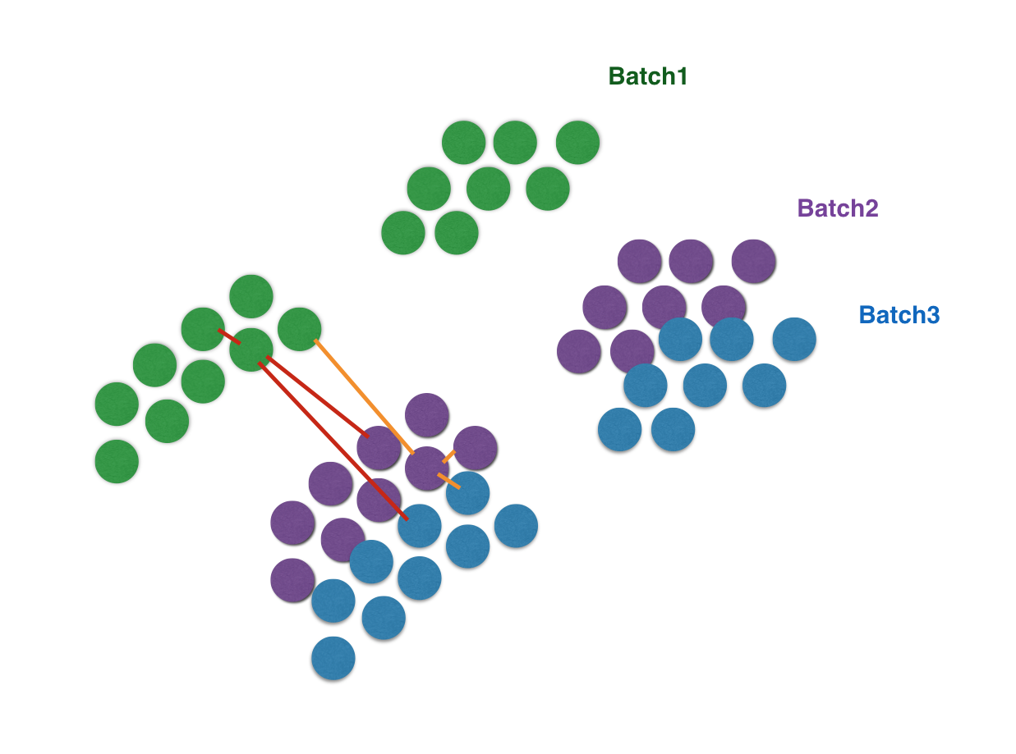
BBKNN
Difference by cell type > difference by batch in a given cell type
- KNN for whole data
- KNN across batch with smaller k
→ Batch corrected pooling

Slide 18
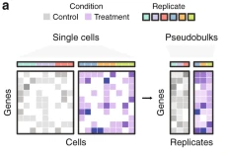
Pseudobulk DE analysis
-Extreme case
-Generate a pseudobulk for each sample (each cell type)
Perform bulk DE analysis (DESeq2, Limma, edgeR …)
-Overcome high dropout
-susceptible to outlier cells
-cannot account for expressing cell ratio
Confronting false discoveries in single-cell differential expression

Slide 19
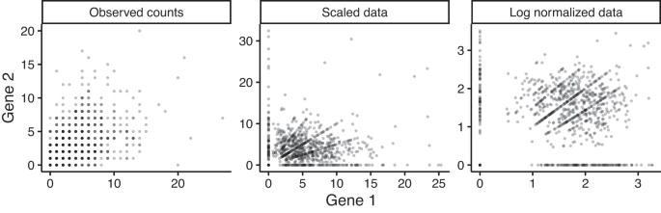
Network analysis in scRNA-seq
-Skewed too much to zero-counts
→ Hard to obtain a suitable correlation
Cell-type-specific co-expression inference from single cell RNA-sequencing data

Slide 20
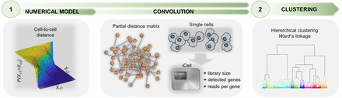
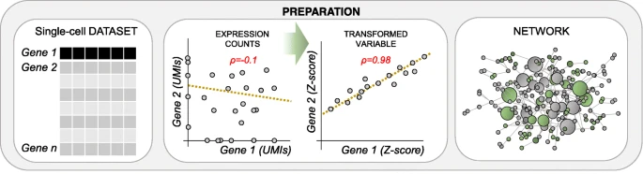
BigScale2
-High granularity clustering: Recursive clustering (Hierarchical clustering)
-all pairwise comparison → DE → measure Z-score for each gene
→ Correlation (similar effect of cell-pooling)

Slide 21
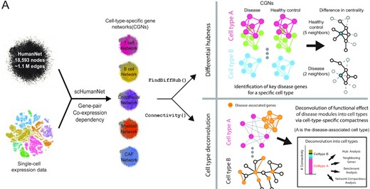
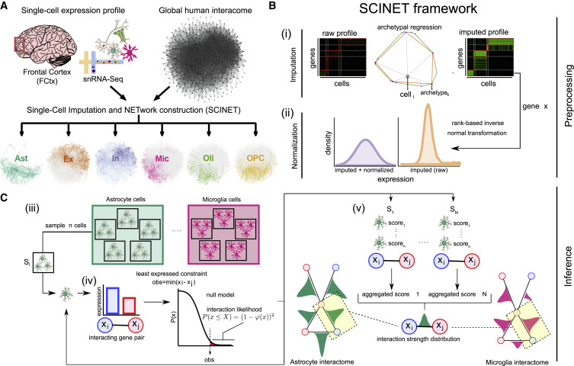
scHumanNet
-Filtering out the “cell-type-specific” network from the reference network
-HumanNetv3, String
*SCINET framework
-clustering → Archetype → transcriptome interpolation (smoothing)
-gene expression transformation
Better distribution
-subsampling (per cell type)
-p-value for interacting gene-pair vs Null
-aggregate p-values by Fisher’s method
Or
Just take the edge and use the original edge score

Slide 22
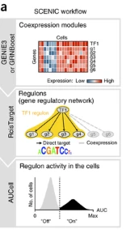
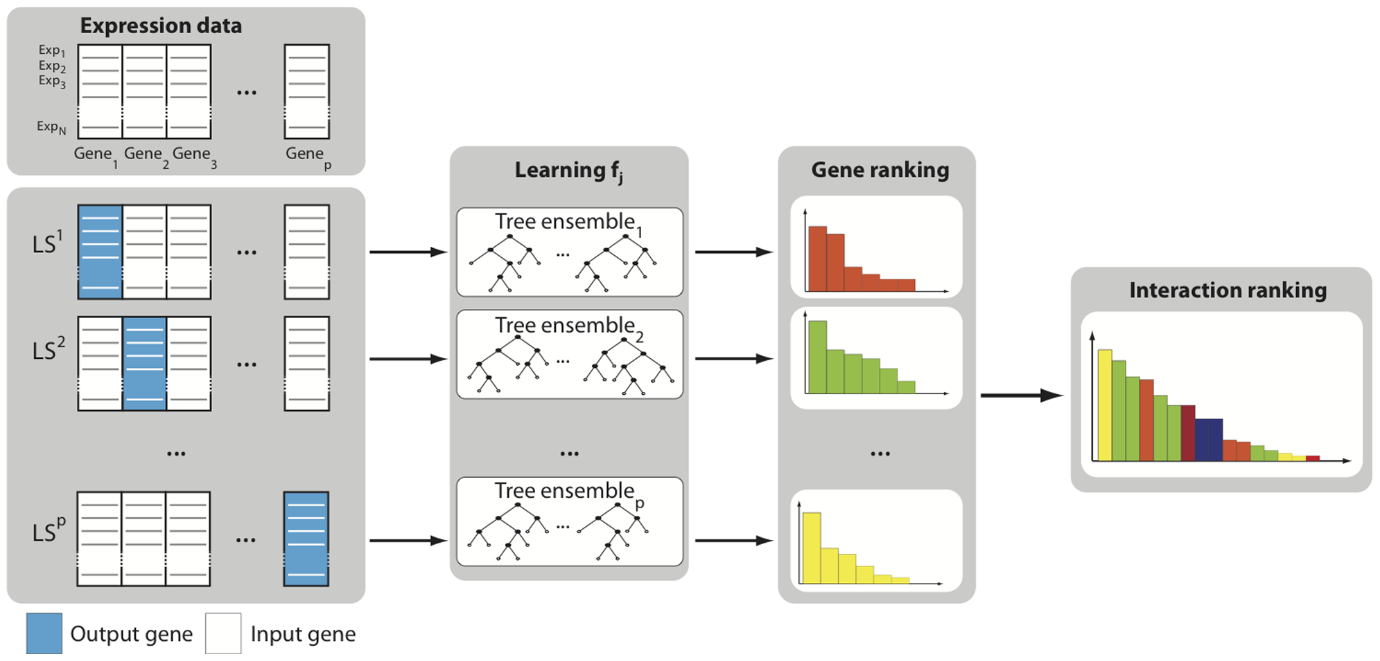
SCENIC (genie3)
*Genie3
-Constructing gene-regulatory network (or Transcription Factor regulatory NW: TRN)
-Based on Genie3 (developed for bulk RNA data)
-output gene exp ← explained by input genes (random forest) [coexpression pattern] → TF filtering
-output gene (i) ← input gene (j1, j2, j3) score → ranking (by importance)
→ GRNBoost for speed
Notes:
RF: bootstrapping → bagging
Importance: each node (gene)이 classification 얼마나 잘하는지 (information gain 측정)

Slide 23
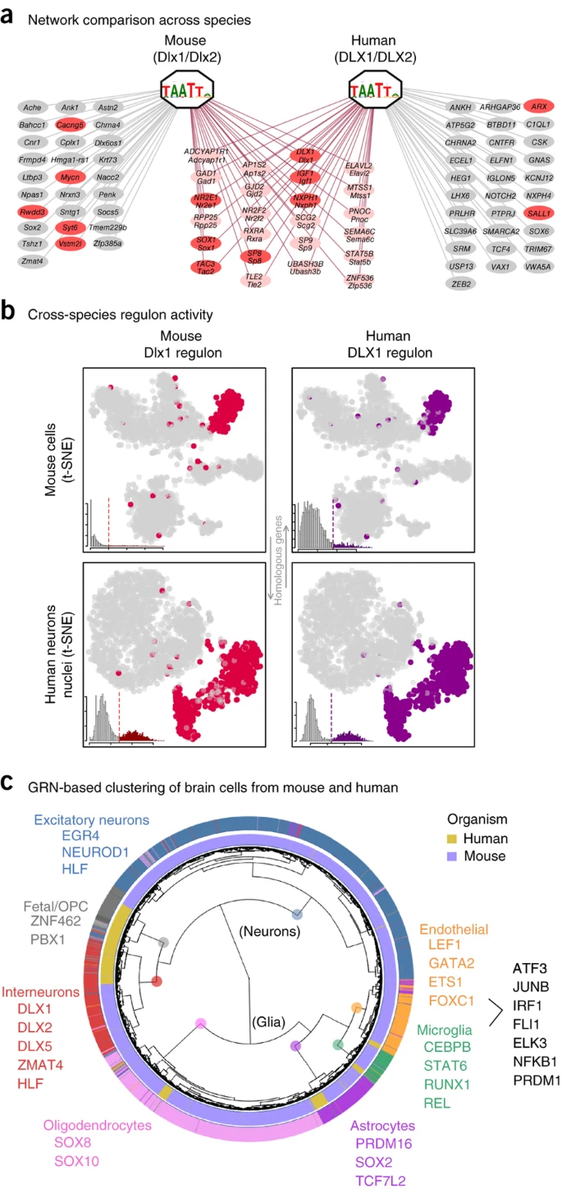
SCENIC (genie3)
-We obtained TF- target gene (correlation or association)
Not all the TF binds to the target gene
RcisTarget: cis-regulatory motif analysis
Only enriched TF can bind to the promoter of a given genes
*Regulon activity: AUCell
TF
Regulon
Notes:
RF: bootstrapping → bagging

Slide 24
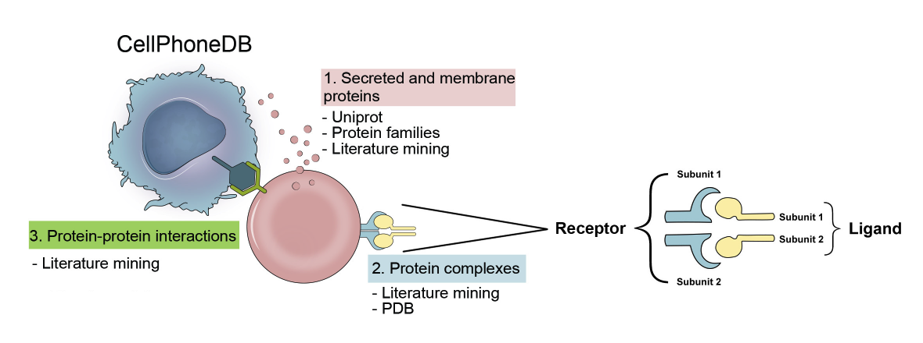
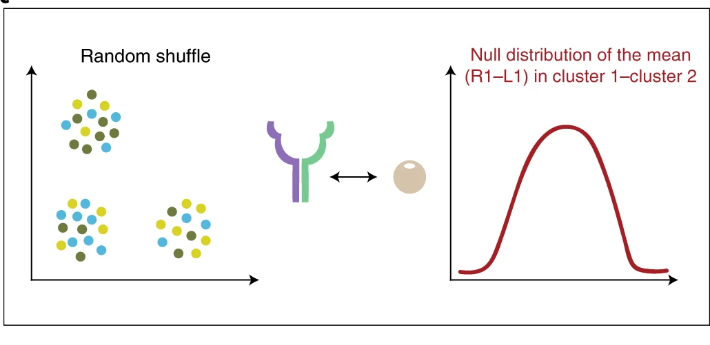
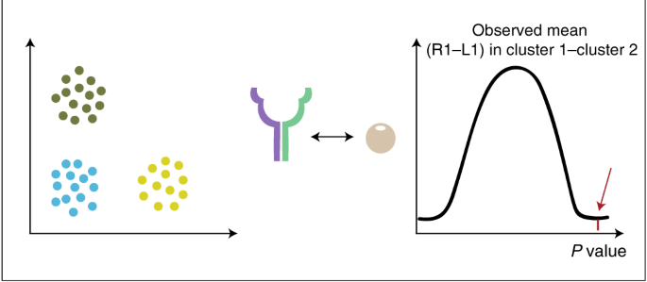
Cell-Cell interaction (CellPhoneDB, CellChat)
-Cluster-to-Cluster interaction
Measure the mean expression of receptor-ligand pair
Shuffle the cells: Null distribution
P-value measurement for each pair
Strength: mean expression
+ complex: mean expression

Slide 25
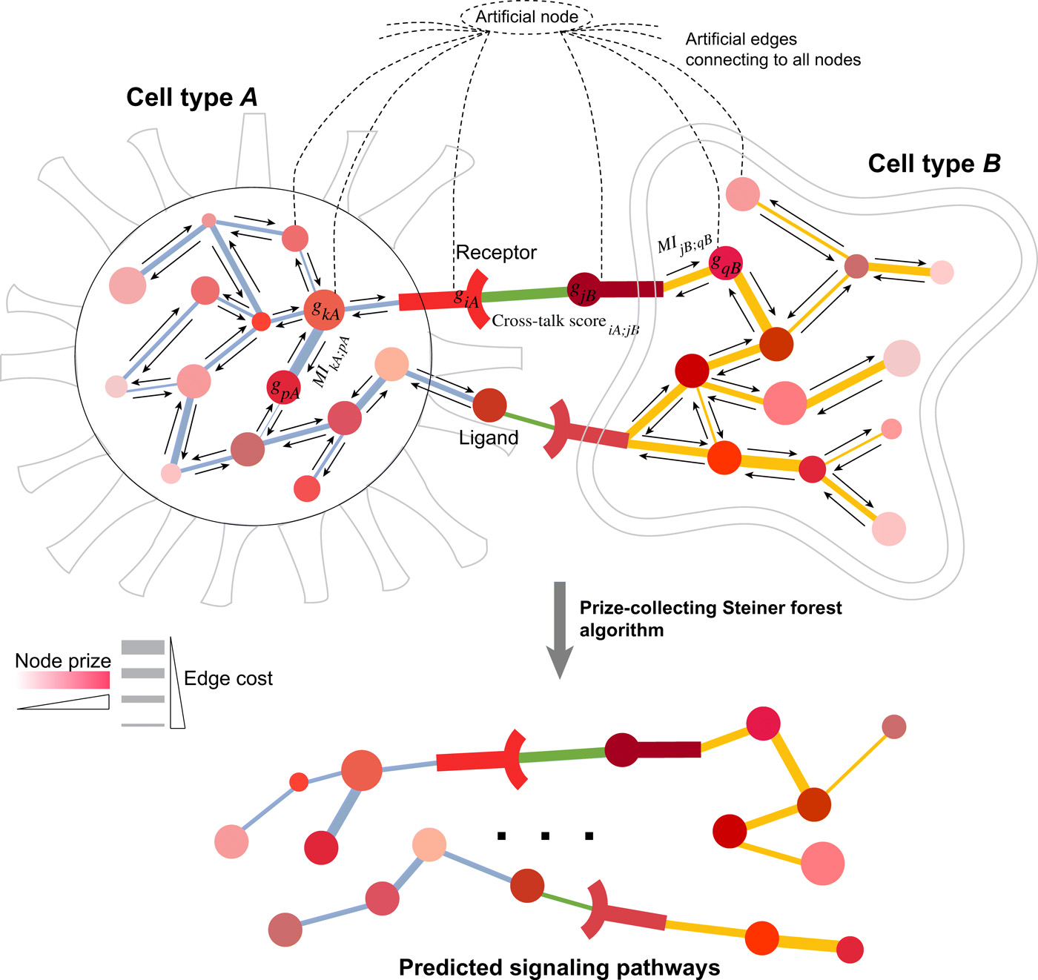
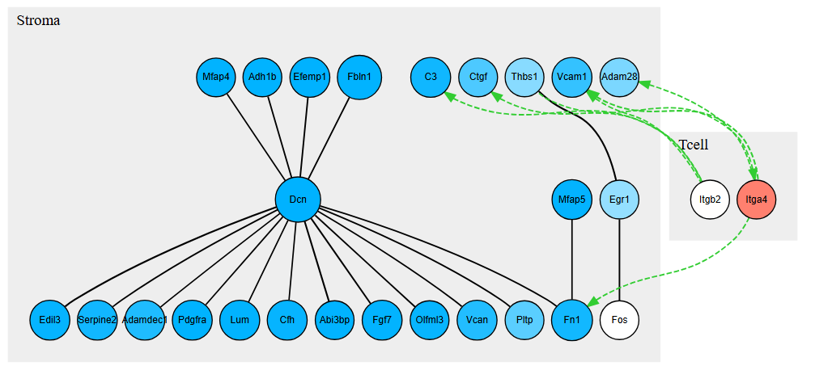
Cell-Cell interaction (CytoTalk)
What is the downstream of interaction?
-Cell-cell interaction: intercellular interaction
-Intra-cellular network: mutual information
(co-occurrence of gene expression across cells)
-Network propagation algorithm
→ Remain only the significant edges

Slide 26
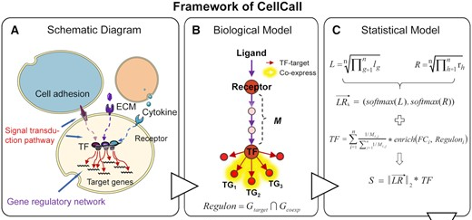
Cell-Cell interaction (CellCall)
LR: conceptually mean expression
Only looking at the gene expression from the ligand-receptor is not enough
It should show some perturbation of target genes due to cell-cell interaction!
Interaction score = LR * TF_{k}
TF_{k}: regulon activity of TF
-LR → TF: KEGG, etc
-TF → regulon: known DB (TRRUST …) & coexpressed with TF
-TF_{k}: GSEA for those regulon
-Multiple TF_{k} : weight sum (number of node; LR → TF)

Slide 27
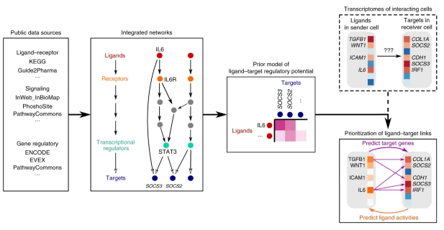
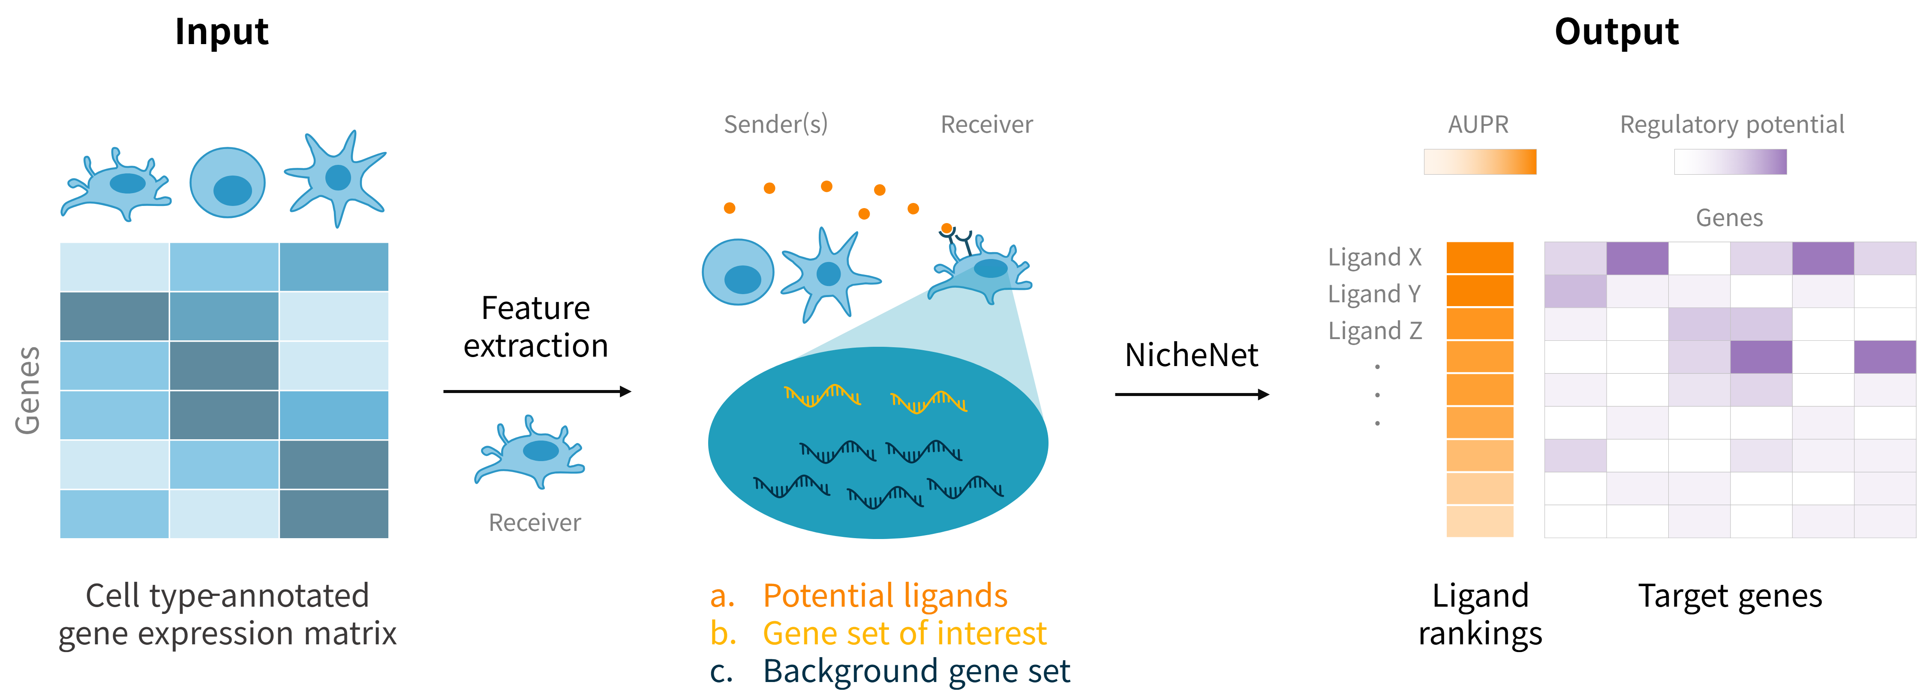
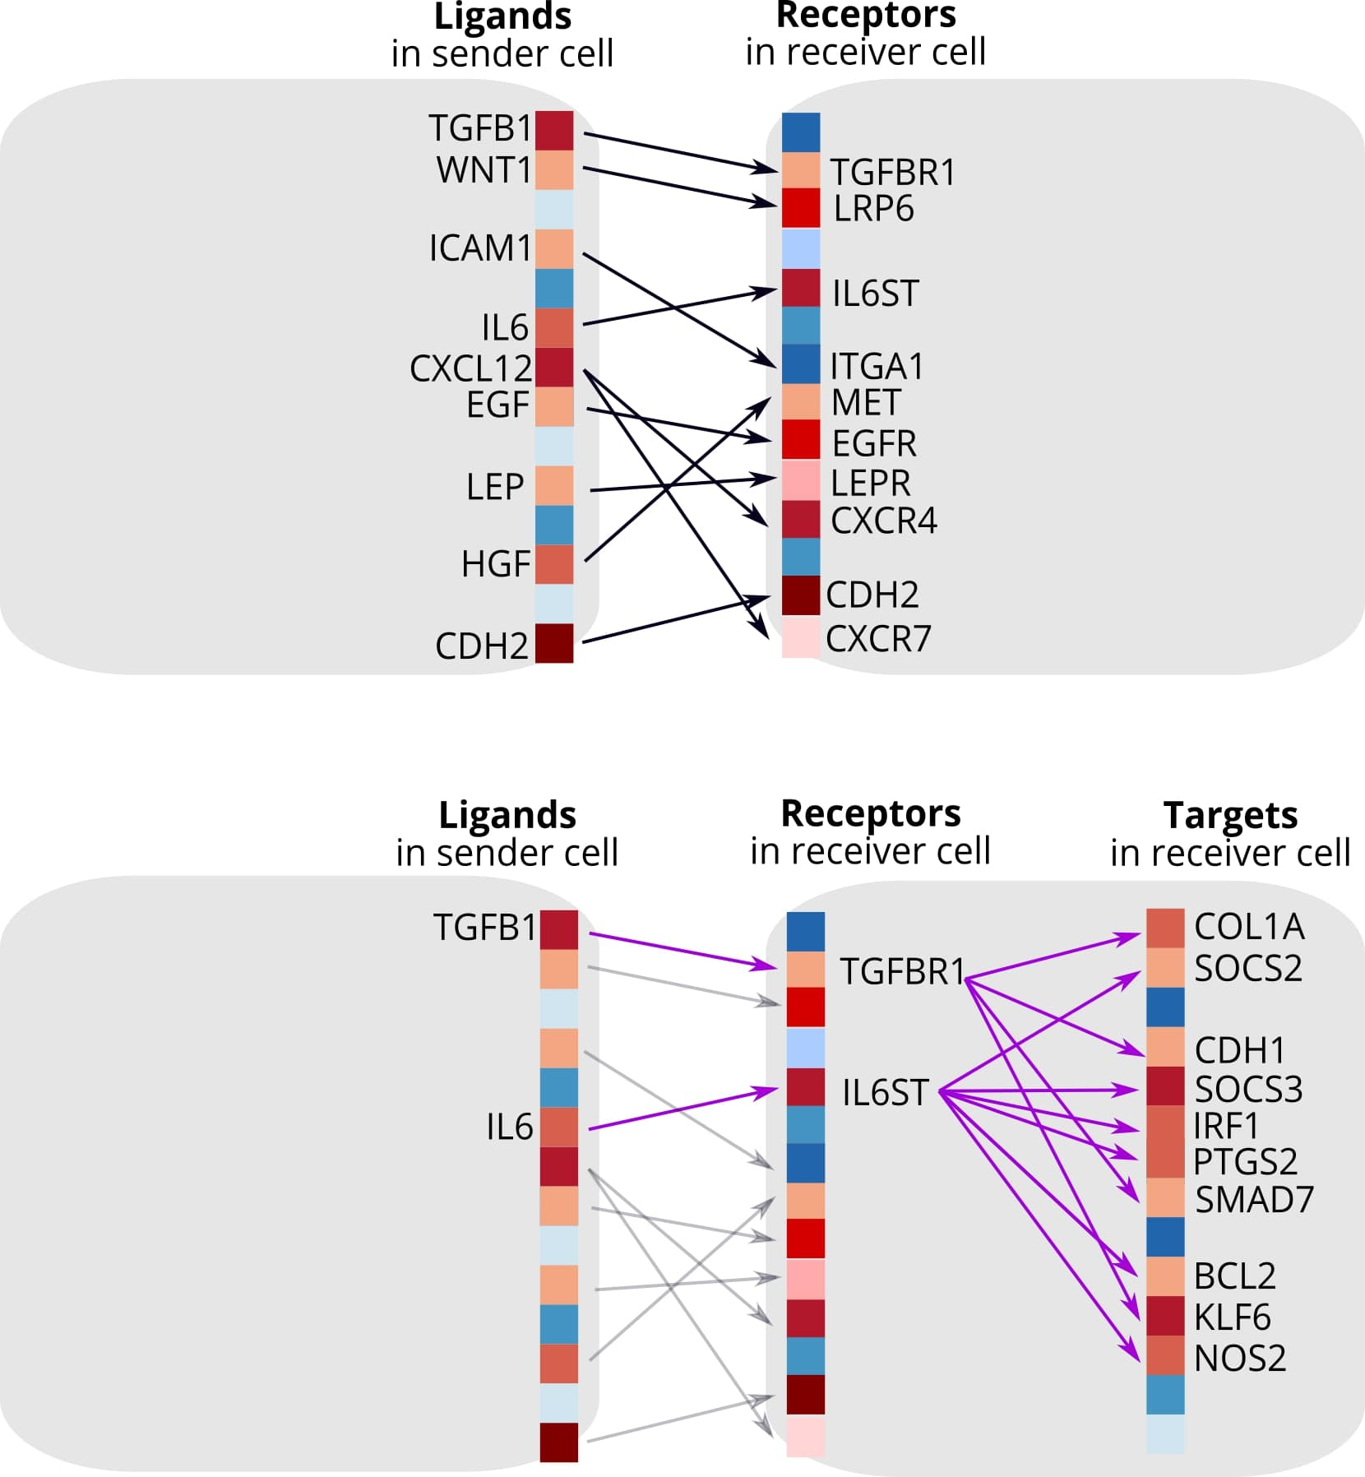
Cell-Cell interaction (NicheNet)
Typical CCC
-Merge each path from DB: weighted network (prior model)
Ligand – receptor – TF – target genes
-ligand ~ potential target genes vs bg genes
-ligand ranking: ligand [exp] ~ predefined targets [gene exp]
(how much ligand expression can differentially express target genes)
-target genes are selected by a predefined ligand-target link
NicheNet

Slide 28
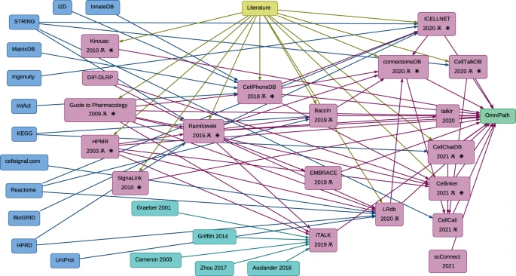
Cell-Cell interaction comparison
-Heterogeneous DB
*KEGG, Reactome, STRING
*Published literature

Slide 29
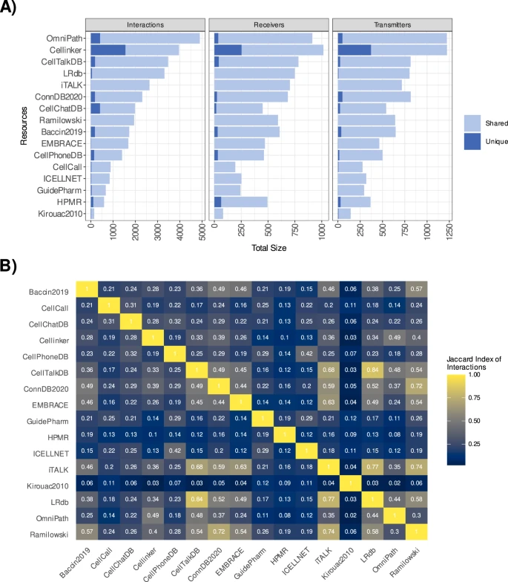
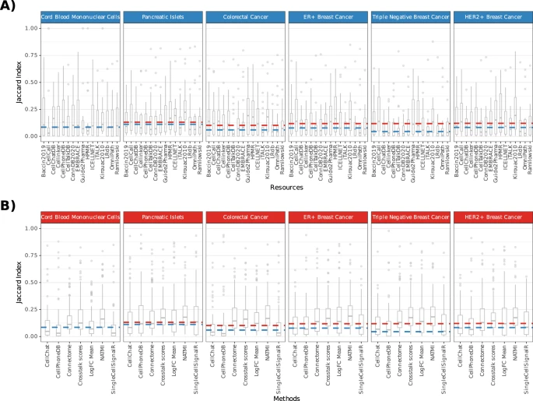
Cell-Cell interaction comparison
-Different CCC methods are too different
Low Jaccard index (low overlap)
-across DB
-across method

Slide 30
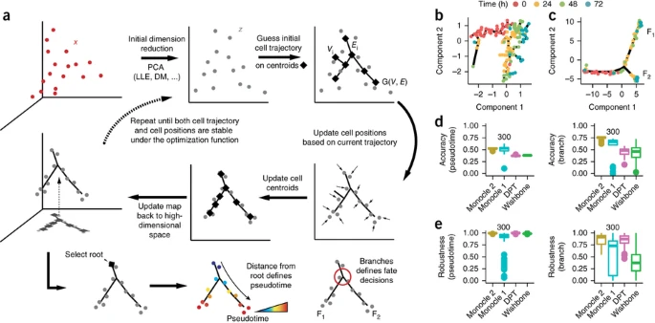
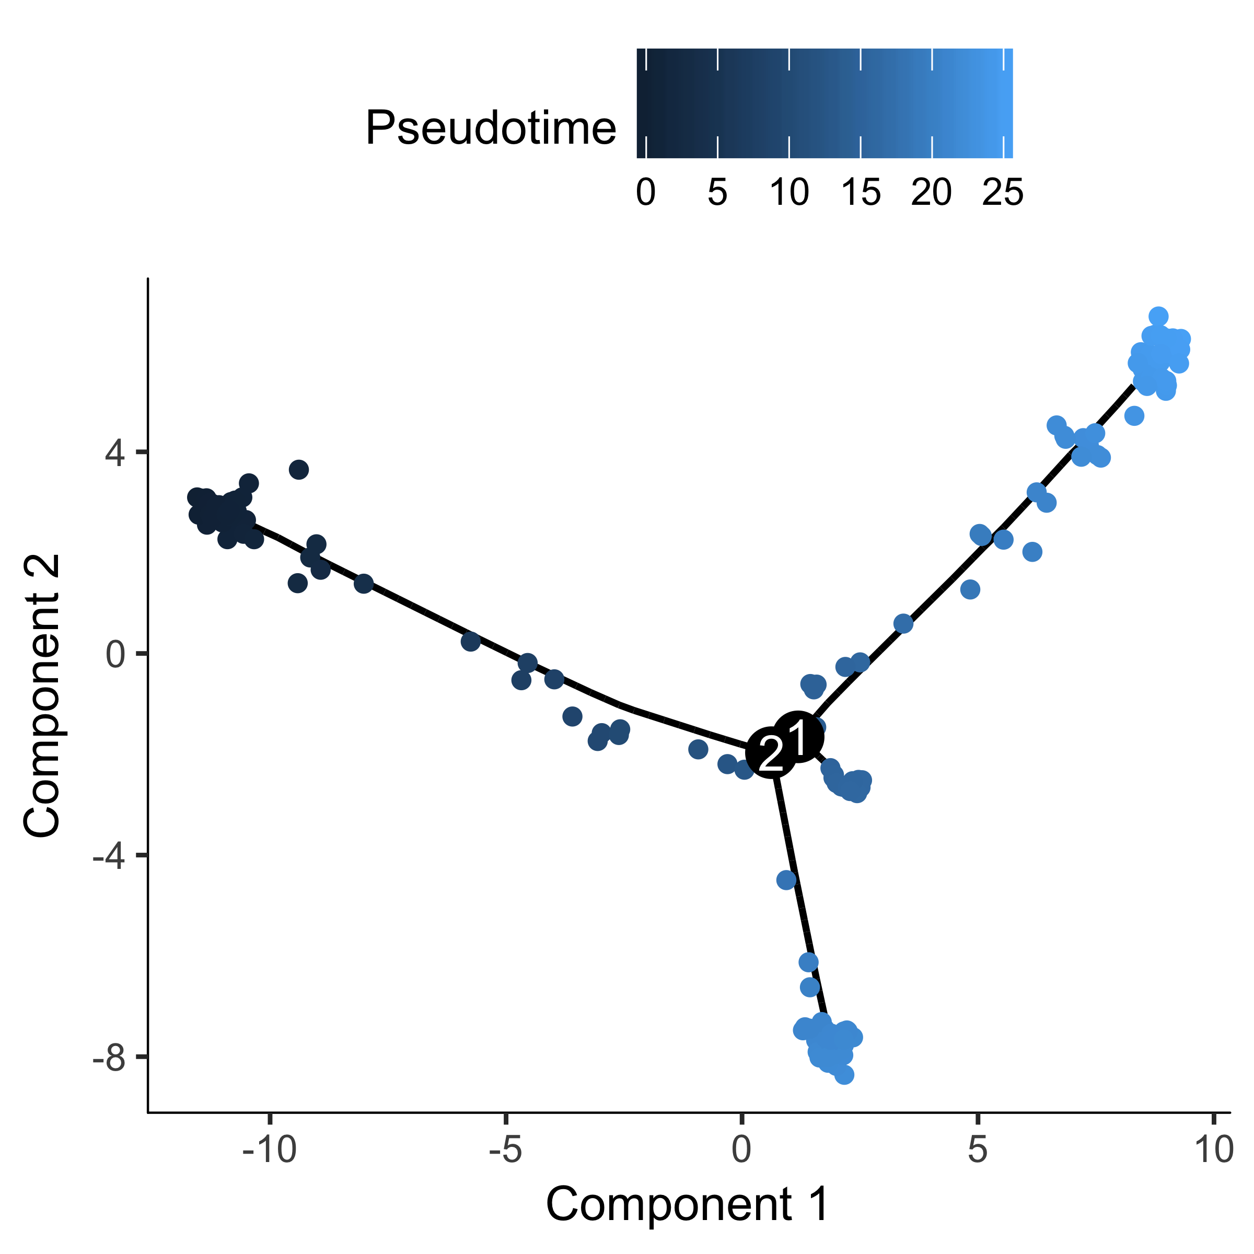
Pseudotime analysis (Monocle2)
Aligning cells into a virtual embedding
-Dimension reduction → initial centroid (k-mean)
→ update cell position
High dimension → re-do until convergence
Conceptually: clustering + network construction
Gene: DEG (across differentiation), HVG …
*Require root cell or cluster

Slide 31
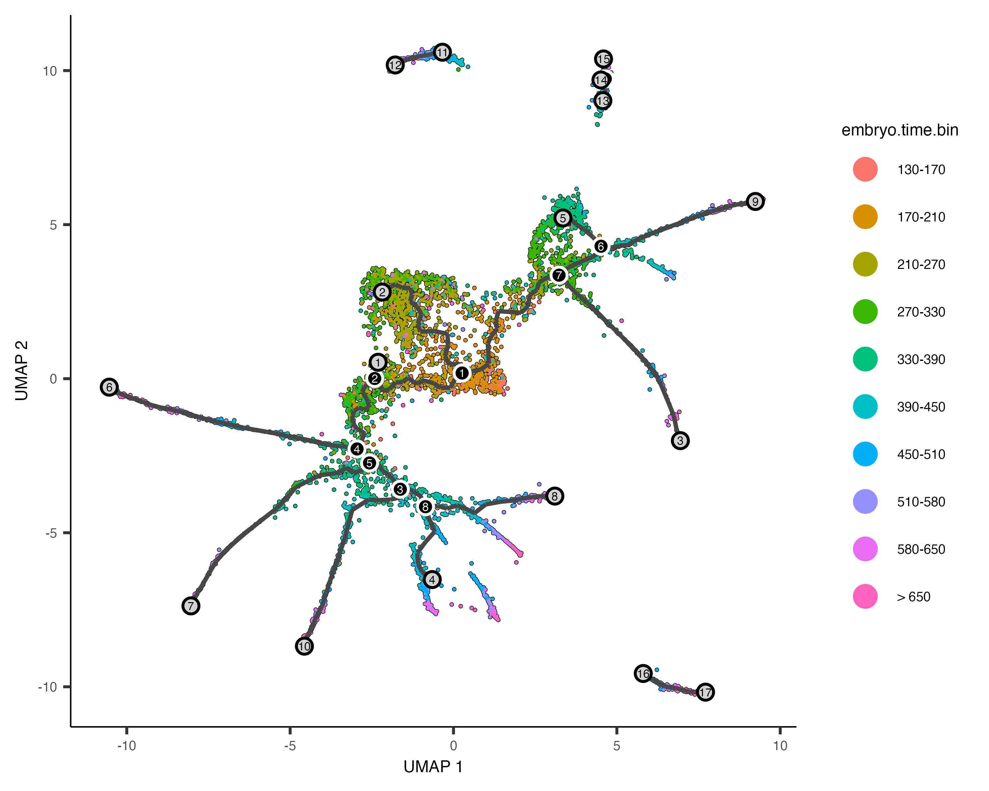
Pseudotime analysis (Monocle3)
Adapt dimension reduction space into a familiar UMAP projection

Slide 32
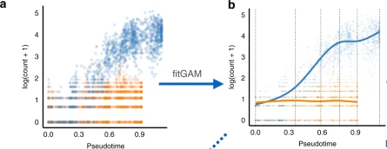
TradeSeq
What kind of genes are associated with a given trajectory
-Pseudotime ~ Gene expression (correlation) → likely to be poor
-Negative binomial generalized additive model (nonlinear approach)
but, super slow …
Maybe, binning??

Slide 33



Velocyto, scVelo
Assumption: during the differentiation, progenitor may have more unspliced RNA while differentiated cell may have fully spliced form
-Compare between unspliced/spliced ratio! (RNA velocity) for each gene
-Merge all the velocities (from all the gene) → project on the user embedding space (UMAP)
-Sum of transition P = 1 for each cell
spliced
unspliced
*RNA velocity: steady-state approximation
spliced RNA deg speed = splicing rate * unspliced RNA
- Spliced RNA * degradation rate = 0
*scVelo: those parameters change across time and cell states

Slide 34


PAGA (Representation)
-Abstraction of trajectory (scvelo) result
Using graph-based cell-cell similarity (→ connectivity calculated by trajectory)
-PAGA transition confidence score: actual / random expected model
The confidence should be interpreted as the ratio of the actual versus the expected value of connections under the null model of randomly connecting partitions.

Slide 36
ImmuneDictionary

