Slide 1
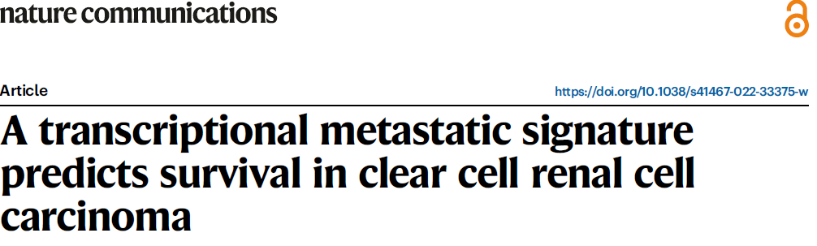
ccRCC 3, normal 3

Slide 2
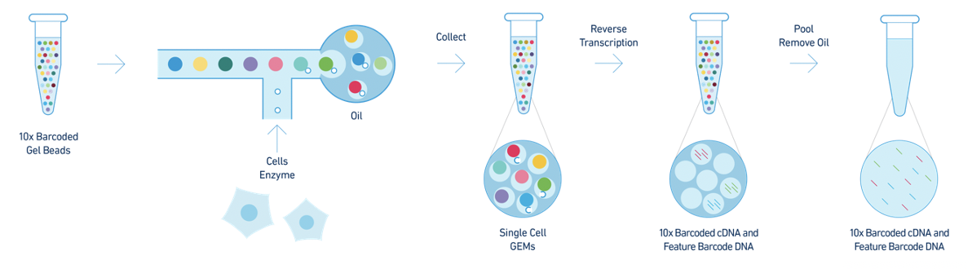
10x genomics

Slide 3
Goal: To learn how to pre-process and analyze single-cell RNA sequencing data with real data
Content
Data importing
Quality control
Normalization & Scaling
Feature selection
Dimension reduction (PCA & UMAP)
Batch correction (Harmony)
Clustering
Celltype annotation
DEG between groups
Signature analysis

Slide 4

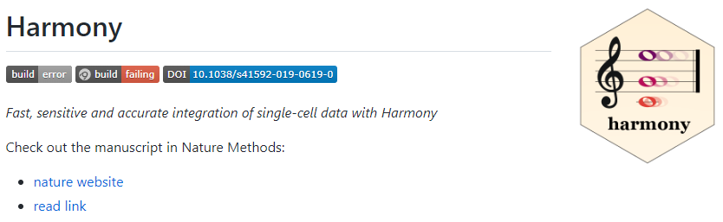
Let’s start!
Requirement
R
install.packages('Seurat’)
# https://satijalab.org/seurat/
install.packages("harmony")
# https://github.com/immunogenomics/harmony
library(Seurat)
library(harmony)

Slide 5
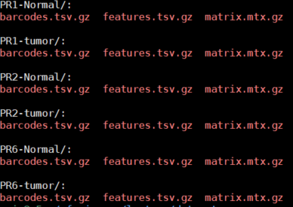
1) Data importing
Why? We should make the object into analyzable format
min.cells: how many cells are expressing that gene
min.features: how many genes are expressed in single-cell (too low → it won’t be a cell; empty droplet)
Script
data <- Read10X(data.dir = "/your_data_folder/") #PR1-Normal
ccrcc <- CreateSeuratObject(counts = data, min.cells = 0, min.features = 0)
ccrcc$sample <- "PR1-Normal"
ccrcc$group <- "normal"
Metadata

Slide 6
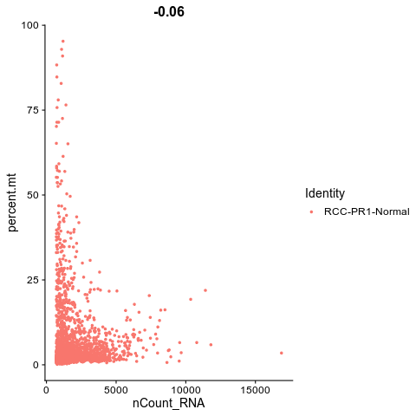
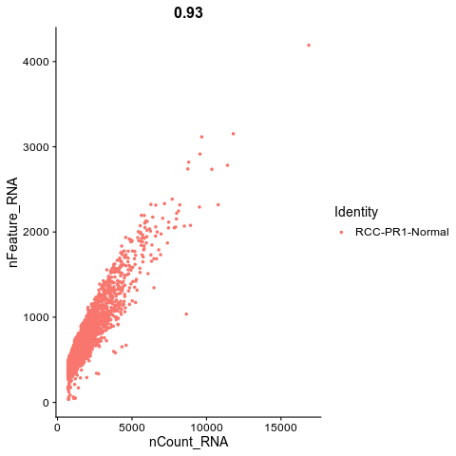
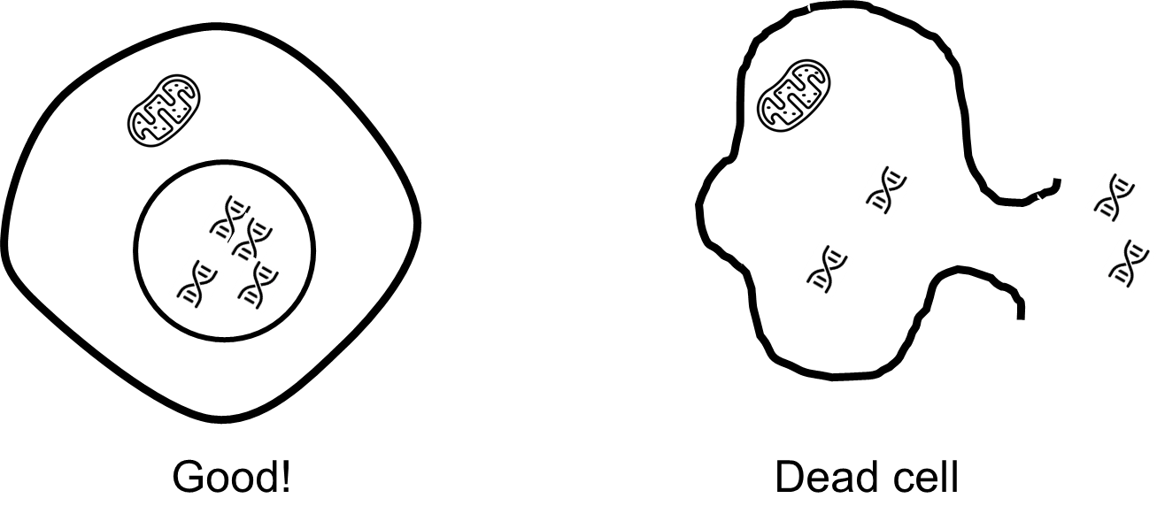
2) Quality control
Why? There might be some bad cells collected
(reason: cell stress during processing, high drop-out)
Low nCount or nFeature → empty droplet
High nCount or nFeature → doublet
High MT % → dead cell
Script
ccrcc[["percent.mt"]] <- PercentageFeatureSet(ccrcc, pattern = "^MT-")
FeatureScatter(ccrcc, feature1 = "nCount_RNA", feature2 = "percent.mt")
FeatureScatter(ccrcc, feature1 = "nCount_RNA", feature2 = "nFeature_RNA")
ccrcc <- subset(ccrcc, subset = percent.mt < 12.5 & nFeature_RNA < 2500 & nFeature_RNA > 200)

Slide 7
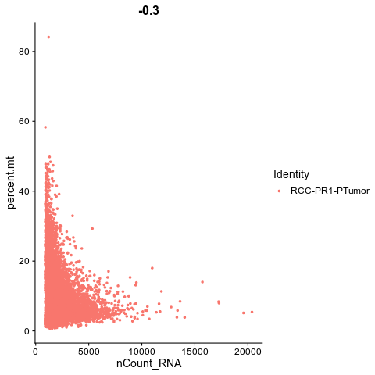
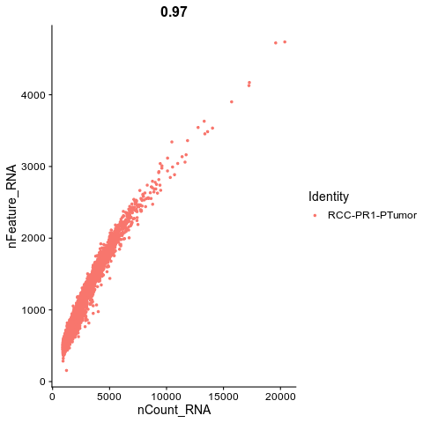
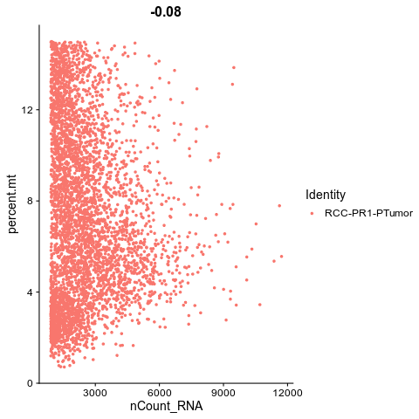
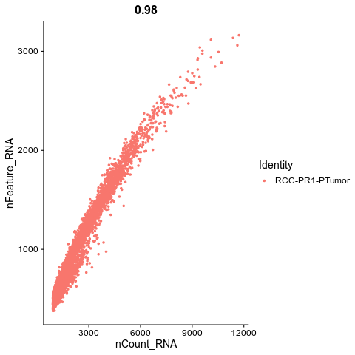
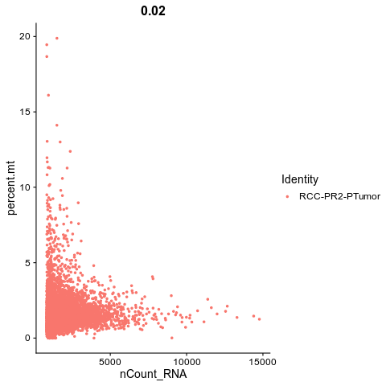
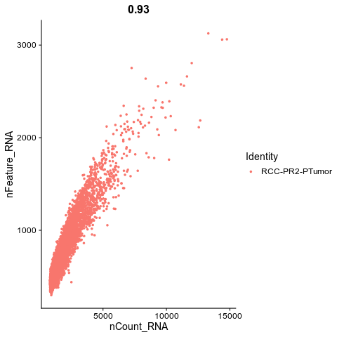
PR1-Normal (12.5, 2500)
PR1-tumor (15, 3200)
PR2-Normal (-)
PR2-tumor (5, 2000)

Slide 8

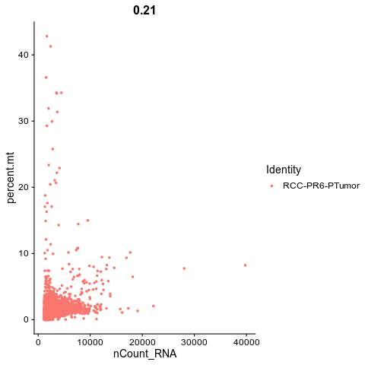
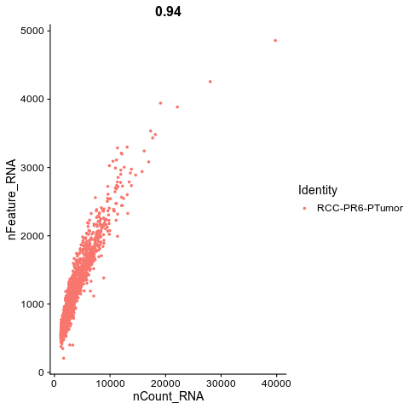
PR6-Normal (-)
PR6-tumor (5, 3000)

Slide 9
3) Normalization & Scaling
Why?
Total read count normalization: Adjust read-depth between each cell
Log-transformation: adjust the variance of the gene expression matrix
Scaling: gives equal weight in downstream analyses, so that highly-expressed genes do not dominate
Script
ccrcc <- NormalizeData(ccrcc, normalization.method = "LogNormalize", scale.factor = 10000)
ccrcc <- ScaleData(ccrcc)

Slide 10

4) Feature selection
Why? scRNA-seq tends to have a lot of drop-out
→ Not all the gene is informative → select informative genes and reduce noise
Script
ccrcc <- FindVariableFeatures(ccrcc, selection.method = "vst", nfeatures = 2000)
variable_list <- VariableFeatures(ccrcc)

Slide 11
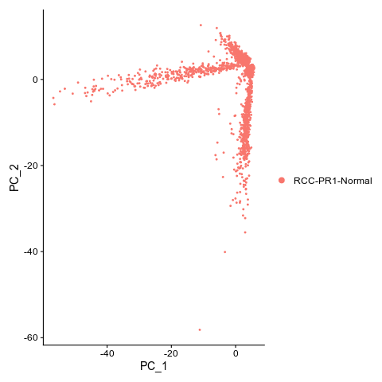
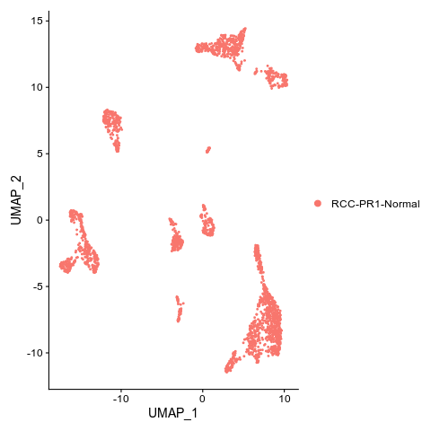
5) Dimension reduction (PCA & UMAP)
Why? Too many features (genes) → hard to interpret
Dimension reduction: abstract of many features!
PCA: commonly used in bulk RNA-seq data → insufficient for scRNA-seq
UMAP: adjusted for scRNA-seq (similar cells to be close and different cells to be far away)
dims: how many axis of PCs to use
Script
ccrcc <- RunPCA(ccrcc, npcs = 50)
ccrcc <- RunUMAP(ccrcc, dims = 1:30)
DimPlot(ccrcc)

Slide 12
6) Batch correction (Harmony)
Script
total<-merge(ccrcc1,y= c(ccrcc2,ccrcc3,ccrcc4,ccrcc5,ccrcc6))
total<-NormalizeData(total)
total<- ScaleData(total)
total<- FindVariableFeatures(total, selection.method = "vst", nfeatures = 2000)
total<- RunPCA(ccrcc1, npcs = 50)
total <- RunUMAP(ccrcc1, dims = 1:30)
DimPlot(total, group.by = "sample")
total <-RunHarmony(total, c(“sample"), dims.use = 1:30, plot_convergence=F)
total <- RunUMAP(total, reduction= "harmony", dims = 1:30)
DimPlot(total, group.by = "sample")

Slide 13
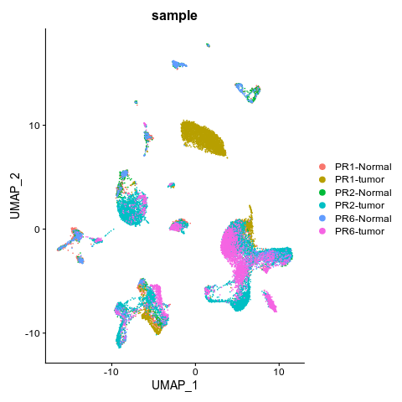
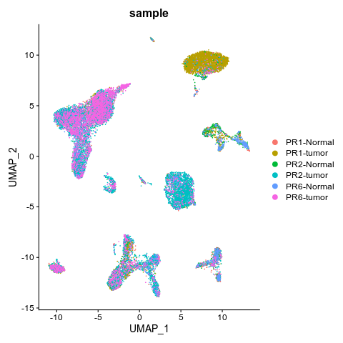
6) Batch correction (Harmony)
Why? To remove technical variation between samples

Slide 14
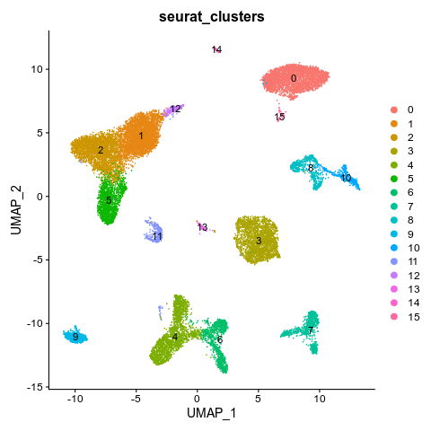
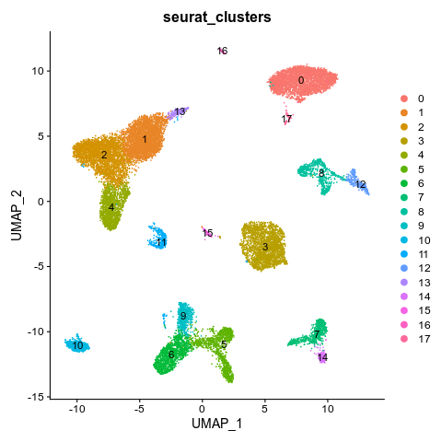
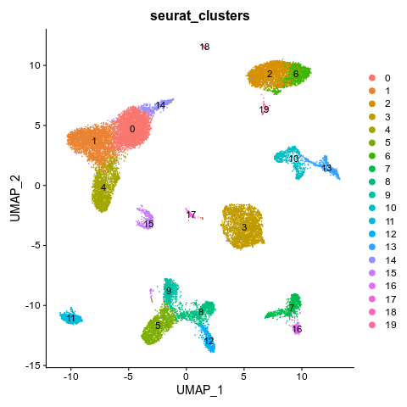
7) Clustering
Resolution → controls the number of clusters
Res: 0.3
Res: 0.5
Res: 1
Script
total <- FindNeighbors(total, reduction = "harmony", dims = 1:30)
total <- FindClusters(total, resolution = 0.3)
DimPlot(total, group.by = "seurat_clusters", label = T)

Slide 15
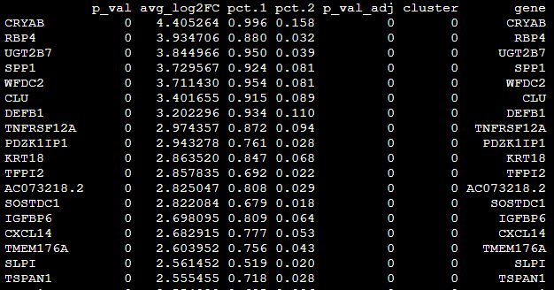
8) Celltype annotation
How? Distribution of marker gene expression
* Immune cell
Tcell: "CD3D", "CD3E"
CD4 T cell: "CD4"
CD8 T cell: "CD8A", "CD8B"
Treg: "FOXP3", "IL2RA"
NK cell: "KLRB1", "GNLY", "KLRD1", "NKG7"
B cell: "MS4A1", "CD79B"
Macrophage: "C1QA", "C1QB", "CD14", "CD68"
Monocyte: "FCN1","S100A8", "S100A9"
Mast: "TPSAB1", "CPA3“
Cycling: "MKI67", "TOP2A“
* Non-immune cell
Pericyte: "CSPG4", "MCAM", "MYH11"
Endothelial cell: "RAMP2", "RNASE1", "ENG", "EGFL7"
Cancer: "PAX8"
Epithelial cell: "SLC26A7", "EPCAM", "MUC1"

Slide 16
8) Celltype annotation
Script
marker <- FindAllMarkers(total, only.pos = TRUE, min.pct = 0.25, logfc.threshold = 0.25)
#tcell NK
png("tcell.png", width = 1600, height = 1200)
FeaturePlot(total, features = c("CD3D", "CD3E", "CD4", "CD8A", "CD8B", "FOXP3", "IL2RA", "KLRB1", "GNLY", "KLRD1", "NKG7"))
dev.off()
#bcell, macrophage, mast, #DC, monocyte
png("bcell_myeloid.png", width = 1600, height = 1200)
FeaturePlot(total, features = c("MS4A1", "CD79B", "C1QA", "C1QB", "CD14", "CD68", "TPSAB1", "CPA3", "FCN1","S100A8", "S100A9"))
dev.off()

Slide 17
8) Celltype annotation
#pericyte, endothelial cell
png("stroma.png", width = 1600, height = 1200)
FeaturePlot(total, features = c("CSPG4", "MCAM", "MYH11", "RAMP2", "RNASE1", "ENG", "EGFL7"))
dev.off()
#tumor, kidney epithelial cell, cycling
png("epi.png", width = 1600, height = 1200)
FeaturePlot(total, features = c("PAX8", "SLC26A7", "EPCAM", "MUC1", "MKI67", "TOP2A"))
dev.off()
###
total <- RenameIdents(total, '0' = 'tumor1', '1' = 'CD4_Tcell', '2' = 'CD8_Tcell','3' = 'pericyte','4' = 'macrophage','5' = 'NK','7' = 'endothelial','8' = 'tumor2','9' = 'Bcell','10' = 'tumor3', '6' = 'monocyte', '11' = 'cycling_Tcell', '12' = 'Treg', '13' = 'mast', '14' = 'unknown1', '15' = 'unknown2')
total$celltype <- total@active.ident
DimPlot(total, group.by = "celltype", label = T)

Slide 18
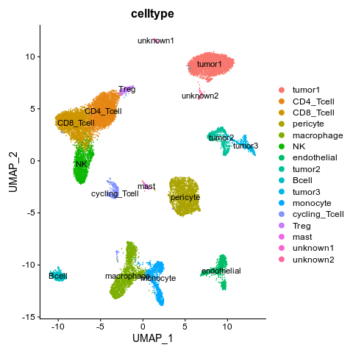
8) Celltype annotation

Slide 19
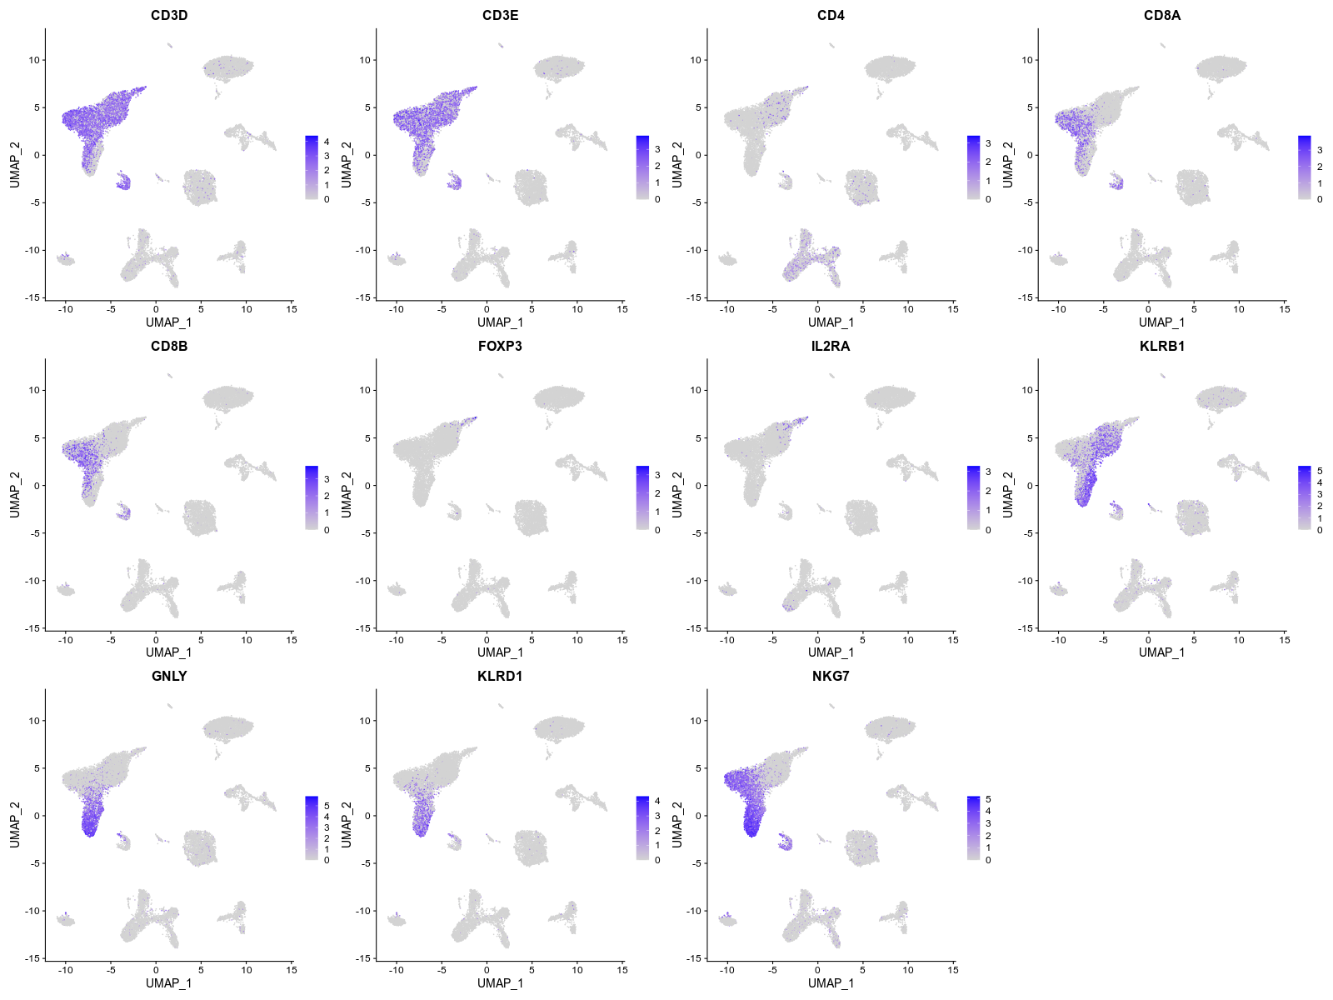
T cell and NK

Slide 20
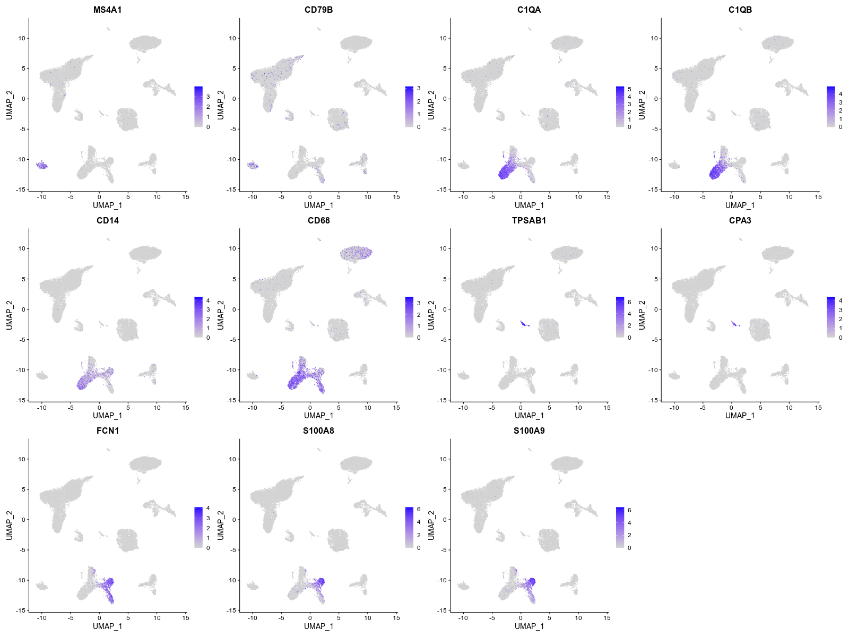
Bcell and myeloid

Slide 21
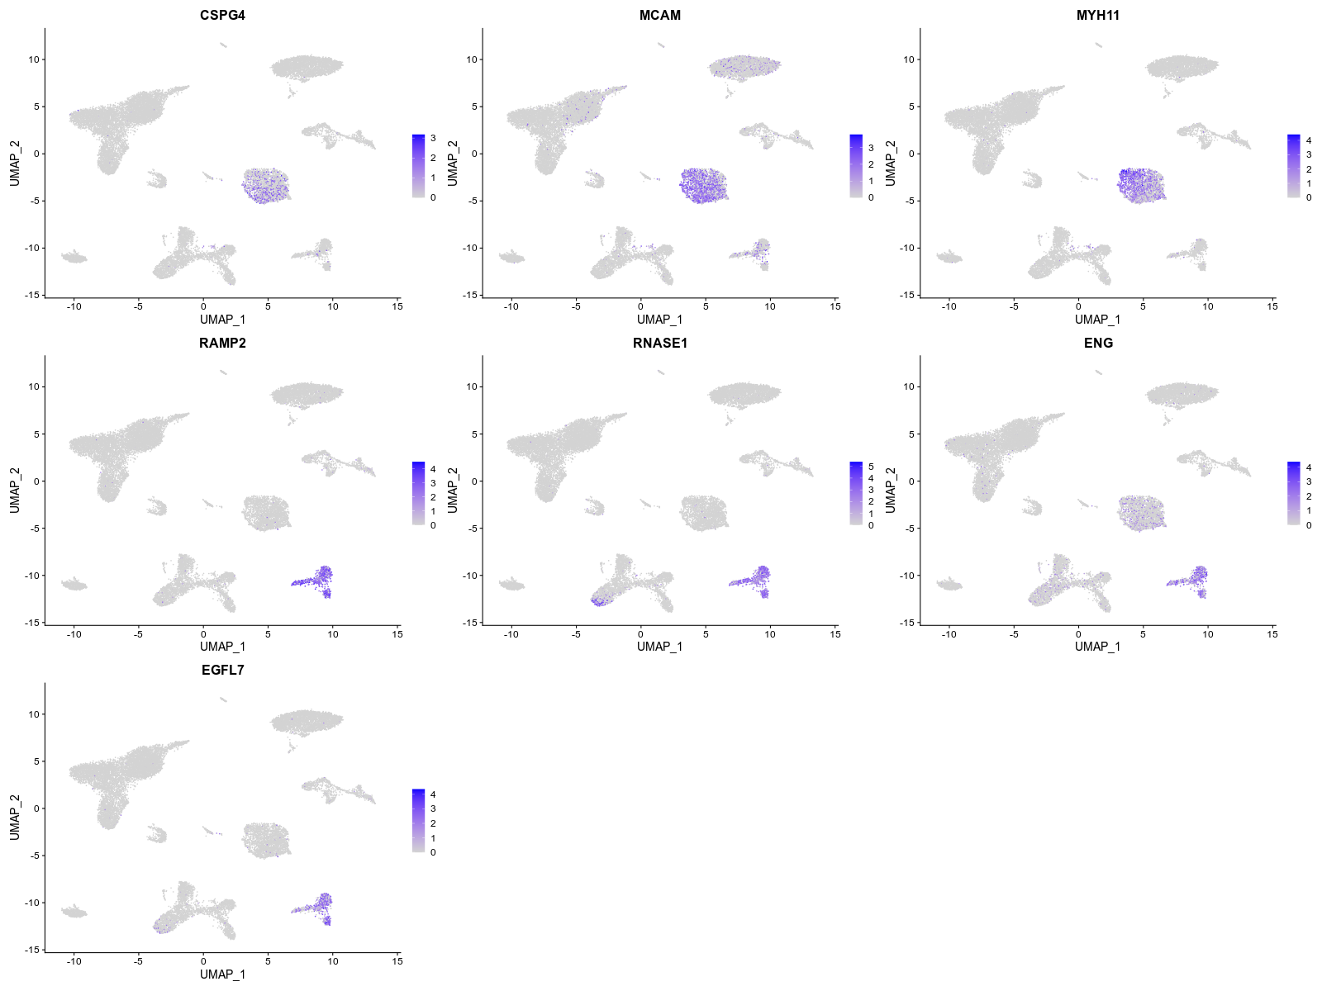
Stroma cell

Slide 22
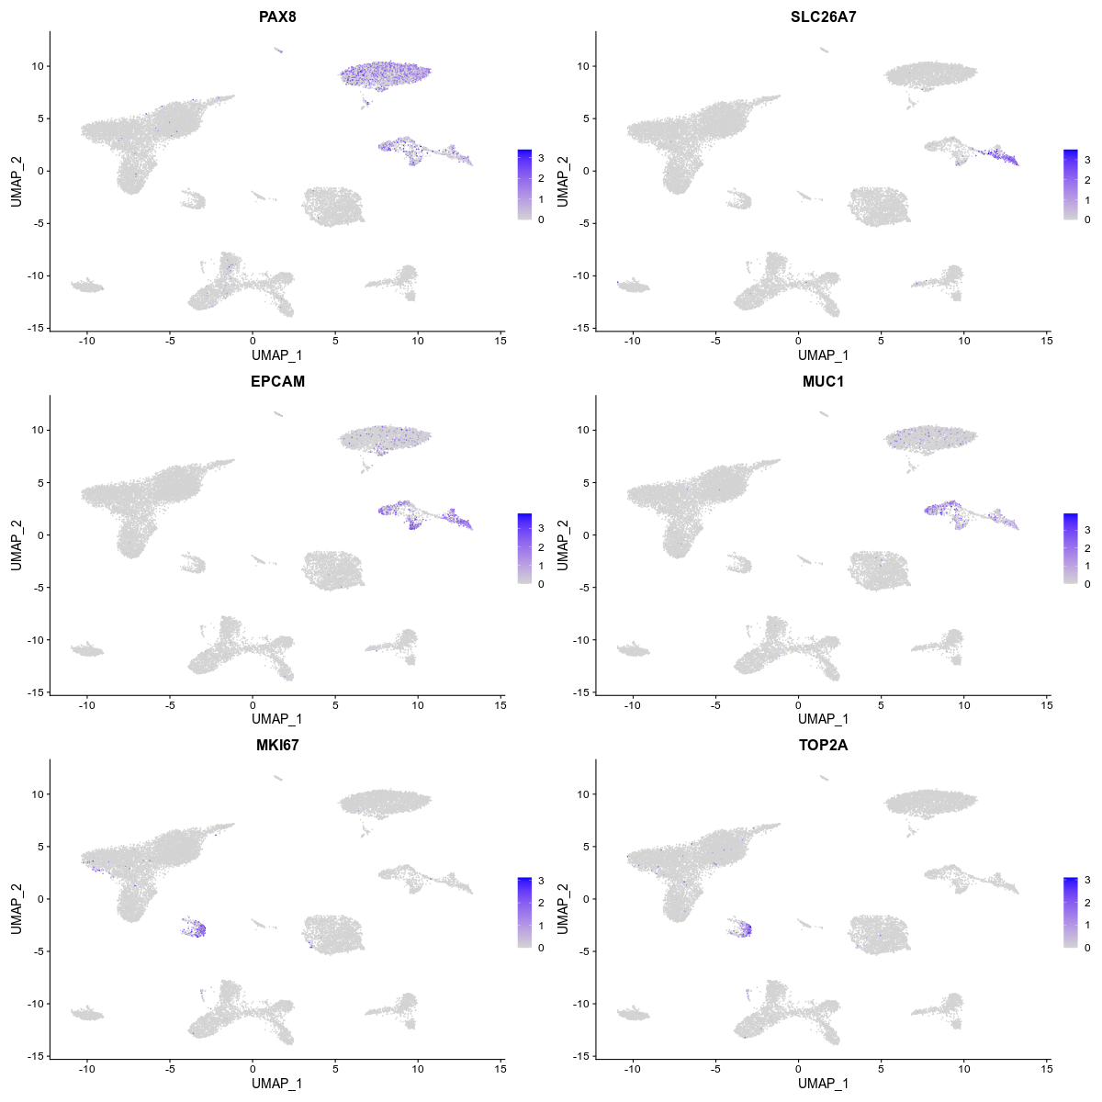
Epithelial and tumor

Slide 23
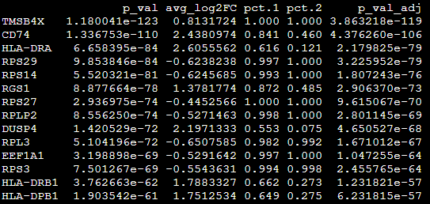
9) Differentially expressed gene analysis between two groups
GZMA: Tumor_CD8 T cell > Normal_CD8 T cell
Cytotoxic
HLA-DRA, HLA-DRB1, HLA-DPB1: Tumor_CD8 T cell > Normal_CD8 T cell
activated
Script
total$group_celltype <- paste(total$group, total$celltype, sep = "_")
total@active.ident<-as.factor(total$group_celltype)
cell1 <- "tumor_CD8_Tcell"
cell2 <- "normal_CD8_Tcell"
deg_cell <- FindMarkers(total, ident.1 = cell1, ident.2 = cell2, min.pct = 0.25, logfc.threshold = 0.25, only.pos = F)

Slide 24
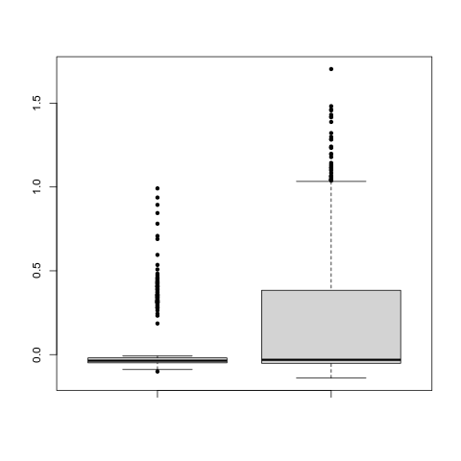
10) Signature analysis
Tumor infiltrating T cell → might be exhausted
Exhaustion signature: PDCD1, CTLA4, HAVCR2, LAG3, TOX
CD8 T cells
P value: 2.595e-05
→ T cells in the tumor-microenvironment are exhausted
Normal
Tumor

Slide 25
Script
p<-c("PDCD1", "CTLA4", "LAG3", "HAVCR2", "TOX")
total<-AddModuleScore(total, features= p)
p1<- (total$Cluster1 +total$Cluster2+total$Cluster3+total$Cluster4+total$Cluster5)/5
total$exh <- p1
z<-subset(total, subset = celltype == "CD8_Tcell")
z1<-z$exh[which(z$group=="normal")]
z2<-z$exh[which(z$group=="tumor")]
wilcox.test(z1,z2)
boxplot(z1,z2, pch = 20, names = c("normal", "tumor"))

