Slide 1
Measurement of electron number per pulse in UED set up
Jaewon Yun

Slide 2
Goal
Accurately measure the electron number per pulse.
3 methods:
Faraday cup
Sum pixel intensity from the CCD
Particle simulations

Slide 3
Why is it important to determine electron number per pulse?
1. More electrons will produce brighter diffraction image
2. It is convention to report the number of electrons for each diffraction images

Slide 4
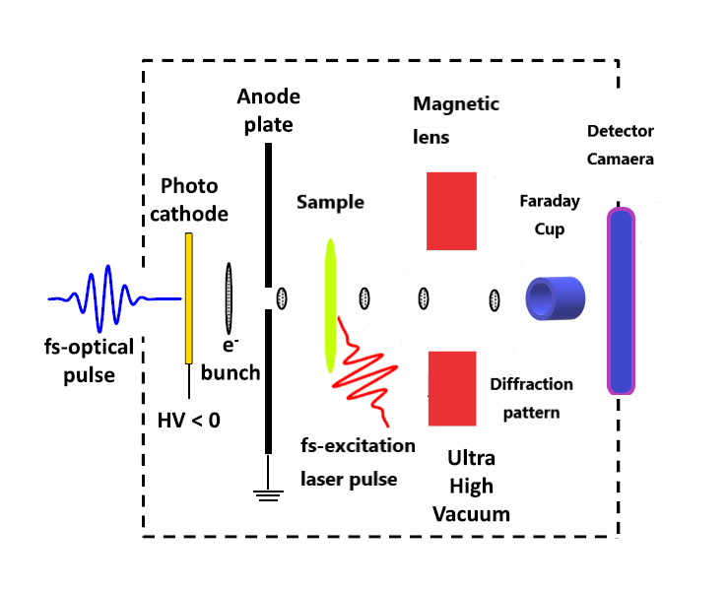

Ultrafast electron diffraction layout
Detector
CCD Camera

Slide 5
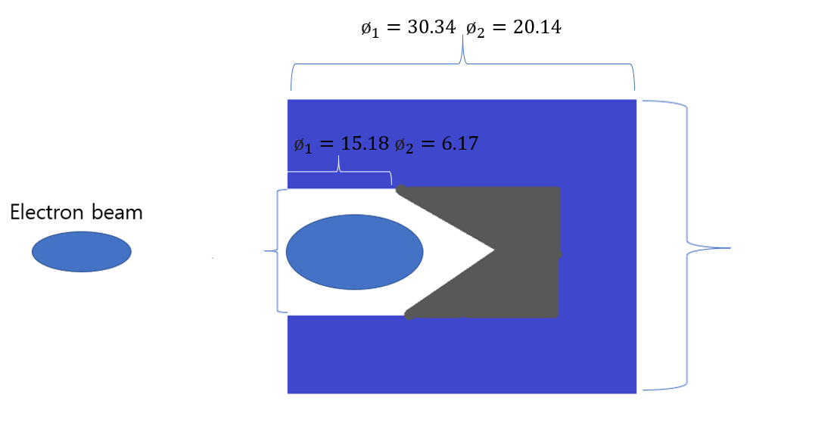


Faraday Cup
All units in mm
$ø_{1}=32.04$
$$ø_{2}=18.17$$
$ø_{1}=9.73$
$$ø_{2}=10.01$$

Slide 6
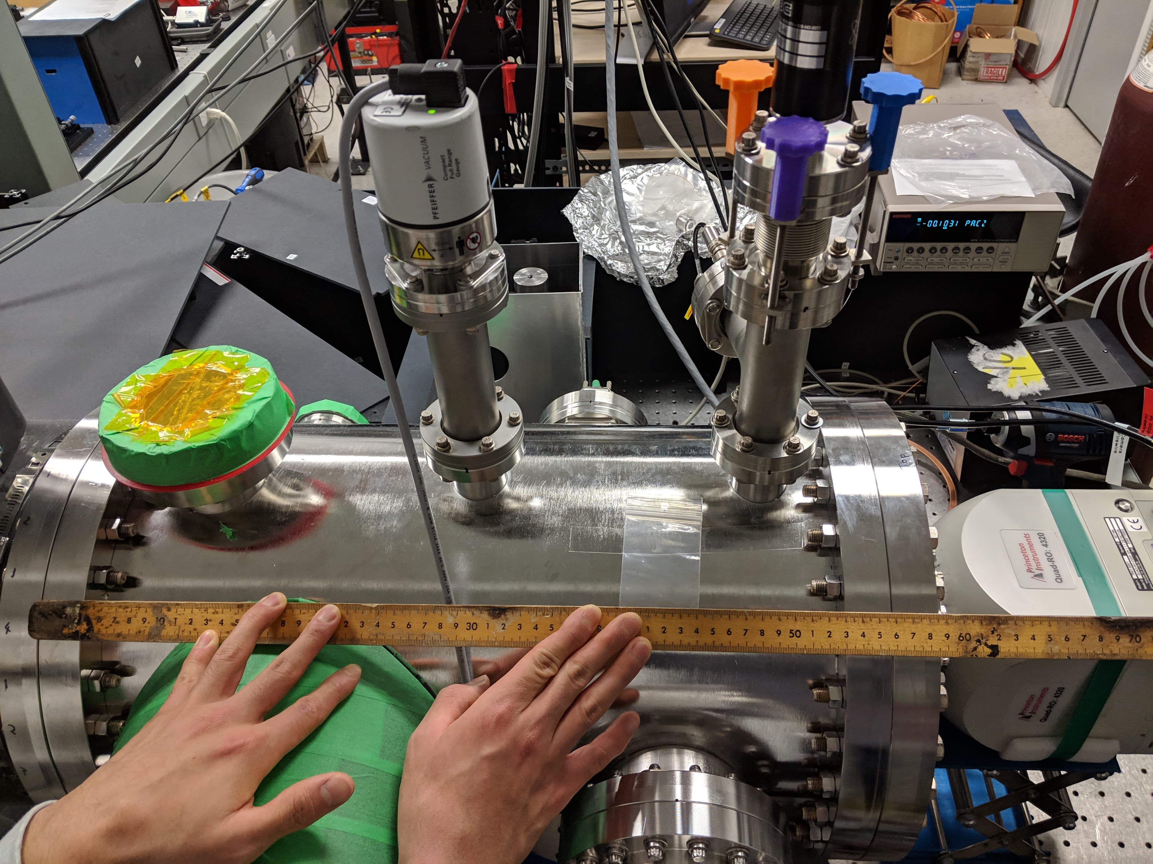
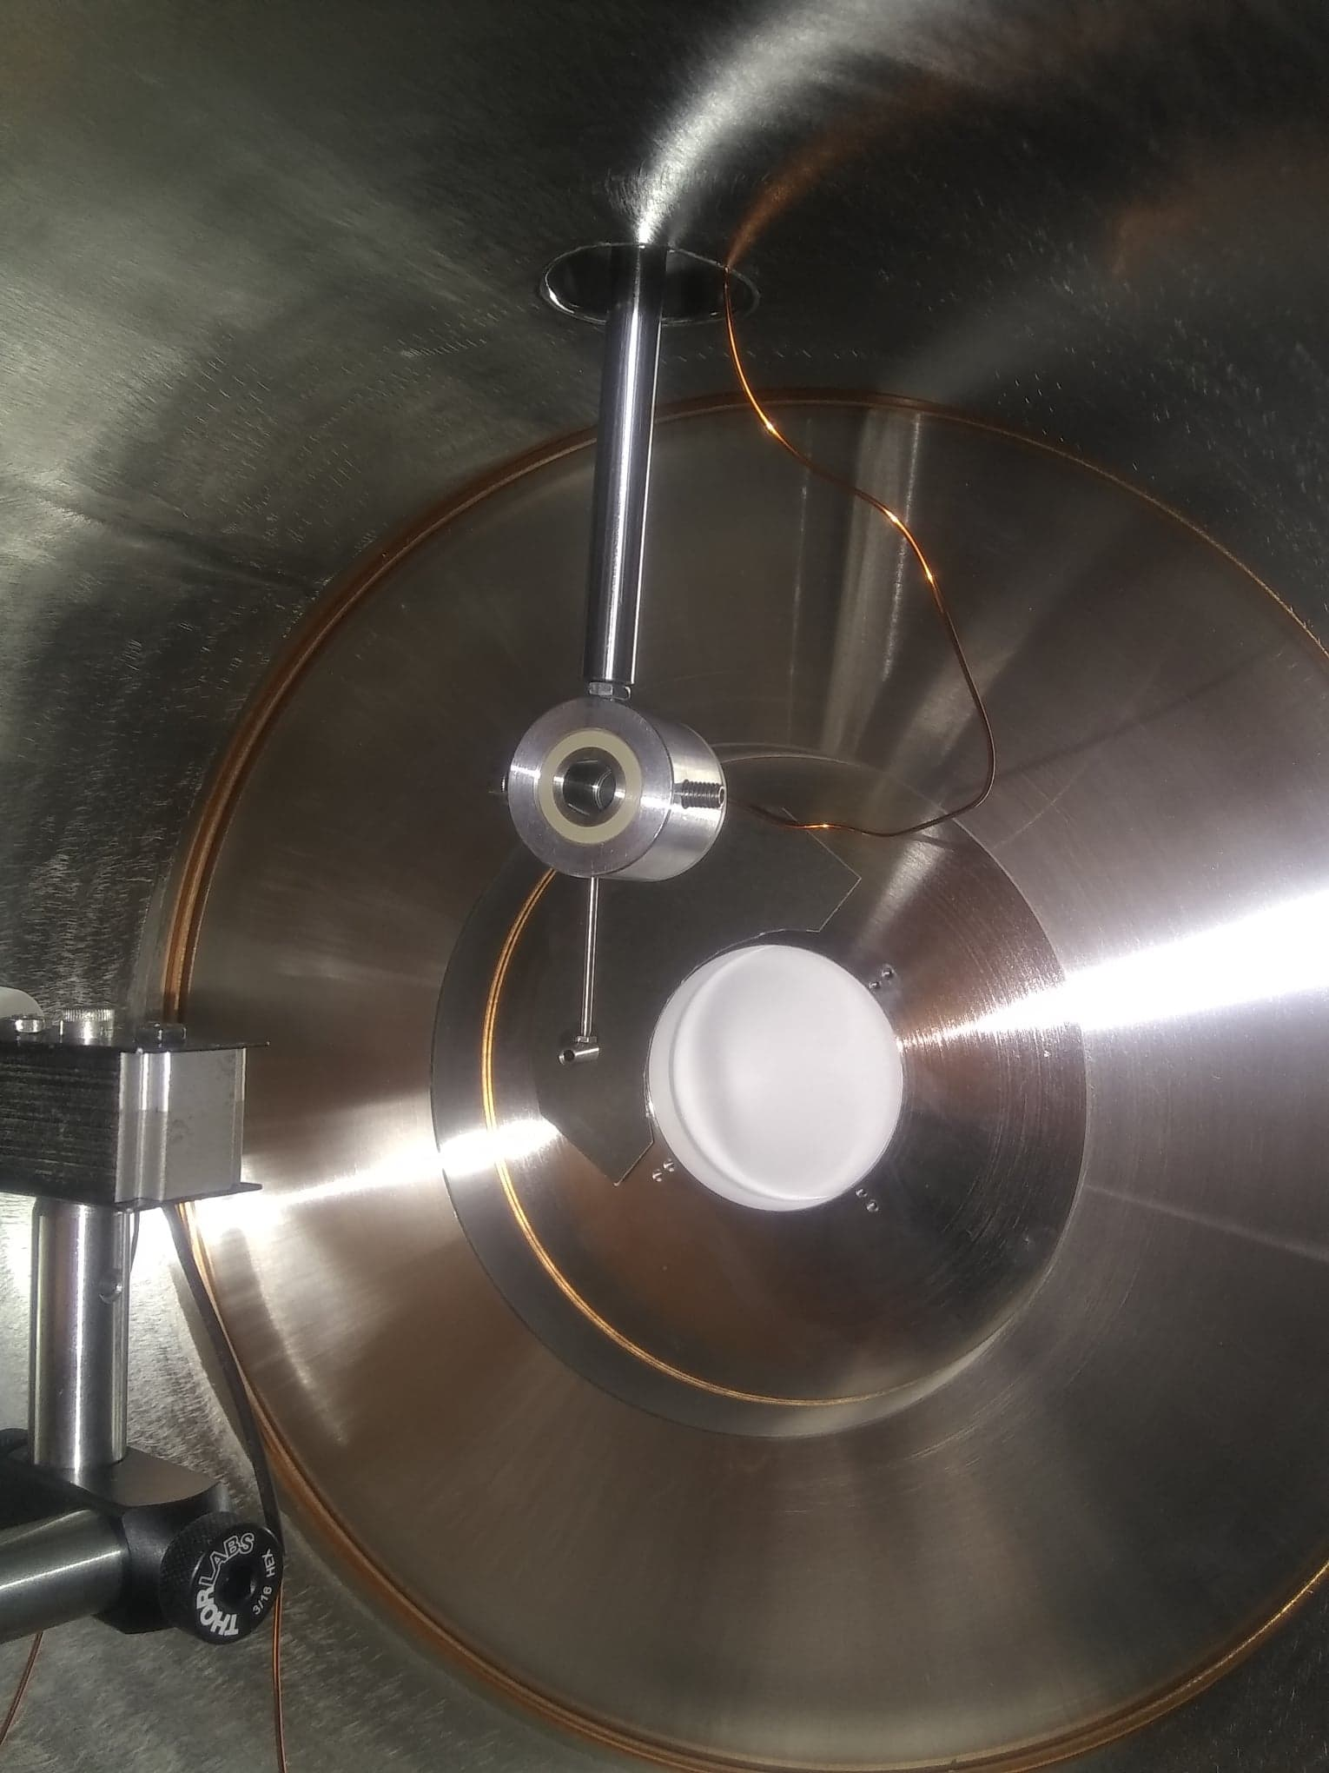
Picture of the Faraday Cup inside the vacuum chamber
Picture of the vacuum chamber

Slide 7
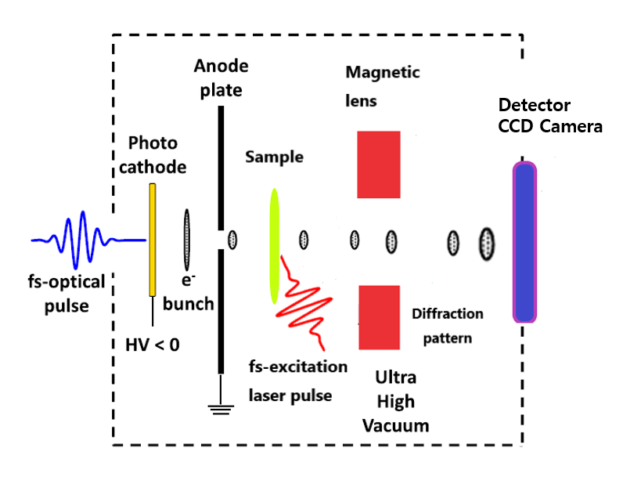
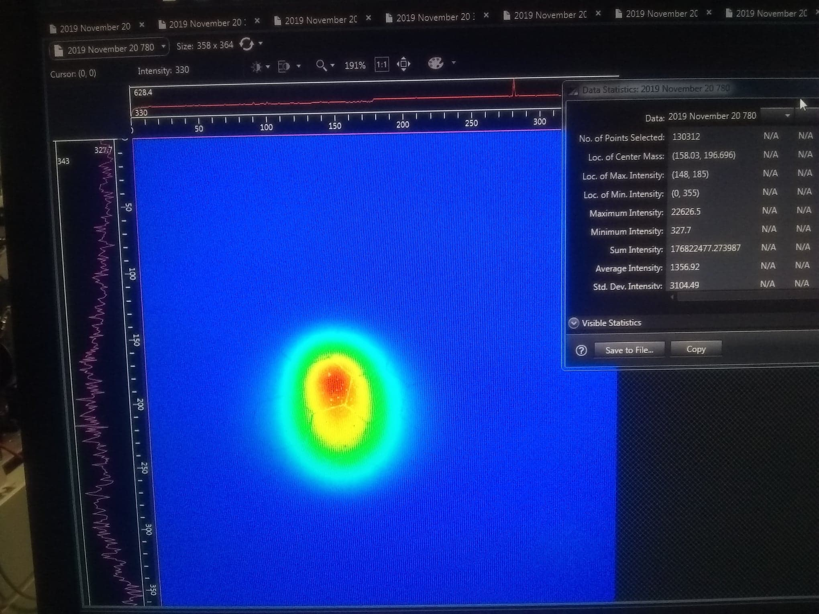
CCD Camera
Quad-RO_4320

Slide 8
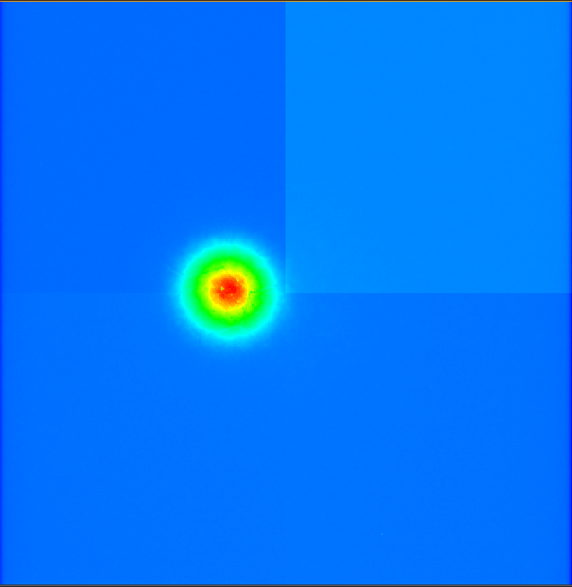
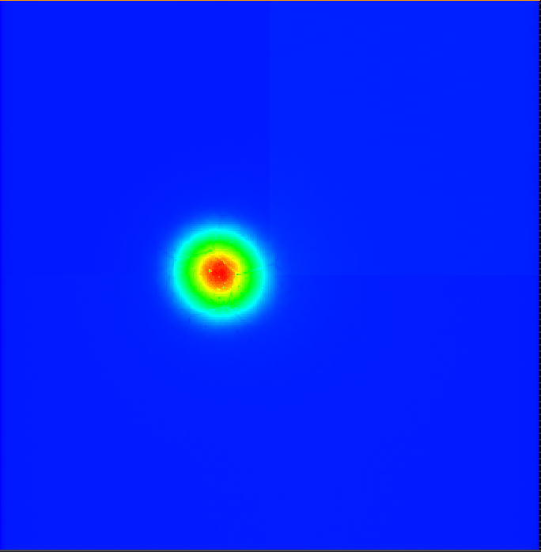
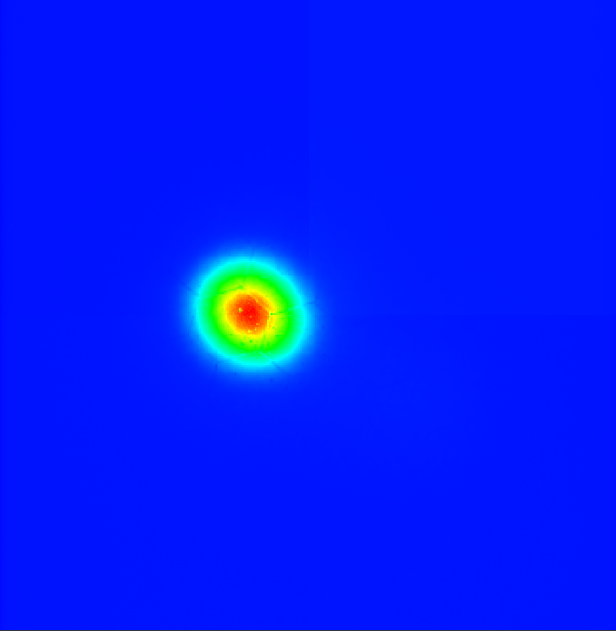
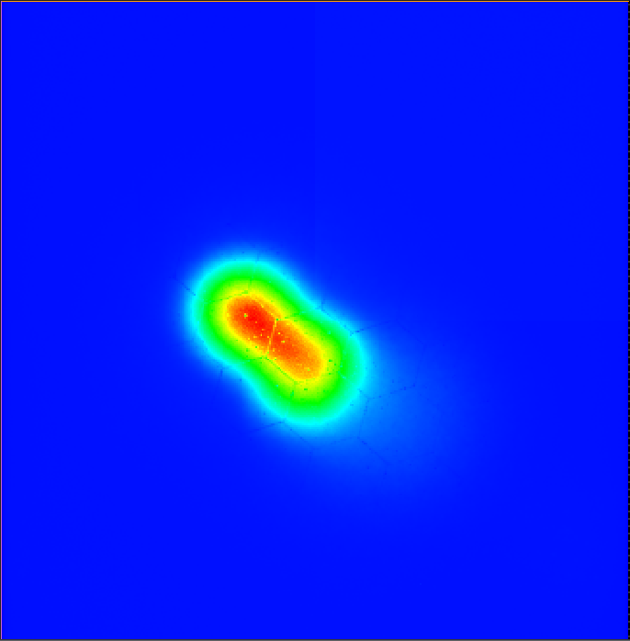
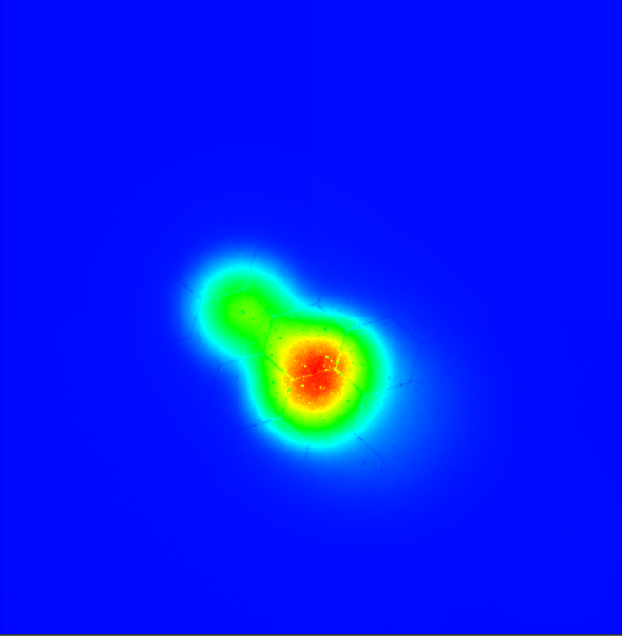
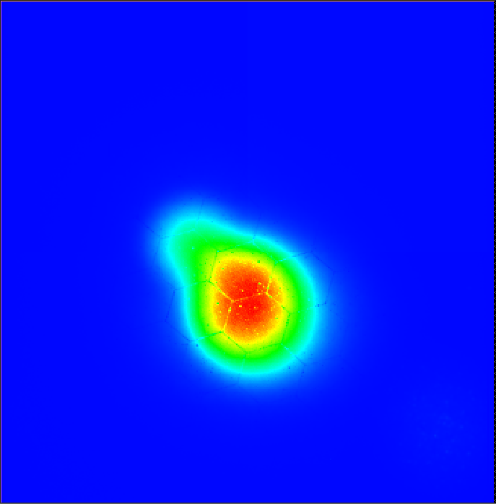
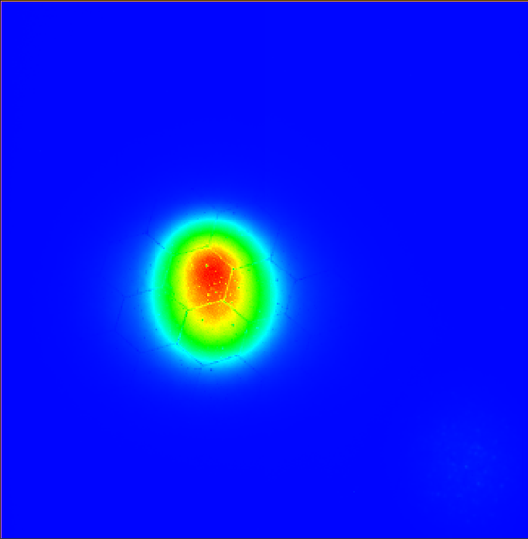
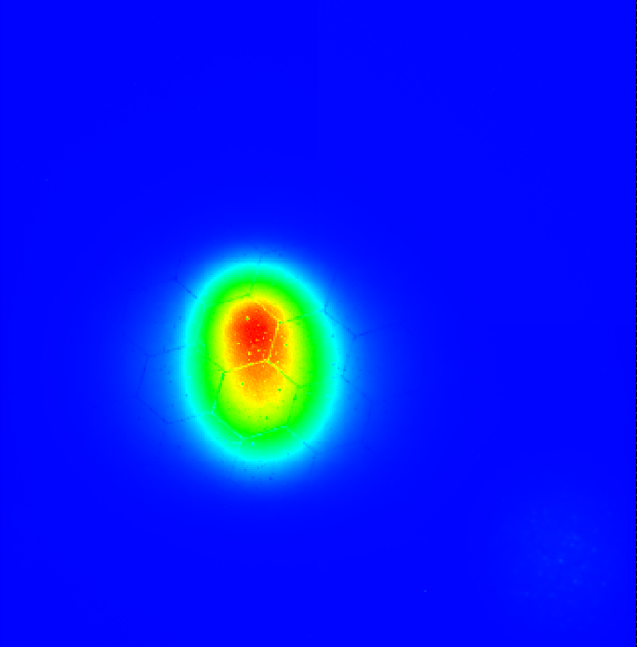
Picture of electron beams (110kV)
Camera Exposure time : 0.2 second
Each image is the average intensity profile of 10 frames
97.5 μW
190.5 μW
255 μW
349.5μW
448 μW
561 μW
656 μW
780 μW

Slide 9
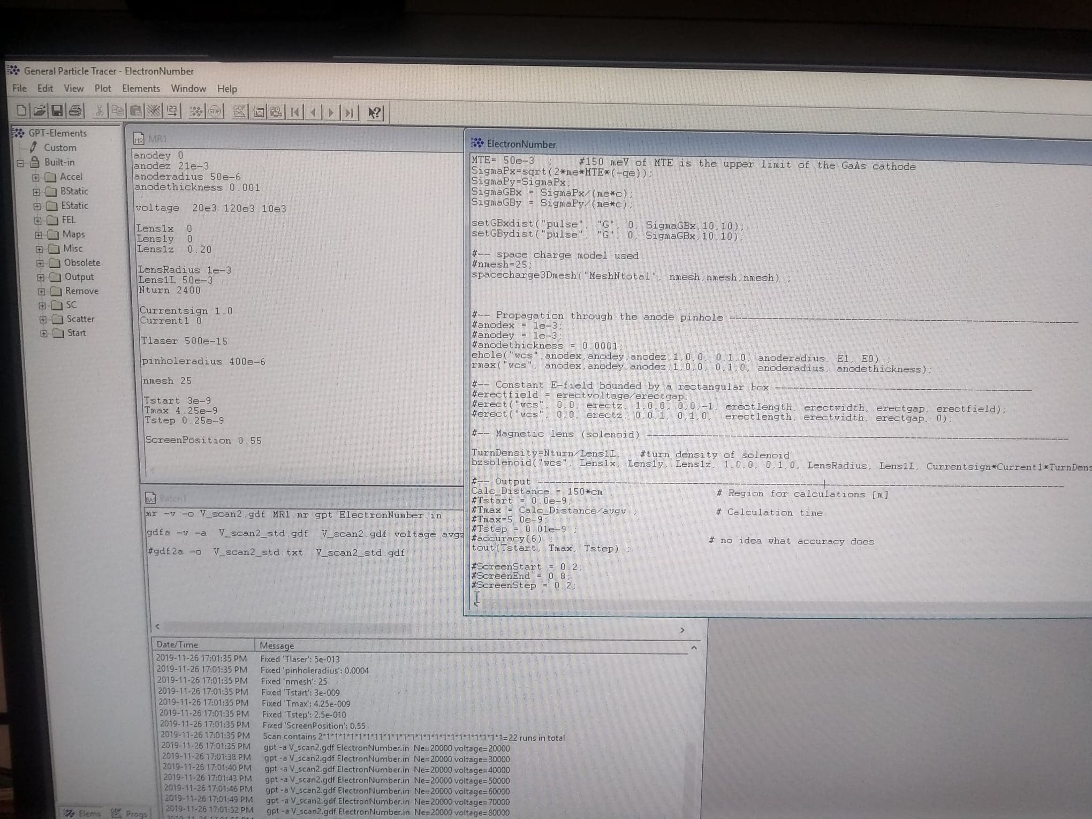
General Particle Tracer Simulation
General Particle Tracer simulates the behavior of an electron beam as it travels from the photocathode through aperture at anode and all the way through the Camera.
It considers the space charge effect and relativistic effect.

Slide 10
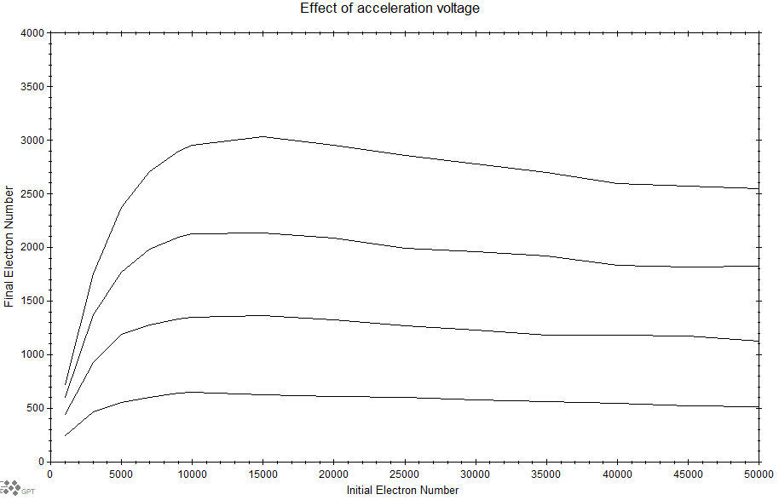
120kV
90kV
60kV
30kV

Slide 15
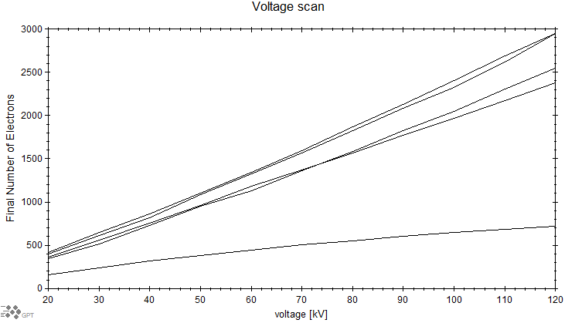
10000
50000
20000
5000
1000

Slide 18
Future Direction
Redo the Faraday Cup measurement and sum intensity camera measurement with adjusted laser position and adjusted Faraday Cup position for each measurement.
Long term work is to wait for the laser to be fixed and redo the measurement

Slide 20
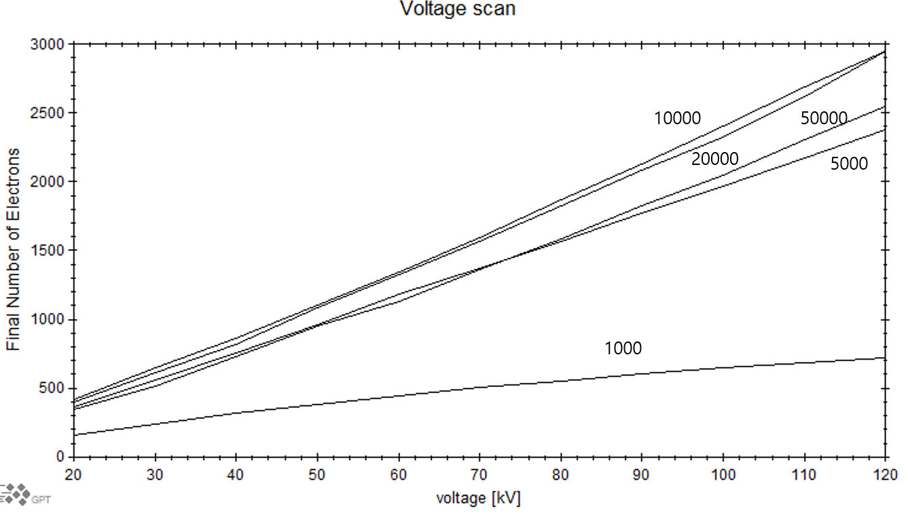

Slide 21
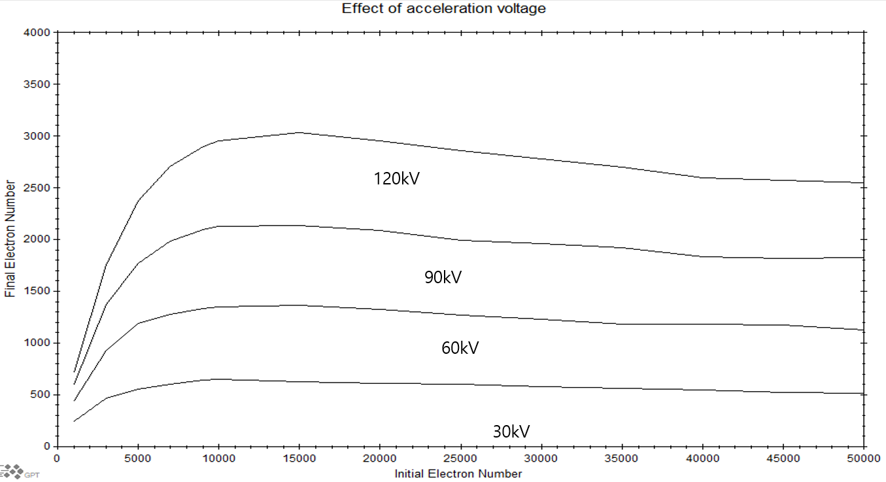
Comparison

Slide 22
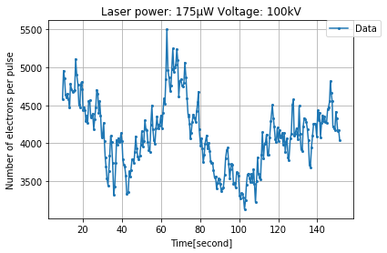
2019.Nov.8 (maximum number of electrons were detected)
Standard deviation :448
Maximum value :5499
Minimum value :3133
Mean value :4122

Slide 23
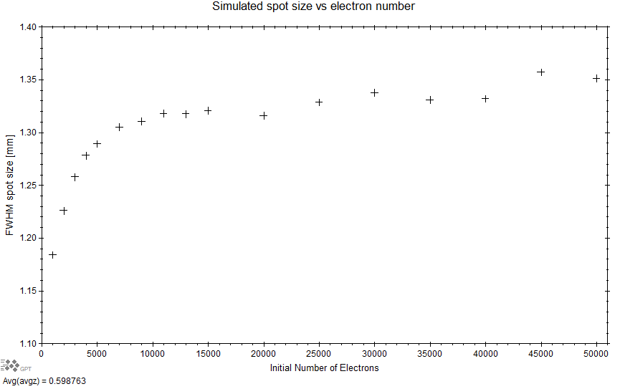
Case for 100kV

Slide 24
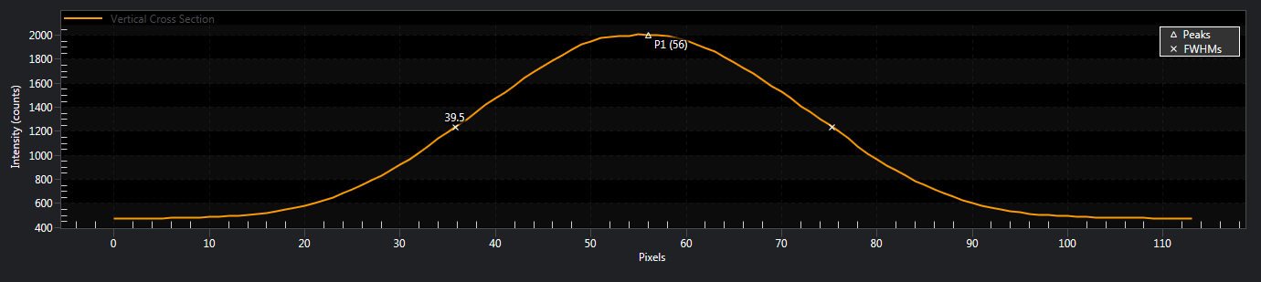
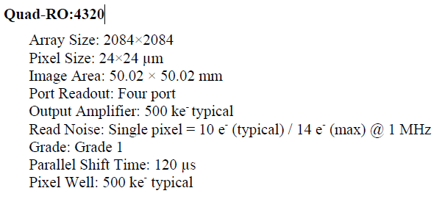
Estimating Beam size (CCD Camera)

