Slide 1
Autumn 2020 Research Plan: Fully Implicit Scheme for Coupled Flow and Geomechanics with EDFM for an Intersection & Stability Analysis
Jaewoo An
September 9th 2020

Slide 2
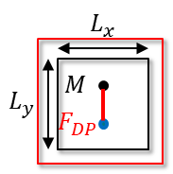
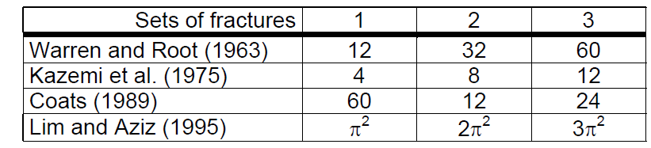




DPDK: Governing equation
$$∇∙σ=0$$
$$\frac{dζ}{dt}+∇∙q=f$$
DPDK-Matrix (ERE 223 note³⁾)
Shape factor
$$T_{FM,DP}=σk_{M}V_{b}$$
$σ=s(\frac{1}{{L_{x}}^{2}}+\frac{1}{{L_{y}}^{2}}$)

Slide 3
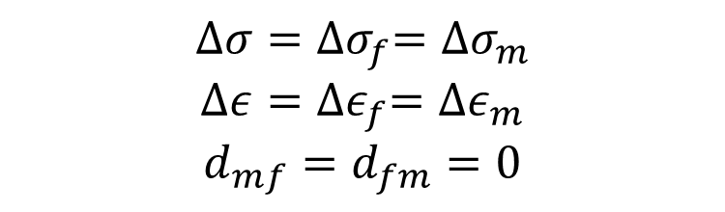
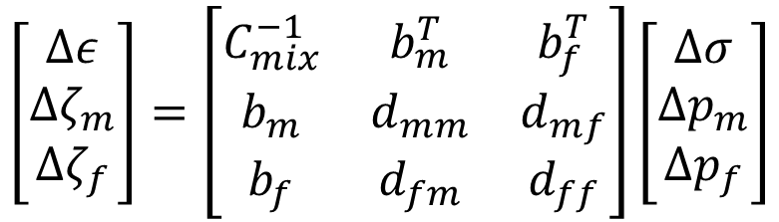
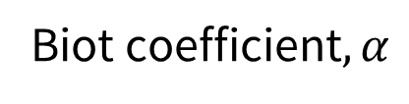
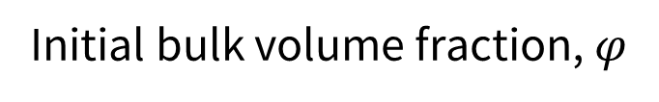
DPDK: Governing equation
$$\left[\begin{matrix}∆ε \\ ∆ζ_{m} \\ ∆ζ_{f}\end{matrix}\right]=\left[\begin{matrix}C_{mix}^{−1} & b_{m}^{T} & b_{f}^{T} \\ b_{m} & d_{mm} & d_{mf} \\ b_{f} & d_{fm} & d_{ff}\end{matrix}\right]\left[\begin{matrix}∆σ \\ ∆p_{m} \\ ∆p_{f}\end{matrix}\right]$$
Assumptions
$$∆σ={∆σ}_{f}={∆σ}_{m}$$
$$∆ε={∆ε}_{f}={∆ε}_{m}$$
$$d_{mf}=d_{fm}=0$$
Input mechanical properties: $E_{m}$, $E_{f}$, $v_{m}$, $v_{f}$ , $φ_{m}$, $φ_{f}$ , $α_{m}$, $α_{f}$
Initial bulk volume fraction, $φ$
Biot coefficient$, α$

Slide 4
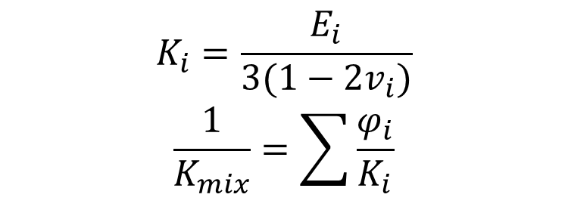
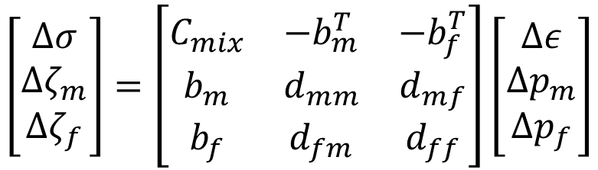
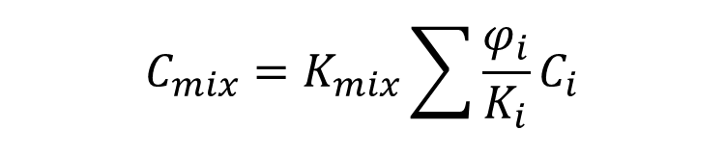
DPDK: Constants for mixed system
$$\left[\begin{matrix}∆σ \\ ∆ζ_{m} \\ ∆ζ_{f}\end{matrix}\right]=\left[\begin{matrix}C_{mix} & −b_{m}^{T} & −b_{f}^{T} \\ b_{m} & d_{mm} & d_{mf} \\ b_{f} & d_{fm} & d_{ff}\end{matrix}\right]\left[\begin{matrix}∆ε \\ ∆p_{m} \\ ∆p_{f}\end{matrix}\right]$$
Input mechanical properties: $E_{m}$, $E_{f}$, $v_{m}$, $v_{f}$ , $φ_{m}$, $φ_{f}\text{, }α_{m}\text{, }α_{f}$
$$K_{i}=\frac{E_{i}}{3(1−2v_{i})}$$
$$\frac{1}{K_{mix}}=\sum{\frac{φ_{i}}{K_{i}}}$$
$$C_{mix}=K_{mix}\sum{\frac{φ_{i}}{K_{i}}C_{i}}$$

Slide 5


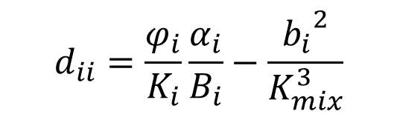
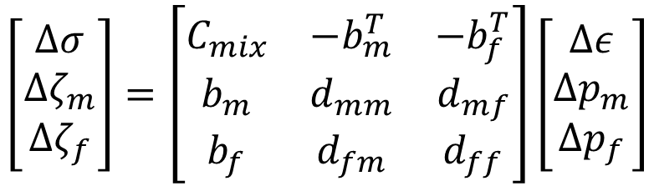


DPDK: Constants for mixed system
$$\left[\begin{matrix}∆σ \\ ∆ζ_{m} \\ ∆ζ_{f}\end{matrix}\right]=\left[\begin{matrix}C_{mix} & {−b}_{m}^{T} & −b_{f}^{T} \\ b_{m} & d_{mm} & d_{mf} \\ b_{f} & d_{fm} & d_{ff}\end{matrix}\right]\left[\begin{matrix}∆ε \\ ∆p_{m} \\ ∆p_{f}\end{matrix}\right]$$
Input mechanical properties: $E_{m}$, $E_{f}$, $v_{m}$, $v_{f}$ , $φ_{m}$, $φ_{f}\text{, }α_{m}\text{, }α_{f}$
$$b_{i}=α_{i}\frac{φ_{i}}{K_{i}}K_{mix}$$
$$d_{ii}=\frac{φ_{i}}{K_{i}}\frac{α_{i}}{B_{i}}−\frac{{b_{i}}^{2}}{K_{mix}^{3}}$$
$$d_{ij}=−\frac{b_{i}b_{j}}{K_{mix}^{3}}$$
$$B_{i}=\frac{M_{i}α_{i}}{K_{i}+α_{i}^{2}M_{i}}$$
$$\frac{1}{M_{i}}=∅_{i}c_{f}+\frac{α_{i}−∅_{i}}{K_{s}}$$

Slide 6


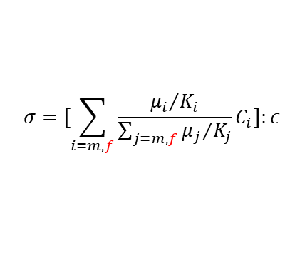



What I learned: comparison between DPDK and EDFM
DPDK: approximate fracture as another bulk medium with fracture porosity
EDFM: approximate fracture as explicit embedded fracture within matrix
F
$$σ=[\sum_{i=m,f}{\frac{{μ_{i}}/{K_{i}}}{\sum_{j=m,f}{{μ_{j}}/{K_{j}}}}C_{i}]:ε}$$
M
$$σ=С:[ε−{([u]⊗∇f)}^{s}]$$
M
$$K_{i}={\frac{∂σ_{v}}{∂ε_{v}}|}_{∆p=0}=\frac{E_{j}}{3(1−2v_{j})}$$
F
$\left[u\right]$ fracture gap
$\left[f\right]$ level-set function
$C$ modulus of elasticity
$σ$ effective stress
$K$ bulk modulus
$μ_{i}$ bulk volume ratio
(Kim, Sonnenthal, and Rutqvist, 2012)
No local problem → less convergence issue
Embedded fracture → Structured grid
Implicit fracture → fracture strain without fracture status
Need to define fracture properties:
$E_{f}$, $v_{f}$, $μ_{f}$
Uniform deformation assumption:
$ε_{v,m+f}=ε_{v,m}=ε_{v,f}$ → less accurate
Need to solve local problem (SDA)
Embedded fracture → Structured grid
Explicit fracture → fracture gap with status (slip/stick/open)
Don’t need fracture properties
Different deformation → More realistic than DPDK

