Slide 1
Fingerprint System
E4357 Embedded Firmware Essentials
Final Project
Jae Yang Park

Slide 2
Fingerprint Recognition
Fingerprint recognition, http://en.wikipedia.org/wiki/Fingerprint_recognition
“It refers to automated method of verifying a match between two human fingerprints. Finger prints are one of many forms of biometrics used to identify individuals and verify their identity.”

Slide 3
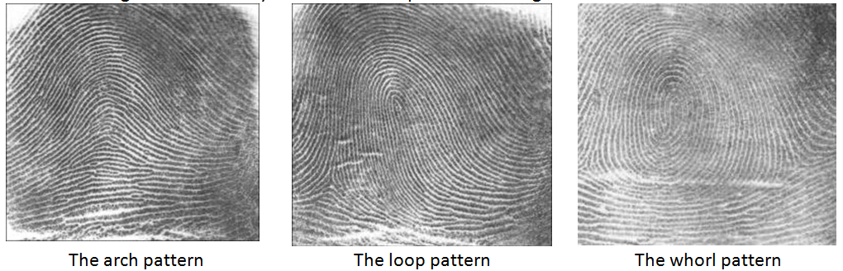
Fingerprint - Patterns
Arch: The ridges enter from one side of the finger, rise in the center forming an arc, and then exit the other side of the finger.
Loop: The ridges enter from one side of a finger, form a curve, and then exit on that same side.
Whorl: Ridges form circularly around a central point on the finger.

Slide 4
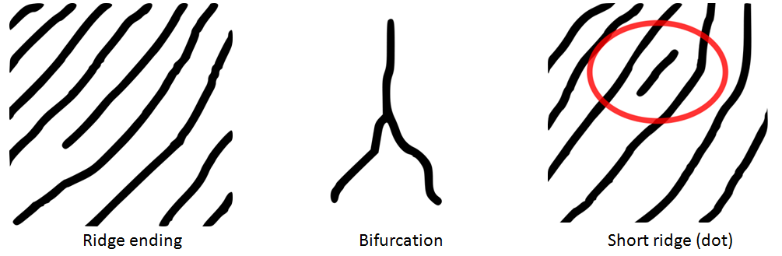
Fingerprint - Minutia
The major minutia features of fingerprint ridges are ridge ending, bifurcation, and short ridge (or dot).
Minutiae and patterns are very important in the analysis of fingerprints since no two fingers have been shown to be identical.

Slide 5
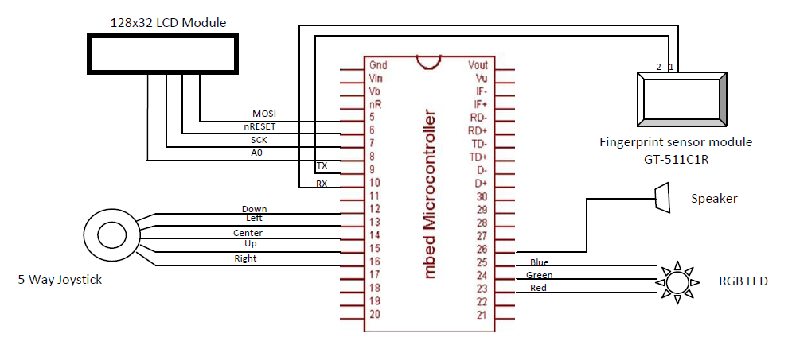
Hardware

Slide 6
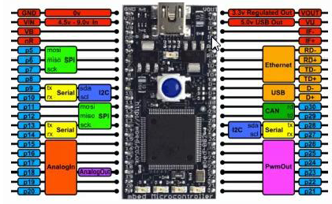
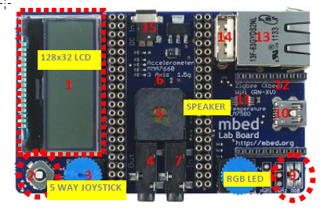
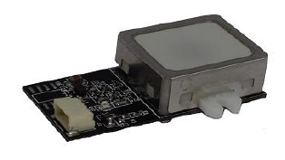
Hardware
Mbed
Mbed Application Board Fingerprint reader module GT-511C1R

Slide 7
GR-511C1R (adh-tech.com.tw)
Item |  | Value
CPU |  | ARM Cortex M3 Core
Sensor |  | Optical sensor
Effective area of the sensor |  | 12 x 12.5 (mm)
Image size |  | 240 x 216 pixels
Resolution |  | 450 dpi
The maximum number of fingerprints |  | 20 fingerprints
Matching mode |  | 1:1, 1:N
The size of template |  | 504 bytes (template) + 2 bytes (checksum)
Communication interface |  | UART, default baud rate = 9600 bps after power on USB ver 1.1, Full speed
False Acceptance Rate (FAR) |  | < 0.001%
False Rejection Rate (FRR) |  | < 0.1%
Enrollment time |  | < 3 sec (3 fingerprints)
Identification time |  | < 1.5 sec (20 fingerprints)
Operating voltage |  | DC 3.3 ~ 6V
Operating current |  | < 130 mA
Operating environment | Temperature | -20˚C ~ +60˚C
 | Humidity | 20% ~ 80%
Storage environment | Temperature | -20˚C ~ +60˚C
 | Humidity | 10% ~ 80%

Slide 8
Menu
Left ⬅ Right ➔ Up ⬆ Down ⬇ Center 
Menu change ⬅ ➔ and 
Value change ⬆ ⬇ and 
Fingerprint System v2.0
[0] Menu
<< MENU >> * RUN
Fingerprint System v2.0
[1] Select ID
<< MENU >> * RUN
Fingerprint System v2.0
[2] Enroll ID
<< MENU >> * RUN
Fingerprint System v2.0
[5] Delete ID
<< MENU >> * RUN
Fingerprint System v2.0
[4] Identify ID
<< MENU >> * RUN
Fingerprint System v2.0
[3] Verify ID
<< MENU >> * RUN

Slide 9
Joystick ISR
void set_ISR(void)
{
debounce.start();
JOY_CENTER.rise(&joy_center_ISR1);
JOY_RIGHT.rise(&joy_right_ISR);
JOY_LEFT.rise(&joy_left_ISR);
JOY_UP.rise(&joy_up_ISR);
JOY_DOWN.rise(&joy_down_ISR);
}

Slide 10
Joystick ISR
void joy_center_ISR1(void)
{
ptr_func[current]();
}
void joy_right_ISR(void)
{
current++;
if (current > MENU_SZ - 1)
current = 0;
debounce.reset();
}

Slide 11
Joystick ISR
void joy_left_ISR(void)
{
current--;
if (current < 0)
current = MENU_SZ - 1;
debounce.reset();
}
void joy_up_ISR(void)
{
EnrollID++;
if (EnrollID > (MAX_ID - 1))
EnrollID = 0;
debounce.reset();
}

Slide 12
Joystick ISR
void joy_up_ISR(void)
{
EnrollID++;
if (EnrollID > (MAX_ID - 1))
EnrollID = 0;
debounce.reset();
}
void joy_down_ISR(void)
{
EnrollID--;
if (EnrollID < 0)
EnrollID = MAX_ID - 1;
debounce.reset();
}

Slide 13
References
ARM mbed Developer Site, https://developer.mbed.org/
mbed Application Board, https://developer.mbed.org/components/mbed-Application-Board/
Fingerprint recognition, http://en.wikipedia.org/wiki/Fingerprint_recognition
GT-511C1R datasheet, http://www.adh-tech.com.tw/files/GT-511C1R_datasheet_V1%205_20140312[1].pdf
Toshihisa T, GT511C3 library, https://developer.mbed.org/users/tosihisa/code/GT511C3/
Toshihisa T, GT511C3test wiki, https://developer.mbed.org/users/tosihisa/code/GT511C3test/wiki/Homepage

