Slide 1

CUSTOMER
SEGMENTATION FOR SMARTER GROWTH
Turning customer personality clusters into focused campaigns, channels, and offers
JOHN A. FAJARDO
Student – AIM PGDAIML
October 2026
Business-facing recommendation | Customer clustering evaluation
Notes:
[Sources]
- Fajardo_Capstone_Clustering_Mktg_Campaign v5.pdf, pages 1–19.
- Visual on this slide was generated with Microsoft Copilot.
[/Sources]

Slide 2
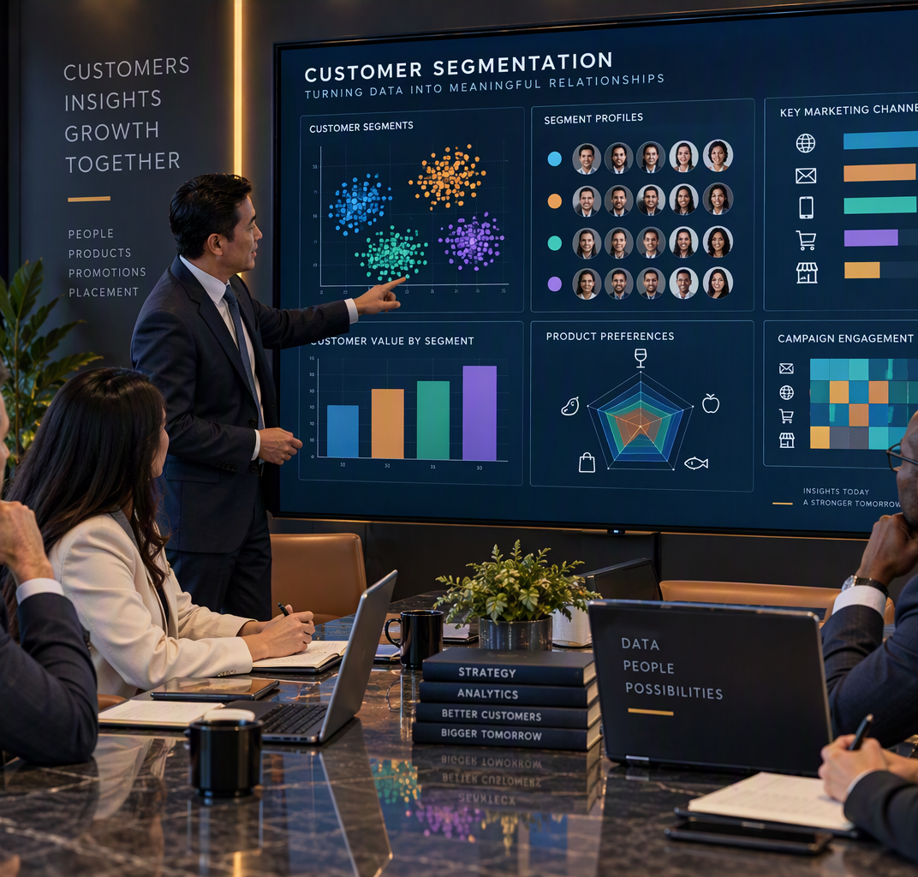
Problem framing: move from broad, costly marketing to focused customer strategies by people, product, promotion and placement.
PEOPLE
PRODUCT
PROMOTION
PLACE
Leadership question
Where should we focus limited resources to improve response, revenue and cost-to-serve?
Notes:
[Sources]
John_Fajardo_Capstone.docx, Problem Understanding & Framing.
Visual on this slide was generated with Microsoft Copilot.

Slide 3
The clustering workflow links model quality to business value
Success requires technically coherent segments that can be activated, measured and governed.
1
2
3
4
5
6
Prepare
Scale
Reduce
Cluster
Validate
Activate
Clean, encode and engineer customer behavior
Standardize features for distance-based models
Use PCA where needed to simplify structure
Compare K-Means and DBSCAN
Elbow + silhouette + stability checks
Profile segments and pilot campaigns
Technical success
Business success
Governance success
Silhouette score for separation and compactness
Elbow method for practical cluster count
Stability across feature sets and seeds
Lower marketing cost and cost-to-serve
Higher sales revenue or campaign uplift
Clear, actionable segment profiles
No leakage from outcome-like fields
Fair targeting across customer groups
Pilot versus control before scale
Notes:
[Sources]
John_Fajardo_Capstone.docx, end-to-end workflow and success metrics.

Slide 4
Data source: Kaggle Customer Personality Analysis
A public marketing dataset supports exploratory segmentation, not production deployment without further validation.
2,240 customers
28 variables
24 missing
0 duplicates
Rows in the original dataset
25 integer, 1 float, 2 categorical
Income values are missing
No duplicated rows reported
What the dataset captures
1
2
3
4
Customer profile
Product spend
Promotion
Placement
Identity, household, recency and complaint
Wine, fruit, meat, fish, sweets and gold
Deals, campaign acceptance and response
Web, catalogue, store and web visits
Source: kaggle.com/datasets/imakash3011/customer-personality-analysis
Notes:
[Sources]
John_Fajardo_Capstone.docx, Data Collection & Understanding.
Fajardo_Capstone_KMeans.pdf, dataset shape and missing values.

Slide 5
Feature landscape mirrors the 4P commercial decision model
The data can inform who to target, what to offer, how to promote and where to sell.
PEOPLE
PRODUCT
PROMOTION
PLACE
ID
Year_Birth
Education
Marital_Status
Income
Kidhome
Teenhome
Recency
Complain
MntWines
MntFruits
MntMeatProducts
MntFishProducts
MntSweetProducts
MntGoldProds
NumDealsPurchases
AcceptedCmp1–5
Response
NumWebPurchases
NumCatalogPurchases
NumStorePurchases
NumWebVisitsMonth
9 features
6 features
7 features
4 features
Notes:
[Sources]
John_Fajardo_Capstone.docx, feature categories and data dictionary.

Slide 6
Parameters relevant to customer segmentation and activation
Domain | Feature | Business meaning | Interpretation
Profile | Income | Yearly household income | Continuous; 24 missing
Profile | Recency | Days since last purchase | 0–99 in source summary
Product | MntWines | Wine spend in last 2 years | Right-skewed spend
Product | MntMeatProducts | Meat spend in last 2 years | Right-skewed spend
Promotion | AcceptedCmp1–5 | Accepted campaign offer | Binary 0/1
Promotion | Response | Accepted latest campaign | Binary 0/1; 14.9% positive
Place | NumWebPurchases | Purchases via website | Count
Place | NumCatalogPurchases | Purchases via catalogue | Count
Place | NumStorePurchases | Purchases in stores | Count
Place | NumWebVisitsMonth | Website visits last month | Count; weak purchase link
Decision rule: exclude identifiers and constants from clustering; treat campaign outcomes carefully to avoid leakage.
Notes:
[Sources]
John_Fajardo_Capstone.docx, data dictionary and critical thinking.
Fajardo_Capstone_KMeans.pdf, descriptive statistics and response rate.

Slide 7
Preprocessing makes distance-based clustering trustworthy
The analysis reduced obvious outliers, encoded categories and standardized numeric scales.
1. Quality checks
2. Outlier rules
3. Encode
4. Scale
5. Retain
Missing values: 24 Income
Duplicates: 0
Year_Birth: 1920–2000
Income: 0–120,000
Spend and channel caps
One-hot encode Education
and Marital_Status
StandardScaler aligns Income,
spend and count variables
2,038 rows after reported
range-based filtering
Why scaling matters
Leadership caution
Without scaling, household income can dominate geometric distance while low-range variables such as website visits contribute little.
Hard thresholds simplify analysis but may remove valuable high-value customers. Document rationale and test sensitivity.
Notes:
[Sources]
John_Fajardo_Capstone.docx, preprocessing and StandardScaler.
Fajardo_John_Capstone_Clustering.pdf, one-hot encoding and filter ranges.

Slide 8
Customer data reveals commercial patterns and modeling risks
Correlations suggest cross-sell and channel opportunities, while skew and imbalance require caution.
Selected correlations
Cross-sell
Campaign
Fruit–Fish
0.59
Wine and meat buyers overlap; fruit, fish and sweets also move together.
Customers accepting campaign 1 are more likely to accept campaign 5.
Fruit–Sweets
0.57
Wine–Meat
0.56
Channel
Income
Catalog–Store
0.52
Catalogue and store purchases rise together, supporting assisted retail.
Higher income is associated with more wine and store purchases.
Cmp1–Cmp5
0.40
Modeling implication
Channel signal
Web visits vs web purchases: −0.056
Strong skew, rare campaign responses and proxy variables can create segments that look mathematically clean but are commercially narrow or unfair.
Traffic alone is not conversion.
Notes:
[Sources]
John_Fajardo_Capstone.docx, correlation heatmap findings and EDA observations.

Slide 9
Model implementation: compare simple segments with density-based anomalies
K-Means offers interpretable baseline segments; DBSCAN exposes irregular behavior and noise.
K-Means baseline
DBSCAN exploration
PCA role
• Standardize selected numeric features
• Use elbow plot to choose k
• Reported implementation selects k = 2
• Silhouette score = 0.44
• Best for simple, spherical segments
• Tune eps and min_samples
• Detect arbitrary shapes and noise
• Performance varies sharply by feature pair
• Useful for anomaly discovery
• Harder to operationalize consistently
• Reduce dimensionality for visualization
• Mitigate multicollinearity
• Preserve major variance patterns
• Improves communication, not automatically quality
• Explain loadings before business use
Recommended decision path
Baseline K-Means
Stress-test features
Compare DBSCAN
Profile segments
Pilot activation
Notes:
[Sources]
John_Fajardo_Capstone.docx, Model Implementation.
Fajardo_Capstone_KMeans.pdf, K-Means k=2 and silhouette 0.44.
Fajardo_John_Capstone_Clustering_PCA.pdf, DBSCAN and PCA workflow.

Slide 10
Maximizing business with insights
The most useful output is the business profile and action, not the score alone. Although higher scores in the model shows higher chances of winning the customer
Business interpretation
Income + AcceptedCmp1
0.791
Year_Birth + AcceptedCmp1
0.776
Targeting
Campaign 1 acceptors average about $78.3k income versus $48.4k for non-acceptors.
K-Means selected features
0.440
Product
Income + Store Purchases
0.056
Wine and meat affinity supports paired offers; healthy-food categories form another theme.
Critical read: the 0.78–0.79 results are driven by a binary campaign field. Validate natural segment structure before using these as personas.
Placement
Catalogue appears to support store purchasing, while website visits alone do not signal purchase.
Notes:
[Sources]
John_Fajardo_Capstone.docx, model results and business insights.
Fajardo_John_Capstone_Clustering_PCA.pdf, reported DBSCAN silhouette scores.

Slide 11

Two customer groups require different treatment
VALUE DEVELOPMENT
PREMIUM GROWTH
Lower income and lower category spend
Higher need for relevance and value
Higher income and stronger wine spend
More active across web and store channels
Targeting objective
Targeting objective
Increase participation and frequency at efficient cost.
Grow basket value, premium mix, and loyalty.
Notes:
[Sources]
- Fajardo_Capstone_Clustering_Mktg_Campaign v5.pdf, pages 17–19. Segment names are business interpretations of the plotted clusters.
- Visual on this slide was generated with Microsoft Copilot.
[/Sources]

Slide 12
Responsible activation: scale only after bias and value checks
Ethical AI is a commercial control: protect customers, reduce reputational risk and improve decision quality.
Proxy bias
Age, income and education may encode socioeconomic disadvantage
Leadership guardrails
Audit
Compare segment membership and targeting rates by age band, education and marital status
1
Exclusion risk
Lower offer acceptance among basic-education customers could trigger reduced access
Measure
Track demographic parity difference and disparate impact; investigate ratios below 0.8
2
Data gaps
No gender or race fields are available for direct fairness auditing
Explain
Use a surrogate classifier with SHAP to explain segment assignment drivers
3
Imbalance
Response is 14.9%; AcceptedCmp2 is 1.3%, making patterns unstable
Experiment
Pilot targeted campaigns against a control group before scaling
4
Leakage
Campaign response fields can dominate clustering and recreate prior decisions
Monitor
Review fairness, cost savings, marketing cost and revenue uplift together
5
Decision: approve a controlled pilot, not full-scale automation.
Notes:
[Sources]
John_Fajardo_Capstone.docx, Critical Thinking, Ethical AI and Bias Auditing.

