Slide 1
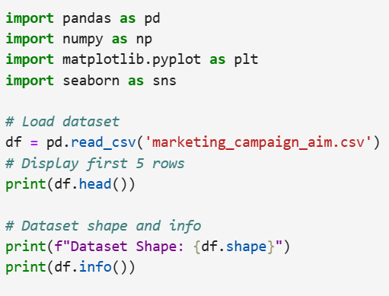
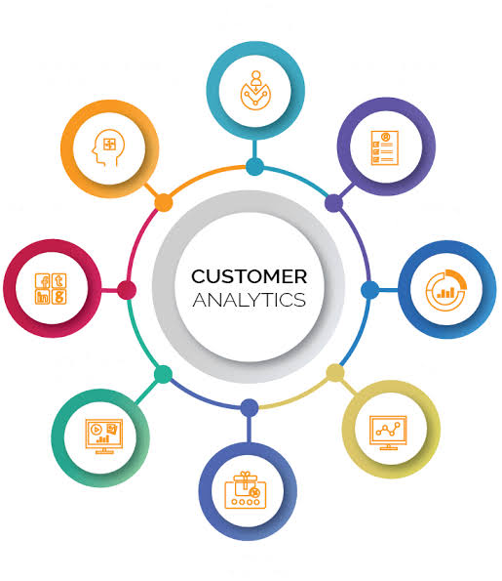
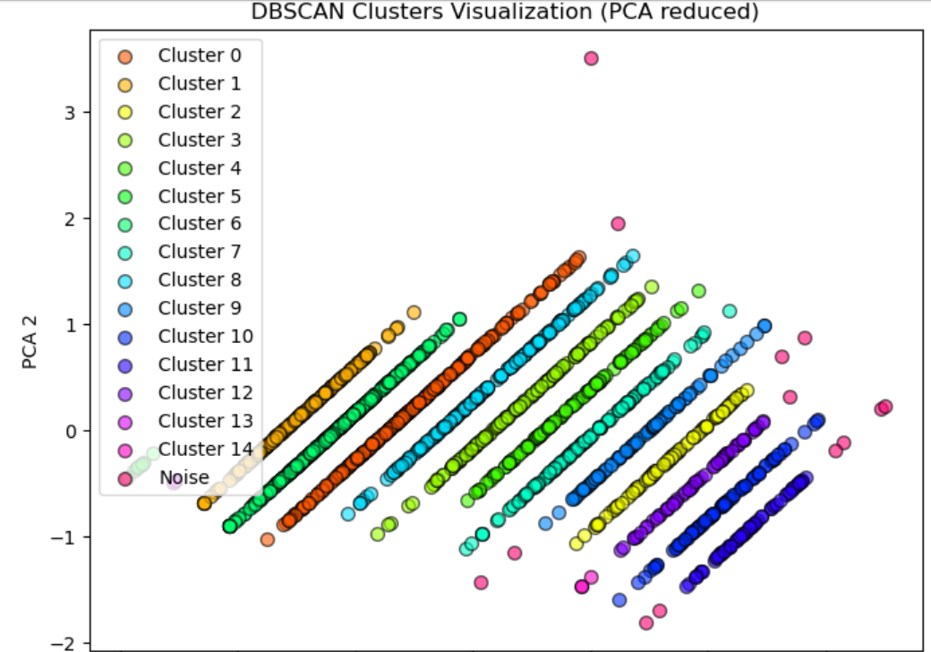
Capstone Project: Technical Presentation
PROJECT DOMAIN
Clustering Option (Unsupervised)
TOPIC
Customer segmentation and preference
SCOPE
JOHN A. FAJARDO
Student – AIM PGDAIML
October 2026
Selected insights from selected features, not every business question on the dataset
Notes:
Business problem: companies spend development and marketing money across the whole customer base without knowing who is most likely to buy. This raises cost-to-serve. Framed as an unsupervised clustering task. Scope is deliberately limited to selected insights from selected features. The four tiles map to the 4Ps: People, Products, Promotion, Placement.

Slide 2
Problem: marketing to customers we don't understand
STEP 1 | PROBLEM UNDERSTANDING & FRAMING
Companies market and develop products blindly across their entire customer base, raising cost-to-serve and cutting profitability.
P
P
People
Products
Who do we sell to?
What should we focus on?
TASK TYPE
Customer profile
Spend by category
Unsupervised clustering (customer segmentation)
GOAL
P
P
Group customers by profile, behaviour and preference to target spend
Promotion
Placement
SCOPE
How do we market it?
Where do we sell it?
Selected insights from selected features, not every business question
Deals and campaigns
Web, catalog, store
Notes:
Business problem: companies spend development and marketing money across the whole customer base without knowing who is most likely to buy. This raises cost-to-serve. Framed as an unsupervised clustering task. Scope is deliberately limited to selected insights from selected features. The four tiles map to the 4Ps: People, Products, Promotion, Placement.

Slide 3
Clustering workflow and success metrics
STEP 1 | PROBLEM UNDERSTANDING & FRAMING
1
Prepare & preprocess
2
Reduce & validate
3
Cluster & profile
Engineer RFM-style behaviour features, scale with StandardScaler or RobustScaler and one-hot encode categoricals.
PCA to cut multicollinearity (target 80-90% variance); pick k with the Elbow Method and Silhouette analysis.
Run K-Means or DBSCAN, label every customer, then turn cluster means into marketing personas.
Technical metric
Business KPIs
Model candidates
Silhouette
Cost savings
Lower marketing cost
Higher sales revenue
K-Means: fast and interpretable; spherical clusters only.
DBSCAN: irregular shapes and noise; weak with varying densities.
Ranges from -1 to 1. Near 1 means compact, well-separated clusters.
Notes:
Three-stage workflow from the report. Primary technical metric is silhouette score (-1 to 1). Business KPIs: cost savings, lower marketing cost, higher sales revenue. K-Means is the industry-standard baseline; DBSCAN handles irregular shapes and noise but struggles with varying densities.

Slide 4
Data source: Kaggle Customer Personality Analysis
STEP 2 | DATA COLLECTION & UNDERSTANDING
SOURCE
2,240
28
24
Kaggle: Customer Personality Analysis
kaggle.com/datasets/imakash3011/customer-personality-analysis
File: marketing_campaign_aim.csv
Intended task: cluster customers to summarise segments and market only to the likeliest buyers
Why it fits: mixed profile, product, promotion and channel features suit segmentation
customer records
columns: 1 float, 25 int, 2 object
missing Income values (1.1%)
0
666,666
1893
duplicate rows
max raw Income, extreme outlier
min raw Year_Birth, implausible
Notes:
Public dataset from Kaggle, provided by Dr. Omar Romero-Hernandez. 2,240 rows, 28 columns. 24 missing Income values, no duplicates. Raw outliers: Income max 666,666 and birth year 1893.

Slide 5
Feature summary: four groups across 28 columns
STEP 2 | DATA COLLECTION & UNDERSTANDING
9
Customer
6
Products
7
Promotion
4
Place
ID
Year_Birth
Education
Marital_Status
Income
Kidhome
Teenhome
Recency
Complain
MntWines
MntFruits
MntMeatProducts
MntFishProducts
MntSweetProducts
MntGoldProds
NumDealsPurchases
AcceptedCmp1
AcceptedCmp2
AcceptedCmp3
AcceptedCmp4
AcceptedCmp5
Response
NumWebPurchases
NumCatalogPurchases
NumStorePurchases
NumWebVisitsMonth
Plus 2 constant columns (Z_CostContact = 3, Z_Revenue = 11): zero variance, no clustering value
Notes:
Nine customer-profile features, six product-spend features, seven promotion features and four placement features: 26 informative columns plus two constants (Z_CostContact = 3, Z_Revenue = 11).

Slide 6
Data dictionary
STEP 2 | DATA COLLECTION & UNDERSTANDING
Group | Variable(s) | Type | Meaning and range (raw)
Customer | ID, Year_Birth | int | Unique ID; birth year 1893 to 1996
Customer | Education, Marital_Status | object | Education: Graduation, PhD, Master, Basic, Cycle. Marital: Single, Together, Married, Divorced, Widow, Alone, Absurd, YOLO
Customer | Income | float | Yearly household income, 1,730 to 666,666
Customer | Kidhome, Teenhome | int | Children / teenagers in household, 0 to 2
Customer | Recency, Complain | int | Days since last purchase (0-99); 1 if complained in last 2 years
Products | MntWines, MntFruits, MntMeatProducts, MntFishProducts, MntSweetProducts, MntGoldProds | int | Amount spent in last 2 years (wines 0-1,493; meat 0-1,725)
Promotion | NumDealsPurchases | int | Purchases made with a discount, 0 to 15
Promotion | AcceptedCmp1-5, Response | int (0/1) | 1 if offer accepted in campaign 1-5 / last campaign
Place | NumWebPurchases, NumCatalogPurchases, NumStorePurchases | int | Purchases by channel: website, catalogue, store
Place | NumWebVisitsMonth | int | Website visits in last month, 0 to 20
Constant | Z_CostContact, Z_Revenue | int | Fixed at 3 and 11; no information
Notes:
Compact data dictionary. Ranges are from the raw describe() output, before outlier filtering. Education and Marital_Status are the only object columns; Income is the only float.

Slide 7
Cleaning and preprocessing
STEP 3 | PREPROCESSING, APPLIED EDA & FEATURE ENGINEERING
2,240 → 2,038
666,666 → 113,734
1893 → 1940
rows after range filter
max Income
min Year_Birth
Range filter (inclusive limits)
1
One-hot encoding
Year_Birth 1920-2000; Income 0-120,000
MntWines, MntMeatProducts 0-1,000
MntFruits 0-150; MntFish, MntSweet 0-300
MntGoldProds 0-400
Deals, web, catalog, store purchases and web visits 0-30
Also: 24 null-Income rows dropped; 0 duplicates
pd.get_dummies on Education and Marital_Status (28 → 39 columns)
2
StandardScaler
Mean 0, variance 1, so Income (up to ~114k) cannot swamp NumWebVisitsMonth (max 20)
3
Scaler comparison
MinMax, Standard and Robust boxplots compared before choosing
Notes:
Range filters remove extreme values (Income 666,666; birth year 1893). between() excludes NaN, so the 24 null-Income rows also drop out; 202 rows removed in total (2,240 to 2,038). One-hot encoding via pd.get_dummies took the frame from 28 to 39 columns. Boxplots compared MinMax, Standard and Robust scalers; StandardScaler was used for clustering.

Slide 8
Applied EDA: relationships, feature selection, PCA
STEP 3 | PREPROCESSING, APPLIED EDA & FEATURE ENGINEERING
Selected Pearson correlations
Clustering tendency
Income rises with wine, meat and store purchases. Spend forms two groups: wine + meat, and fruit + fish + sweets + gold.
Feature selection
Filter: Correlation Heatmap & SelectKBest (f_classif, k=5); embedded RF/Lasso noted.
Dimensionality reduction
PCA with 2 components projects the scaled features to visualise cluster structure.
Notes:
Correlations are from the heatmaps in the notebook (Income vs Kidhome shows -0.43 in the heatmap output; the written report says -0.49). Feature selection used SelectKBest with f_classif (k=5) but the demo ran on synthetic make_classification data, so the selected feature_N names do not map to real columns; it must be rerun on the customer features. PCA with 2 components was used to visualise DBSCAN clusters.

Slide 9
K-Means and DBSCAN setup
STEP 4 | MODEL IMPLEMENTATION
K-Means elbow curve (inertia vs k)
1
K-Means
Features: Income, wines, gold, deals, campaigns
StandardScaler; elbow sweep k = 2 to 29
Selected k = 2, random_state = 42
Silhouette = 0.44
2
DBSCAN
Two-feature pairs, StandardScaler
eps = 0.3, min_samples = 3 (4th-NN k-distance graph)
Silhouette computed excluding noise
PCA 2-D plot for visual check
Values read approximately from the notebook plot. No sharp elbow; k = 2 was selected.
Notes:
K-Means: elbow sweep k=2..29 on StandardScaler output, then k=2 with random_state=42, silhouette 0.44. The elbow curve declines smoothly with no sharp elbow; inertia values on the chart are read approximately off the notebook plot. DBSCAN: 2-feature pairs, eps=0.3, min_samples=3, silhouette excludes noise, PCA-2D plot for visual inspection.

Slide 10
Results: silhouette comparison across models
STEP 4 | MODEL IMPLEMENTATION
Silhouette score by model
Model | Features | Clusters | Noise | Silhouette
K-Means | Income, wines, gold, deals, campaigns | 2 | n/a | 0.44
DBSCAN | Income x AcceptedCmp1 | 2 | 2 | 0.791
DBSCAN | Year_Birth x AcceptedCmp1 | 2 | 0 | 0.776
DBSCAN | Income x NumStorePurchases | 15 | 13 | 0.056
DBSCAN | Income x MntWines | 1 | 6 | n/a
High scores are structural
Counts fragment
Model choice
0.78-0.79 comes from the binary AcceptedCmp1 axis: accepters (mean income 78.3k) vs non-accepters (48.4k).
NumStorePurchases is discrete, so DBSCAN cut Income x Store into 15 bands (0.056).
K-Means k=2 for multi-feature segments; DBSCAN for outliers (noise mean Income ~103k).
Notes:
Silhouette scores: K-Means k=2 0.44 (multi-feature); DBSCAN Income x AcceptedCmp1 0.791 (2 clusters, 2 noise points: accepters mean income 78,272 vs 48,377); DBSCAN Year_Birth x AcceptedCmp1 0.776; DBSCAN Income x NumStorePurchases 0.056 with 15 clusters and 13 noise points; DBSCAN Income x MntWines found only 1 cluster plus 6 noise points (mean income 103,018, wines 610), so silhouette could not be computed. The high scores are driven by the binary feature separating the clusters.

Slide 11
Ethical AI and bias auditing
STEP 5 | CRITICAL THINKING
1
Limitations found
2
Bias risks
3
Audit and mitigation (planned)
Silhouette 0.78-0.79 reflects a binary axis, not natural groups
Imbalance: Response 14.9% positive; AcceptedCmp2 1.3%
Leakage risk: campaign-response fields as clustering inputs
Year_Birth, Income and Education act as age and socioeconomic proxies
Basic-education customers accepted fewer offers; targeting on that risks exclusion
Rare labels (YOLO, Absurd, Alone) are data noise, not real groups
No gender or race fields to audit
Compare segment membership and targeting rate by age band, education, marital status
Metrics: demographic parity difference, disparate impact (>= 0.8)
Explain segments with SHAP on a surrogate classifier
Mitigate: cap proxy features, reweight, human review before campaigns
Notes:
Honest status: limitations are identified from the notebooks; the fairness audit and SHAP/LIME explanations are planned, not yet executed. Dataset has no gender or race fields, so age, income, education and marital status are the available sensitive or proxy attributes. Disparate impact uses the 0.8 (four-fifths) rule of thumb.

