Slide 1
Adaptor Signature Based Atomic Swaps Between Bitcoin and a Mimblewimble based Cryptocurrency
Master thesis presentation
By Jakob Abfalter

Slide 2

Outline
Motivation
Background & Problem Description
Methodology
Atomic Swap Protocol
Implementation
Challenges

Slide 3
Problem Description & Motivation
As of July 2021: > 10.000 Cryptocurrencies (Source CoinMarketCap.com).
Interoperability increasingly important topic:
Decentralized coin exchange.
Running applications on a different blockchain (for instance, WBTC).
Scaling (Second Layer Networks – Payment Channels).

Slide 4
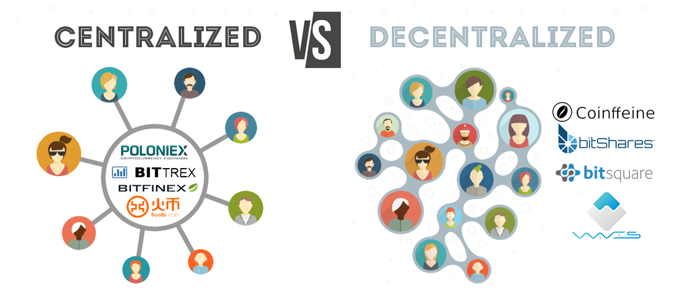
Centralized Exchanges
Problems with trusted exchange:
Hacking attacks
MtGox – 850.000 BTC (~$450m)
BitGrail - $195m
Quadriga - $140m
KYC regulations (barrier of entry)

Slide 5
Decentralized Exchanges
Problems with decentralized exchanges:
Less efficient
Lower liquidity
Higher complexity for the user
Hybrid solutions possible: Orderbook is centralized

Slide 6
Background & Problem Description

Slide 7
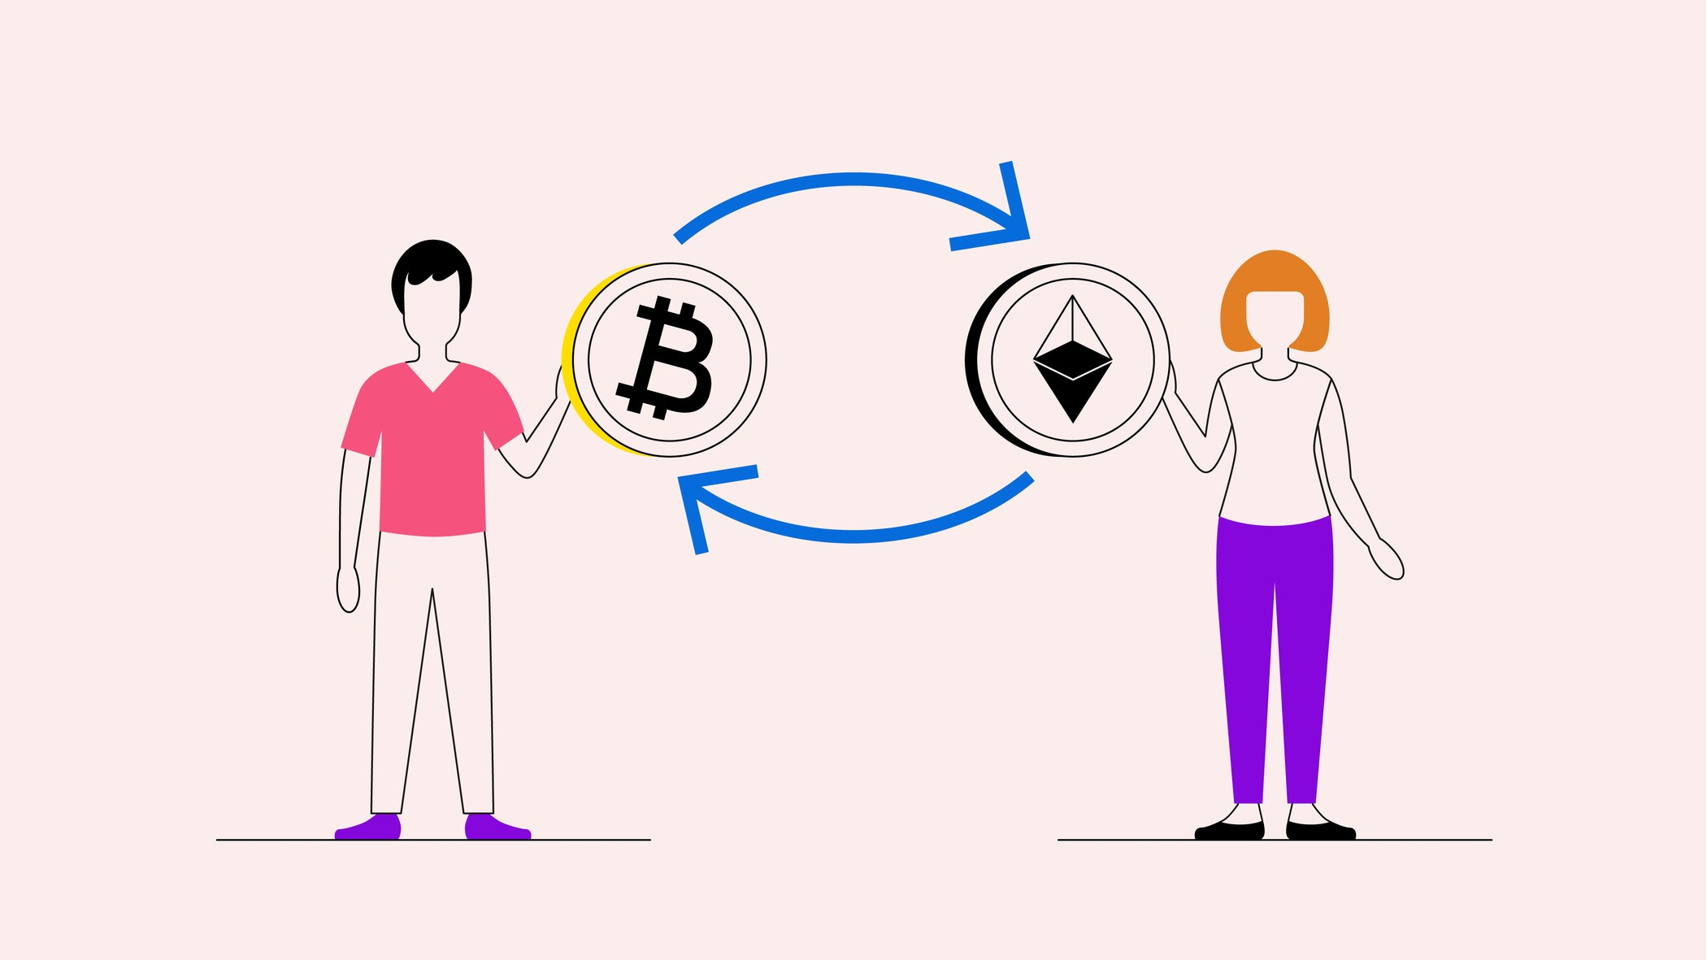
Atomic Swaps
Protocol allowing P2P exchange of two Cryptocurrencies.
Enable decentralized exchange.
Built on scripting/smart contract capabilities of blockchains.

Slide 8
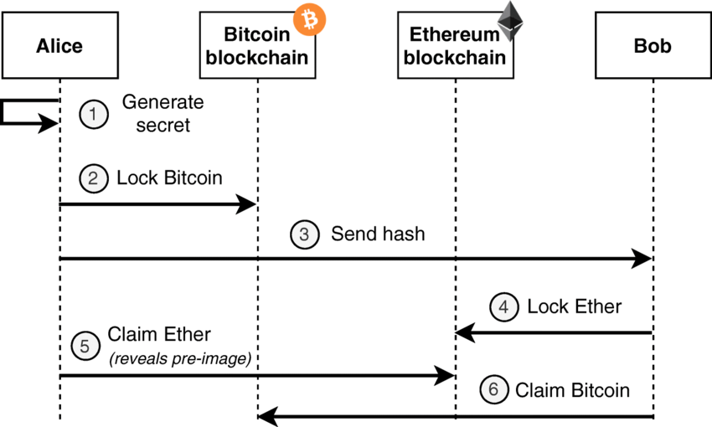
Atomic Swaps
Two-phase process:
Locking phase: Funds are are locked in contracts on both sides (HTLCs)
Claiming phase: Conditional release of the funds to new owners (or refund if dispute)

Slide 9




Privacy-Enhancing Cryptocurrencies
Encrypted transactions values (Homomorphic Commitment + Rangeproof).
Cryptographic tools to obfuscate transaction graph:
Coin mixing
Stealth addresses
Ring signatures
Lack of scripting/smart contract capabilities (cost of increased privacy)
Often not listed on centralized exchanges due to regulatory reasons.

Slide 10

The Mimblewimble Protocol
Anonymous Tom Elvis Jedusor released the whitepaper in 2016.
Harry Potter references. Mimblewimble is a tongue-tying spell.
Goal: Improving user privacy while being space efficient.

Slide 11
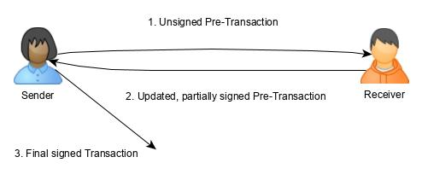
The Mimblewimble Protocol
First Cryptocurrency that works without the concept of addresses.
Ownership is given by opening of Pedersen commitments.
Transaction signature under the Excess point (output – input commitments) ➨ Transaction building is a two-party protocol!
Pruning of spent outputs allowed!

Slide 12
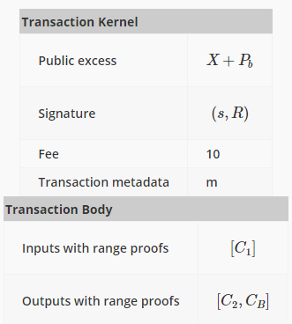
Mimblewimble Transaction

Slide 13
Adaptor Signatures
Scriptless Scripts by Andrew Poelstra
Using cryptographic signatures to build primitive contracts:
Build a Pre-Signature σ‘ under pk for a statement X = gˣ (Not yet valid signature)
Adapting the Pre-Signature σ‘ into the valid σ will expose x (to those knowing the Pre-Signature)

Slide 14
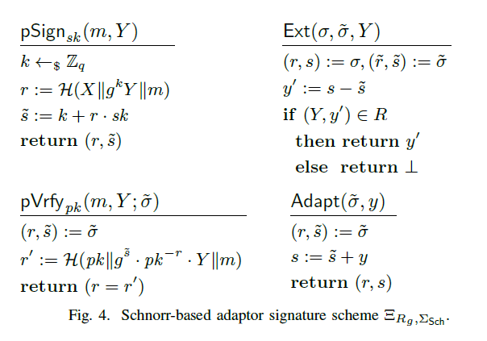
Adaptor Signatures

Slide 15
Methodology

Slide 16
Methodology
Two-Party Adaptor Signatures (Needed for Mimblewimble).
Schnorr Instantiation + Correctness and Security proof of protocol.
Formalize 3 Mimblewimble Transactions:
Normal transaction (Based on Fuchsbauer et al.).
„Multisig“ transactions (Shared coins introduced – One-to-Two and Two-to-One transactions).
Contract transactions (Make use of Two-Party Adaptor Signatures).
Correctness and Security proofs for all transaction protocols.
Build Atomic Swap protocol using Multisig and Contract transactions.

Slide 17
Atomic Swap Protocol

Slide 18
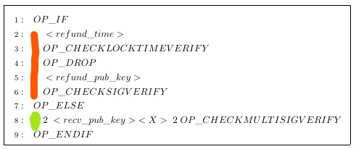

Atomic Swap Protocol Bitcoin side
Bitcoins are locked in a P2SH address by Bob.
Alice can spend the funds if she receives x of X = gˣ.
Bob can spend after timeout <refund_time>.

Slide 19
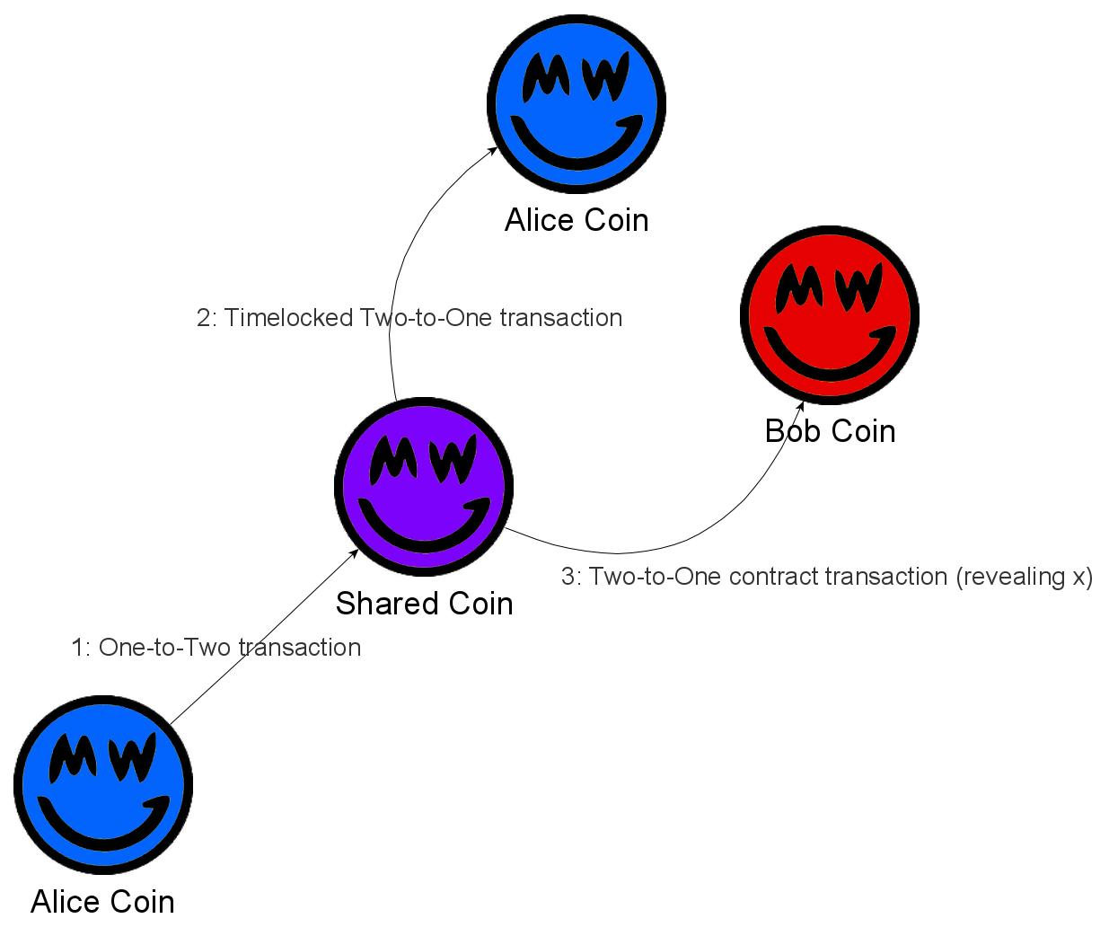
Atomic Swap MW side
Funds are locked in a two-party coin, each party owning a key share.
Funds are refunded back to Alice in a time-locked transaction.
Contract Transaction to send the locked Grin funds to Bob while revealing x of gˣ to unlock the Bitcoin funds for Alice.

Slide 20
Atomic Swap – Practical Difficulties
How to choose a reasonable timeout?
Choose a long enough real-world timeout.
Either use Unix timestamp timeout of blockchain average block time to calculate block height.
Still potential problems possible in edge cases.
How to choose transaction fees correctly?
Particularly a problem on Bitcoin because of high network load.
Find a balance between fast confirmation time and not losing too many funds.

Slide 21
Implementation

Slide 22
Implementation
POC implementation in Rust.
Atomic Swap between Bitcoin (BTC) and Grin (GRN).
Deployed and tested on testnets.
Published as an open-source project on Github.
40k Euro in BTC funding granted by Grin to a developer in March for a production-grade variant (Independent from my work).

Slide 23
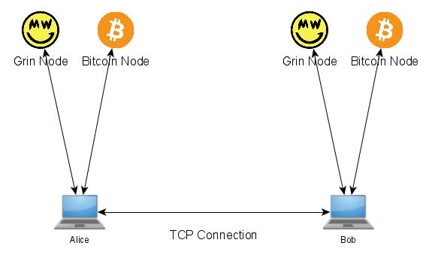
Implementation
Communication via TCP channel.
Communication with Bitcoin Core and Grin Core nodes to publish/verify transactions and check blockchain state.
Simulation via docker containers.

Slide 24
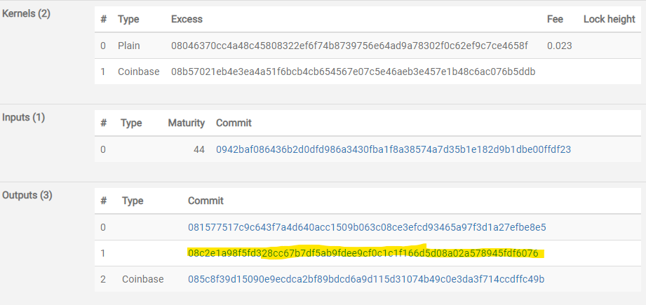
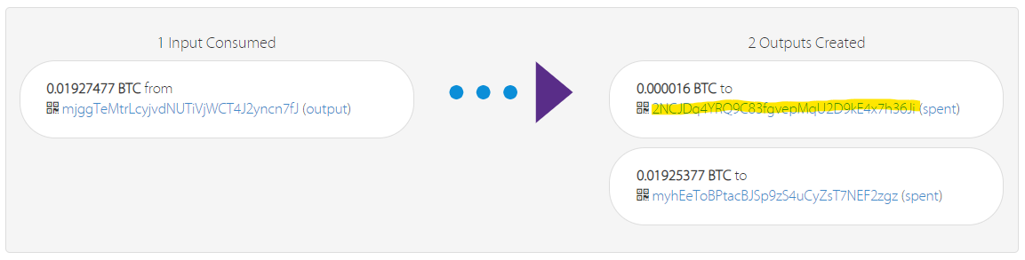
Locking phase

Slide 25
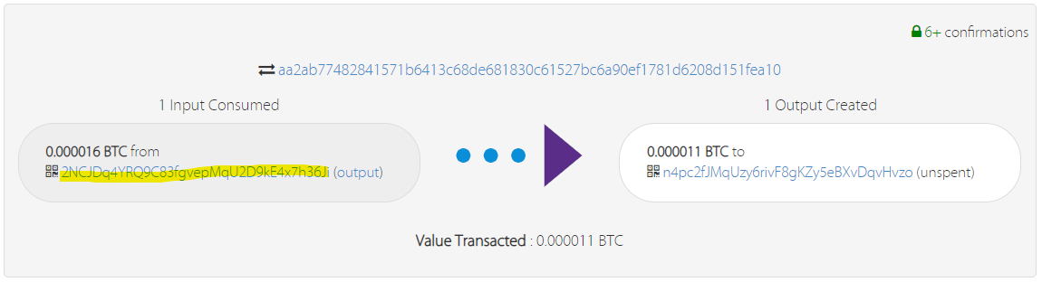
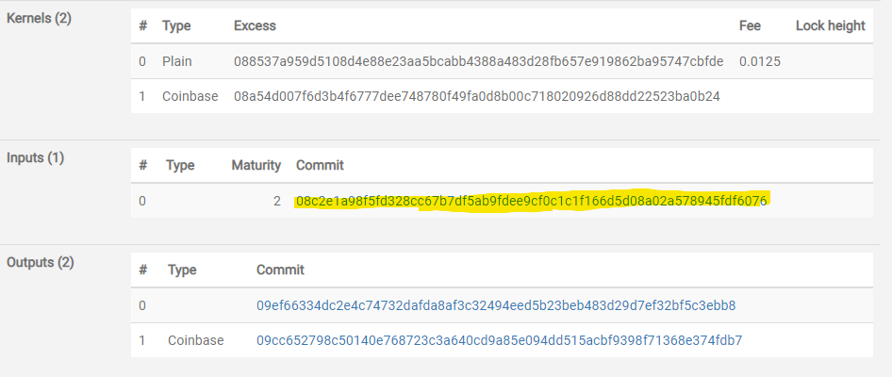
Claiming phase

Slide 26

The bumpy road towards finishing my thesis

Slide 27
Challenges and Milestones
Formalizing the Signature Scheme and Transaction protocols (Several iterations).
Constructing Security Proofs for Signature Scheme and transaction protocols (Learning Simulator Proofs).
Implementation:
Learning Rust (Grin libraries only available in Rust).
Grin v5 Hardfork in Jan 2021 (Testnet already in Dec 2020).
Two-Party Rangeproofs are necessary for shared coins!
Bug in time-locked grin transaction (Thankfully, Grin developers very helpful)
Producing correctly formed and signed transactions (Debugging really hard!)

Slide 28
Summary
Goal: Improving Interoperability between Cryptocurrencies to enable decentralized coin exchange.
A complex problem for Privacy-Enhancing Cryptocurrencies, due to lack of scripting capabilities.
Formalized a scriptless approach for the Mimblewimble protocol utilizing Adaptor Signatures.
Security and Correctness proofs of the protocols.
PoC Implementation and successful evaluation on testnets.

Slide 29

Q&A
Thank you for your attention!

