Slide 1
IlmuOne Data Assessment Test
By Jafar Shodiq

Slide 2
Data
File name format : Year + Quarter. e.g. 2010Q1 is first quarter in year 2010. The files are in CSV format
Total dataset : 46, from year 2010 - 2021 with an exception only Q1 and Q2 in year 2021
Labels : Vary (1000 - 3000 rows)
Features : 7
Features
Date : The date of the sales (YY-mm-dd)
Category1 : First word of the item category
Category2 : Second word of the item category
Category3 : Third word of the item category
Maker : The name of the item maker
Sales : Number of sales
Identifier : Item ID

Slide 3
Objectives
Data cleaning and preprocessing
Data modeling (forecasting)
Decision Making
Additional Notes
The daily date data is not complete
Data anomaly in June 19 2019 and December 09 2020

Slide 4
Data Cleaning and Preprocessing

Slide 5
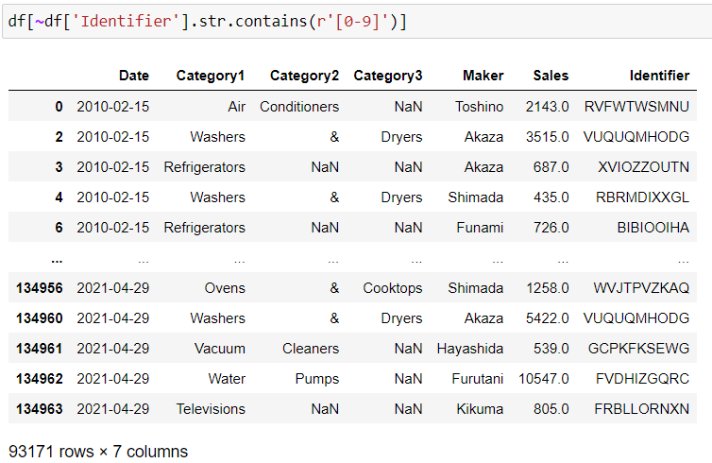
Take Out the Data Belonging to PT. D.K. Works

Slide 6
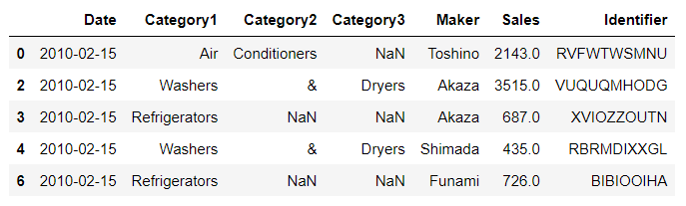
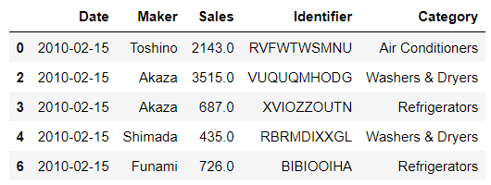
Reshape the Data

Slide 7
Furthermore
Convert date type to datetime object
Fill missing sales values with the mean by Identifier from each quarter

Slide 8
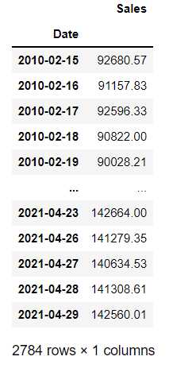
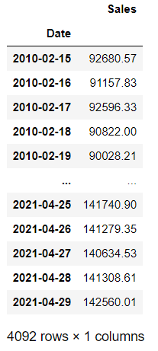
Group-by Date Column and Interpolate the Missing Daily Sales

Slide 9
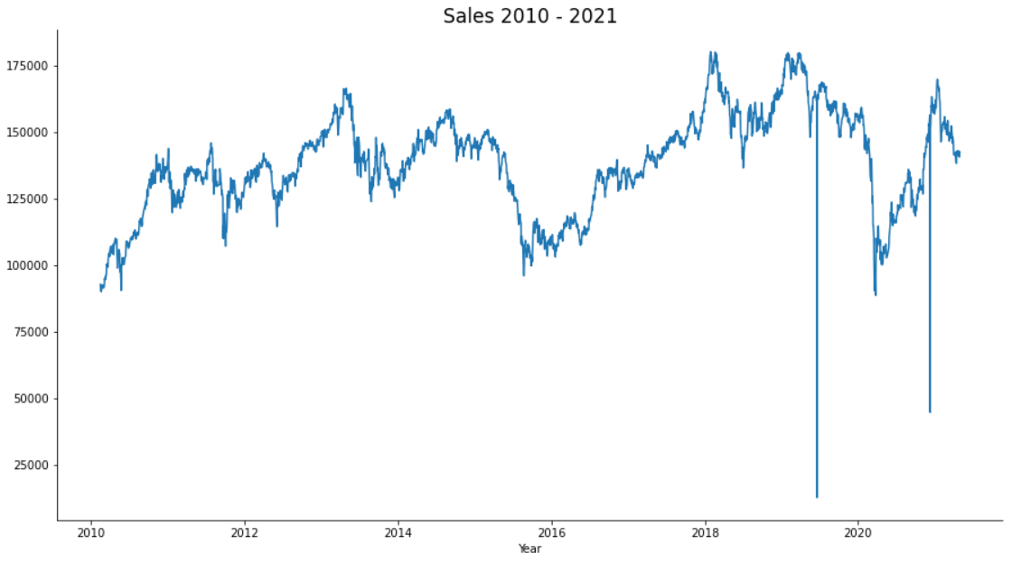
Data Anomaly
December 09 2020
Sales: 44665.81
June 19 2019
Sales: 12617.0

Slide 10
Data Modeling (Forecasting)

Slide 11
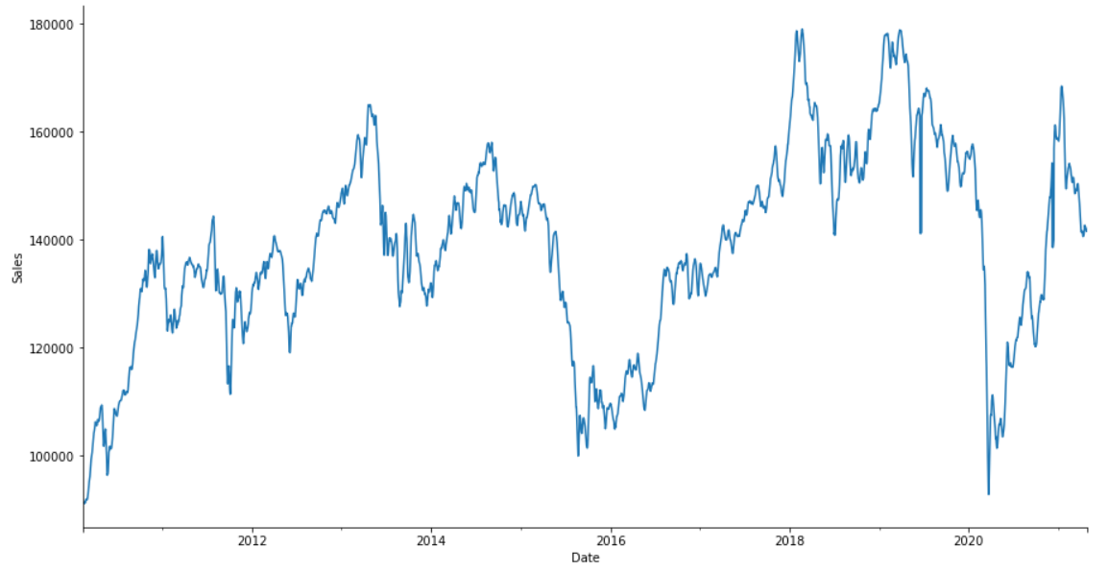
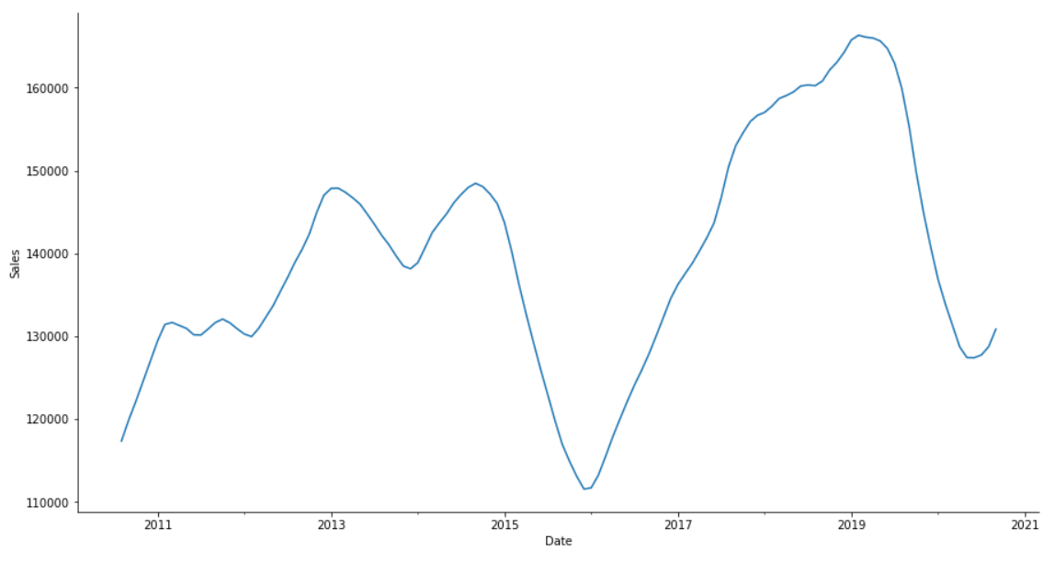
Year 2010 – 2021 Trend
Daily
Monthly

Slide 12
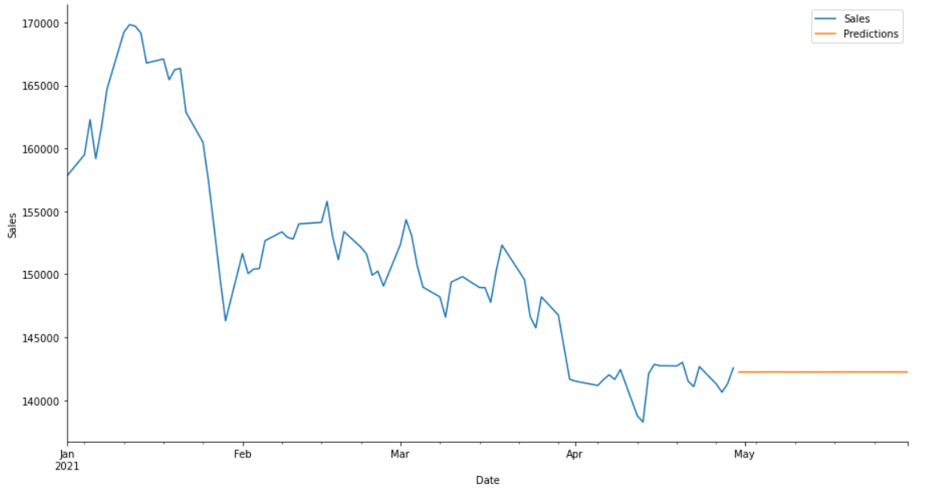
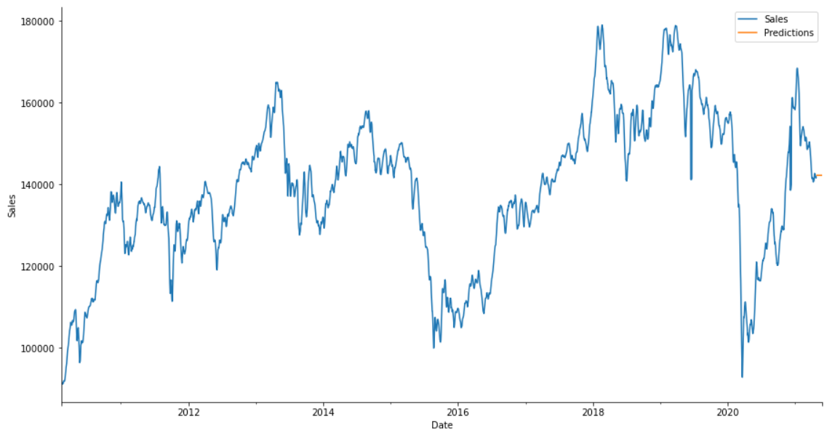
Forecast Result
MSE : 642071.47
RMSE : 801.29
Forecast mean sales: 142239.41

Slide 13
Forecast Result
With RMSE 801.29, we would say this forecast model did a pretty good job. Though we would prefer you do not use this result as a final company decision. There are many other unpredictable events that could affect the sales values.
Based on the forecast, future sales number would be 142,239.41 sales per day.

Slide 14
Sales 30 Million Prediction
From the available data, total sales from 2021-01-04 to 2021-04-29 was 11,849,286 sales. With the forecast result 142,239.41 sales per day, total 30 million sales would happen in 2021-09-04 (September 4th).

Slide 15
Decision Making

Slide 16
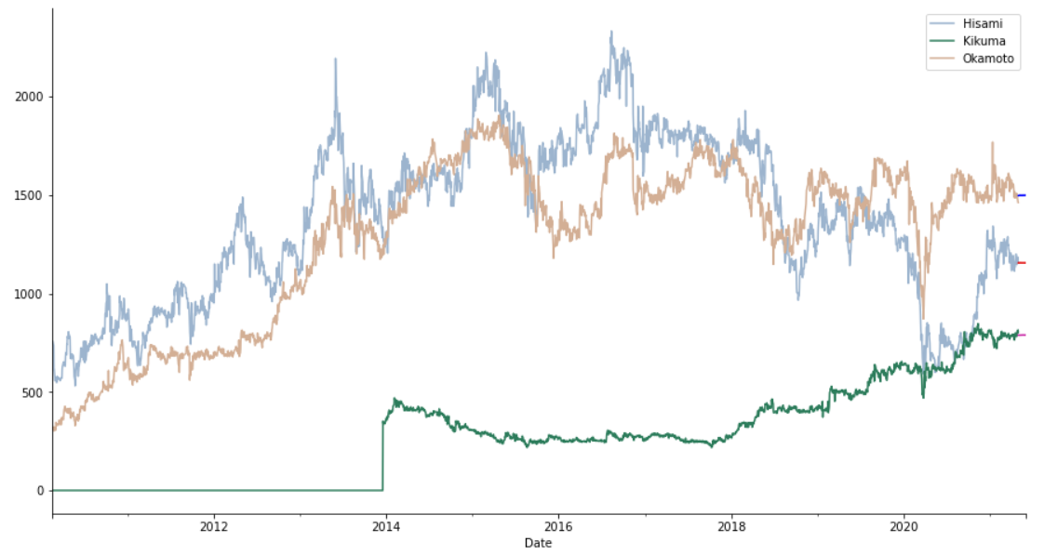
Exclusion
Bottom 3 maker with the least sales

Slide 17
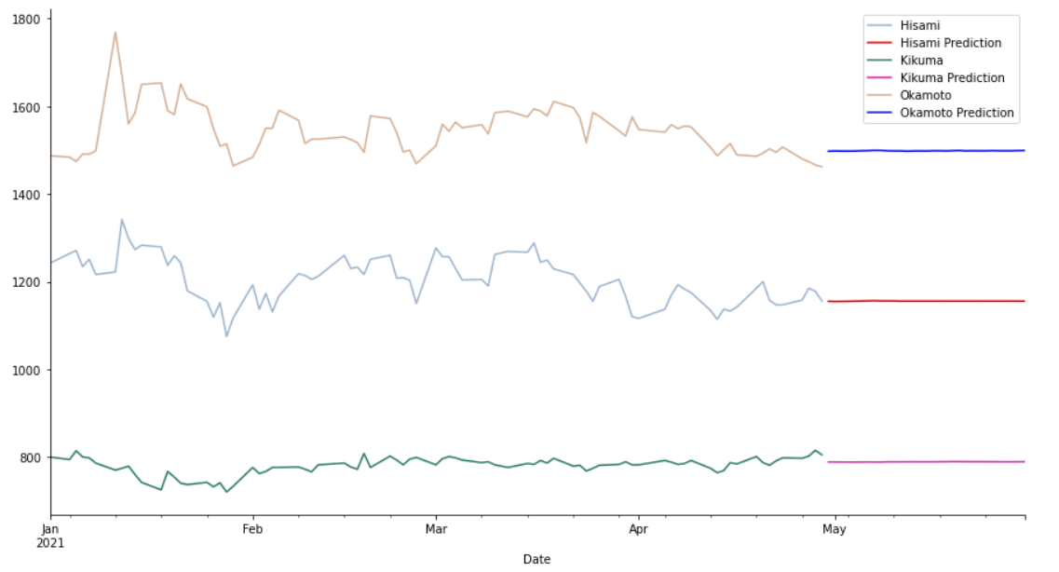
Year 2021
Maker | Main Category | Num of Items | Sales mean | Forecast sales mean
Okamoto | Televisions | 81 | 1,289.86 | 1,498.42
Hisami | Vacuum Cleaners | 81 | 1,382.76 | 1,155.52
Kikuma | Televisions | 81 | 411.01 | 788.80

Slide 18
Exclusion
We would leave the decision on which one should be cut to the client.

Slide 19
Improve the Data
Problem: Incomplete and inconsistent sales date
Suggestion(s):
Input data daily, or
Input data monthly
Problem: Separated category name (1 word = 1 column)
Suggestion(s):
Combine those words into one category column from the start

Slide 20
Thank You
By Jafar Shodiq

