Slide 1
Lending Club Case Study Loan Default Risk Analysis
A Detailed Exploratory Data Analysis

Slide 2
Introduction
Overview of the Problem:
Lending Club, an online loan marketplace, faces challenges in assessing the risk of loan defaults. The goal of this case study is to analyze borrower data and identify key factors that contribute to loan default. By understanding these factors, we can help Lending Club minimize financial losses and improve lending decisions.
Business Objective:
Identify patterns that indicate if a borrower is likely to default on their loan.
Use Exploratory Data Analysis (EDA) to derive insights from the data.
Provide actionable recommendations to reduce risk and enhance decision-making in the loan approval process.

Slide 3
Dataset Overview
The dataset contains loan data from Lending Club, covering the period from 2007 to 2011.
It includes 39,717 rows and 111 columns, with various borrower and loan attributes.
Data Structure
Data Types
74 columns of type float64 (e.g., loan amounts, interest rates, and other numerical attributes).
13 columns of type int64 (e.g., categorical codes and numeric counts).
24 columns of type object (e.g., dates, strings like loan grade, and borrower information).
Key Attributes
Loan Amount: The amount requested by the borrower.
Interest Rate: The annual interest rate for the loan.
Loan Status: Whether the loan was fully paid, charged off (defaulted), or is still current.
Debt-to-Income Ratio (DTI): The ratio of the borrower’s debt payments to their income.
Annual Income: Reported annual income of the borrower.
Verification Status: Indicates whether the borrower’s income was verified.
Home Ownership: Borrower’s home ownership status (Own, Rent, Mortgage).
Purpose
This dataset allows for an in-depth analysis to determine the factors contributing to loan defaults, which can guide lending decisions.

Slide 4
Data Quality and Cleaning
Overview of Data Cleaning:
Missing Values: Handled using a combination of removal and imputation (e.g., median values for numerical data).
Outliers: Detected and removed using the Interquartile Range (IQR) method, especially for loan amounts and incomes.
Data Transformation: Converted categorical variables (e.g., loan grade, loan status) into numerical codes and formatted dates.
Key Fixes:
Imputed Missing Data: Filled missing values for important variables like revol_util and annual_inc.
Removed Outliers: Cleaned outliers to ensure the analysis wasn't skewed.
Dropped Irrelevant Columns: Removed columns like emp_title and emp_length to simplify the dataset..

Slide 5
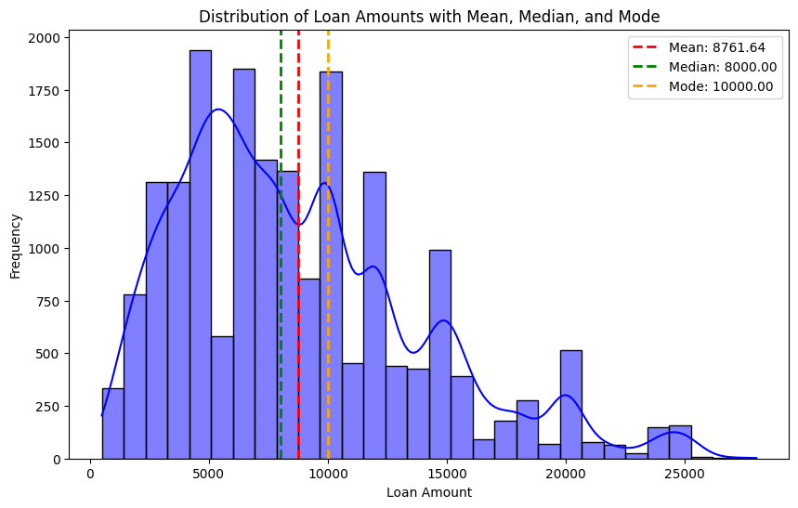
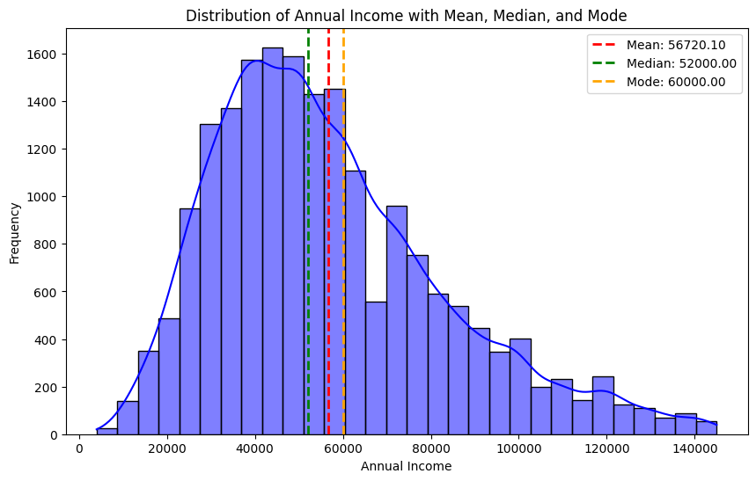
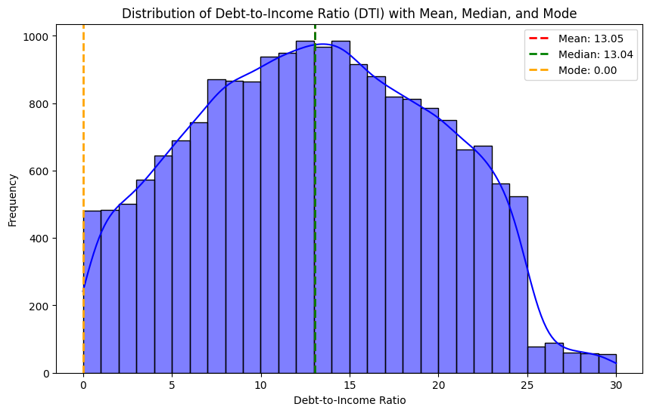
Univariate Analysis - Loan Amount
Loan Amount (loan_amnt)
Mean: 8,761.64, Median: 8,000, Mode: 10,000
Insight: Right-skewed, most loans are between 5,000 and 12,000, with a few large loans pulling the mean upward.
Interest Rate (int_rate)
Mean: 10.73%, Median: 10.65%, Mode: 10.65%
Insight: Slightly right-skewed, most rates between 7.74% and 13.11%, higher rates signal riskier loans.
Annual Income (annual_inc)
Mean: 56,720.10, Median: 52,000, Mode: 60,000
Insight: Right-skewed, most incomes range from 40,000to60,000, with some high earners pulling up the mean.
Debt-to-Income Ratio (dti)
Mean: 13.05%, Median: 13.04%, Mode: 0%
Insight: Nearly symmetrical; a notable number of borrowers have no debt, but some have DTIs up to 30%.

Slide 6
Univariate Analysis - Interest Rate

Slide 7
Univariate Analysis - Annual Income

Slide 8
Univariate Analysis - Debt-to-Income Ratio (DTI)

Slide 9
Bivariate Analysis - Loan Amount vs Loan Status

Slide 10
Bivariate Analysis - Interest Rate vs Loan Status

Slide 11
Bivariate Analysis - Annual Income vs Loan Status

Slide 12
Bivariate Analysis - Categorical Variables

Slide 13
Heatmap - Correlation Matrix

Slide 14
Key Driver Variables

Slide 15
Conclusion and Recommendations

