Slide 1
Adaptive Filter and Equalizer
Jafet Morales

Slide 2
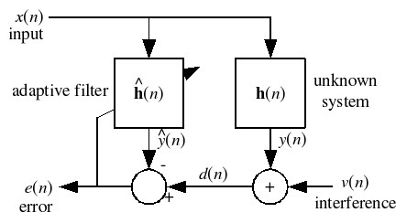
What kind of filter is this?

Slide 3
Experiment 1 – Estimation of a given filter
Load the input sequence x[n]
  Uniform distribution of 100 random integer numbers from -5 to 5
Filter it with a filter h[n] to obtain y[n]
  h[n] = [ 1/9 2/9 3/9 2/9 1/9 ]
Iterate an adaptive filter to get an estimate of h[n]

Slide 4
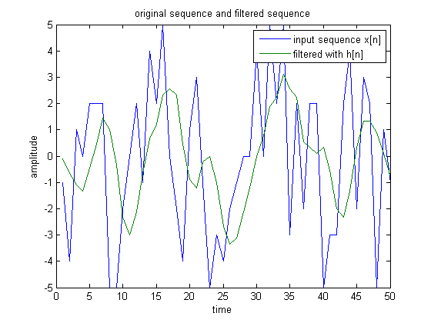
Results (1)

Slide 5
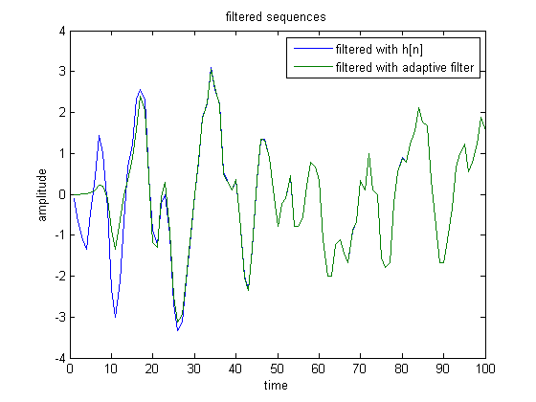
Results (2)

Slide 6
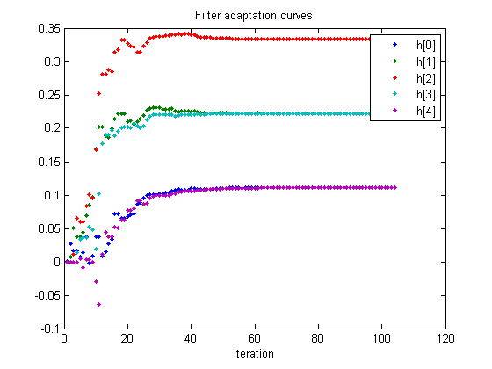
Results (3)

Slide 7
Experiment 2 – Denoising of quantization noise
Load 16 bit song and quantize it with 4bit
Iterate over a filter that can make the 4bit song sound more like the 16 bit song

Slide 8
Results
Listen carefully to 16 bit, 4 bit, and filtered version of 4 bit song

Slide 9



Analog Filter
K controls low frequency gain
P controls bandwith

Slide 10
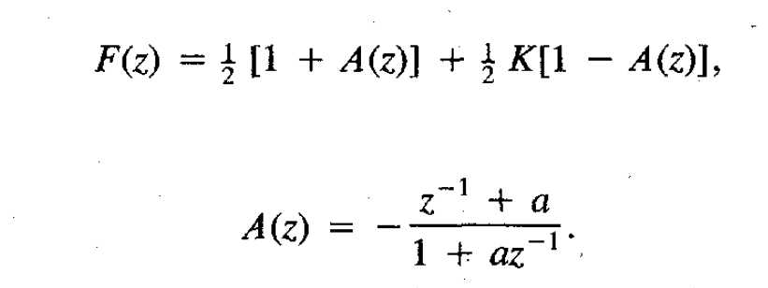
Digital Filter

Slide 11

Low pass to band pass
Final equation for the equalizer will have parameters a,b, and K.
a: controls bandwidth
b: controlscenter frequency
K: controls gain at the center frequency

Slide 12
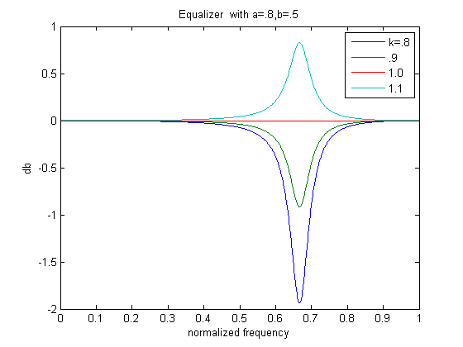

Slide 13
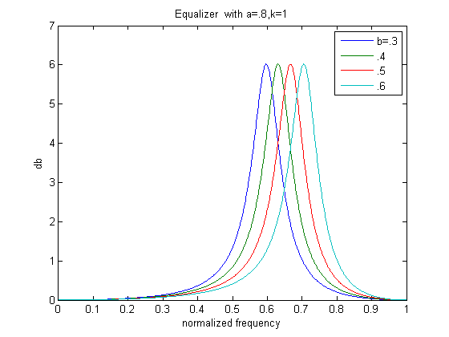

Slide 14
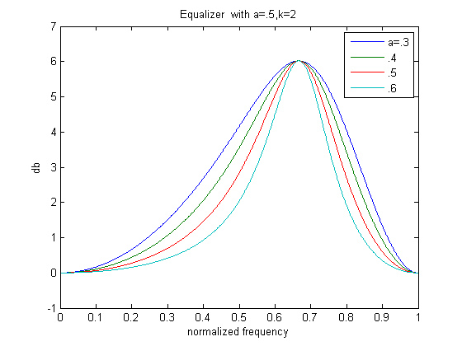

Slide 15
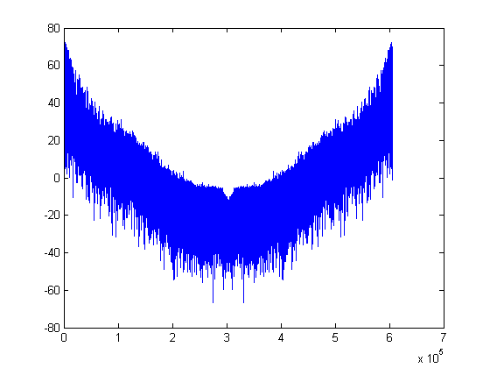

Slide 16
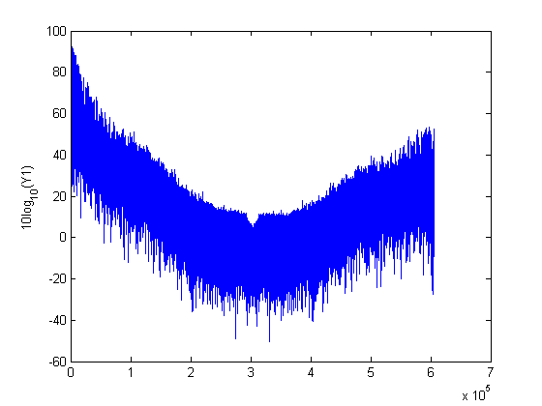

Slide 17
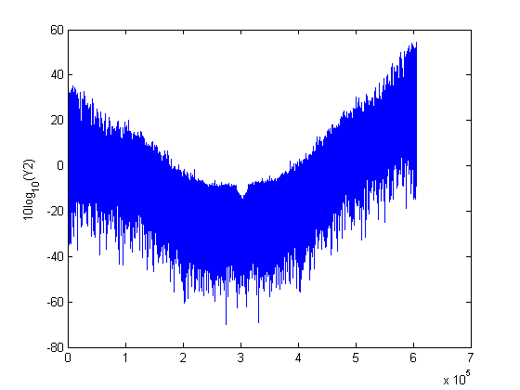

Slide 18
Conclusions
An adaptive filter can be used for estimating a filter, denoising a signal
By choosing the right parameters for an equalizer, we can enhance or remove the power of certain frequencies in the signal. The parameters are: gain at the center frequency, location of center frequency, and bandwidth of the equalizer

Slide 19
References
[1] Lecture 10 - Design IIR Digital Filter, Sos Agaian
[2] Tunable Digital Frequency Response Equalization Filters, Phillip A. Realia and Sanjit K. Mitra

