Slide 1
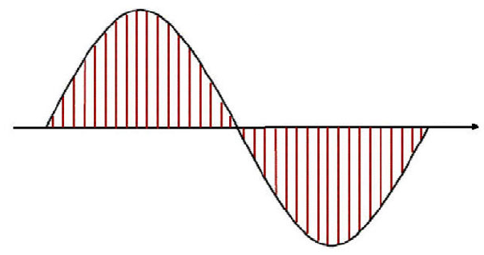
EE-5163 Digital Signal Processing
Project #2 - Audio Sampling & Quantization
Fall 2011
Jesus Luna @00883277 – Sampling
Quantization
Jafet Morales @00601612 – Sampling
Quantization

Slide 2
DSP Project 2
Objectives:
Understand effects of downsampling
Aliasing reduction by pre-filtering
Understand effects of quantization
Content:
Comparison between downsampled and original audio signals
Pre-filtering
Comparison between prefiltered signal and its downsampled signal
Quantization
Errors

Slide 3


Original flute audio signal
Original signal values:
Sampling rate: 22.05KHz
Signal resolution: 16 bits/sample
Size: (96375,1)
Undersampled signal values:
Sampling rate: 2.756KHz
Signal resolution: 16 bits/sample
Size: (12046,1)

Slide 4
Original signal vs. undersampled signal
Signal information is lost after undersampling, specially at low and high peaks.

Slide 5
Pre-filtering
To reduce aliasing after undersampling, a low pass filter is used on the original signal.
Cutoff frequency = ½ of under sampling frequency
Cutoff frequency = 1.378KHz

Slide 6
Low pass filter applied to signal
The low pass filter is used to eliminate all the frequencies above half the sampling rate.

Slide 7
Reconstruction of signal after filtering

Slide 8
Pre-filtered signals, original vs. undersampled
Aliasing was not as noticeable on the undersampled signal when a low pass filter was applied before sampling.

Slide 9

Quantization

Slide 10
Quantization
% QUANTIZATION ROUTINE
% IMPLEMENTATION BY JAFET MORALES AND JESUS LUNA
% QUANTIZATION EQUATION WAS OBTAINED FROM THE SYLLABUS FOR
% EE-5163-DIGITAL SIGNAL PROCESSING CLASS AT UNIVERSITY OF TEXAS AT SAN
% ANTONIO. INSTRUCTOR: SOS AGAIAN
% INPUTS:ORIGINAL SIGNAL,NUMBER OF LEVELS,VALUE FOR THE HIGHEST LEVEL
% OUTUTS:QUANTIZED SIGNAL
function y=quant(x,levels,maxv)
% DELTA IS THE SPACING BETWEEN LEVELS
delta=2*maxv/(levels-1);
y=maxv*double(x>=maxv)+(floor(x/delta)+.5)*delta.*double(x>(-maxv)&x<maxv)-maxv*double(x<=(-maxv));

Slide 11
Experiment
1. Read downsampled WAV file
3. Quantize signal
4. Save new downsampled and quantized WAV file

Slide 12
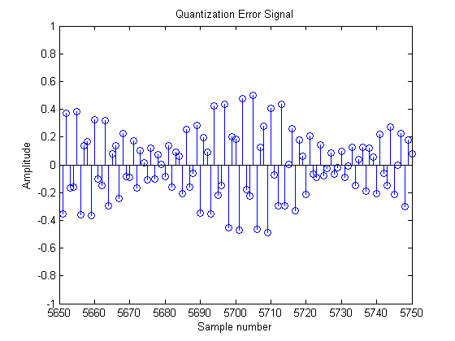
Original Signal

Slide 13
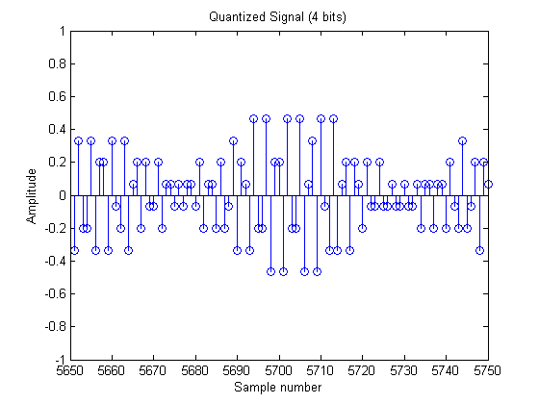
Quantized Signal (4 bits)

Slide 14
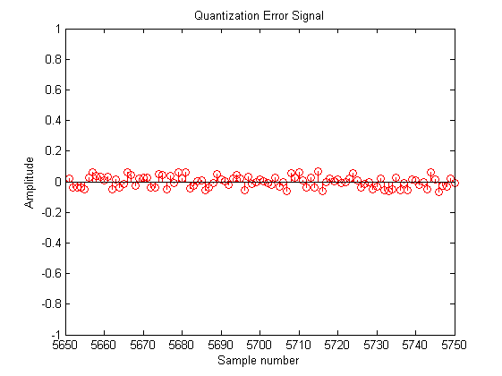
Quantization Error Signal

Slide 15
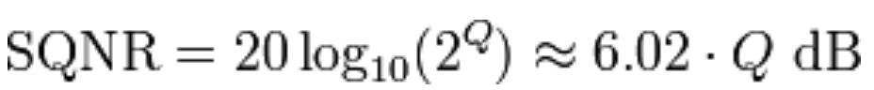
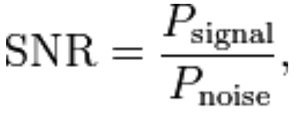
Quantization Error
When the quantization error is uniformly distributed between -1/2delta and 1/2delta and the signal is uniformly distributed across the range:
24.0824 dB
We calculated the signal to noise ratio using the error signal as a noise signal and obtained a lower SQNR:
10.3986 dB

Slide 16
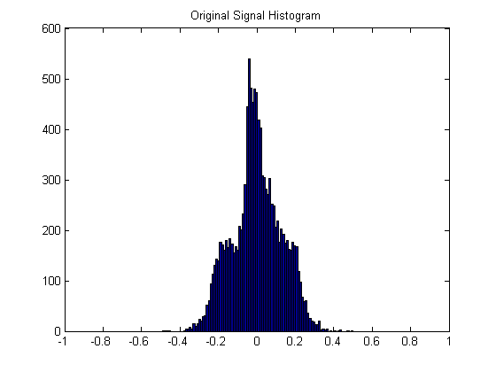
Our Signal Was Not Uniformly Distributed Across Range

Slide 17
Sources
Dr. Sos Agaian notes Fall 2011
https://ccrma.stanford.edu/~jos/sasp/Example_1_Low_Pass_Filtering.html
http://homepages.udayton.edu/~rhardie1/ECE203/sound.htm
http://www.cs.tut.fi/sgn/arg/intro/basics.html
http://www.eetimes.com/design/programmable-logic/4017985/Designing-Digital-Filters
http://www.dsplog.com/2007/06/17/interpreting-the-output-of-fft-operation-in-matlab/
http://eeweb.poly.edu/~yao/EE3414/quantization.pdf
http://www.mathworks.com/help

