Slide 1
Contents:
Abstract
Introduction
Literature Survey
Existing System
Proposed System
Block Diagram
Methodology
Software Requirements
Code
Snapshots
Figures
Advantages
Conclusion
Future scope
References

Slide 2
Abstract
A challenging aspect of scene text recognition is to handle text with distortions or irregular layout. In particular, perspective text and curved text are common in natural scenes and are difficult to recognize.
In this work, we introduce ASTER, an end-to-end neural network model that comprises a rectification network and a recognition network. The rectification network adaptively transforms an input image into a new one, rectifying the text in it.

Slide 3
Contd:
It is powered by a flexible Thin-Plate Spline transformation which handles a variety of text irregularities and is trained without human annotations.
The recognition network is an attentional sequence-to-sequence model that predicts a character sequence directly from the rectified image. The whole model is trained end to end, requiring only images and their ground truth text.

Slide 4
Introduction
Scene text recognition has attracted great interest from the academia and the industry in recent years owing to its importance in a wide range of applications.
Recent advances in scene text recognition are driven by the success of deep learning-based recognition models.
Among them are methods that recognize text by characters using convolutional neural networks (CNN), methods that classify words with CNNs and methods that recognize character sequences using a combination of a CNN and a recurrent neural network (RNN)].

Slide 5
contd:
Our method falls into the category of structured learning. It is based on the attentional sequence-to-sequence learning models [13], [14]. Such a model learns to predict an output sequence from an input sequence and was originally proposed for machine translation and speech recognition tasks.
The proposed project introduces ASTER, which stands for Attentional Scene TExt Recognizer with Flexible Rectification, for scene text recognition. ASTER tackles the irregular text problem with an explicit rectification mechanism.

Slide 6
LITERATURE SURVEY
In paper [1], [2] focus on document text recognizition methods.
Paper [3] discuss about binarization methods that are often adopted for segmenting characters. Limitation of this method, when applied to scene text, these methods fail to handle the large variation in text appearance and the noise in natural images.
Paper [4], [5] and [6] discuss how to adopt deep neural networks for text recognition. Some methods use convolutional neural networks, (CNNs) to localize and recognize characters.

Slide 7
Contd..
Paper [7], [8], [9] how to create two CNNs to localize and recognize characters respectively, follows a similar approach but used only one CNN to perform both tasks simultaneously.

Slide 8
Existing System
Optical Character Recognition (OCR) systems dedicated to document text, scene text recognition remains a challenging problem. The large variations in background, appearance, and layout pose significant challenges, which the traditional OCR methods cannot handle effectively.
Using convolutional neural networks (CNN), methods that classify words with CNNs and methods that recognize character sequences using a combination of a CNN and a recurrent neural network (RNN)].

Slide 9
Existing System Contd…
In spite of their success, these methods do not explicitly address the problem of irregular text, which is text that is not horizontal and frontal, has curved layout, etc. Instances of irregular text frequently appear in natural scenes. Typical cases include oriented text, perspective text, and curved text.

Slide 10
Proposed System
ASTER, an end-to-end neural network model that comprises a rectification network and a recognition network.
The rectification network adaptively transforms an input image into a new one, rectifying the text in it.
It is powered by a flexible Thin-Plate Spline transformation which handles a variety of text irregularities and is trained without human annotations.

Slide 11
Contd:
The recognition network predicts a character sequence from the rectified image in an attentional sequence-to sequence manner. Built on the attention mechanism proposed in the recognition network effectively encapsulates character detection, character recognition, and language modelling into a single model, achieving accurate recognition. Furthermore, we extend the traditional unidirectional decoder into a bidirectional one. The bidirectional decoder consists of two decoders with opposite decoding directions. It merges the outputs of both decoders, leveraging the dependencies in both directions.

Slide 12

Block Diagram
Given an input image, the rectification network transforms the image to rectify the text in it through an extensive set of experiments on a number of standard datasets.

Slide 13
Contd:
The recognition network predicts a character sequence from the rectified image in an attentional sequence-to sequence manner.
Built on the attention mechanism proposed in the recognition network effectively encapsulates character detection, character recognition, and language modelling into a single model, achieving accurate recognition.

Slide 14
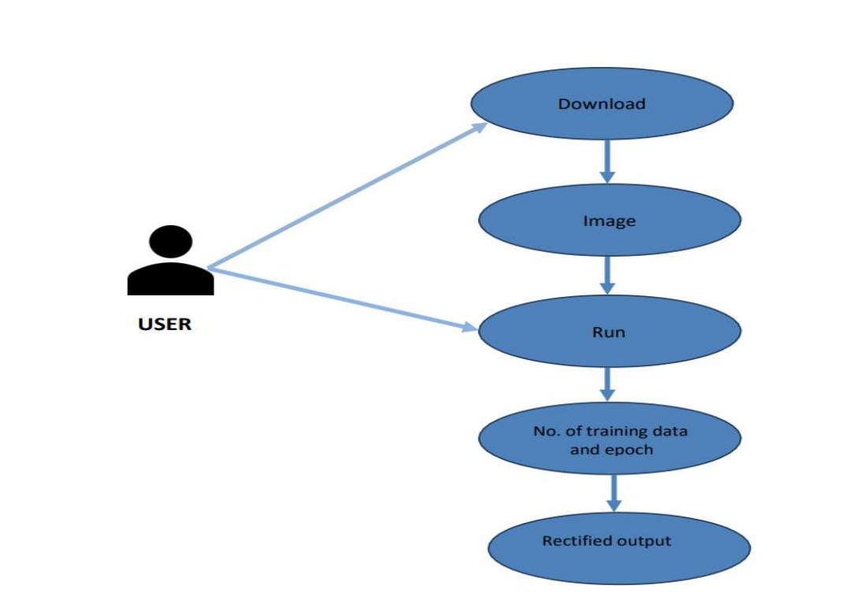
Methodology:

Slide 15
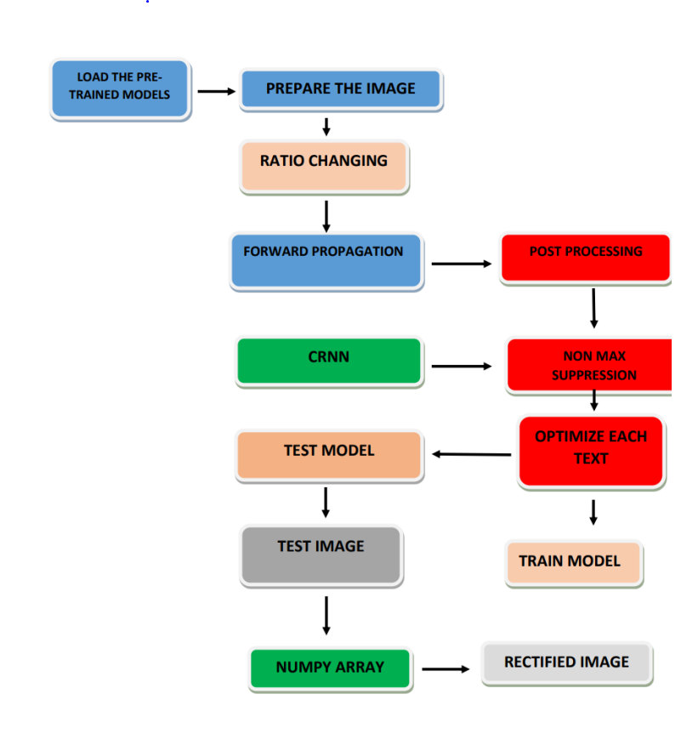

Slide 16
System Requirements
Software Tools:
Anaconda 3
Numpy
Pandas
Matplot
Pytorch
Jupyter Note book
Python 3.10

Slide 17
Contd:
Domain: Machine Learning, Deep learning
Programming language: Python
Operating System: Windows 10 and above
Hardware Requirement:
Computer with 4GB RAM and 500GB and i5 Processor

Slide 18
Sample code:
import cv2
import numpy as np
from imutils.object_detection
import non_max_suppression img = cv2.imread('D:/downloads/OCR_LNP.PNG’)
## ------------- Load the pre-trained models ---------------
model = cv2.dnn.readNet('D:/downloads/frozen_east_text_detection.pb') model1 = cv2.dnn.readNet('D:/downloads/crnn.onnx’)
## ------------- Prepare the image ----------------
# use multiple of 32 to set the new img shape
height, width, _ = img.shape
new_height = (height//32)*32
new_width = (width//32)*32
print(new_height, new_width)
# get the ratio change in width and height
h_ratio = height/new_height
w_ratio = width/new_width
print(h_ratio, w_ratio)
blob = cv2.dnn.blobFromImage(img, 1, (new_width, new_height),(123.68, 116.78, 103.94), True, False)

Slide 19
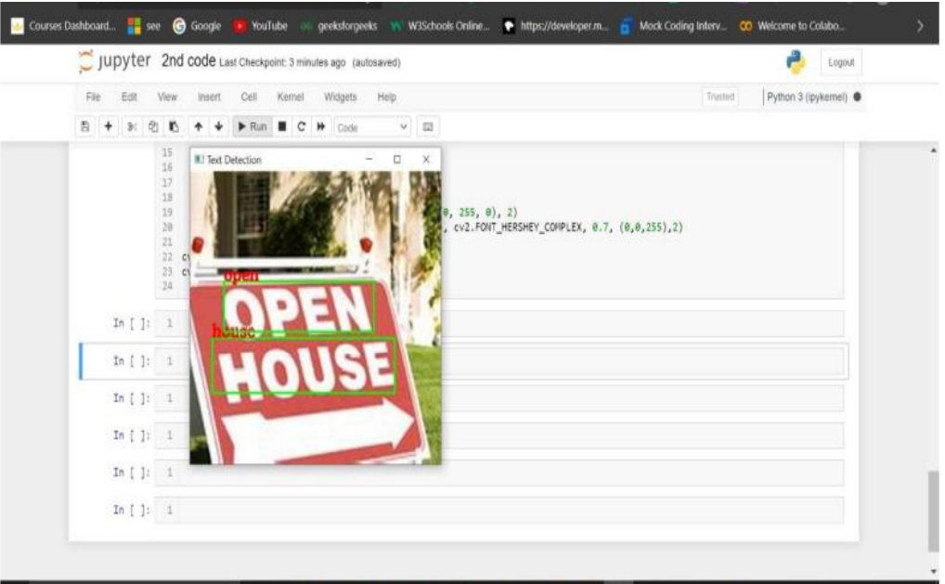
Snapshots:

Slide 20
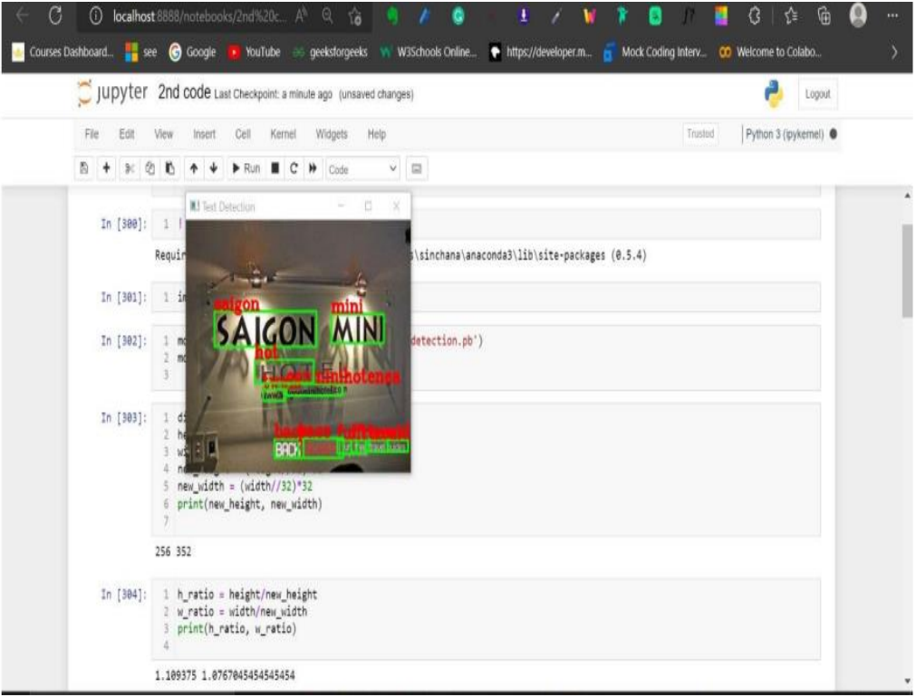

Slide 21
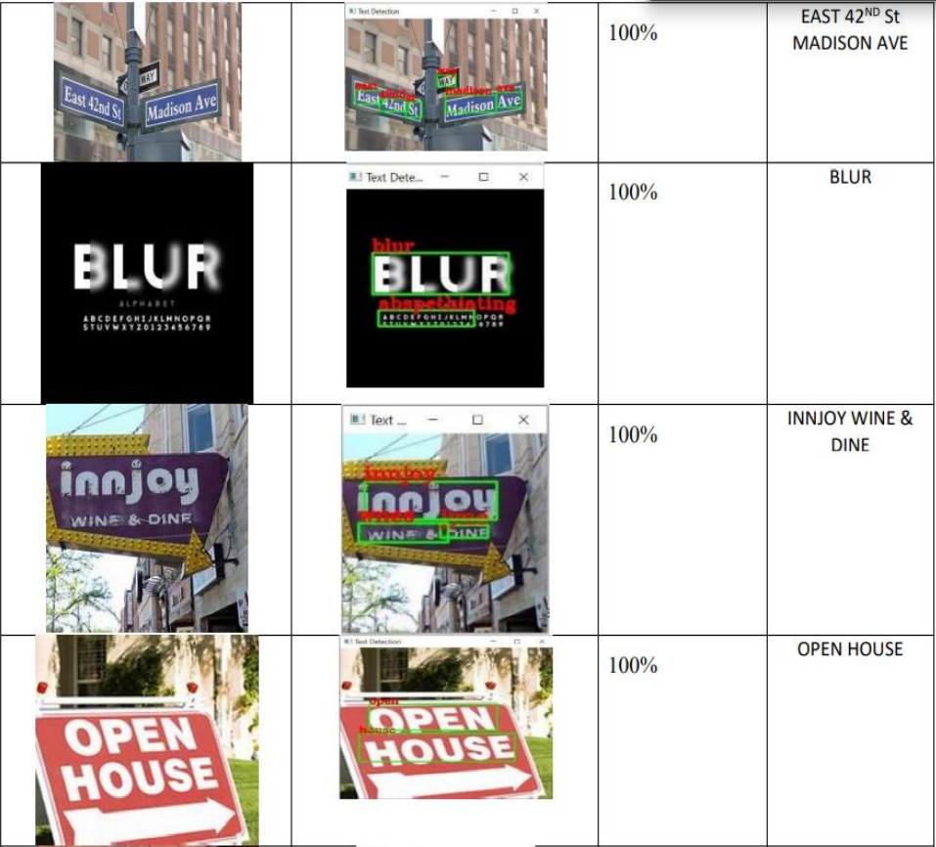

Slide 22
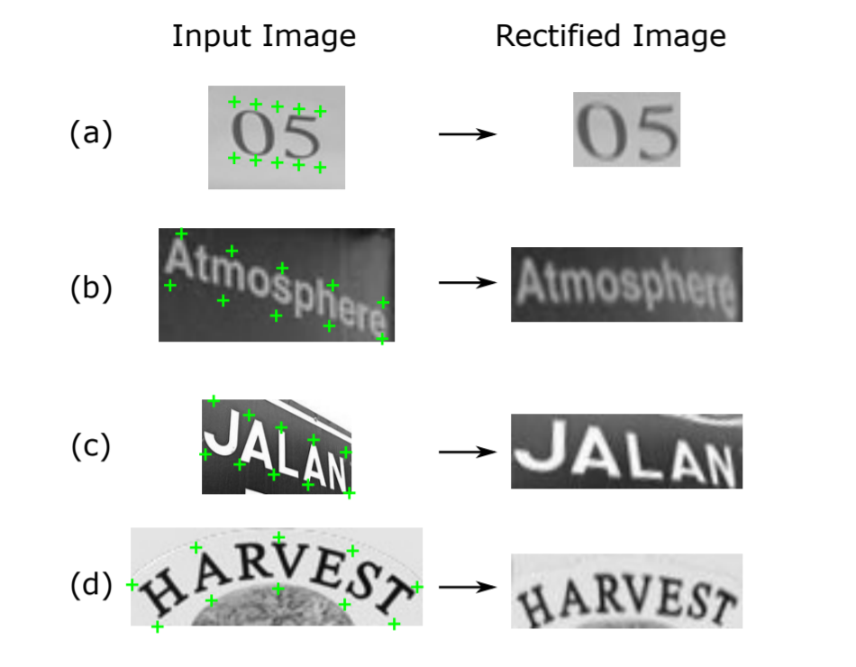
Figures:
Fig:- Image Rectification

Slide 23
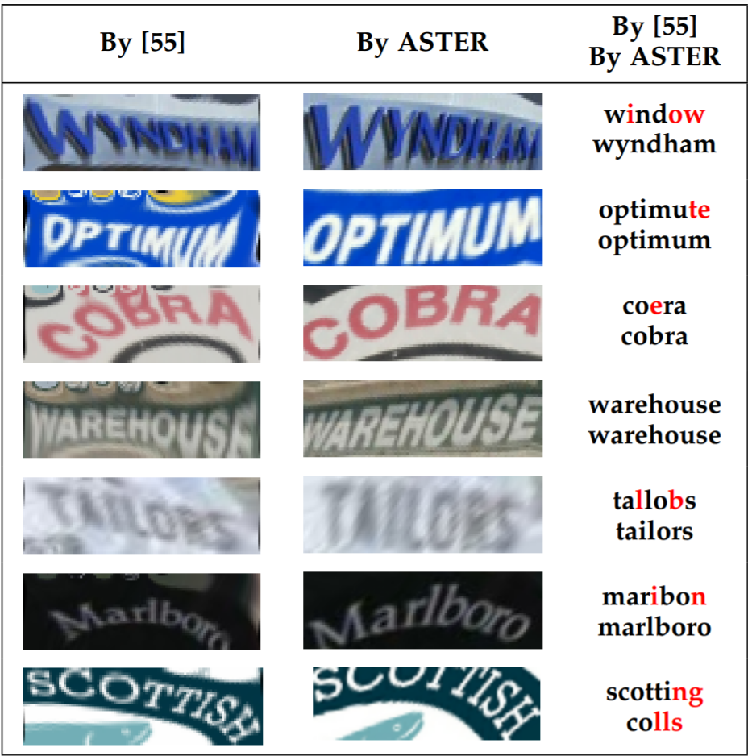
Contd:
Fig:- Existing and proposed system text recognition

Slide 24
Advantages
It handles a variety of text irregularities and is trained without human annotations.
ASTER tackles the irregular text problem with an rectification mechanism.
The text recognition network predicts a character sequence directly from the rectified image.
ASTER can rectify detection boxes via its rectification network.
ASTER shows extra merits in terms of strengthening text detectors.

Slide 25
Conclusion
This proposed project work will address the irregular text recognition problem with an explicit rectification mechanism based on the STN framework and the TPS transformation. The resulting text recognizer, called ASTER, shows superior performance on cropped text recognition and end-to-end recognition tasks.

Slide 26
Future Scope
The purposes of this survey are three-fold: 1) introduce up-to-date works, 2) identify state-of-the-art algorithms, 3) predict potential research directions in the future.
The project has a very vast scope in future. The project can be implemented on intranet in future. Project can be updated in near future as and when requirement for the same arises, as it is very flexible in terms of expansion hence run the entire work in a much better, accurate and error free manner

Slide 27
Future Scope contd:
As one of the most influential inventions of humanity, has played an important role in human life, so far from ancient times. The rich and precise information embodied in text is very useful in a wide range of vision-based applications, therefore text detection and recognition in natural scenes have become important and active research topics in computer vision and document analysis. Especially in recent years, the community has seen a surge of research efforts and substantial progresses in these fields, though a variety of challenges (e.g. noise, blur, distortion, occlusion and variation) still remain.

