Slide 1
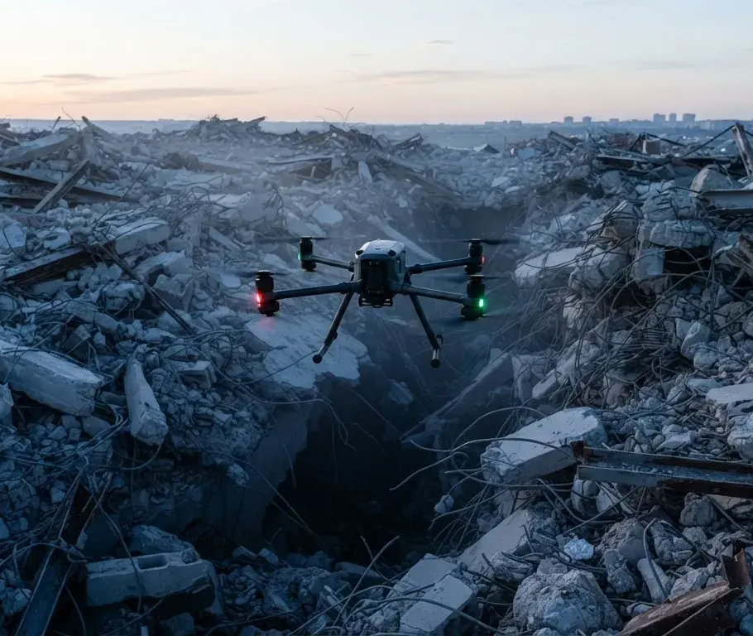
AURA
AURA: Autonomous Search
& Rescue Telemetry Node
Eliminating the rescue blind
spot in the "Golden Hour" of
disaster.

Slide 2
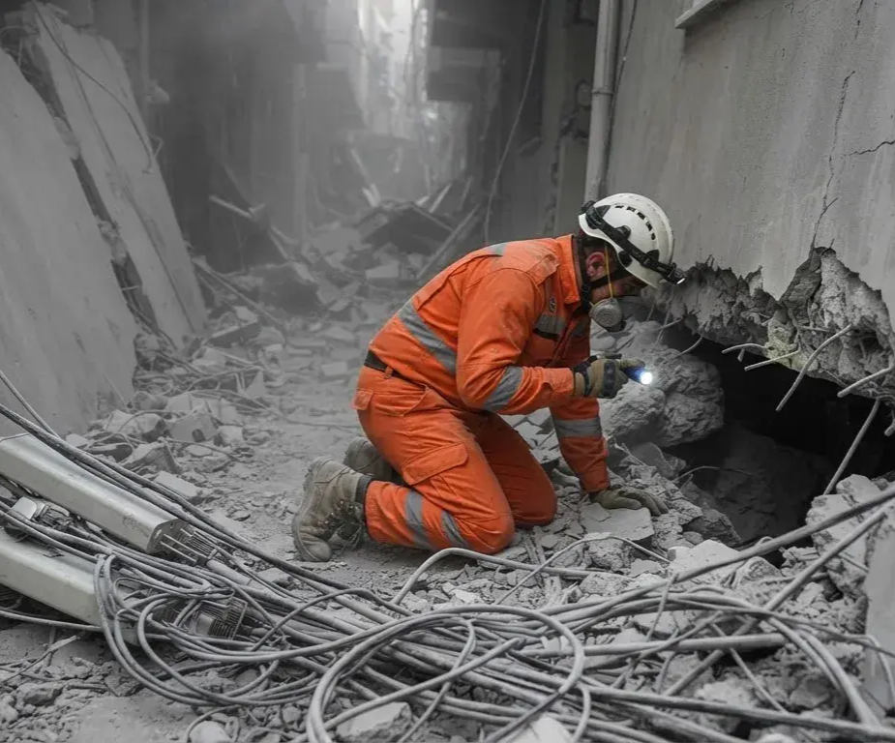
The Golden Hour
Crisis
Infrastructure Collapse
Cellular towers and power grids are instantly
destroyed, leaving responders in the dark.
Blind Search
Responders are forced to search vast, unstable
debris fields without real-time data.
Equipment Barriers
Existing radar is fragile, expensive (₹5-10
Lakhs), and relies on active networks.
When disaster strikes, the first 60 minutes
decide the fate of trapped victims.

Slide 3
A rapidly deployable
The AURA Swarm
system of autonomous
nodes designed to enter
Deployment
structural fissures before
humans.
Low-Cost
Decentralized
Surgical
Precision
Manufactured for
Creates its own
under ₹800 per
offline local Wi-Fi
Scans for
node, allowing for
telemetry beacon
survivable voids
sacrificeable
without needing
and provides exact
swarm deployment.
cellular backhaul.
GPS coordinates
for extraction.

Slide 4
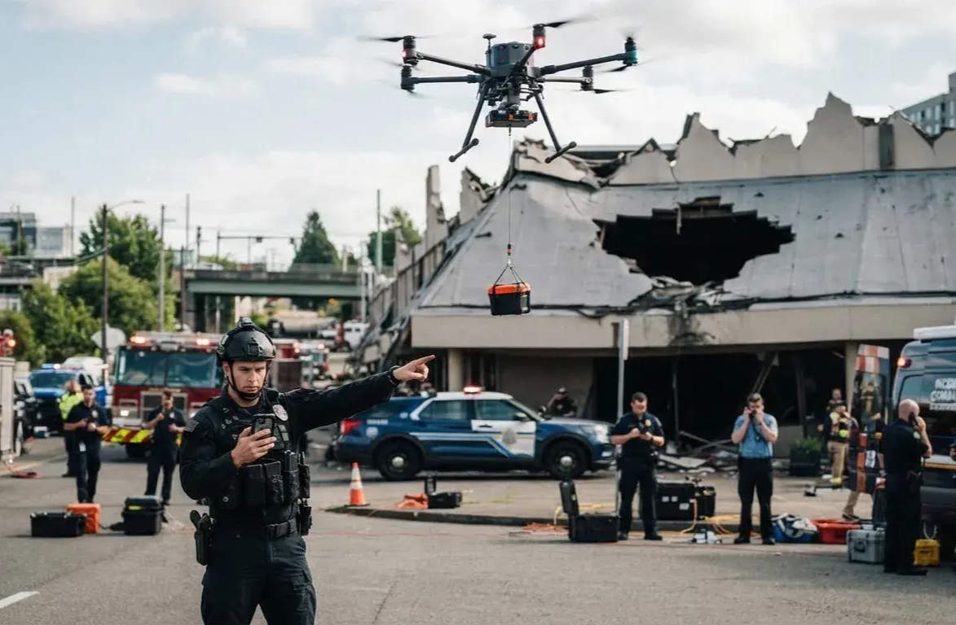
Operational Process
Flow
How AURA moves from drone deployment
to life-saving tactical data.
01
02
03
04
05
Drone Deployment
Edge Void Detection
Geospatial Locking
Autonomous
Tactical Dashboard
Beacon
Nodes are dropped directly
Ultrasonic pulsing
Onboard GPS queries
The node initializes an
Responders connect via
into inaccessible structural
measures clearance to
satellites to lock exact
independent, local
smartphone to view depth
fissures.
identify survivable cavities.
latitude and longitude.
emergency Wi-Fi network.
and pinpoint coordinates.

Slide 5
Robust edge computing
System Architecture Map
and sensory arrays
designed for extreme
disaster environments.
Unconnected
Edge
Sensory Input
Location
Connected
Device
Processing
Ultrasonic array for
Tracking
Device
Limited processing
ESP32
void clearance
Active satellite GPS
Decentralized
and communication
microcontroller
module
emergency
onboard processing
broadcast

Slide 6
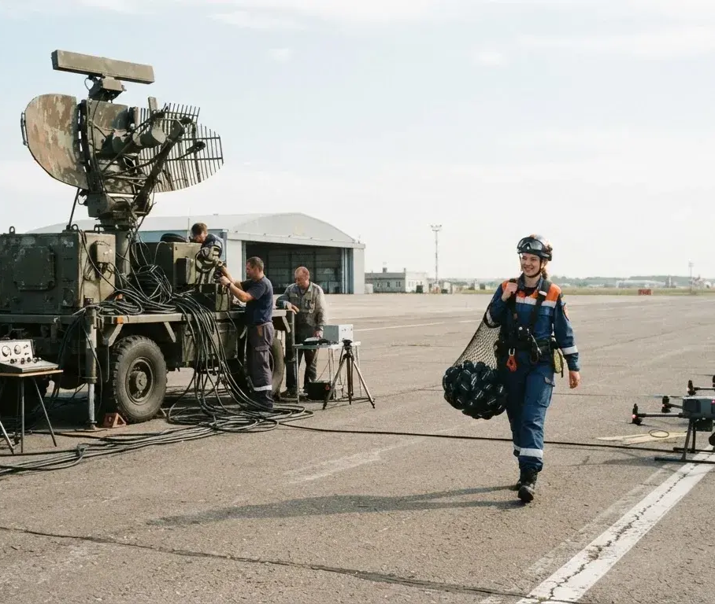
Traditional Rescue
Unit Cost
Traditional Radar (₹5L-10L) vs. AURA Node
vs. AURA System
(Under ₹800).
Deployment Risk
High equipment loss vs. Sacrificeable drone-
deployable nodes.
Network Dependency
Requires active backhaul vs. 100%
autonomous offline network.
Search Strategy
A paradigm shift in cost-efficiency,
Slow manual surface sweeps vs. Simultaneous
deployment risk, and search strategy.
grid mapping via swarm.

Slide 7
Technical Implementation
The AURA node utilizes an
ESP32 microcontroller to
run a localized web server.
Responder
Access
Wi-Fi Network
Broadcast
JSON Payload
Creation
GPS
Coordinate
Void
Acquisition
Detection
Ultrasonic
Data
Processing

