Slide 1


Slide 2

Introduction
What is e-commerce

Slide 3
Project Proposal
BACKGROUND HISTORY
PROBLEM STATEMENT
solution
TOOLS BEING UTILIZED

Slide 4
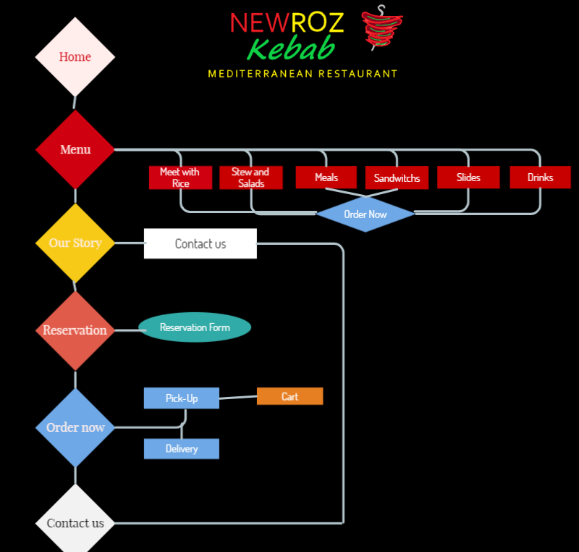

Slide 5
FOOD CLASSIFICATION
Meat with rice
Sandwiches
Sides
Ground beef Kebab
Chicken Tikka
Beef kebab with beef tikka
Lamb kebab with lamb tikka
Beef tikka
Chicken shawarma with rice
Chicken tikka beef kebab mix
Chicken tikka with lamb mix
Falafel meal
Mixed meal plate
Naan
Baklava
Fries
Stew and Salads
Falafel sandwich with fries
Sherwarma sandwich with fries
Chicken shawarma sandwich with fries
Chicken wrap with fries
Steak with Fries
Hummus with naan
Lamb kebab salad
Chicken tikka salad
Steak salads
Lamb stew
Meals
10 pc falafel meal with fries
Mixed plate meal for 2
Drinks
Sodas
Tea

Slide 6
Conclusion
What is next?

Slide 7

ANY QUESTIONS

