Slide 1

Breast Cancer Analytics
Jagadish Rao
Google Data Analytics Capstone Project
Dec 2021

Slide 2
Introduction
Cancer is a disease that inflicts its pain, suffering, disfigurement and eventual death if not detected and treated early.
For women, breast cancer is a silent killer that can strike anytime, so knowing and proactively acting on the disease patterns is critical.
The identification of breast cancer trends in the USA has been selected for this capstone project.
This analysis is approached from a data analytics perspective and has no claims to being a substitute or auxiliary to a professional medical study or advice.

Slide 3
Analysis Objectives
There are many open questions that this analysis seeks to answer:
Does cancer rate vary by geographical location
Does race play a part
Does increasing age lead to a higher risk
Is there a relationship between race and age as related to cancer risk

Slide 4
Raw Data
United States Cancer Statistics - Incidence: 1999 - 2018, WONDER Online Database. United States Department of Health and Human Services Centers for Disease Control and Prevention and National Cancer Institute; 2021.
Dataset: United States and Puerto Rico Cancer Statistics, 1999-2018 Incidence https://wonder.cdc.gov/cancer-v2018.HTML
Standard Population: 2000 U.S. Std. Million
Cancer incidence (rate) data is standardized to a population of 100k.
The downloaded raw data files are tab delimited text files with Header.
breast_cancer_2000_2004.txt
breast_cancer_2005_2009.txt
breast_cancer_2010_2013.txt
breast_cancer_2014_2018.txt

Slide 5
Analysis Tools
Environment: RStudio 2021.09.1+372 “Ghost Orchid” for macOS
Language: R
Libraries: tidyverse; here; janitor; skimr; validate; usmap
Functions:
bind_rows ()
clean_names ()
select ()
rename ()
skim ()
tabyl ()
confront()
group_by ()
summarise ()
ggplot ()
plot_usmap ()

Slide 6
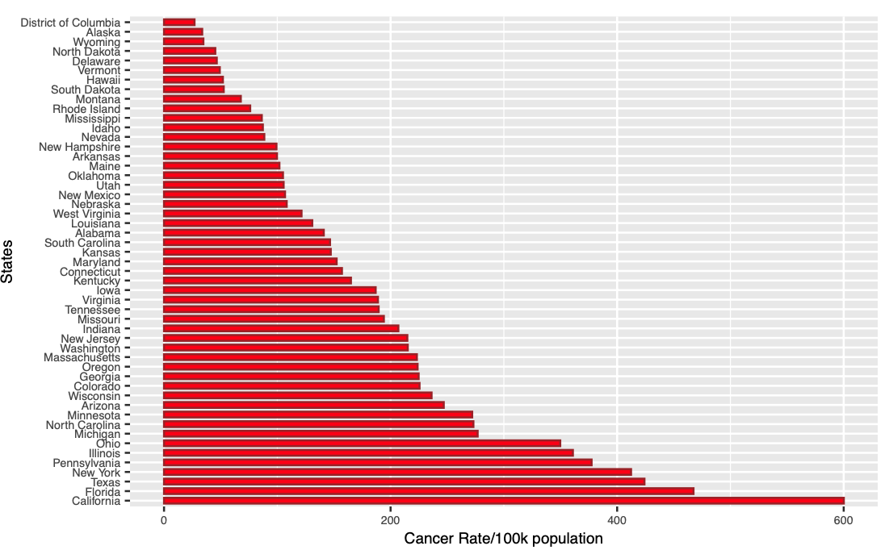
Breast Cancer Rate by State
Years 2003 − 2017

Slide 7
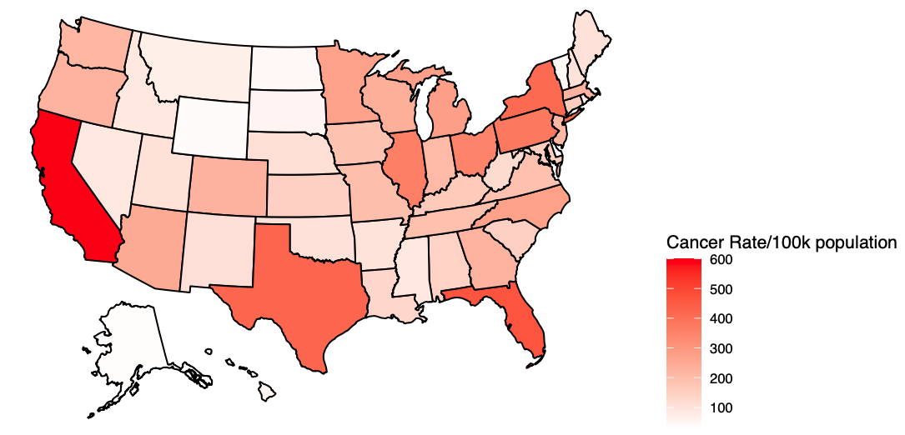
Breast Cancer Rate by State
Years 2003 − 2017

Slide 8
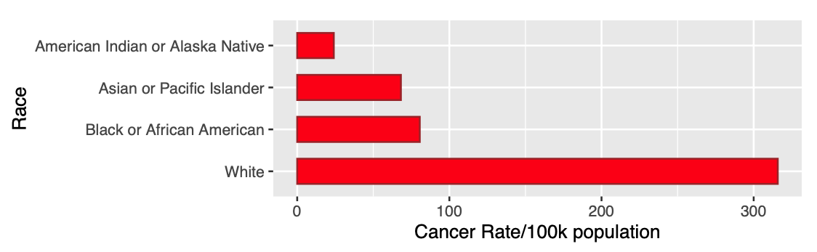
Breast Cancer Rate by Race
Years 2003 − 2017

Slide 9
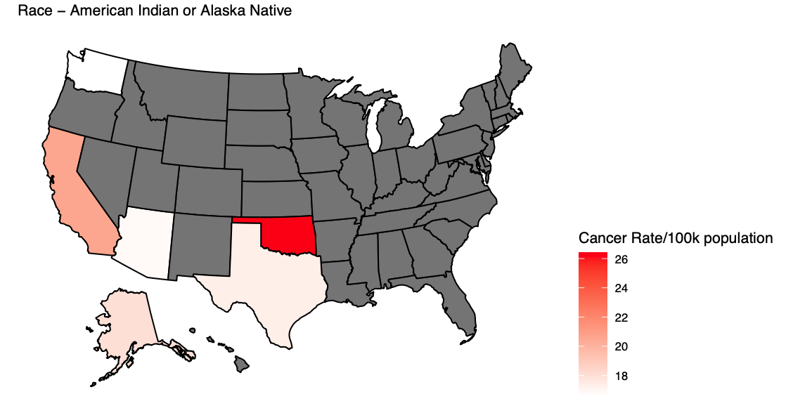
Breast Cancer Rate by State and Race
Years 2003 − 2017
Gray indicates No Data

Slide 10
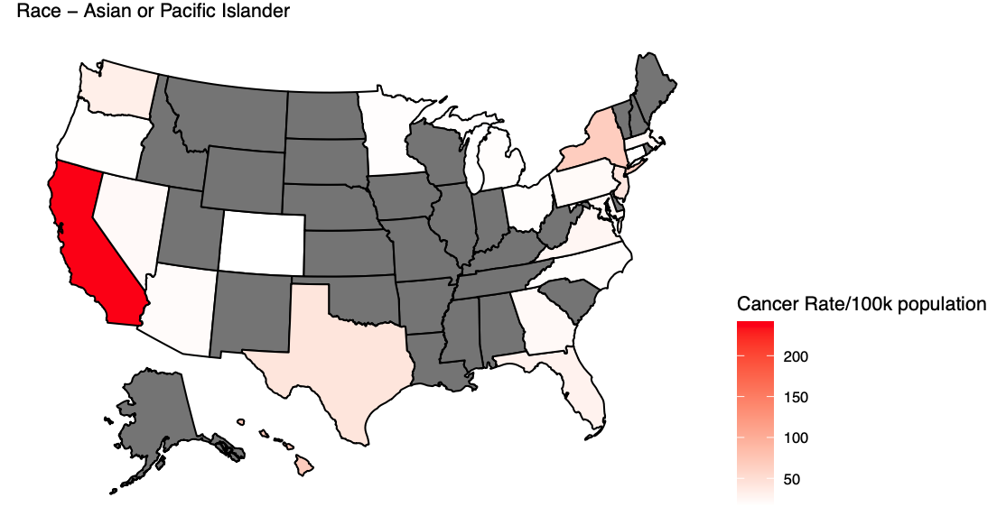
Breast Cancer Rate by State and Race
Years 2003 − 2017
Gray indicates No Data

Slide 11
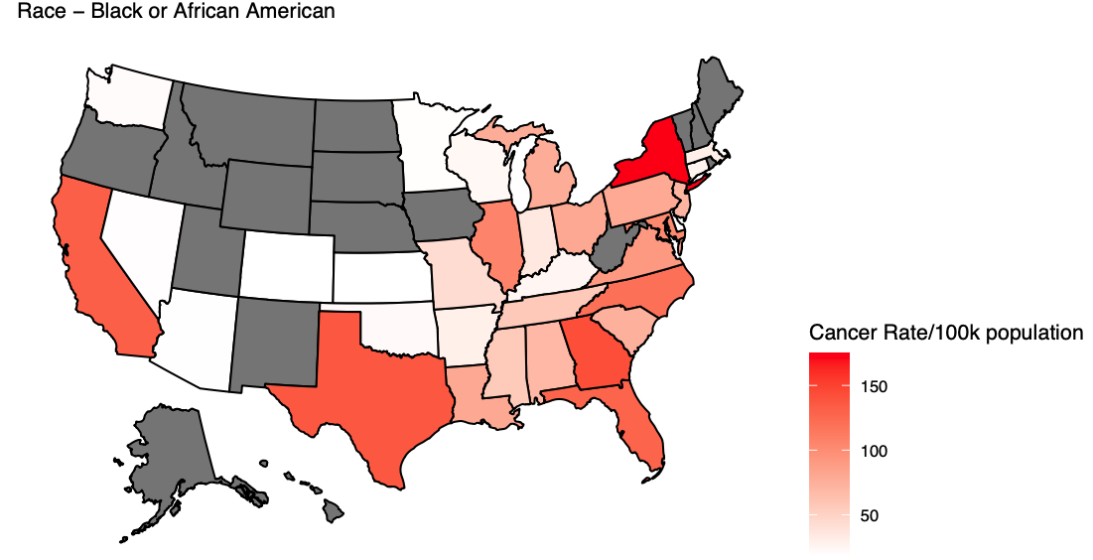
Breast Cancer Rate by State and Race
Years 2003 − 2017
Gray indicates No Data

Slide 12
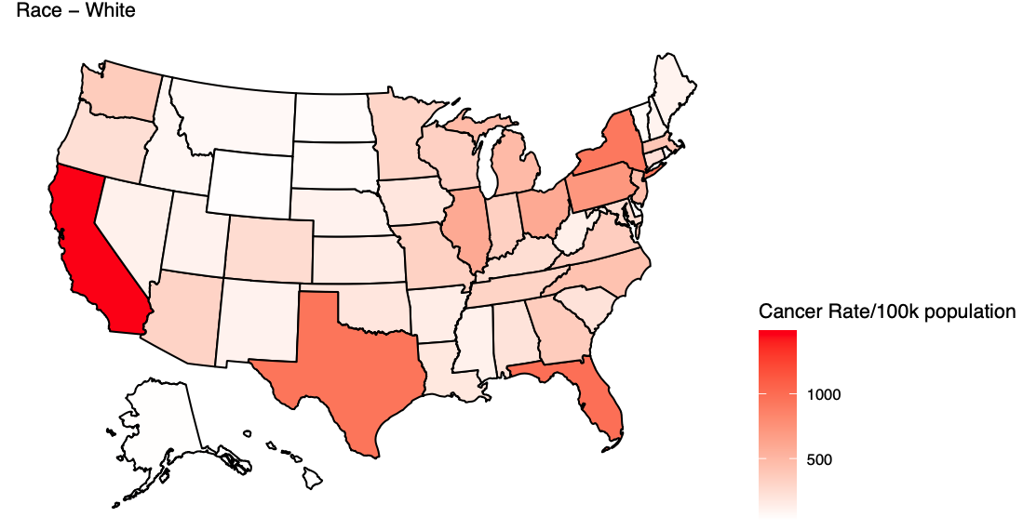
Breast Cancer Rate by State and Race
Years 2003 − 2017

Slide 13
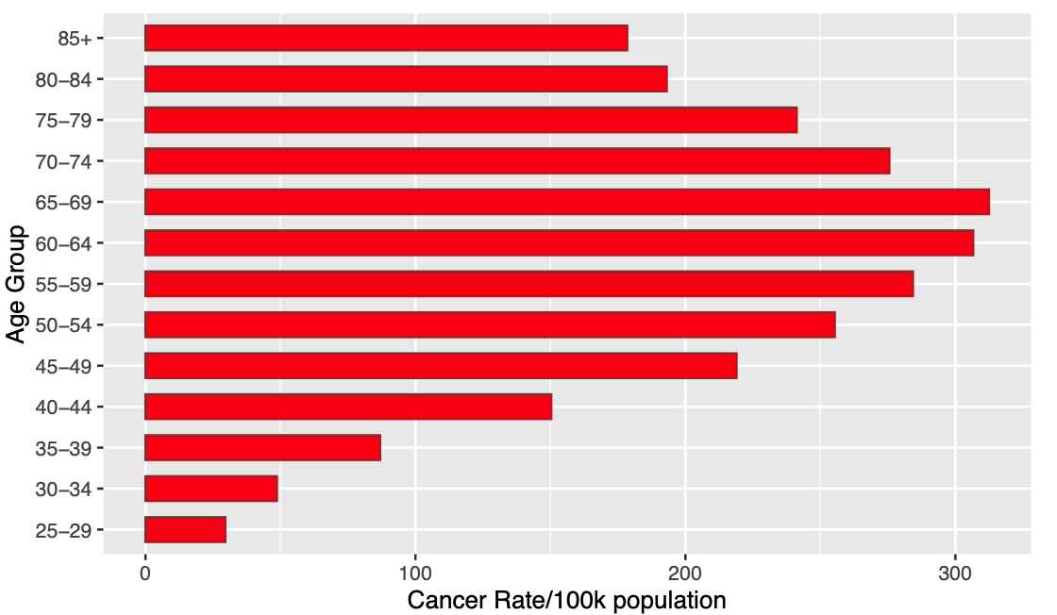
Breast Cancer Rate by Age group
Years 2003 − 2017

Slide 14
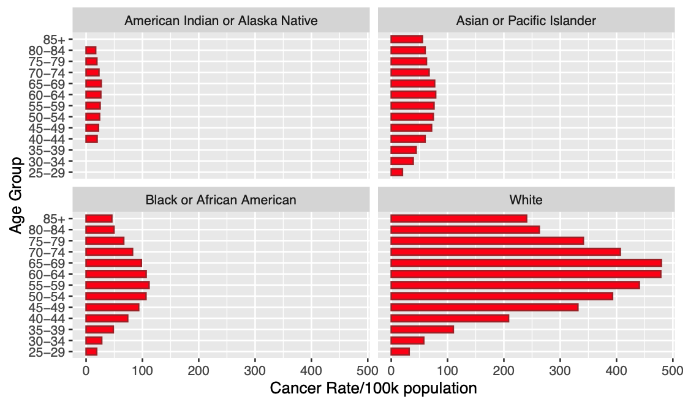
Breast Cancer Rate by Age group and Race
Years 2003 − 2017

Slide 15
Conclusions
1. Cancer incidence rate varies by geographical location (State). Since individual states are comprised of populations of different races and ages, it is the composite of these variables that determines the cancer rate of a state.
2. Race has an impact on the cancer rate with White being the highest. This may be due to factors such as lifestyle and genetics, and it is possible for results to be influenced by additional factors listed below.
3. Increasing age leads to a higher risk, with a peak at 65-69 years followed by decreasing risk. This is observed across all races, however the overall cancer rate varies by race, with White being the highest.
4. There is a relationship between race and age related cancer risk. The pattern of increasing cancer rate as age increases upto 65 years followed by a decline is consistent across all races.

Slide 16
Additional Factors not addressed by this Analysis
Better access to medical care that leads to a higher detection/incidence rate
Child bearing
Dietary choices
Income levels that afford access to medical care or preclude it
Awareness and motivation for regular breast cancer screening
In conclusion, there are numerous factors, many of which are outside the scope of this analysis that play a part in predicting a breast cancer probability. The variables used in this analysis are historical statistics that only serve as trend indicators and merit deeper scientific scrutiny with relevent datasets.

