Slide 1
The Smartest AI Nutrition Assistant
CAPSTONE PROJECT
Presented By:
Gorantla Jagadeep – Malla Reddy University – CSE(Cyber Security)

Slide 2
OUTLINE
Problem Statement (Should not include solution)
Proposed System/Solution
System Development Approach (Technology Used)
Result (Output Image)
Conclusion
Future Scope
References

Slide 3
Problem Statement
Currently, many individuals struggle to maintain a healthy diet due to lack of personalized guidance and easy access to credible nutritional information. It is important to provide users with meal recommendations that align with their health goals, dietary preferences, and local food availability. Eventually, delivering a virtual assistant that offers consistent, personalized meal planning becomes a critical requirement. The crucial part is the dynamic generation of diet plans tailored to user inputs, powered by generative AI, to ensure practical and sustainable nutritional habits.

Slide 4
Proposed Solution
The proposed system offers personalized, affordable, and balanced meal plans by using AI and user inputs. It is built on IBM Cloud Lite or Granity, tailored to individual dietary preferences, health goals, and restrictions.
1. Data Collection
User Inputs:
Dietary preferences (vegetarian, non-vegetarian, vegan)
Allergies or restrictions (e.g., lactose intolerance, gluten-free)
Health goals (e.g., weight loss, muscle gain, diabetic-friendly)
Meal type preferences (e.g., light dinner, high-protein breakfast)
Number of meals per day (e.g., 3 meals + 1 snack)
2. Data Preprocessing
Normalize and structure user input (e.g., one-hot encoding)
Map preferences to nutrition requirements
Exclude meals containing allergens or restricted ingredients

Slide 5
Proposed Solution
3. Meal Plan Generation
Use generative AI or rule-based logic (Watson NLP, LangChain)
Generate daily meal combinations (breakfast, lunch, snack, dinner)
Ensure each meal is under 60 characters and budget-friendly
Match meals to health goals and dietary rules
Promote variety, regional relevance, and taste balance
4. Deployment
Interface: IBM Watson Assistant (chat or voice)
Backend logic: IBM Cloud Functions
Storage: IBM Cloud Object Storage or Granity
Optional: Voice input via IBM Watson Speech APIs
5. Evaluation
User satisfaction (thumbs up/down on suggestions)
Alignment with user input and nutrition goals
A/B testing for logic improvement

Slide 6
Proposed Solution
Result
Users receive a full-day meal plan (4 meals) that is:
Customized to their needs and goals
Affordable, accessible, and nutritionally balanced
Accompanied by health benefits like "high in fiber", "good for digestion", etc.
Closing Message Example:
Thanks for chatting with Nutrition Agent! Your personalized meal plan is ready. Stay consistent, stay healthy.
Explore more at: Conferbot Nutrition Advisor

Slide 7
System Approach
Nutrition Meal Planner
Requirements:
Laptop (4GB+ RAM), Python 3.8+, IBM Cloud Lite
Libraries:
pandas, numpy – data | langchain, transformers – AI
streamlit – UI | ibm_watson, speech_recognition – APIs
Methodology:
Input: User preferences, allergies, goals
Processing: Map to nutrients, filter allergens
AI Engine: Suggest 60-char affordable Indian meals
Output: Daily meal plan with health tags
Deployment: IBM Watson Assistant + Cloud Functions

Slide 8
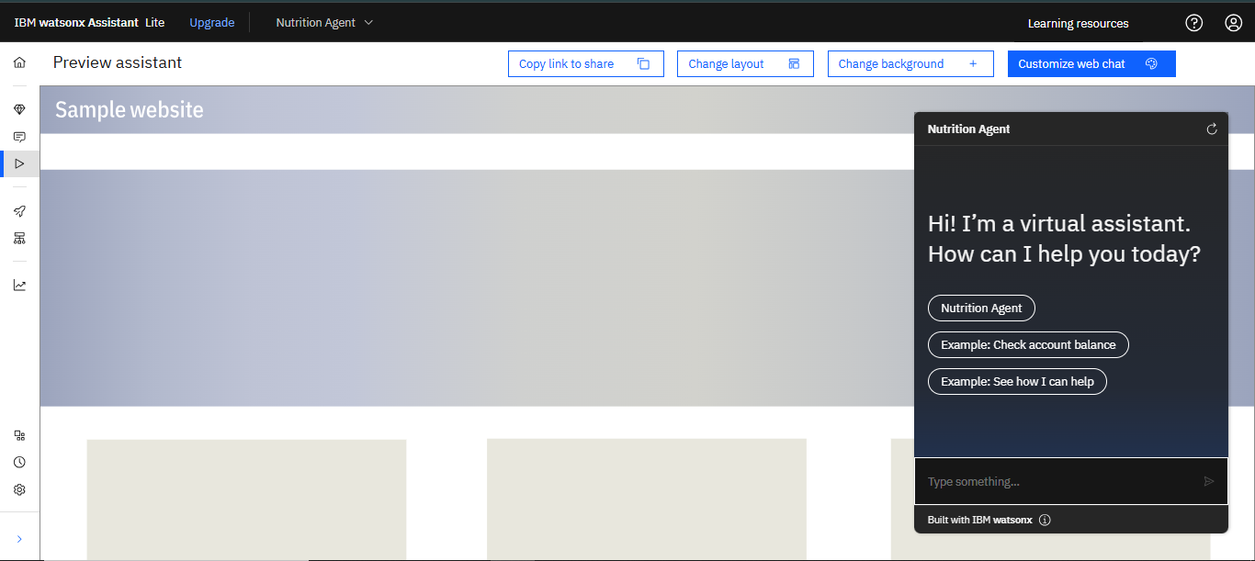
Result

Slide 9
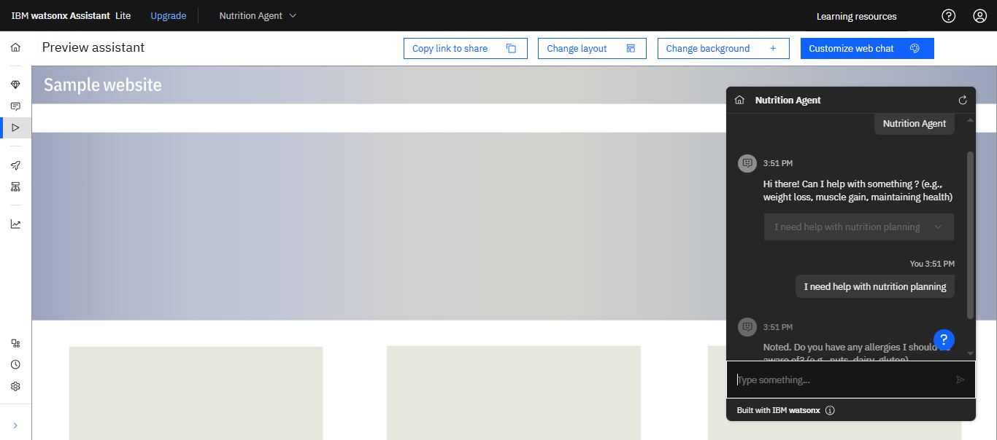
Result

Slide 10
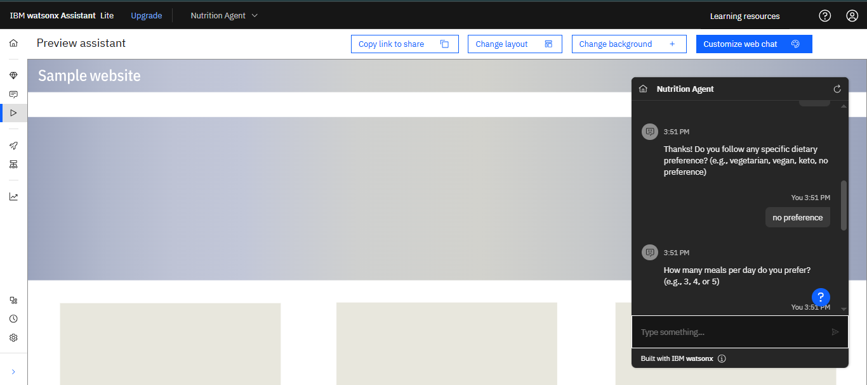
Result

Slide 11

Result

Slide 12
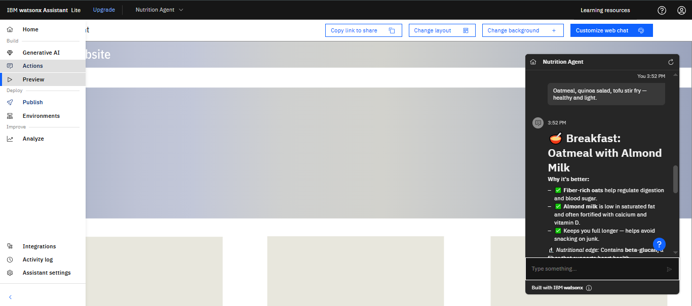
Result

Slide 13
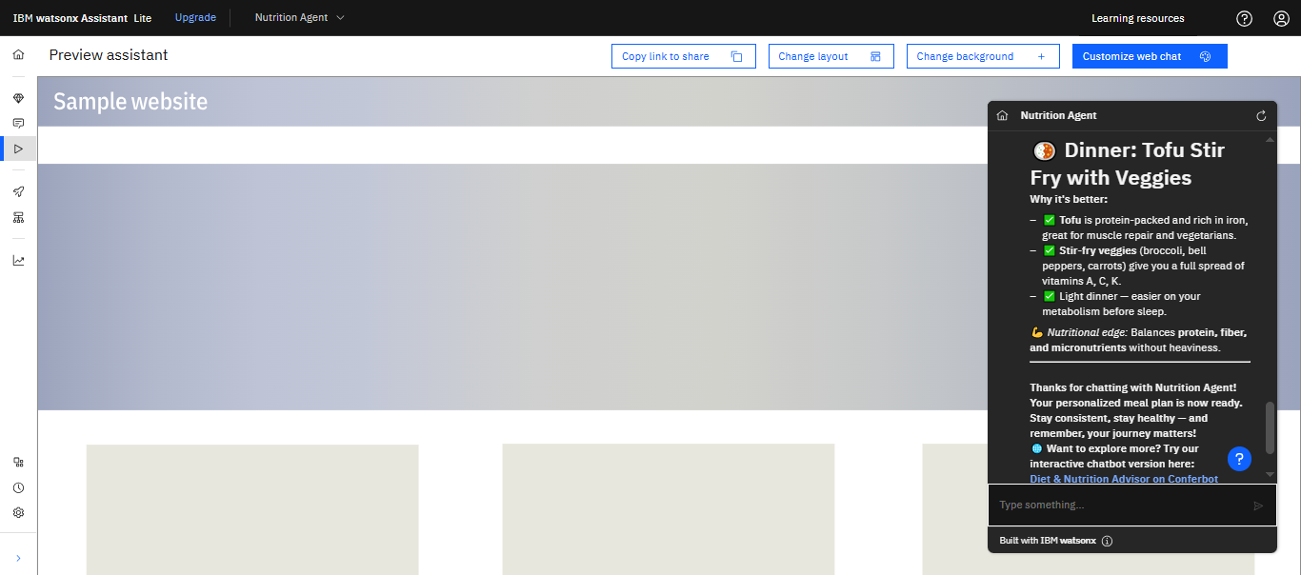
Result

Slide 14
Conclusion
The proposed Nutrition Agent system effectively delivers personalized, affordable, and nutritionally balanced meal plans using AI and IBM Cloud services. By collecting user preferences such as dietary restrictions, health goals, and meal types, the system successfully generates daily Indian meal suggestions under 60 characters, making it simple and accessible for users.
The AI-driven approach proved efficient in handling diverse user needs. However, challenges included ensuring cultural variety, maintaining short meal names, and balancing nutrition with affordability. Future improvements could include deeper personalization using user feedback, integration with wearable health data, and multilingual support.
Overall, the system demonstrates that personalized dietary planning can be made scalable, accurate, and user-friendly—supporting healthier lifestyles through intelligent automation.

Slide 15
Future scope
In the future, the Nutrition Agent can be enhanced by integrating with wearable fitness trackers and health apps to generate real-time, activity-based meal plans. This would allow the system to adapt daily recommendations based on a user's step count, sleep, or calorie burn. Expanding the platform with multilingual capabilities will make it accessible to users across diverse regions, promoting better health literacy and engagement. Additionally, the system could suggest nearby, cost-effective grocery options based on selected meals, improving convenience and affordability.
Further improvements include the ability to track user progress toward health goals like weight loss, sugar control, or muscle gain using AI-based monitoring. Personalized recipe customization (e.g., spice level, ingredient swaps) and voice-enabled features can make the tool more interactive and user-friendly. With continued updates, the Nutrition Agent could evolve into a full-scale virtual health companion that offers long-term dietary guidance and wellness insights tailored to individual needs.

Slide 16
References
IBM Watson Assistant Documentation
IBM Cloud Docs – https://cloud.ibm.com/docs/assistant
(Used for deploying conversational interfaces and handling user input)
LangChain for AI Agent Development
LangChain Docs – https://docs.langchain.com/
(Framework for building generative AI workflows)
Nutritional Guidelines
Indian Council of Medical Research (ICMR) – https://www.nin.res.in/
(Used for mapping user goals to dietary macros and Indian meal standards)
"Generative AI for Personalized Meal Planning"
IEEE Xplore Conference Paper, 2023 – https://ieeexplore.ieee.org/document/10157486
(Discusses use of LLMs for personalized nutrition solutions)
"DietGPT: Personalized Meal Generation Using GPT Models"
arXiv preprint arXiv:2304.13777 – https://arxiv.org/abs/2304.13777
(Used for understanding how LLMs generate food recommendations)

Slide 17
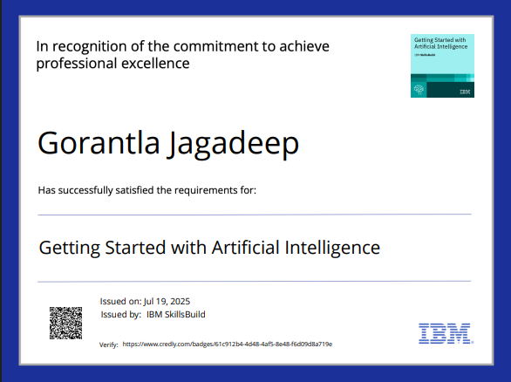
IBM Certifications
Screenshot/ credly certificate( getting started with AI)

Slide 18
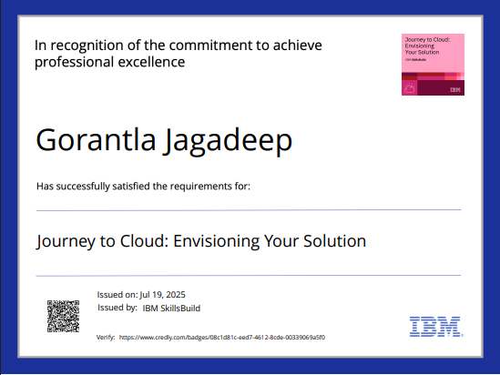
IBM Certifications
Screenshot/ credly certificate( Journey to Cloud)

Slide 19
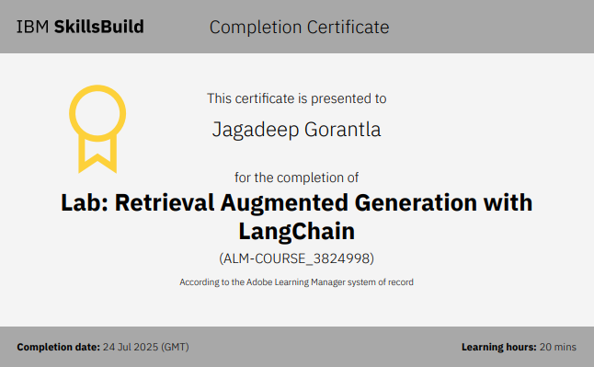
IBM Certifications
Screenshot/ credly certificate( RAG Lab)

Slide 20
THANK YOU

