Slide 1


Slide 2
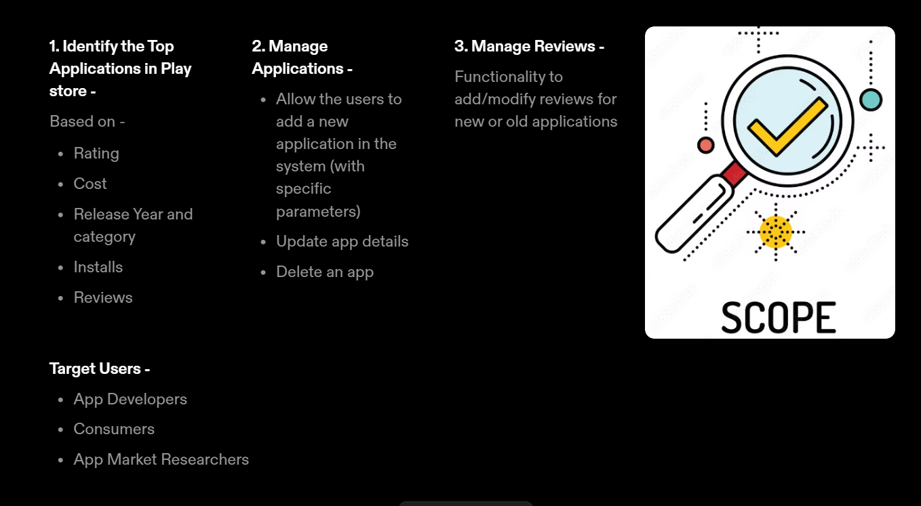
Project Scope

Slide 3
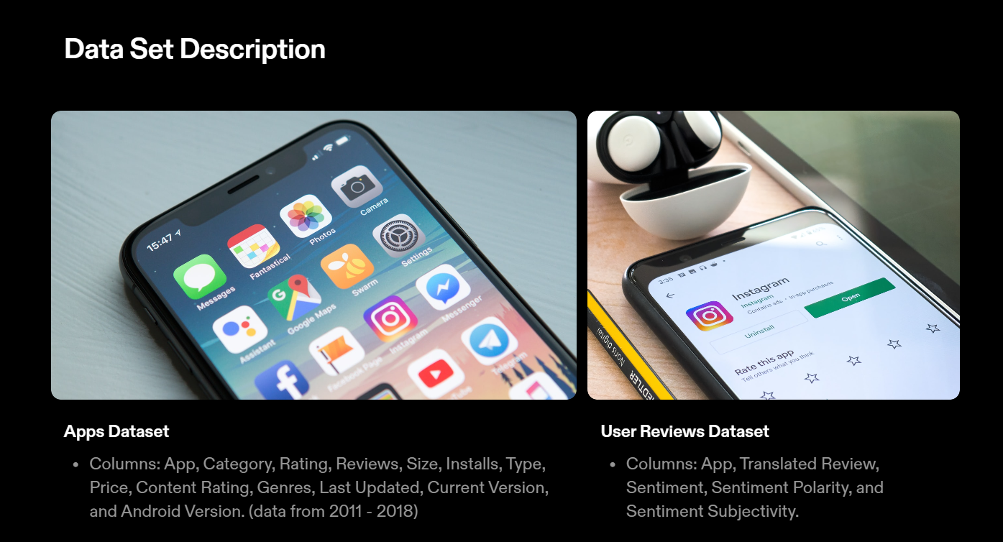

Slide 4
