Slide 1
LENDING CLUB CASE STUDY SUBMISSION
Name: Srinivas soma
Gajula Jagadeesh

Slide 2
Lending Club Case Study (EDA)
This is case study on lending club which is a online portal where people apply for loan and borrow money. Lending club is for two kind of people. Lenders and borrows. We are on lenders side. We are provided with data and we need to conduct Exploratory data analysis on data. Data contains more than 100 variables but, We are concerned about loan_status the target variable which contains 3 categories of loan status. Fully paid, current and charged off. We need to tell the most effecting variables in an application and hints of loan application will be defaulted. So that lenders or investors will be aware of the coming events.
Loan approvals will be based on analysis conducted. So every hint and variable matters. This EDA eases application process even before it is shown to lender. Applications will be filtered in minutes and loan status will be predicted in real time.

Slide 3
Steps involved
Univariate analysis
Plotting numerical distributions
Plotting categorical data
Univariate
Observing numerical data
Understanding categorical data
Bivariate analysis
Grouping and plotting categorical variables
Calculating significance for numerical data
Loan.csv
Importing
Data importing
Data understanding and observing
Basic cleaning
Dropping all null columns
Dropping cols with one unique values
More Cleaning
Dropping cols with missing values > 50
Examining rows
Creating heat maps
Heatmap for numerical values
Heatmap with loan_status vs variables
Filtering numerical
Filtering and taking only significant variables
Pair plot
Pair plotting numeric correlations
Plotting distributions on types of loans
Advanced cleaning
Imputing and cleaning rows
Manually dropping less significant cols
Separation variables
Creating dataframe having only categories
Creating dataframe having numeric values
Concise
Merging numerical columns to concise data
Cleaning categorical variables like datetime

Slide 4
Observations from data
Data understanding:
Dataset contain 111 columns and approx. 39k rows
More than 50 columns were complete null values
About 14% of loans were defaulted
Few numerical columns distributions where skewed
Basic cleaning:
57 were left after dropping all null columns
6 columns were having only one unique value so dropped since it can’t help us
3 columns were found with more than 50% of missing values
maximum values missing in any given row is 6
Advanced Cleaning:
Need to drop irrelevant columns like id, member_id, since they are purely random
Since dataset is large enough and we can confidently drop few rows with missing values
Separating numerical and categorical data is easy way

Slide 5
Observations from data
Separation of numerical and categorical data:
23 columns have pure numerical data
13 were categorical (datatype object may contain datetime and percentage values)
loan_amnt, funded_amnt and funded_amnt_inv distributions were identical
4 columns contained datetime
Univariate analysis:
More numerical column distributions were skewed
8 columns were very crucial
Bivariate analysis:
Data is grouped based
Risk factors are discussed further in PPT
Numerical Analysis:
lot of numerical variables were found insignificant

Slide 6
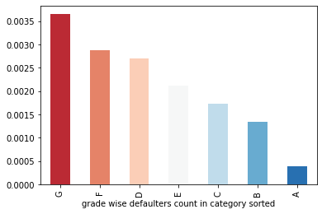
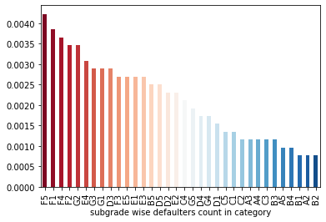
Categorical analysis and hints
Variable grade:
G grade have highest defaulters followed by F grade
Variable sub_grade:
F5 have highest defaulter rate
sequence risk is given above

Slide 7
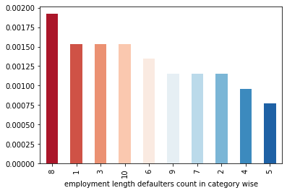
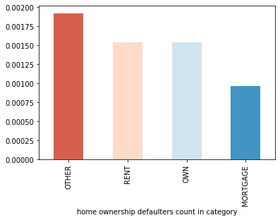
Categorical analysis and hints
Category emp_length:
emp_length > 8 and < 4 is risky
8 and 1 year have more defaulters
Category home_ownership:
Other category is more risky
rent and own have same level risk so not a problem

Slide 8
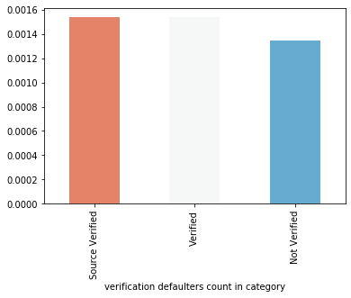
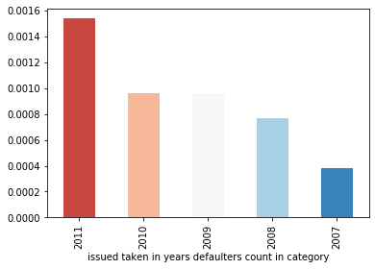
Categorical analysis and hints
Category verification status:
Verification status don’t have much significance
Category issue_d_year:
-this is derived from issue_d column
-2011 have highest defaulter count.
-defaulters were steadily increasing from 2007 to 2011

Slide 9
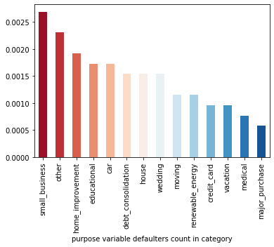
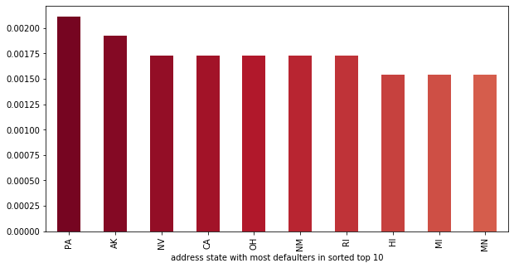
Categorical analysis and hints
Category purpose:
Top 10 states with high defaulter rate is plotted above
Top states were PA and AK
Category purpose:
small business have highest defaulting risk followed by other

Slide 10
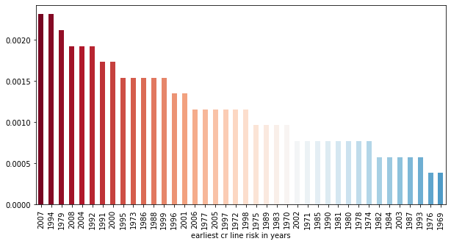
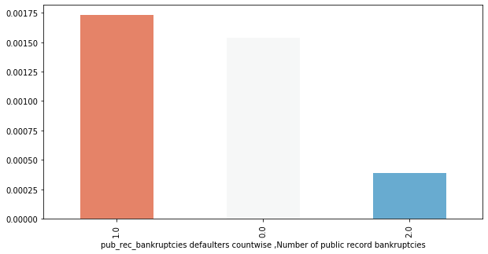
Categorical analysis and hints
Category earliest_cr_line_year:
this is a derived metric
2007 and 1994 have highest defaulter count
Category Pub_rec_bankruptices:
here more count is on one record of bankruptcy
its doesn’t state any risk in sequence, But not
recommended to approve loan easily with at least
one bankruptcy

Slide 11
Numerical variables analysis
Not all the given variables have significant effect on loan_status. This is calculated by feature importance method with sklearn ensemble classifier.
Significant numeric variables have effect on outcome are
loan_amnt
installment
total_pymnt
total_pymnt_inv
total_rec_prncp
total_rec_int
total_rec_late_fee
recoveries
collection_recovery_fee
last_pymnt_amnt

Slide 12
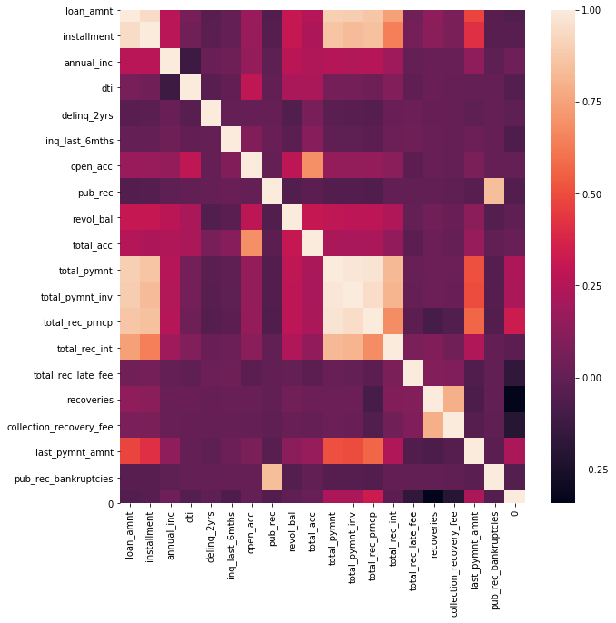
Numerical analysis
This is correlation heatmap of all numerical variables
Loan_amnt and installement have good correlation
Total_payment , total_payment_inv and total_rec_princp have
good correlation
Last ZERO indicates loan_status have a strong negative correlation
with recoveries
Lot other insights can be drawn from this single picture

Slide 13
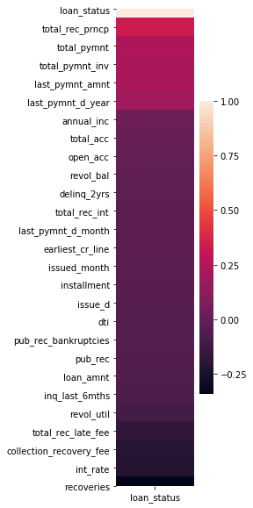
Numerical analysis
This is correlation heatmap loan_amnt with all other variables.
Lot of variables have approx. zero and negative correlation
Only few variable share positive correlation.
You can see heatmap and conclude the which variables
could lay intuition for outcome

Slide 14
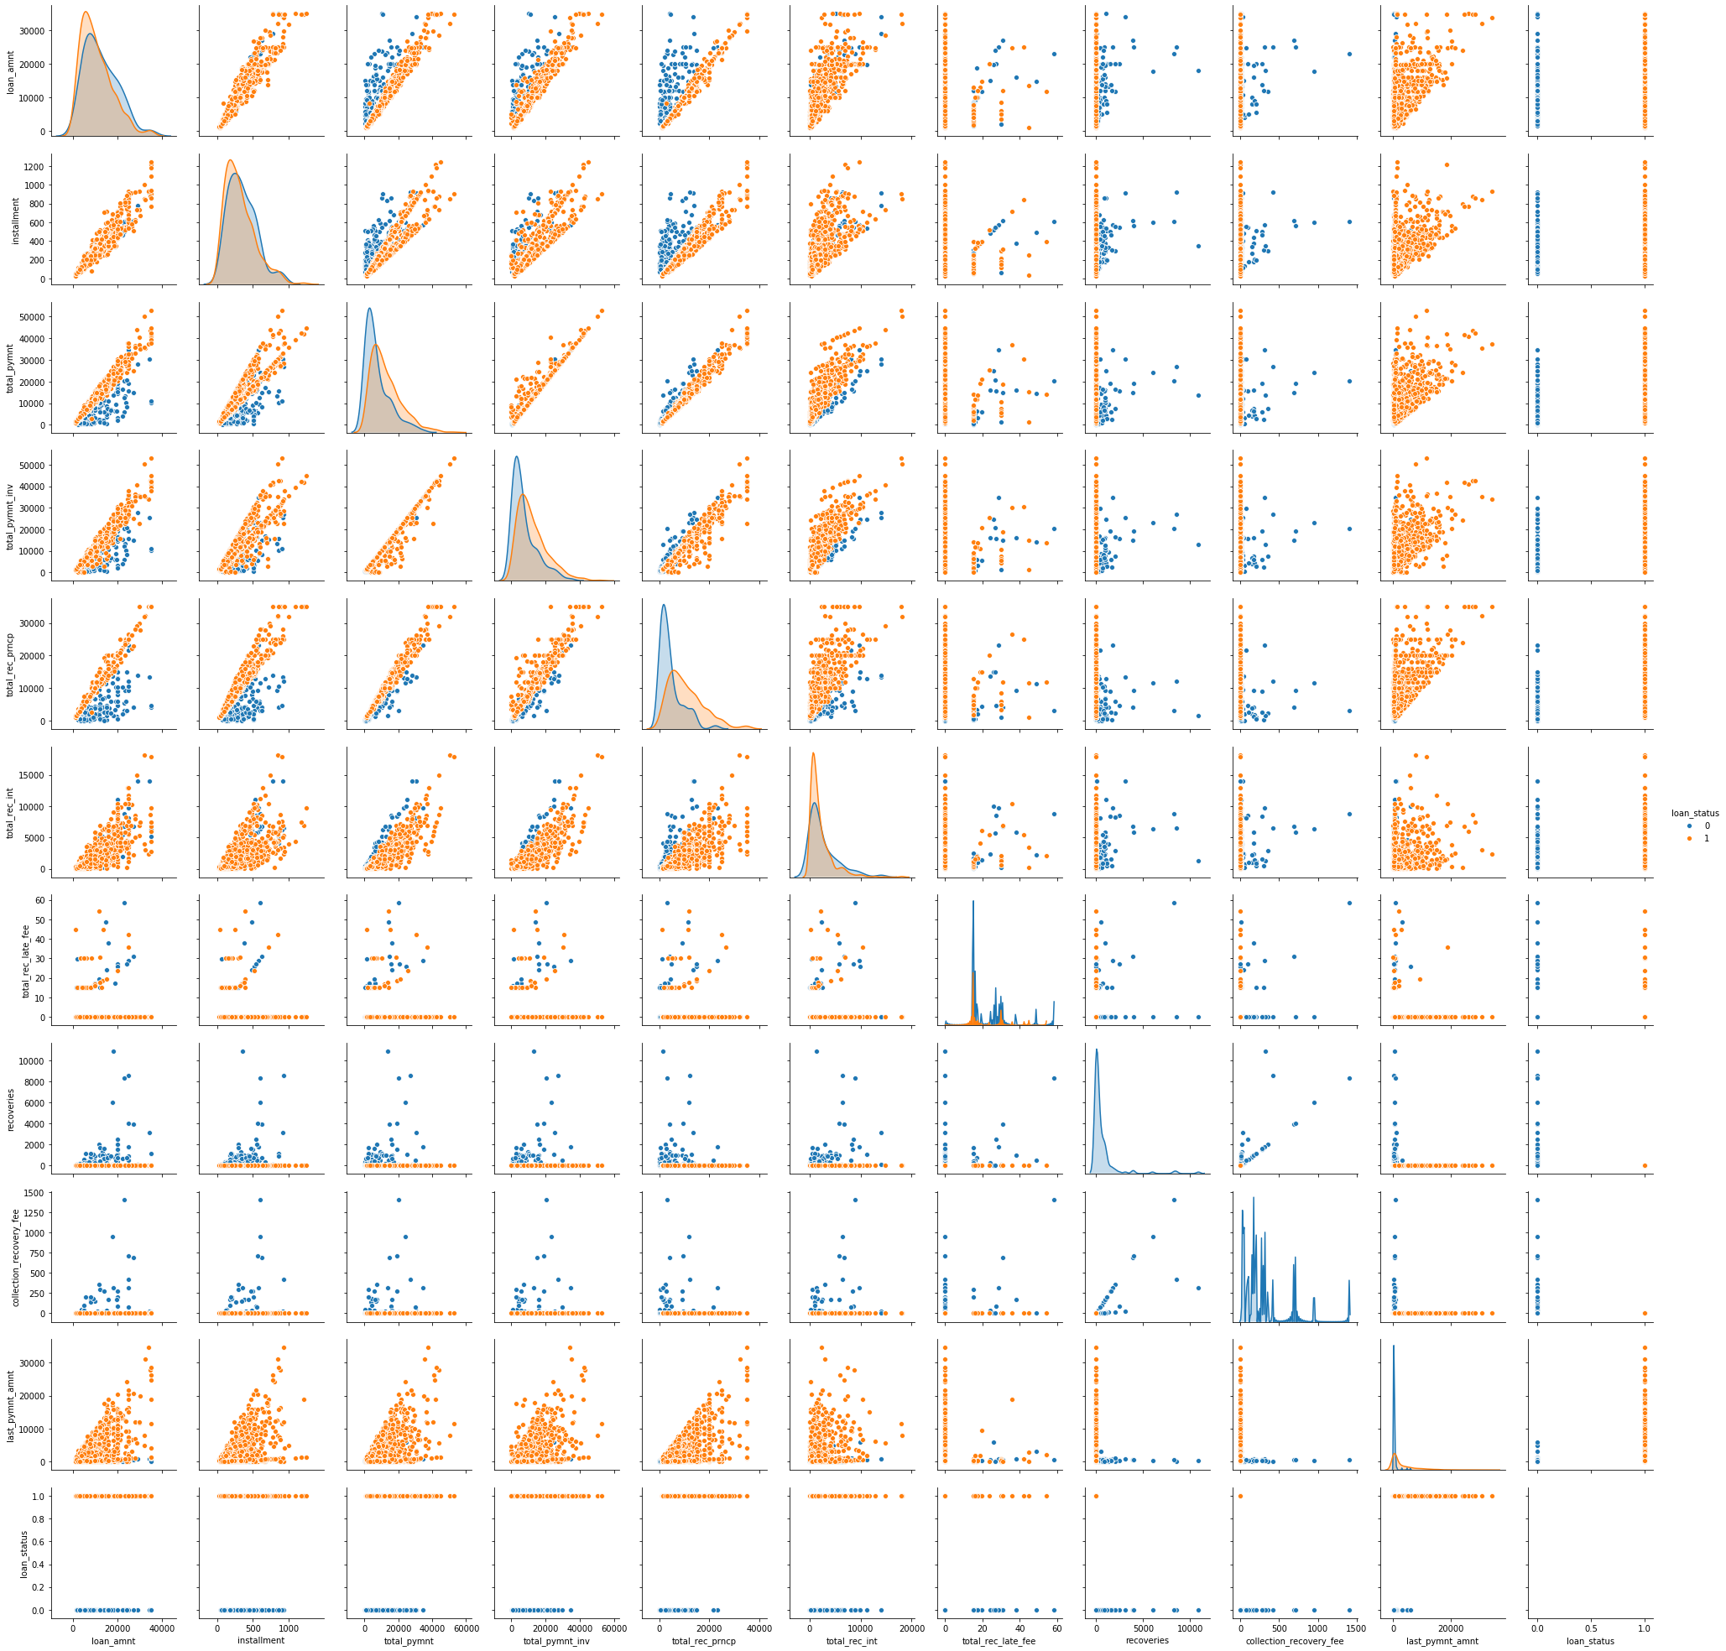
plot
Pair plot between all significant
Numeric variables
You can see correlation in plots
We actually trained a classifier
model only on numerical data
built with keras and got upto 95+
accuracy.
Github link

Slide 15
Conclusion
Lending club data is real world data. Every insight help lender for better outcome and its really intuitive for learners. Numerical was bit confusing because distribution is not even. Categorical data was little easier.
This Case study is really a great experience and exposure to real world datasets. we got to learn about risk analysis for the first time. Exploratory data analysis have no end we can each into each variable and draw new insights. We are just limited with time and resources. We don’t need that much of depth in every aspect, think it will go in logistic fashion and flat out at some point. Since too much preparation won’t work. we wanted to do further analysis with derived metrics. We got to learn some profound things and sanity ways of exploring into datasets. I really thankful for group mate. He was guiding me with better suggestions and same in case of student mentor. Its really a great hands on experience.
Thank you

