Slide 1
Spark Funds INVESTMENT ASSIGNMENT SUBMISSION
Submitted by
Jagadeesh gajula

Slide 2
Spark Funds investment analysis
Spark Funds is an asset management company. CEO of that company wants to understand the trends in global economy to invest money into. Spark Funds have 2 major constraints over investment. Range of investment lies in 5 to 15 million dollars and its should be an English speaking country for ease of communication. Strategy will be as of tendency and human intuition we always want best. So we are in journey in finding that best ones for company to invest.
We have data from Crunchbase to work with. Analysis is conducted in various types.
Funding type analysis : we have few types of funding rounds in a company lifecycle like seed, angel, venture, etc.. So our goal is to dig the best suitable funding type in this section.
Country analysis: Since company invests globally we should be looking for best countries. We will pick up top 3 English speaking countries.
Sector analysis: Asset management always deals with multi sector business. We have to jump into best category for good returns.
As always said divide and conquer. We have checkpoints in the process however rules and target stay same in every part.

Slide 3
Problem solving flowchart
companies
mapping
Rounds 2
data
filter
In suitable investment type
top3
Creating dataframe with name top3
analyze
Analyzing counts
Analyzing amount raised
Top 3 countries
Filtering the investment range
Wikipedia
Pandas to extract country data
Process and list English speaking countries
Company.csv
Companies dataframe
Rounds.csv
Rounds 2 dataframe
Mapping.csv
Mapping dataframe
Unique company
Unique company
Top3
Country 1
Country 2
Country 3
Master_frame
primary
observing mapping
Cleaning category list
melt
Making long form with melt
Filtering the invalid
drop
Final frame contains category list and main sector
Plot based on amount raised in top 3 countries
Dropping null rows
Finding missing values in each column
Dropping columns
Find best investment type
Individually analyzed counts, best sectors and best companies
Filtering top 9 countries
Creating top9 dataframe
Mapping dataframe
Merge countries frames for sector plotting
End
Plot top 9 countries with amount raised
Top9 merged with mapping

Slide 4
Investment type analysis
Every company lifecycle have few stages of funding like seed, angel, venture, etc... We consider it as investment type. We are finding best investment type on average of amount raised lies between 5 to 15 million. I found venture investment type average lies in Spark Funds range of investments and no other type of investment lies in that plane. This average is being calculated from Master_frame dataframe which we created by merging companies and rounds2 dataframes.
By analysis I found that venture is our go to investment type of investment. After this I filtered out other investment types out of frame for ease of working.

Slide 5
Country Analysis ( by type venture)
Country analysis is done based on amount raised by companies in that country. So I used master_frame for sorting the top9 best countries and created a dataframe top9 and I found that.
Above given list of countries are top 9 and they are sorted in descending fashion of amount raised.
I extracted list of English speaking countries from Wikipedia link. Matching the top country list:
These are top 3 English speaking countries as our Spark Funds only deals with English speaking countries.
Further I created a dataframe with top 3 countries for ease of analysis.
['USA', 'CHN', 'GBR', 'IND', 'CAN', 'FRA', 'ISR', 'DEU', 'JPN']
['USA', 'GBR', 'IND']

Slide 6
Sector Analysis
Sector analysis is done in quite different way. I broke top 3 dataframe in 3 dataframes each having specific country since every country have different best sector to invest. Every country is beautiful in its own terms so best sectors might be different in each one of them. Here are the top 3 in every country.
Country 1 (‘USA’)
Country 2 (‘GBR’)
Country 3 (‘IND’)
Others
Social, Finance, Analytics, Advertising
Cleantech / Semiconductors
Others
Social, Finance, Analytics, Advertising
Cleantech / Semiconductors
Others
Social, Finance, Analytics, Advertising
News, Search and Messaging

Slide 7
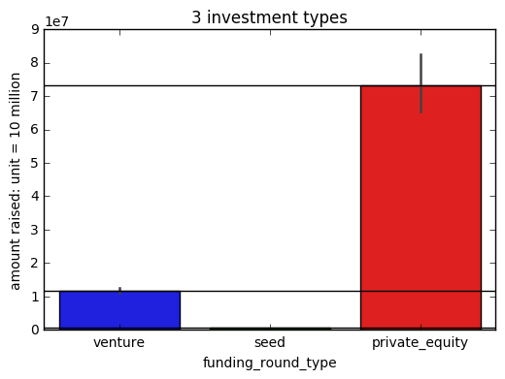
Graph showing 3 different investment types in venture globally
Graph is created from master_frame showing distribution of average scale in 3 different types of investments globally and each unit in Y scale is 10 million so our venture lies in 5 to 15 million range (11.x million). Horizontal black line shows the average. Seed investment is almost earthed to zero compared to both.

Slide 8
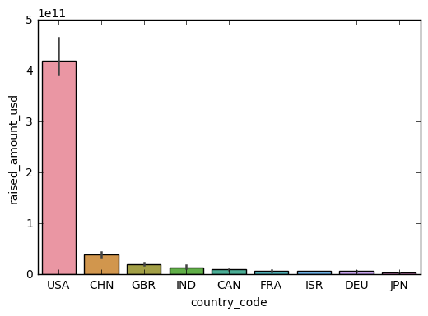
Country analysis : Graph showing the top 9 countries including English and non-English
Above Graph is created from top9 dataframe showing average amount raised by companies in particular country.
This graph considers both English speaking and non-English speaking countries. As you can see the
USA, CHINA & GREAT BRITAIN are the top3 countries. But china is non English country so 3rd place goes to INDIA.

Slide 9
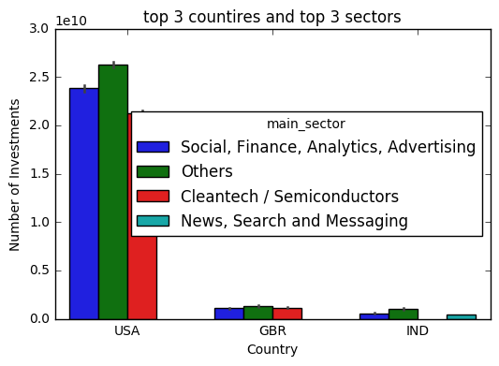
Sector analysis: Graph showing the best 3 sectors with count average in top 3 countries.
This graph is generated by concatenating top 3 countries dataframes in end. We can observe the USA is way
beyond than other countries. In every sector and surprisingly OTHER sector is top sector in every country.

Slide 10
Conclusions
I think we can’t put all of our eggs in single basket because losing it will be complete loss. So if I have to invest I would prefer USA since its best country to invest and its way beyond than others. I would invest in different sectors in USA but sometimes country may get into certain problems. so I prefer little percentage can be invested into Great Britain and India. Little concern is about OTHER sector since other may contain lot of variables and we don’t have enough data about other sector. We might need to get little specific about it.
Data understating is all about visualization. I prefer more visualizations here and there. I learned many things apart from technical analysis.
This assignment is great opportunity to refresh my knowledge and gentle introduction towards real life data analysis. It took lot of time and effort and obviously help from stackoverflow. I understood lot of things that we were not taught in college during this assignment. However felt like a real analyst for while. Thank you

