Slide 1
Java 9
By
Dr. Rajesh Upadhyay

Slide 2
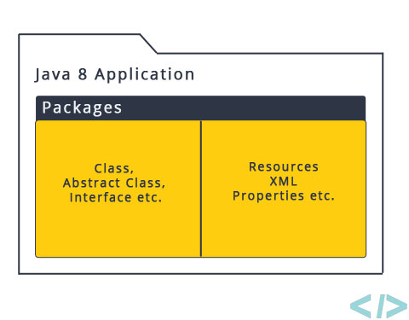
Java 8 project structure

Slide 3
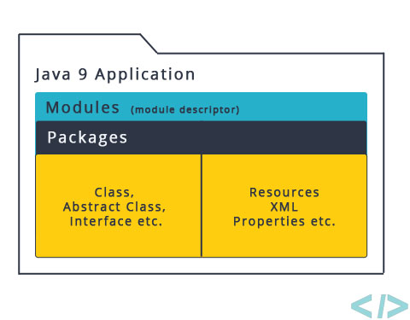
Java 9 project structure

Slide 4
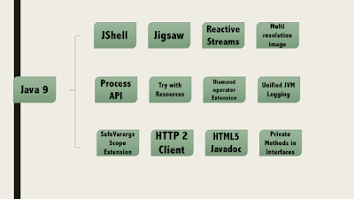
Java 9 features

Slide 5
HotSpot
we found so far on the PermGen successor:Metaspace. We will also compare the runtime behavior of the HotSpot 1.7 vs. HotSpot 1.8 (b75) when executing a Java program “leaking” class metadata objects.
Metaspace: A new memory space is born
The JDK 8 HotSpot JVM is now using native memory for the representation of class metadata and is called Metaspace; similar to the Oracle JRockit and IBM JVM's.
The PermGen space is gone and has been replaced with Metaspace (JEP 122). The JVM options -XX:PermSize and –XX:MaxPermSize have been replaced by -XX:MetaSpaceSize and -XX:MaxMetaspaceSize respectively.

Slide 6
Cont…
The good news is that it means no more java.lang.OutOfMemoryError: PermGen space problems and no need for you to tune and monitor this memory space anymore.
While this change is invisible by default, we will show you next that you will still need to worry about the class metadata memory footprint. Please also keep in mind that this new feature does not magically eliminate class and classloader memory leaks.

Slide 7
features
PermGen space situation
This memory space is completely removed.
The PermSize and MaxPermSize JVM arguments are ignored and a warning is issued if present at start-up.
Metaspace memory allocation model
Most allocations for the class metadata are now allocated out of native memory.
The klasses that were used to describe class metadata have been removed.
Metaspace capacity
By default class metadata allocation is limited by the amount of available native memory (capacity will of course depend if you use a 32-bit JVM vs. 64-bit along with OS virtual memory availability).
A new flag is available (MaxMetaspaceSize), allowing you to limit the amount of native memory used for class metadata. If you don’t specify this flag, the Metaspace will dynamically re-size depending of the application demand at runtime.

Slide 8
Features cont…
Metaspace garbage collection
Garbage collection of the dead classes and classloaders is triggered once the class metadata usage reaches the “MaxMetaspaceSize”.
Proper monitoring & tuning of the Metaspace will obviously be required in order to limit the frequency or delay of such garbage collections. Excessive Metaspace garbage collections may be a symptom of classes, classloaders memory leak or inadequate sizing for your application.
Java heap space impact
Some miscellaneous data has been moved to the Java heap space. This means you may observe an increase of the Java heap space following a future JDK 8 upgrade.
Metaspace monitoring
Metaspace usage is available from the HotSpot 1.8 verbose GC log output.
Jstat & JVisualVM have not been updated at this point based on our testing with b75 and the old PermGen space references are still present.

Slide 9
Java 8 date time
cover the following drawbacks of old date-time API.
Not thread safe −
java.util.Date is not thread safe, thus developers have to deal with concurrency issue while using date. The new date-time API is immutable and does not have setter methods.
Poor design − Default Date starts from 1900, month starts from 1, and day starts from 0, so no uniformity. The old API had less direct methods for date operations. The new API provides numerous utility methods for such operations.
Difficult time zone handling − Developers had to write a lot of code to deal with timezone issues. The new API has been developed keeping domain-specific design in mind.

Slide 10
Java 8 date-time API
under the package java.time.
Following are some of the important classes introduced in java.time package.
Local − Simplified date-time API with no complexity of timezone handling.
Zoned − Specialized date-time API to deal with various timezones.

Slide 11
Nashorn javascript
With Java 8, Nashorn, a much improved javascript engine is introduced, to replace the existing Rhino.
Nashorn provides 2 to 10 times better performance, as it directly compiles the code in
memory and passes the bytecode to JVM.
nashorn uses invoke dynamics feature, introduced in Java 7 to improve performance.
jjs

Slide 12
Concurrency
New methods have been added to the
java.util.concurrent.ConcurrentHashMap
java.util.concurrent.ForkJoinPool
The new java.util.concurrent.locks.StampedLock class has been added to provide a capability-based lock with three modes for controlling read/write access

Slide 13
Cont…
New classes have been added to the java.util.concurrent.atomic package:
DoubleAccumulator
DoubleAdder
LongAccumulator
LongAdder

Slide 14
Compact profiling
Java SE 8 release also includes compact profiles, an API for unsigned integers, and an API for integer arithmetic overflow/underflow detection

Slide 15
examples
C:\Users\rajesh\Desktop\CPDemo>javac *.java
C:\Users\rajesh\Desktop\CPDemo>javac -profile compact2 CPDemo.java
C:\Users\rajesh\Desktop\CPDemo>javac -profile compact3 CPDemo.java
C:\Users\rajesh\Desktop\CPDemo>javac -profile compact1 CPDemo.java
CPDemo.java:1: error: Statement is not available in profile 'compact1'
import java.sql.Statement;
^
CPDemo.java:5: error: Statement is not available in profile 'compact1'
Statement stmt;
^
2 errors

Slide 16
Jdeps tools
C:\Users\rajesh\Desktop\CPDemo>jdeps CPDemo.class
CPDemo.class -> C:\Program Files\Java\jdk1.8.0_25\jre\lib\rt.jar
<unnamed> (CPDemo.class)
-> java.lang
-> java.sql
C:\Users\rajesh\Desktop\CPDemo>jdeps -verbose -P CPDemo.class
CPDemo.class -> C:\Program Files\Java\jdk1.8.0_25\jre\lib\rt.jar (compact2)
CPDemo -> java.lang.Object
compact1
CPDemo -> java.sql.Statement
compact2

