Slide 1
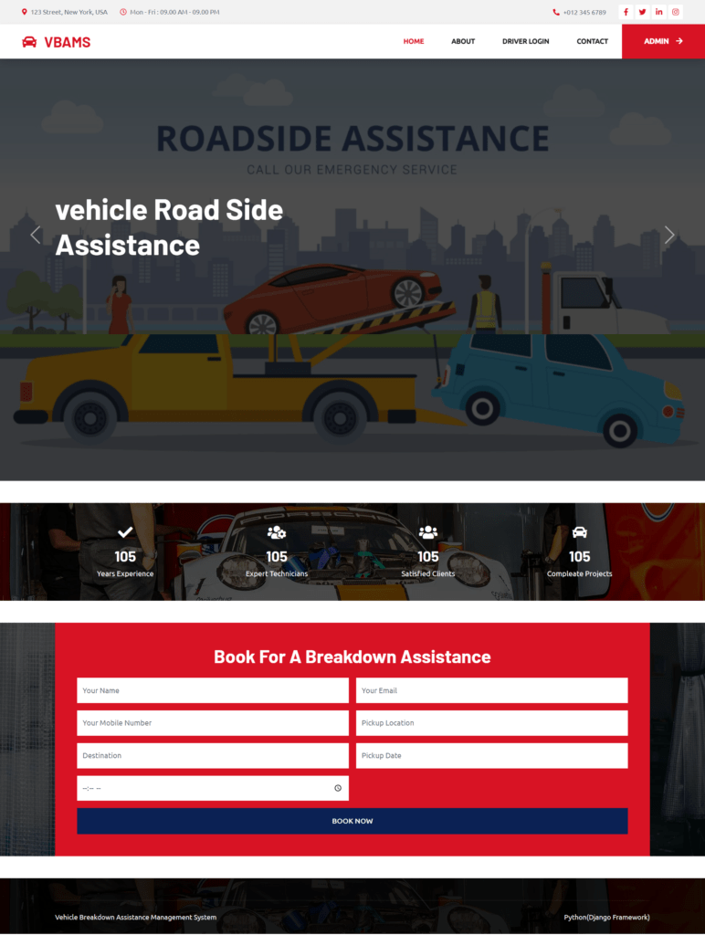

iNTERNSHIP PROJECT
( ON ROAD VEHICLE BREAKDOWN ASSISTANCE FINDER )
It is a web - based application for managing vehicle bookings.
It is developed by using PHP, MySql and CSS with admin and user functionality.
FEATURES :
Admin panel to manage booking, vehicles and users.
User registration, login and vehicle booking Real-time vehicle availability and request handling

Slide 2
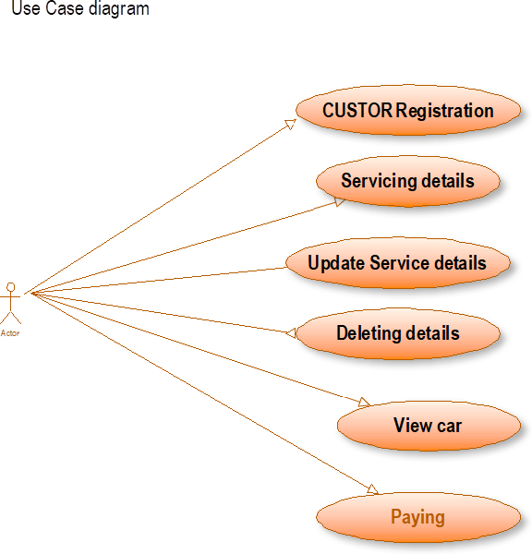
SYSTEM COMPONENTS :
SYSTEM ARCHITECTURE :
FRONTEND DEVELOPMENT
HTML, CSS & JAVASCRIPT
BACKEND DEVELOPMENT PHP & MySQL SERVER
APACHE ( WAMP/ XAMPP )

Slide 3
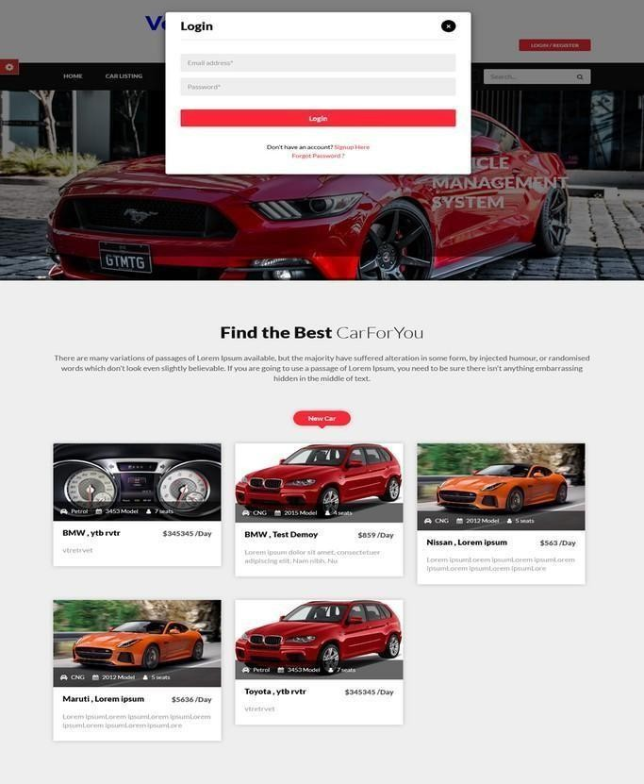
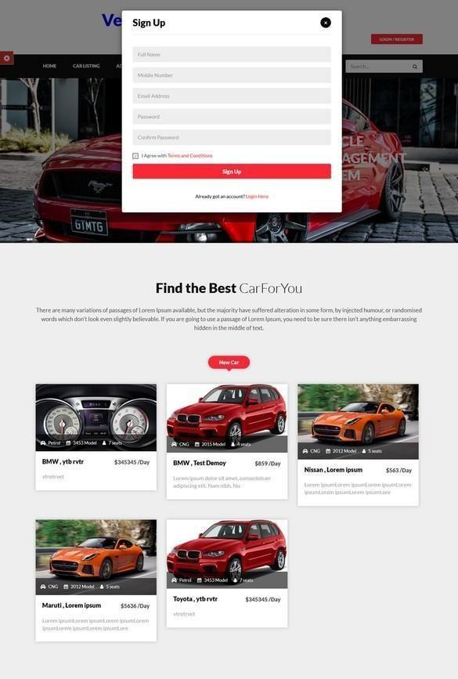
IMPLEMENTATION
Admin Module :
Add, Update and Delete Vehicle.
Manage booking and customer data.
User Module :
View vehicles list.
Book vehicles through an online form.
Check booking status.

Slide 4
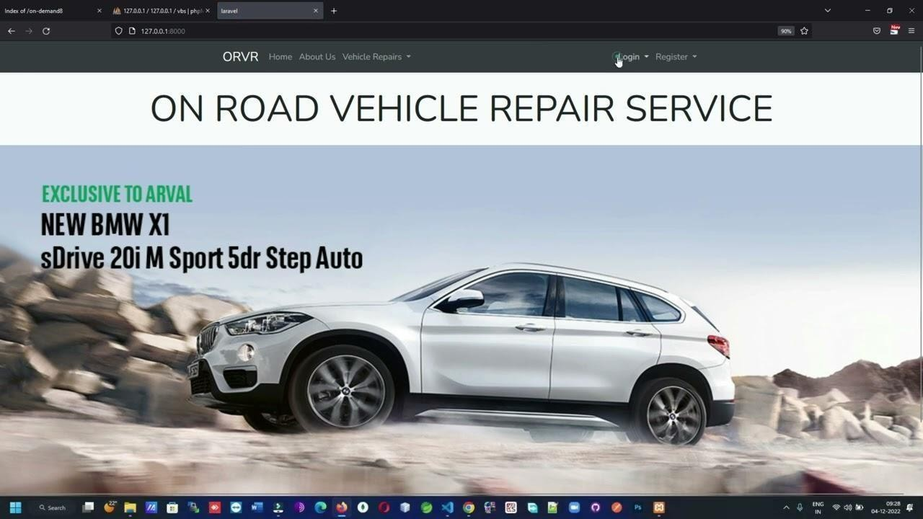
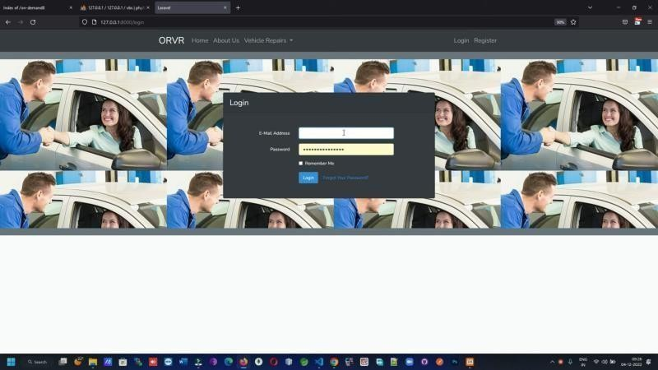
OUTPUT :
The system simplifies vehicle management for rental services.
Ensures efficient breakdown assistance. Mobile App services for easy access.
AI-based Booking Recommendations to suggesting the breakdowns unexpectedly.
GPS Tracking for real-time vehicle location monitoring.

Slide 5
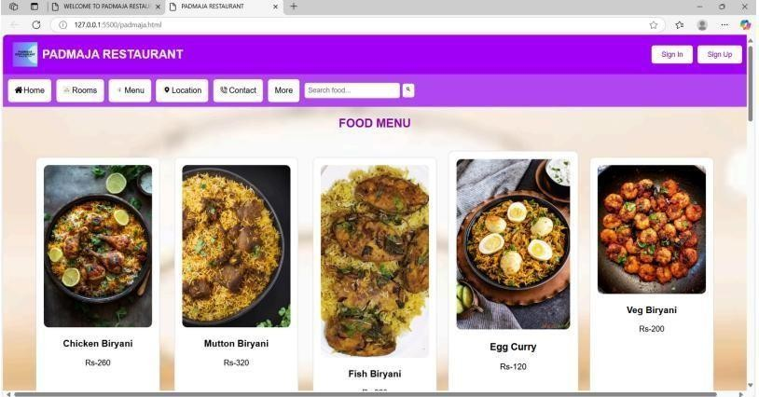
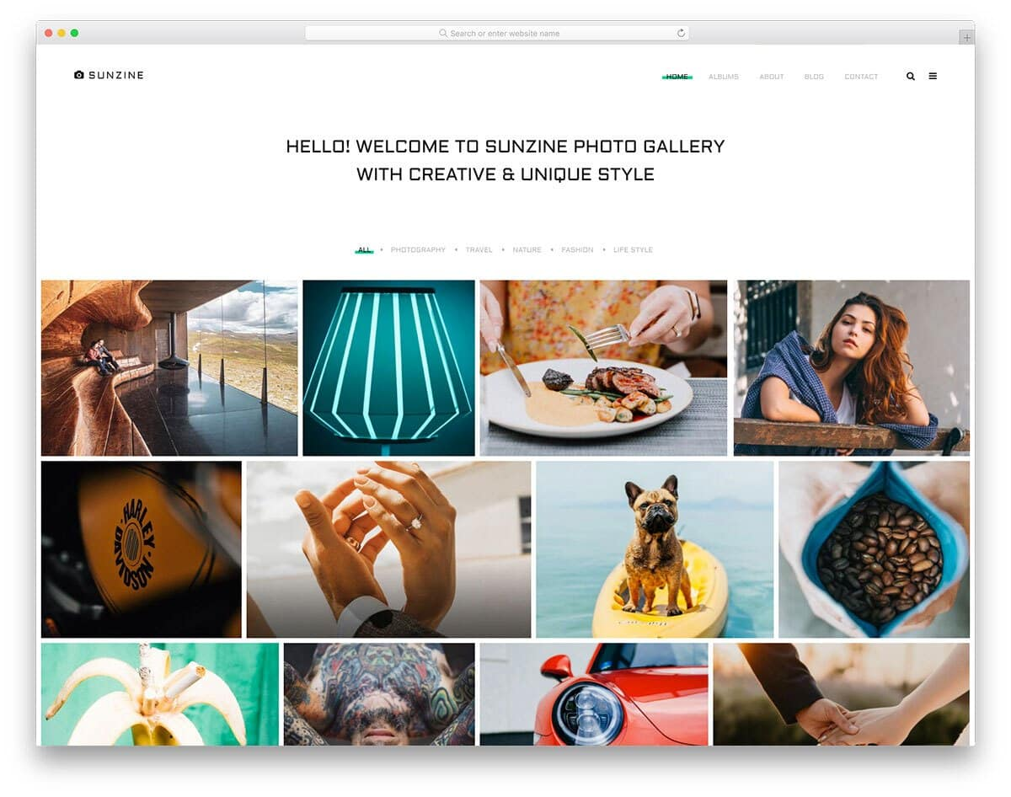

CONCLUSION
The restaurant website project showcases the essentials of online ordering, user engagement, and responsive web design.
The photo Gallery project provides an efficient and visually appealing way to manage and display images dynamically.
The On-Road Vehicle Breakdown Assistance system ensures quick and efficient roadside support, making service requests and management seamless.
All three projects enhance user experience and streamline interactions between users and required services

Slide 6


