Slide 1
Solar Events Prediction
By
Naga Jagadeesh Mutala
Advisor: Dr. Daniel Pimentel-Alarcón

Slide 2
Agenda
Introduction
Goal
Approach
Dataset
Logistic Regression & Log Lasso
Experiments
Challenges
Results
Future Work

Slide 3
Introduction
Solar events create disruptions in communication infrastructure and power grid failures.
The physical process which triggers these events is yet to be discovered.
We mainly focused on Active Region, Coronal Hole, Flare and Sigmoid.

Slide 4
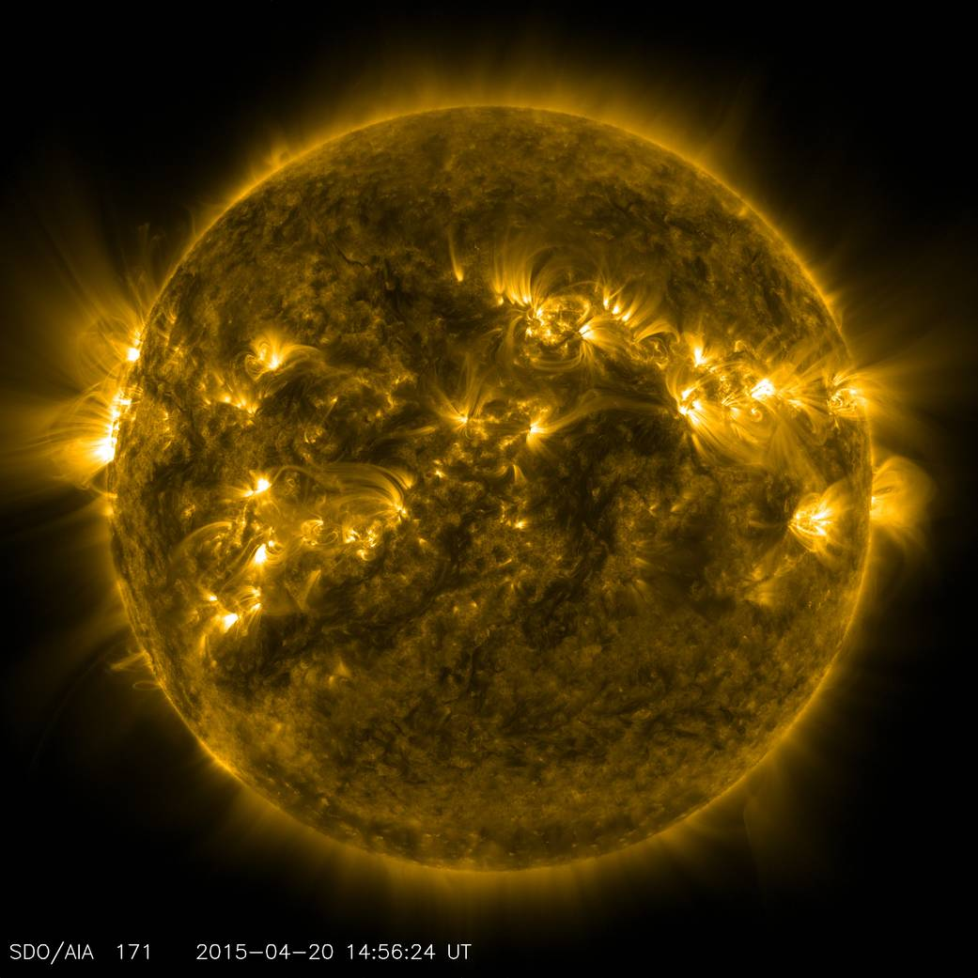
Active Region
Active regions are the places where Sun's magnetic field is especially strong.
They spawn explosive "solar storms" such as solar flares and Coronal Mass Ejections.

Slide 5
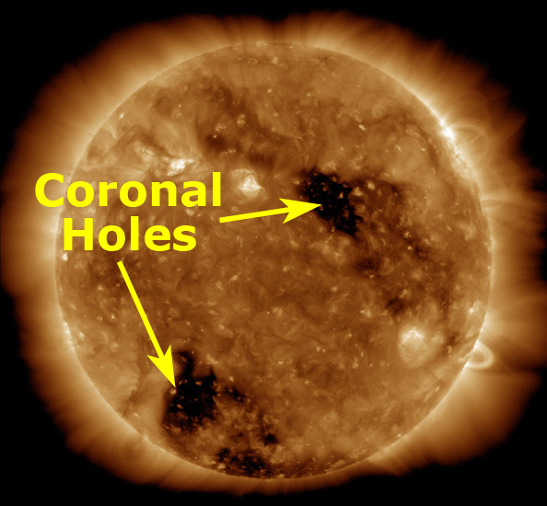
Coronal hole
Coronal Holes are large, dark areas where coronal density is very less.
These discharge solar winds at a speed about twice the average.

Slide 6
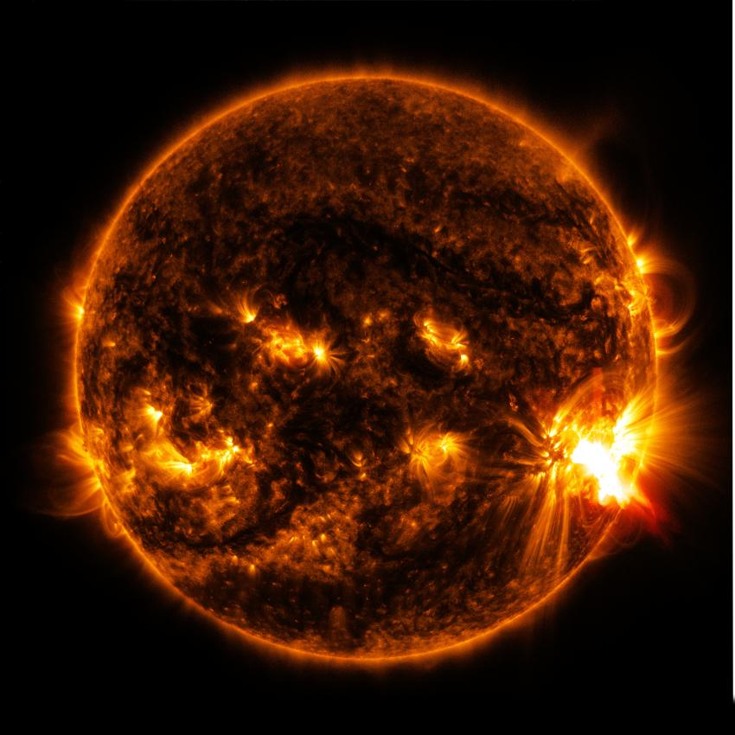
Solar Flare
Solar flares are a sudden explosion of energy with lot of radiation into the space.
They effect communications and radio transmissions.

Slide 7
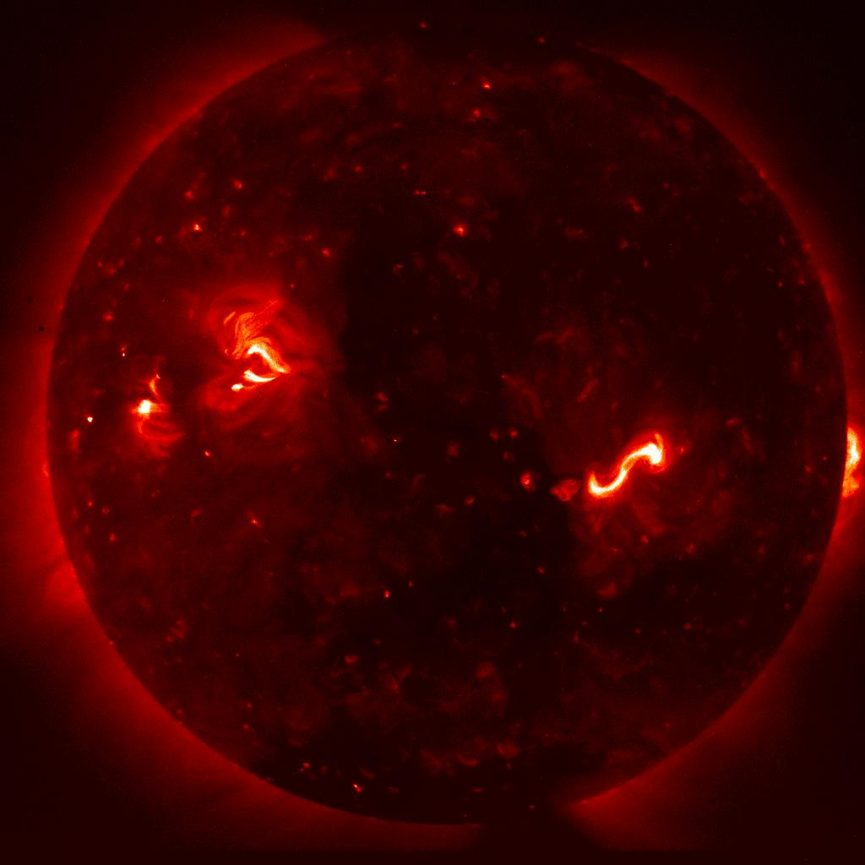
Sigmoid
Sigmoids are S-shaped structures found in the outer atmosphere of the Sun.
It has magnetic flux tubes which helps in flare eruption processes.

Slide 8
Agenda
Introduction
Goal
Approach
Dataset
Logistic Regression & Log Lasso
Experiments
Challenges
Results
Future Work

Slide 9
Goal
Implement Machine Learning Algorithms and identify the features which are responsible for the occurrence of solar events.
Use these features for predicting the occurrence of future solar events.

Slide 10
Related Work
Most of the current methods for solar events prediction are data-driven approaches.
The prediction was made using some prominent Machine Learning models such as SVM, KNN and some deep learning technologies like CNN.
In our work, we implemented Lasso Logistic Regression to predict future solar events.

Slide 11
Agenda
Introduction
Goal
Approach
Dataset
Logistic Regression & Log Lasso
Experiments
Challenges
Results
Future Work

Slide 12
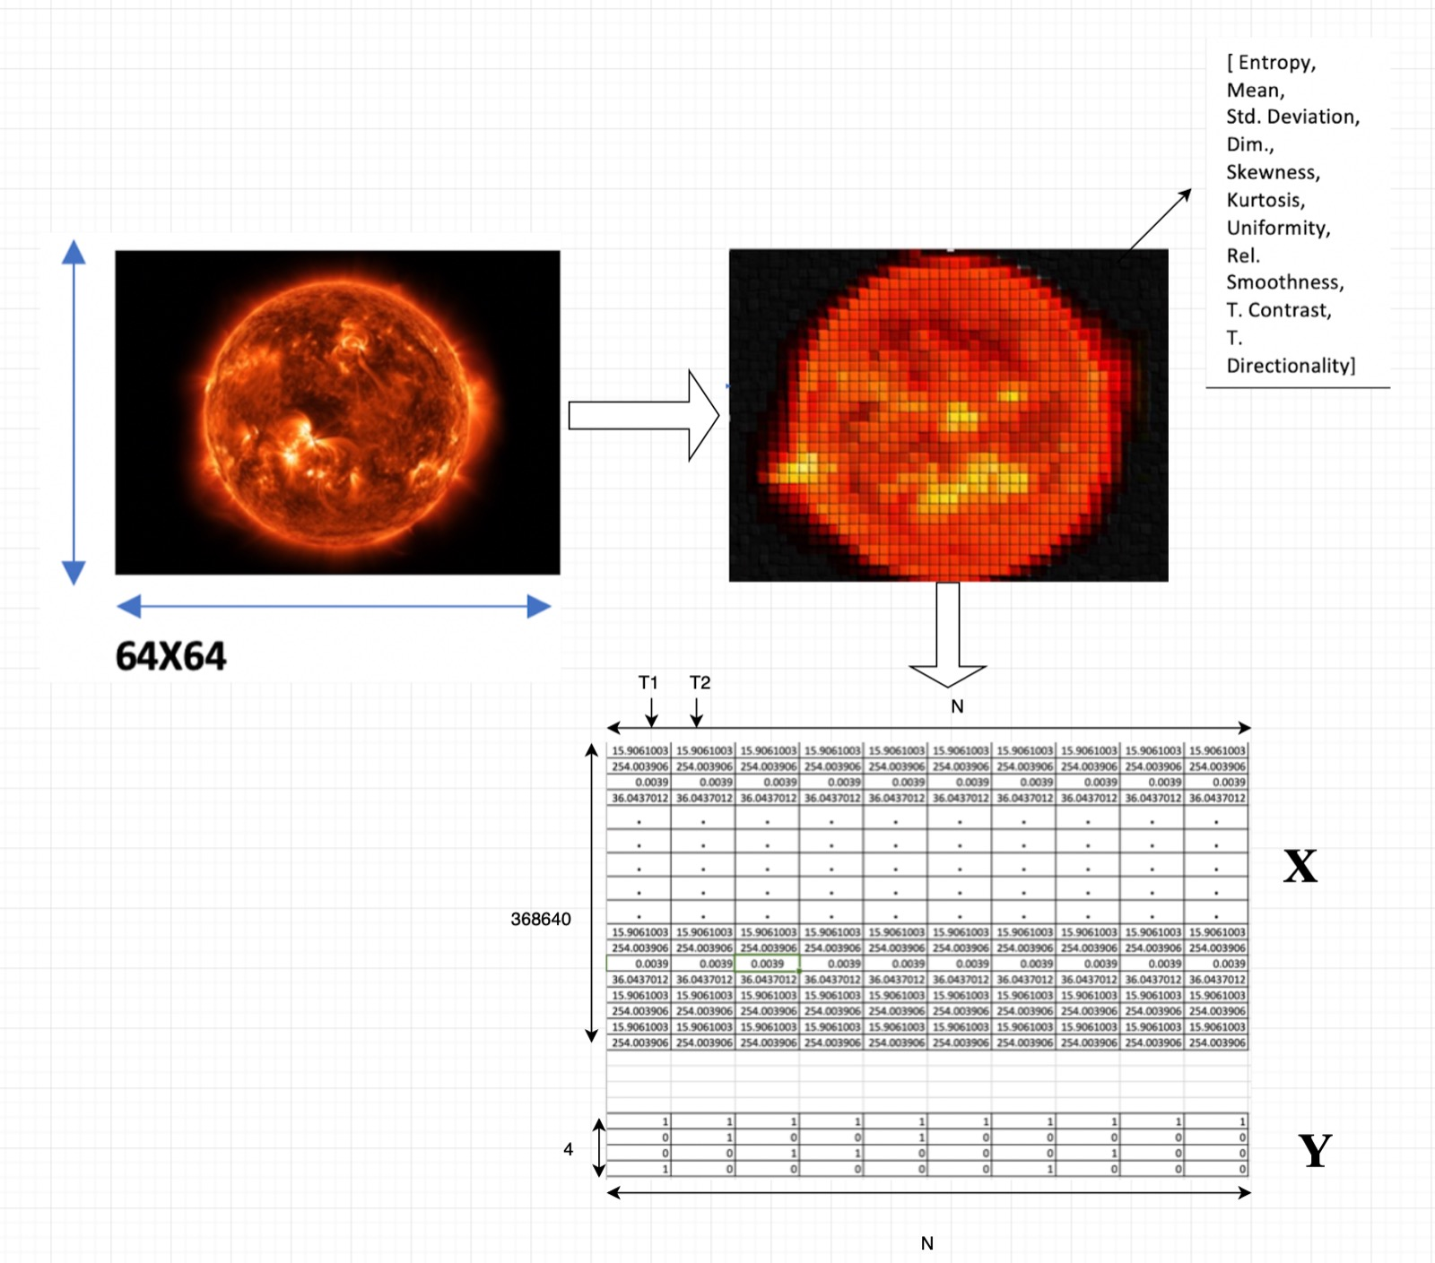
Approach

Slide 13
Agenda
Introduction
Goal
Approach
Dataset
Logistic Regression & Log Lasso
Experiments
Challenges
Results
Future Work

Slide 14
Dataset
SDO Solar Images taken between January 1, 2012 and December 31, 2014.
Images were taken at 9 Wavelengths [94,131,171,193,211,304, 335,1600, 1700].
Each image was divided into 64X64 cells and ten parameters were extracted from each cell.

Slide 15
APIs
Image Parameter XML [GET]:
http : //dmlab.cs.gsu.edu/dmlabapi/params/SDO/AIA/64/ full/?wave =171&starttime = 2012−02−13T20:10:00
Temporal Event Search Query [GET]:
http://isd.dmlab.cs.gsu.edu/api/query/temporal?starttime, endtime,tablenames, sortby, limit, offset, predicate

Slide 16
Agenda
Introduction
Goal
Approach
Dataset
Logistic Regression & Log Lasso
Experiments
Challenges
Results
Future Work

Slide 17
Logistic Regression
Logistic Regression is a classification algorithm used to assign observations to a discrete set of classes.
It is based on the computing likelihood of a process belonging to a class based on its information and previous samples information.

Slide 18
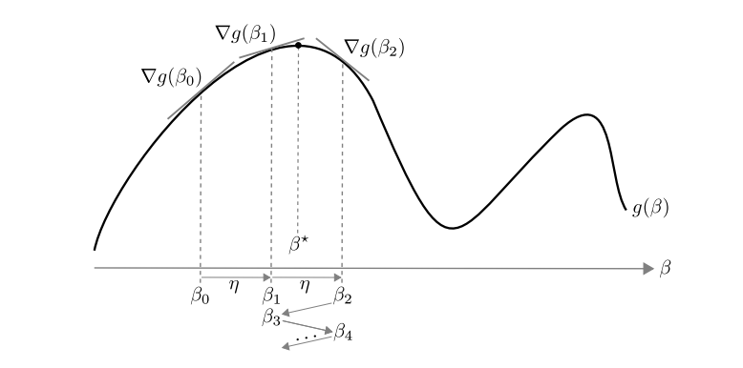
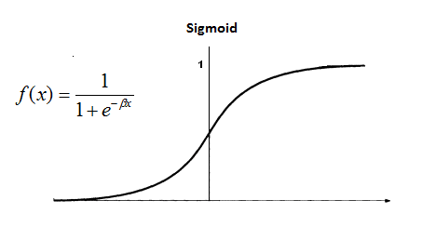
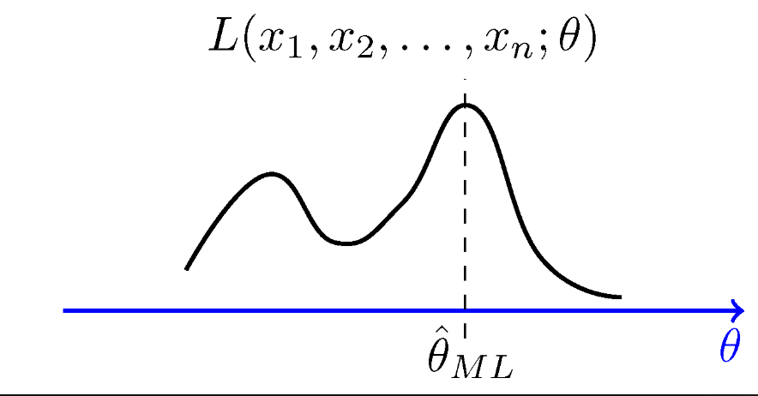
Elements of Logistic Regression
Sigmoid Function
Likelihood Function

Slide 19
How can we better it?
Make beta values sparse.
Select significant coefficients/features.
Achieve better accuracy.

Slide 20
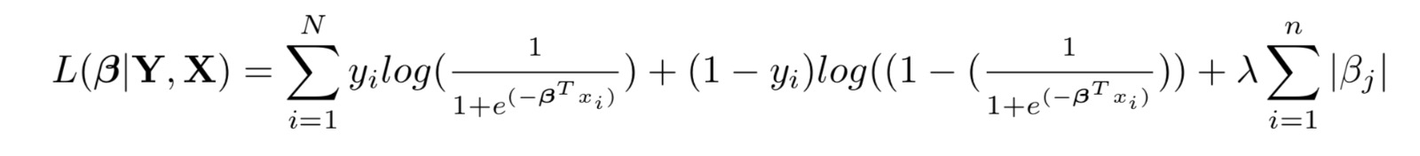
Log. Lasso
Log. Lasso is a linear model that estimates sparse coefficients.
It performs two main tasks: Regularization and Feature Selection.
It applies regularization process by penalizing the coefficients of the regression variables shrinking some of them to exactly zero.
Loss function:

Slide 21
Agenda
Introduction
Goal
Approach
Dataset
Logistic Regression & Log Lasso
Experiments
Challenges
Results
Future Work

Slide 22
Experiments
Performed Logistic Regression on various timeframes where we get a combination of 0s and 1s.
Calculated the mean of all β values obtained at different timeframes and compared the accuracy of the model.
Implemented Logistic Lasso Regression for improving the accuracy.

Slide 23
Agenda
Introduction
Goal
Approach
Dataset
Logistic Regression & Log Lasso
Experiments
Challenges
Results
Future Work

Slide 24
Challenges
Since Y is very sparse in a specified time frame, we received a sequence of either all 0's or all 1’s.
Out of several coefficients that we have got, selecting significant coefficients was a difficult task.

Slide 25
Agenda
Introduction
Goal
Approach
Dataset
Logistic Regression & Log Lasso
Experiments
Challenges
Results
Future Work

Slide 26
Results

Slide 27
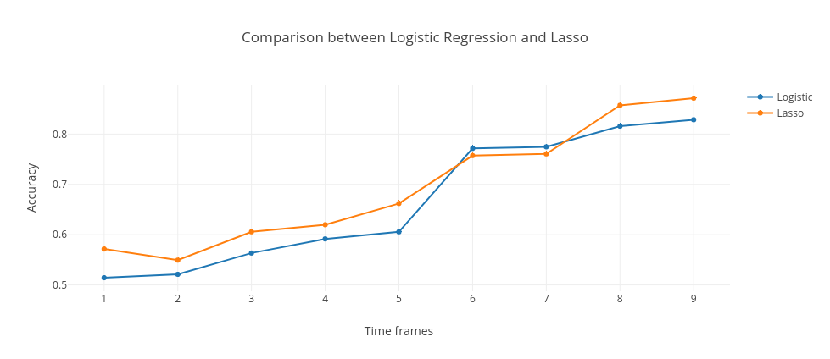
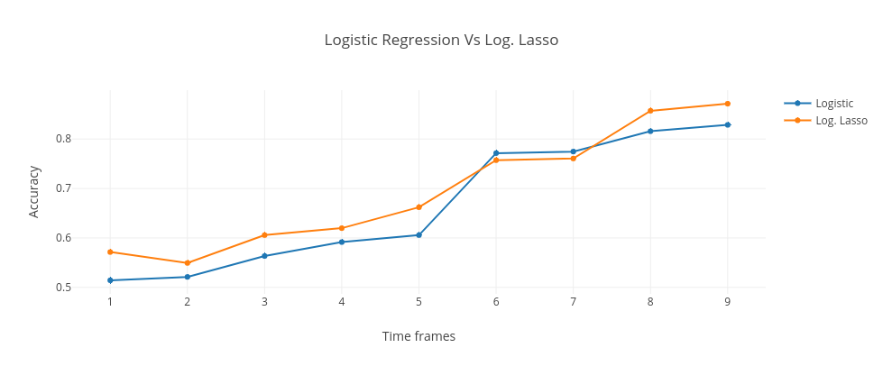
Logistic vs Log. Lasso
Average Accuracy:
Logistic : 0.66514867
Log. Lasso : 0.694925106

Slide 28
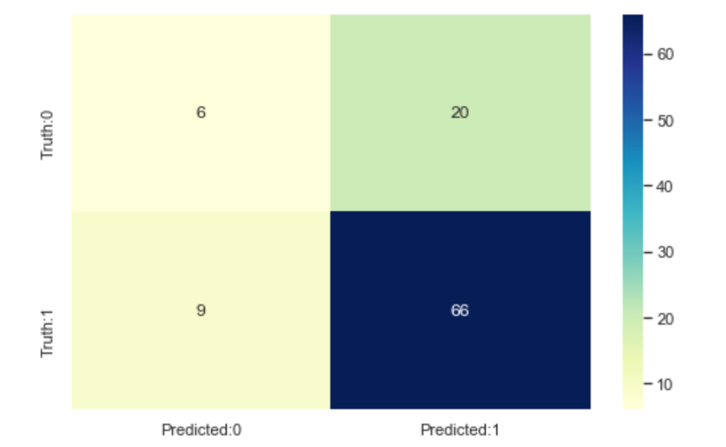
Confusion Matrix for Logistic
F1 Score: 0.81987

Slide 29
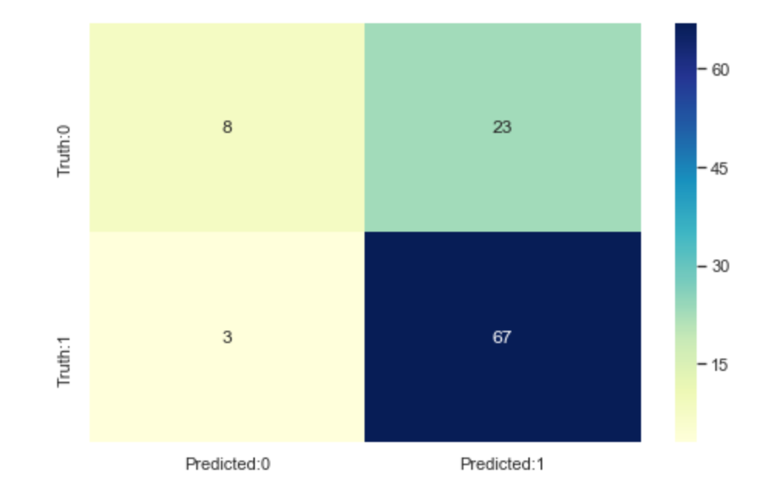
Confusion Matrix for Log. Lasso
F1 Score: 0.8375

Slide 30
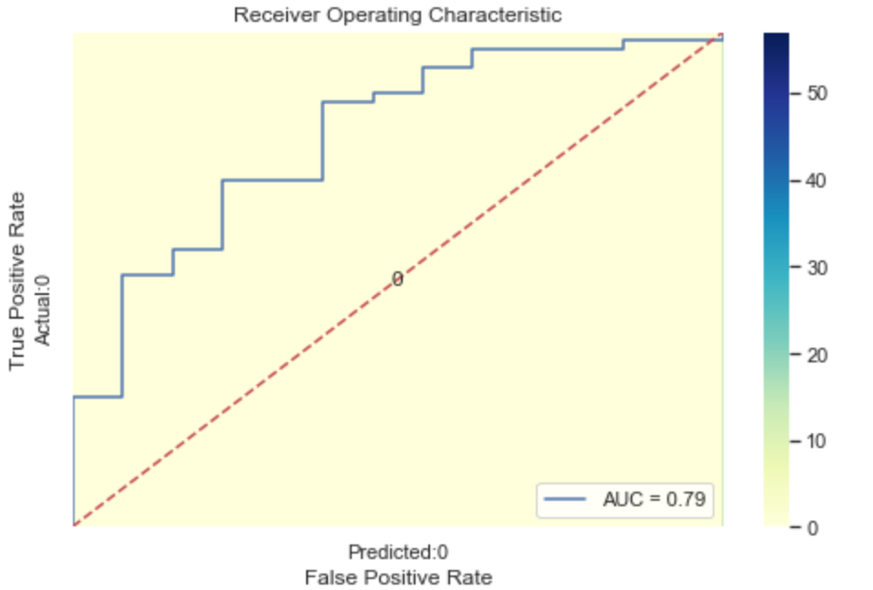
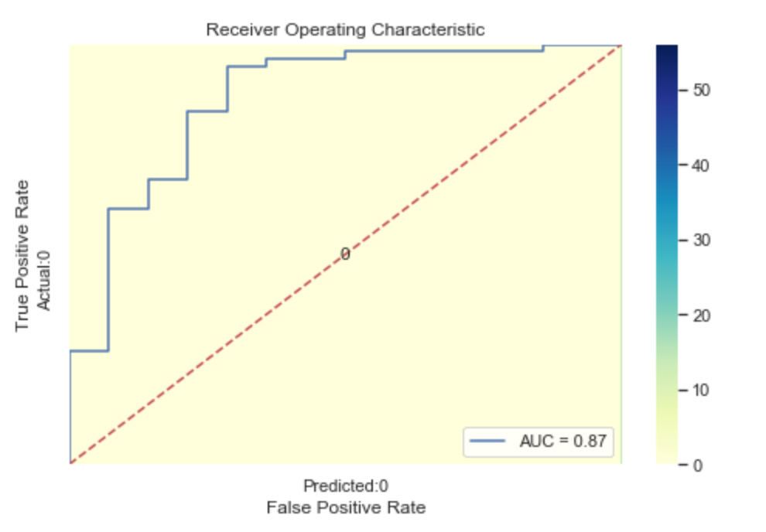
ROC Curve – Higher the better
Logistic
Log. Lasso

Slide 31
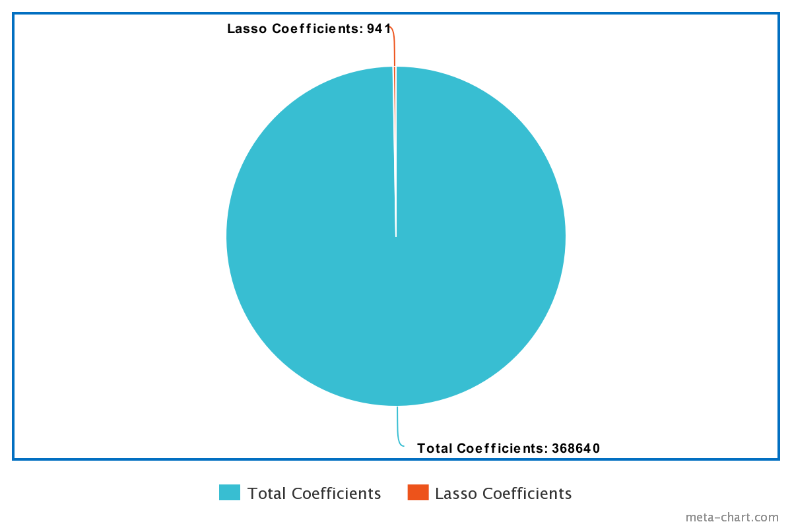
Coefficients difference

Slide 32
Agenda
Introduction
Goal
Approach
Dataset
Logistic Regression & Log Lasso
Experiments
Challenges
Results
Future Work

Slide 33
Future Work
Improvise the model accuracy.
Implement other Machine Learning models.

Slide 34

Reproducibility
Clone the repository https://github.com/jagadeeshmn/SDO-eventprediction.git
Install the packages using
$pip install -r requirements.txt
Open Jupyter Notebook and execute cells

Slide 35

Demo

Slide 36
References
Ruizhe Ma, Soukaina Filali Boubrahimi, Shah Muhammad Hamdi, Rafal A. Angryk, Solar flare prediction using multivariate time series decision trees, 2017.
Xin Huang, Huaning Wang, Long Xu, Wenqing, Sun Learning solar flare forecasting model from magnetograms, 2017.
Tomas Suk, Stanislava Simberova by Solar flare retrieval, detection and analysis, 2016.
Yukiko Yamamoto, Daichi Itoh, Setsuo Tsuruta, Takayuki Muranushi, Yuko Hada-Muranushi, Syoji Kobashi, Yoshiyuki Mizuno, Rainer KnaufSolar, flare prediction by SVM integrated CBGA with dynamic mutation rate, 2016.
Soukaina Filali Boubrahimi, Rafal Angryk, Multivariate Time Series Nearest Neighbor Search: A Case Study on Solar Flare Prediction, 2018.
Shah Muhammad Hamdi, Dustin Kemptin, Soukaina Filali Boubrahimi, Rafal A. Angryk, A time series classification-based approach for solar flare prediction, 2017.
Yoshio Taniguchi, Yoshihiko Kubota, Setsuo Tsuruta, Takayuki Muranushi, Yuko Hada-Muranushi, Yoshiyuki Mizuno, Syoji Kobashi, Yoshitaka Sakurai, Rainer Knauf, sAndrea Kutics, A SVM integrated Case Based Learning Data GA for Solar Flare Prediction, 2018.
Tarek A M Hamad Nagem, Rami Qahwaji, Stan Ipson, Deep learning teachology for the prediction of solar flares from GOES data, 2017.
Michele Piana, Federico Benvenuto, Anna Maria Massone, Cristina Campi, FLARECAST: An I4.0 Technology for Space Weather Using Satellite Data, 2018.
Ddenis Ullmann, Slava Voloshynovskiy, Lucia Kleint, Sam Krucker, Martin Melchior, Cedric Huwyler, Brandon Panos, DCT-Tensor-Net for Solar Flares Detection on IRIS Data, 2018.
Ahmet Kucuk, Juan M. Banda, Rafal A. Angryk, Data Descriptor:A large-scale solardynamics observatory imagedataset for computer visionapplications, 2017.

