Slide 1
Spark-Broadcast Join
Breaking down Broadcast() function

Slide 2
What is Broadcast Join in Spark
Used for joining a large data frame with a small dataframe
Cannot be used incase of two large data frames
It has two phases
——>the smaller dataset is broadcasted across the executors in the cluster where the larger table is located
——->A standard hash join is performed on each executor

Slide 3
Why Broadcast Join ?
Spark in default uses Shuffle hash join which involves shuffling both bigger and smaller datasets consuming a lot of time
In shuffle join, for each join after you finish you have to shuffle it to disk and that can produce many unnecessary intermediate results
Also data skew occurs as the shuffled data goes into one partition
Broadcast joins are easier to run on a cluster. Spark can “broadcast” a small DataFrame by sending all the data in that small DataFrame to all nodes in the cluster. After the small DataFrame is broadcasted, Spark can perform a join without shuffling any of the data in the large DataFrame.
Naturally handles data skew since it doesn’t involve much shuffling

Slide 4
Concept of Broadcast Join
Machine 1
Small table
Large table part 1
Small table
Machine 2
Small table
Large table part 2
Here the small dataset is being broadcasted to all the executors in the cluster where join is needed
Machine 3
Small table
Large table part 3

Slide 5
Implementation
Spark.sql.autoBroadcastJoinThreshold——>this can be configured to set maximum size in bytes for a data frame to be broadcasted
“-1” will make it disabled
Default—>10485760—10MB
joinedTable = largeTable.join(broadcast(smallTable),”equality _operator”)

Slide 6
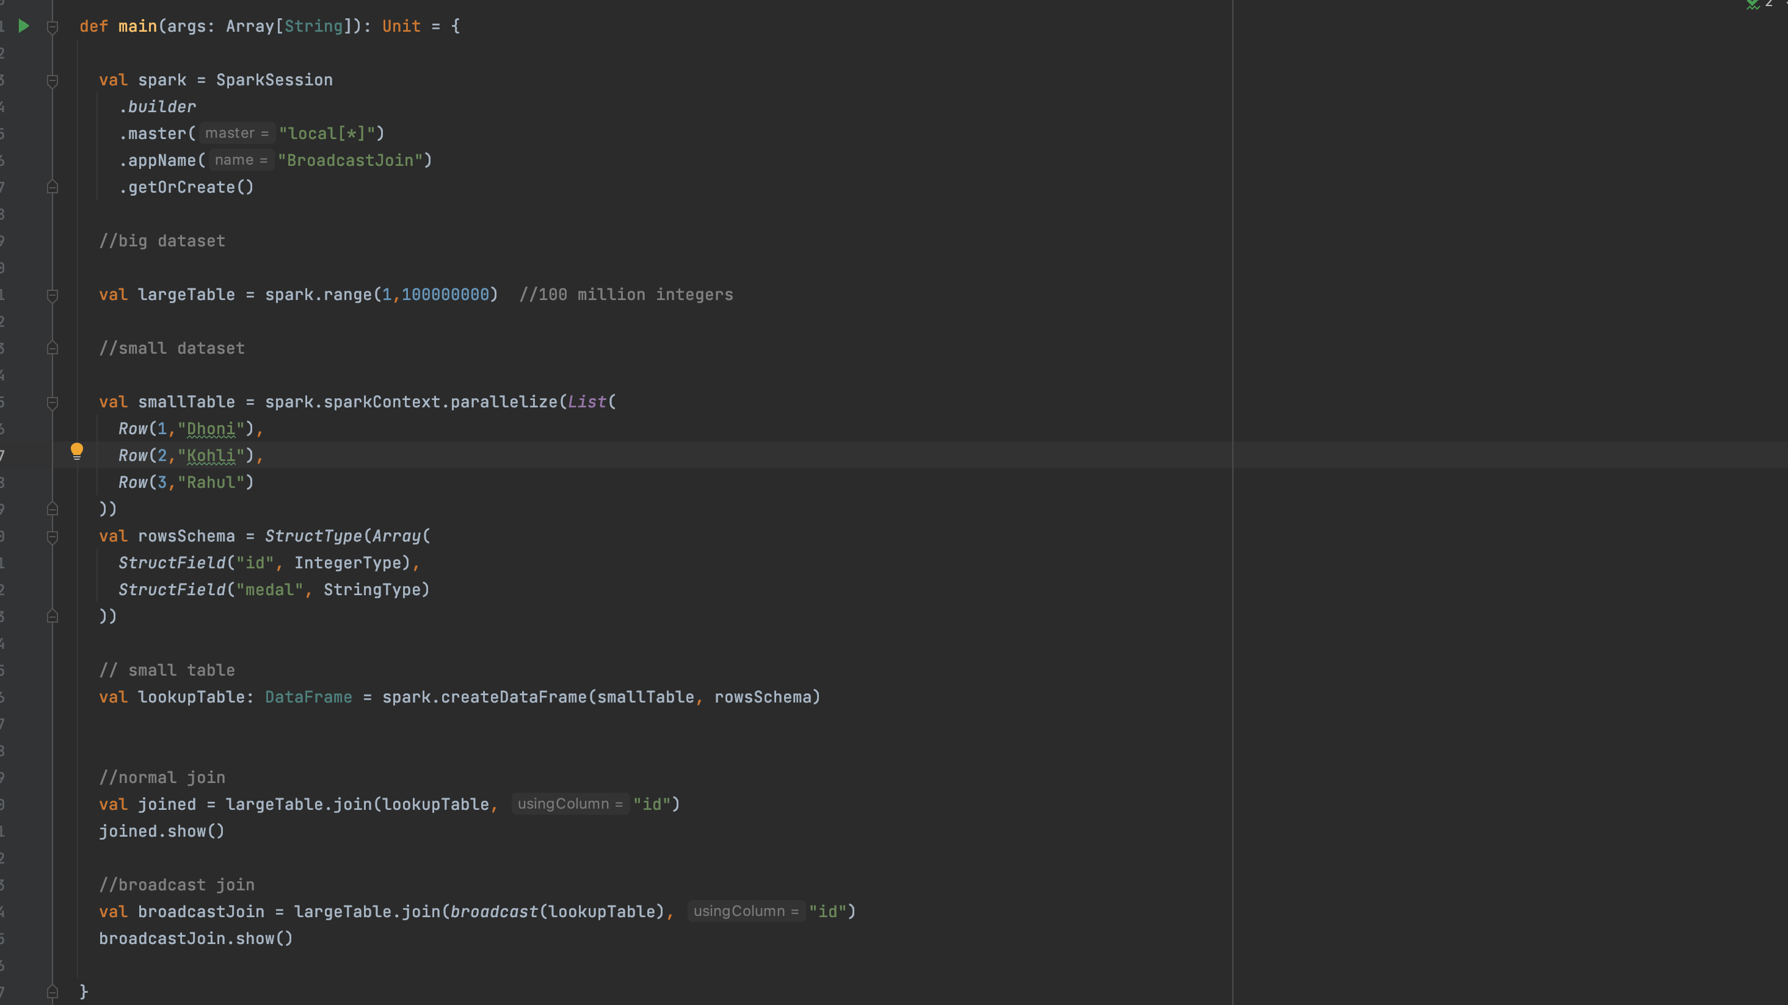
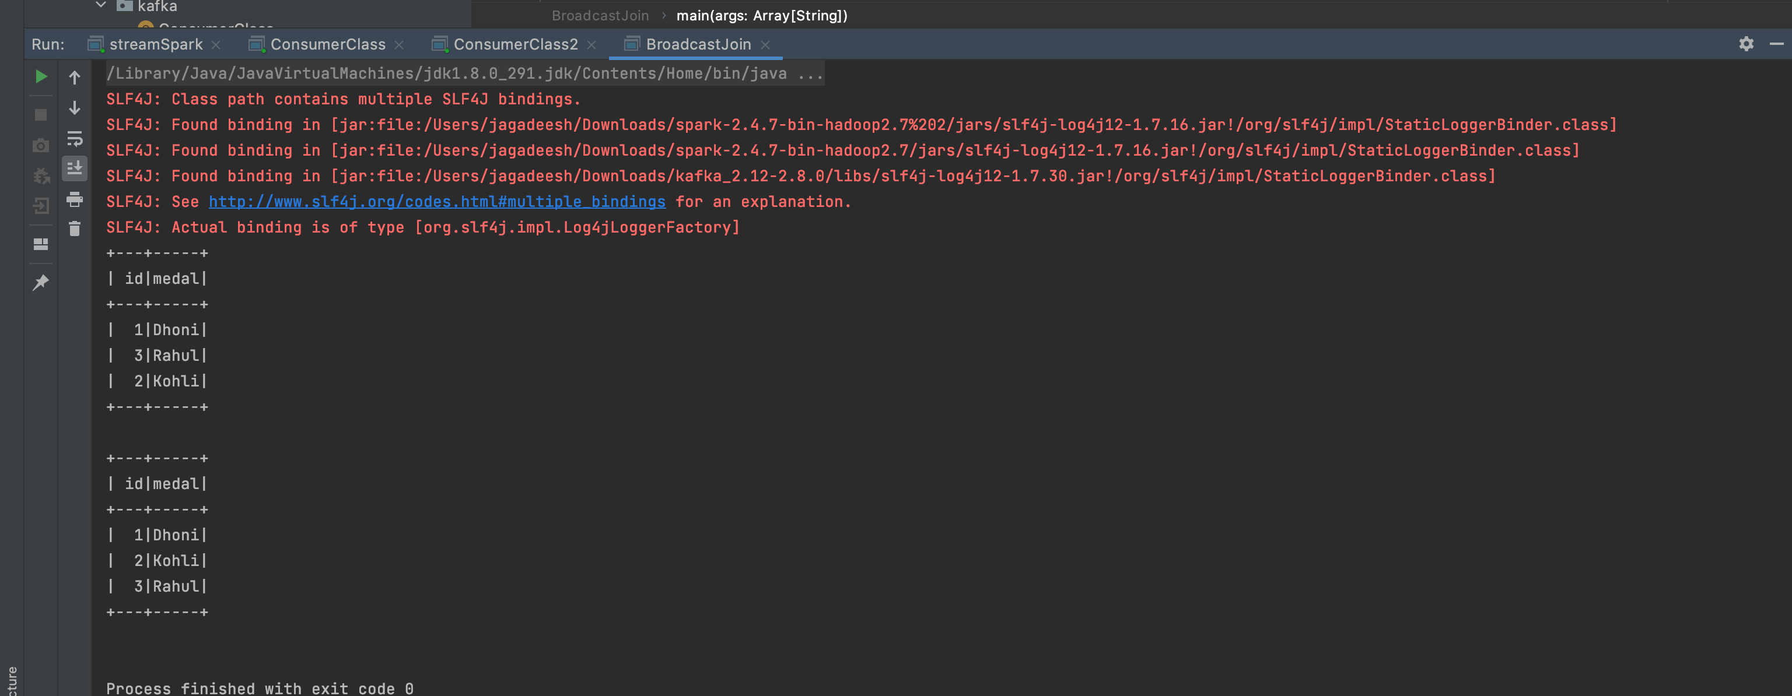
Output

Slide 7
Code observations
At default,a sort-merge join on the columns “id” and ”id” (with different identifiers under the hash tag), which requires a sort of the big dataFrame that involves shuffling of big dataFrame
And a sort,shuffle,filter of the small dataFrame—->costs time—>data skew—->intermediate results
Whereas BroadcastJoin involves no shuffling as the smaller dataset is broadcasted to all the nodes and join operation is performed across the executors

