Slide 2
Binary Tree Traversal
BFS (Breadth First Search)
Level-Order
DFS (Depth First Search)
Pre-Order (V – L – R)
In-Order (L – V – R)
Post-Order (L – R – V)

Slide 4
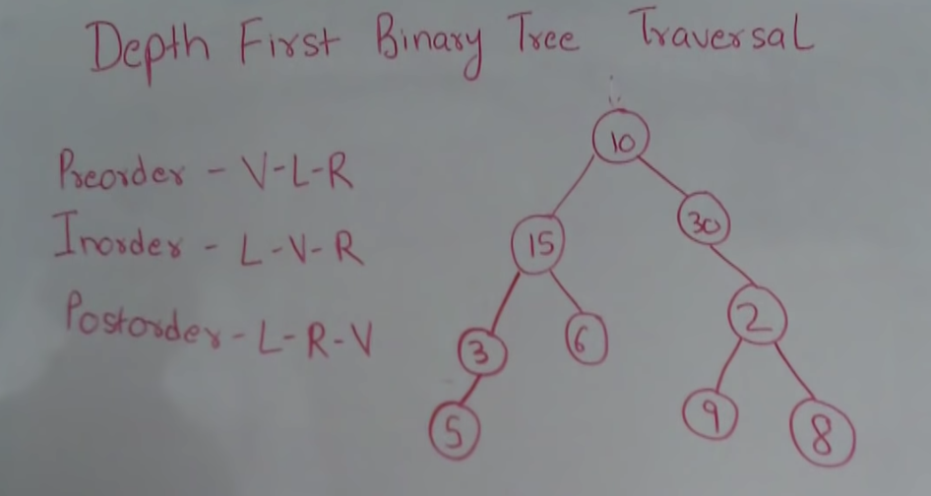
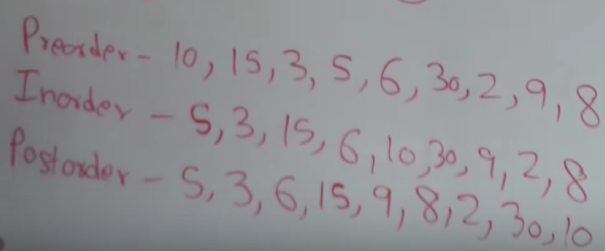
public void preOrder(Node root) {
if (root == null) {
return;
}
System.out.print(root.data + " ");
preOrder(root.left);
preOrder(root.right);
}
public void inOrder(Node root) {
if (root == null) {
return;
}
inOrder(root.left);
System.out.print(root.data + " ");
inOrder(root.right);
}
public void postOrder(Node root) {
if (root == null) {
return;
}
postOrder(root.left);
postOrder(root.right);
System.out.print(root.data + " ");
}

Slide 5
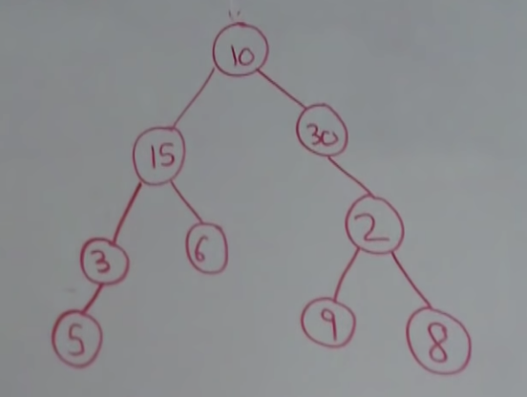
Pre-Order (V – L – R)
public void preOrder(Node root) {
if (root == null) {
return;
}
System.out.print(root.data + " ");
preOrder(root.left);
preOrder(root.right);
}
root: { data: 10, left: { data:15 ..}, right: { data: 30 ..} }
System.out.print(root.data + " ");
preOrder(root.left);
root: { data: 10, left: { data:15 ..}, right: { data: 30 ..} }
System.out.print(root.data + " ");
preOrder(root.left);
root: { data: 10, left: { data:15 ..}, right: { data: 30 ..} }
System.out.print(root.data + " ");
preOrder(root.left);

Slide 6
root: { data: 10, left: { data:15 ..}, right: { data: 30 ..} }
System.out.print(root.data + " ");
preOrder(root.left);
root: { data: 15, left: { data:3 ..}, right: { data: 6 ..} }
System.out.print(root.data + " ");
preOrder(root.left);
root: { data: 3, left: { data:5 ..}, right: null }
System.out.print(root.data + " ");
preOrder(root.left);
root: { data: 5, left: null, right: null }
System.out.print(root.data + " ");
preOrder(root.left);
root: null
preOrder(root.right);
root: null
preOrder(root.right);
root: null
preOrder(root.right);
root: { data: 6, left: null, right: null }
System.out.print(root.data + " ");
preOrder(root.left);
root: null
preOrder(root.right);
root: null
preOrder(root.right);
root: { data: 30, left: null, right: { data: 2 ..} }
System.out.print(root.data + " ");
preOrder(root.left);
root: null
preOrder(root.right);
root: { data: 2, left: { data: 9, .. }, right: { data: 8, ..} }
System.out.print(root.data + " ");
preOrder(root.left);
root: { data: 9, left: null, right: null }
System.out.print(root.data + " ");
preOrder(root.left);
root: null
preOrder(root.right);
root: null
preOrder(root.right);
root: { data: 8, left: null, right: null }
System.out.print(root.data + " ");
preOrder(root.left);
root: null
preOrder(root.right);
root: null

